Slide 1
Building a Python Customer-Service Chatbot
100505349
2021-SPR-OC-KED-6CC555 Data Mining and Foundations of AI

Slide 2
EDA – Literature Review

Slide 3
Spacy Library Testing

Slide 4
Spacy
Natural Language Processing library
Able to split text into tokens and recognise the “type” of a token – splitting them into nouns, adjectives etc.
Distinctly not a prebuilt chatbot library. Spacy only intends to be a framework for NLP centric projects (such as chatbots) to build from

Slide 5
“Doc” Objects
When parsing a string, Spacy will generate a “Doc” – a sequence of tokens
These Doc objects store a large amount of data pertaining to the contents of a token
The Doc file implements a similarity function – converting the token array into a vector format based on its properties
The library includes a similarity function – comparing an input to the Doc and returning a similarity score

Slide 6
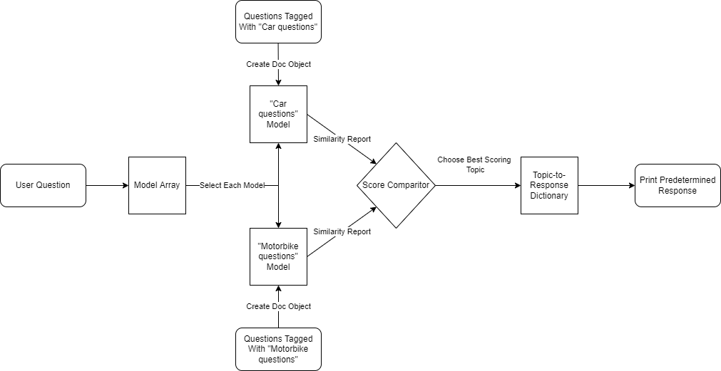
Building a Simple Question Classifier in Spacy
By creating multiple doc files – each with its own topic area – and then training said file with questions relating to its assigned topic, a simple topic comparison can be created
When receiving an input, each model can be polled for its similarity score. The highest similarity score can then be interpreted as the expected topic area

Slide 7






Spacy Model
Notes:
(Note that only 10 inputs were specified per topic)

Slide 8
Spacy Advantages & Disadvantages
Model has the ability to distinguish multiple different topics
Able to be saved – minimizing the need for retraining
Library has GPU support
Training is unfocused – because the similarity score is an averaged score, common words like “and” may have significant weighting
There is no guarantee that more training data may improve performance – in fact, it may lower the performance. Since the scoring is average based, more words may spread the average thinner over time
The current method requires manual categorisation of training data

Slide 9
Spacy Conclusions
The Spacy library can be used to meet the objective, however the approach is flawed and unpredictable
The methods used are more automated pattern matching than artificial intelligence
While Spacy may prove useful as a tool within the chatbot, the results of solely using Spacy as a model show significant issues

