Slide 1
Building a Python Customer-Service Chatbot
100505349
2021-SPR-OC-KED-6CC555 Data Mining and Foundations of AI
Notes:
Went about this project in a strange order:
Problem Analysis & Libraries
Solution Development
EDA & Preprocessing
Evaluation & Refinement

Slide 2
Problem Analysis

Slide 3
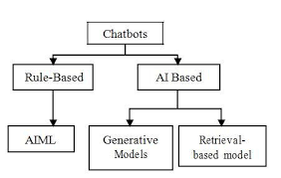
Customer Service Chatbot
Chatbots often fall under two distinct categories –generative or retrieval chatbots
Generative chatbots are designed to create new dialogue – rather than picking a predetermined output, these models attempt to create entirely new responses.
Retrieval chatbots take a different approach – attempting to classify an input and determine the most appropriate predetermined response.
This task is a customer service chatbot, meaning the chatbot is expected to give logical responses to questions and complaints – making a retrieval chatbot the superior option for this specific task.
https://ijtre.com/images/scripts/2019060732.pdf
Notes:
Generative chatbots can be used to create conversations, a feature that can be extended by the incorporation of systems like memory, however due to the fact they are only attempting to replicate human speech, not logic, they are often not suited to tasks that require a specific answer.
Retrieval chatbots are less dynamic than generative chatbots but are superior when dealing with questions that require logic.
https://ijtre.com/images/scripts/2019060732.pdf

Slide 4

Library - Spacy
Natural language processing library
Able to split text into tokens and recognise the “type” of a token – splitting them into nouns, adjectives etc.
Built as a framework to construct other projects upon, including chatbots
Other chatbots and chatbot libraries (such as chatterbot) are dependent on spacy – demonstrating it is applicable for this field
Notes:
Combine this and DOC?

Slide 5
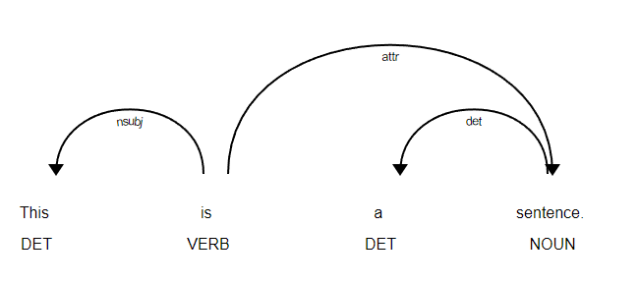
Doc Objects
When parsing a string, Spacy will generate a “Doc” – a sequence of tokens
These Doc objects store a large amount of data pertaining to the contents of a token – its position, dependencies on other words etc.
These attributes are generated during training - allowing the Doc model to learn grammar rules and even identify nouns and their importance
After training, the doc tokens each store a vector of their personal data
https://spacy.io/usage/visualizers
Notes:
https://spacy.io/usage/visualizers

Slide 6
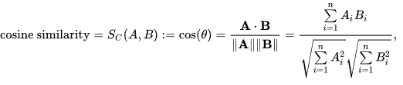
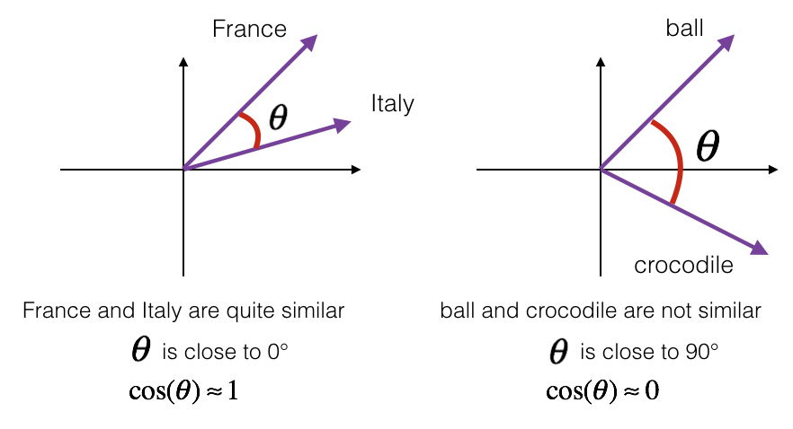
Spacy Similarity
Spacy includes a function called similarity – allowing the contents of one doc object to be compared against another
The similarity report uses the cosine similarity formula – effectively using the cosine of the “angle” between the two vectors as a representation of the similarity of two doc objects
Cosine similarity is meant to be used on a small scale – hence the spacy implementation uses the average of the similarity for each item in the doc object against the comparison doc object
https://en.wikipedia.org/wiki/Cosine_similarity
https://datascience-enthusiast.com/DL/Operations_on_word_vectors.html
Notes:
https://en.wikipedia.org/wiki/Cosine_similarity
https://datascience-enthusiast.com/DL/Operations_on_word_vectors.html

Slide 7
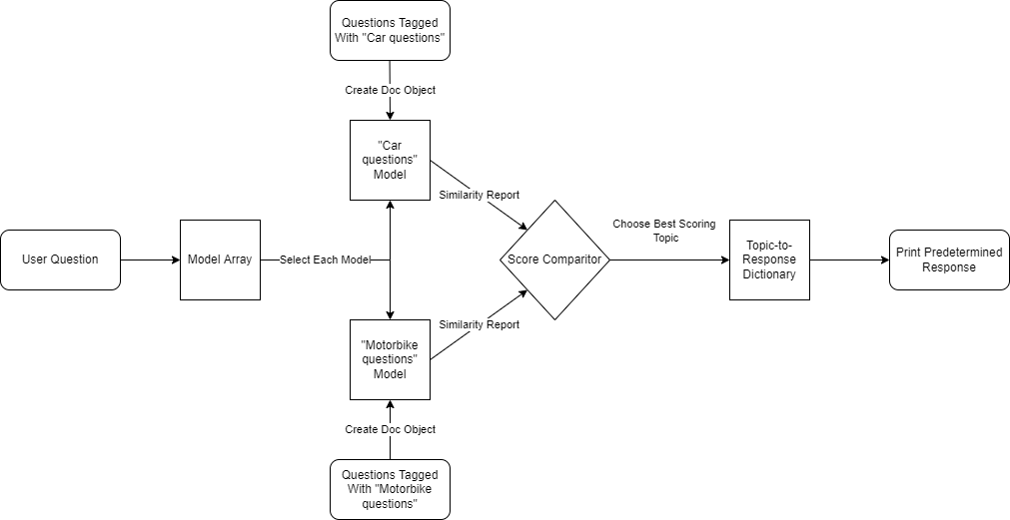
Building a Question Classifier in Spacy
By creating multiple doc files – each with its own topic area – and then training said file with questions relating to its assigned topic, a simple topic comparison can be created
When receiving an input, each model can be polled for its similarity score. The highest similarity score can then be interpreted as the expected topic area

Slide 8
Solution Development

Slide 9






Simple Implementation
For testing purposes, a model was produced using 30 questions, each categorised into “car” for purchasing a car, “maintenance” for repair questions, and “bike” for purchasing a bike
Said items were split evenly – 10 questions for each.
20% of the items, chosen randomly, were then selected as test data.
Accuracy was varied – sometimes reaching as low as 20%, sometimes reaching 100% for the test data
Tests using a simple input system proved that even in high accuracy models, the results were still inconsistent

Slide 10
Extended Implementation
The lack of training data in the previous test provided too little insight into the strength of spacy as a question classification tool
Using the twitter questions and answers database – trimmed to only include questions directed at @AppleSupport
1200 questions were manually categorised into 8 categories; questions about apps, complaints, hardware related questions, questions relating to apple accounts and services such as iCloud, operating system issues, network issues, questions about purchasing an apple product and questions that required a human response.
Notes:
https://www.kaggle.com/thoughtvector/customer-support-on-twitter

Slide 11
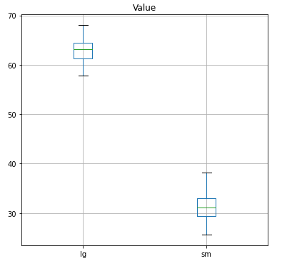
Extended Implementation - Results
Initial tests showed significantly reduced accuracy – averaging only around 30% when trained with a 70/30 train test data split
Language Training
Before training on a specific dataset, spacy will train itself on a general English dataset to learn to simple structures such as verbs and adjectives
By default, spacy incorporates two language files – en_core_web_sm and en_core_web_lg. These are a small and large English dataset respectively
When trained with the large English dataset, the accuracy almost doubled – averaging roughly 63% accuracy
Accuracy (Percentage) spread across 100 iterations of the large (left) and small (right) trained models
Notes:
(Note that up to this point all items have used the small English dataset, whereas second test used the large English dataset)

Slide 12
Critical Analysis – Averages Hypothesis
“How can I buy a phone?”
Trained Data | Similarity
How can I buy a phone? | 100%
Where are phones available for purchase? | 16%
Total: | 58%
Notes:
Introduce problem – since spacy uses averages as its measure of overall similarity, is it possible that the model will become less effective the more training data it receives?
State that this is an example and not how spacy works really

Slide 13
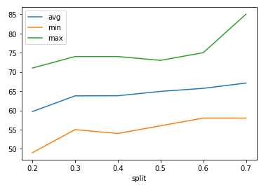
Critical Analysis – Testing the Hypothesis
In theory, this idea of averages lowering the accuracy proportionally with training data should be provable by lowering the training data
To test this, 30 iterations were modelled for each 10% step between 20% and 70% training data. Regardless of how much training data was provided, only 100 items of test data were provided to each – ensuring the resultant accuracy was not dependent on the size of the test data.
The results of said test alleviated concerns as the accuracy of the model seemed to correlate with the amount of training data – disproving the hypothesis entirely.
Percent accuracy (Y-axis) against the decimal proportion of the data given as training data (X-axis)
Notes:
X is the proportion of training data (20% to 70%). Y is the accuracy score in percentage

Slide 14
Responses, Polarity and Objectivity
As the model is retrieval-based, all the possible responses must be predetermined.
To match each topic with a single response, while technically completing the objective, would make the model seem robotic and stiff – while also making any incorrect predictions seem worse.
This is alleviated by the use of the SpacyTextBlob library. By adding the contents of this library to the NLP pipeline, the model can be trained to recognise the polarity and objectivity of an input.
Polarity refers to the sentiment of an input – how positive or negative it is.
Objectivity refers to how personalised the input is – distinguishing between personal and general questions.

Slide 15
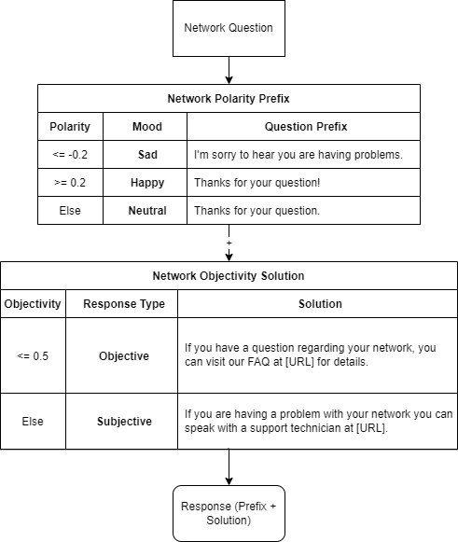
Responses, Polarity and Objectivity (Cont.)
We can use these metrics to expand the “humanity” of the model – granting it the ability to recognise the prose of an input and choose the appropriate response.
By first evaluating the topic of the question, then the polarity and objectivity, we can construct a sentence (As seen in the diagram)
For example, the input “I'm sad that my internet is not working” would be classified as a “Sad” and “Subjective” input, granting the personalised response:
“I’m sorry to hear you are having problems. If you are having a problem with your network you can speak with a support technician at [URL]”

Slide 16
Exploratory Data Analysis
Notes:
The solution developed previously has proven sufficient to build a model from, but requires a more suitable dataset to work from.

Slide 17
Finding a Dataset
Up until now all datasets used have been manually categorised – and thus are subject to personal bias.
Manual categorisation requires extensive work in order to produce a sizeable dataset. The perfect dataset should be easy to extend.
Dataset must consist of two things – A topic and a question. Any dataset that includes these two items, or has a way to derive these two items is be suitable.
Notes:
Talk about the datasets in use and how they were flawed

Slide 18

Stack Exchange API
Stack Exchange is a group of websites that allow users to pose questions and receive user-submitted answers. There are a number of stack overflow websites, each specialised to a specific topic, and even within the topics, questions are required to be given tags that narrow down their field even further.
Stack Exchange offers API support – allowing developers to query their questions and return masses of results. Notably, the API functionality allows tags to be specified.
By making API requests for a specific tag, a list of questions relating to that tag can be returned. If this is done for multiple tags and with a big enough volume of questions, a dataset can be compiled linking the topic and the question.

Slide 19
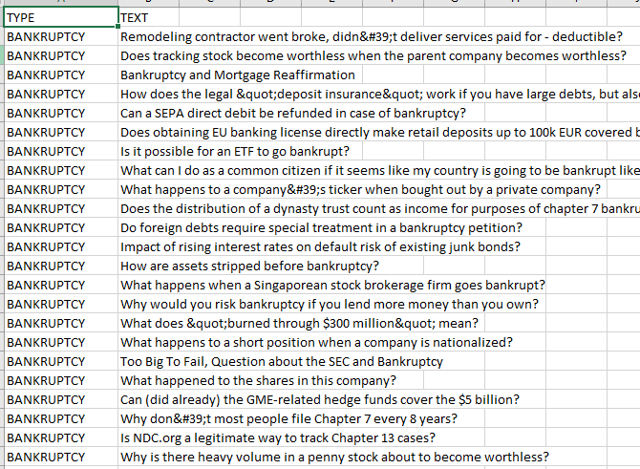
Stack Exchange API
Limited the scope of the task to just finance and money – effectively making the AI a banking customer service chatbot.
Used the website https://money.stackexchange.com/ as the target for the API.
Pulled 500 questions relating to seven topics - bankruptcy, taxes, stocks, loans, pensions, real estate and 401k.
If a topic didn’t have enough questions, only pulled the available questions
This produced roughly 3000 questions with their associated topics – with the potential to request more if needed
https://api.stackexchange.com/2.3/questions?site=money&key=[REDACTED]&tagged=bankruptcy&sort=activity&pagesize=100&page=1

Slide 20
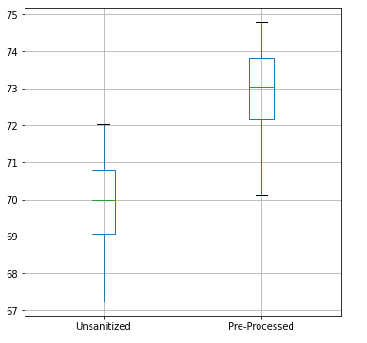
Pre-Processing & Feature Selection
Removed all data except the tag used in the API query and the text – as the other data (such as date of posting) is entirely irrelevant to the task
Manually removed invalid data from the downloaded set – including non-ascii characters
Used Spacy’s tokenizer to filter out all the “stop words” – words that are excessively common and can bias results if not removed – from inputs, training and testing data. This same process was also used to filter out all punctuation. In effect, this removes all but the key words from a sentence, making it easier to compare data.
This improved accuracy by roughly 3% when compared to unsanitized tests
Accuracy (percentage) of the unsanitized and pre-processed models.

Slide 21
Evaluation

Slide 22
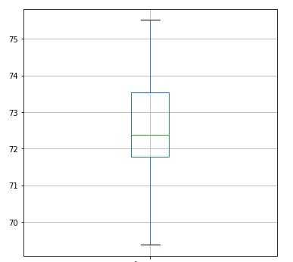
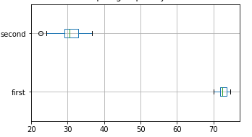

Question Accuracy Testing
Provided with a 70/30 training/test split and tested with 100 different permutations
Results consistently averaged 72.5% accuracy
When inputting manual data, there were very few incorrect predictions. However, irrelevant or nonsensical inputs often still receive a high similarity score to a topic.
Accuracy (percentage) spread across one hundred iterations of the model
An expected input being classified as a happy objective question about real estate
An unexpected input being classified as a neutral subjective question about stocks
Accuracy (Percentage) between the first and second guesses of the model
Notes:
Y = percent accuracy for this test

Slide 23
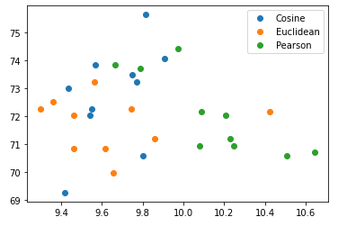
Similarity Methods
Spacy uses cosine similarity as its default similarity scoring metric, but there are other ways to compute similarity
Two other significant metrics of similarity are Euclidean distance and Pearson Coefficient.
By implementing each method, we can see the changes in accuracy and determine which similarity algorithm is best suited for this task
After testing each algorithm 10 times, checking both their percent accuracy and time to compute in milliseconds, there were no significant differences between the algorithms in either field.
Comparison between algorithms, with the time in milliseconds taken to compute on the x-axis and the percentage accuracy of the iteration on the y-axis

Slide 24
Thank you for your time

