Slide 1
Building a Python Customer-Service Chatbot
100505349
2021-SPR-OC-KED-6CC555 Data Mining and Foundations of AI

Slide 2
Problem Analysis - Task & Library Analysis

Slide 3
Customer Service Chatbot
Chatbots often fall under two distinct categories –generative or retrieval chatbots
Generative chatbots are designed to create new dialogue – rather than picking a predetermined output, these models attempt to create entirely new responses.
Retrieval chatbots take a different approach – attempting to classify an input and determine the most appropriate predetermined response.
This task is a customer service chatbot, meaning the chatbot is expected to give logical responses to questions and complaints – making a retrieval chatbot the superior option for this specific task.
Notes:
Generative chatbots can be used to create conversations, a feature that can be extended by the incorporation of systems like memory, however due to the fact they are only attempting to replicate human speech, not logic, they are often not suited to tasks that require a specific answer.
Retrieval chatbots are less dynamic than generative chatbots but are superior when dealing with questions that require logic.

Slide 4
Spacy
Natural Language Processing library
Able to split text into tokens and recognise the “type” of a token – splitting them into nouns, adjectives etc.
Distinctly not a prebuilt chatbot library. Spacy only intends to be a framework for NLP centric projects (such as chatbots) to build from

Slide 5
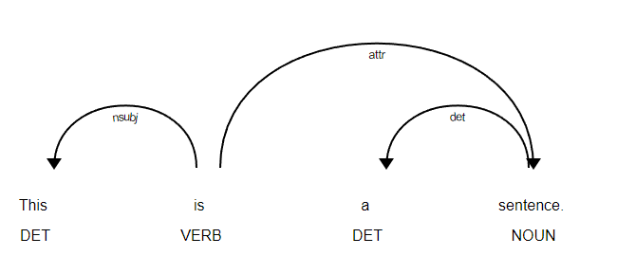
“Doc” Objects
When parsing a string, Spacy will generate a “Doc” – a sequence of tokens
These Doc objects store a large amount of data pertaining to the contents of a token – its position, dependencies on other words etc.
These attributes are generated during training - allowing the Doc model to learn grammar rules and even identify nouns and their importance
After training, the doc tokens each store a vector of their personal data
Notes:
https://spacy.io/usage/visualizers

Slide 6
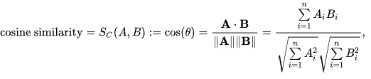
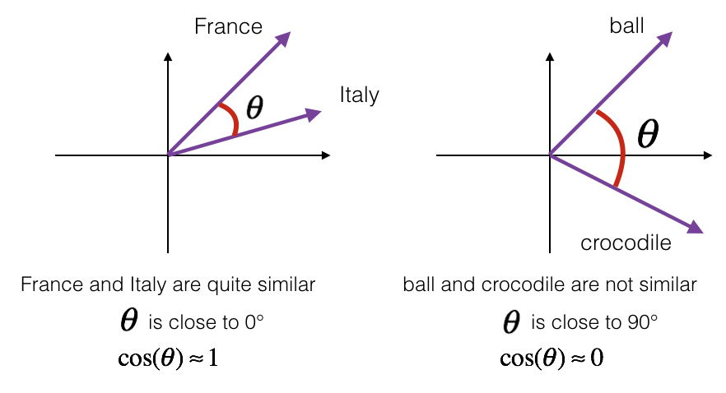
Spacy Similarity
Spacy includes a function called similarity – allowing the contents of one doc object to be compared against another
The similarity report uses the cosine similarity formula – effectively using the cosine of the “angle” between the two vectors as a representation of the similarity of two doc objects
Cosine similarity is meant to be used on a small scale – hence the spacy implementation uses the average of the similarity for each item in the doc object against the comparison doc object
Notes:
https://en.wikipedia.org/wiki/Cosine_similarity
https://datascience-enthusiast.com/DL/Operations_on_word_vectors.html

Slide 7
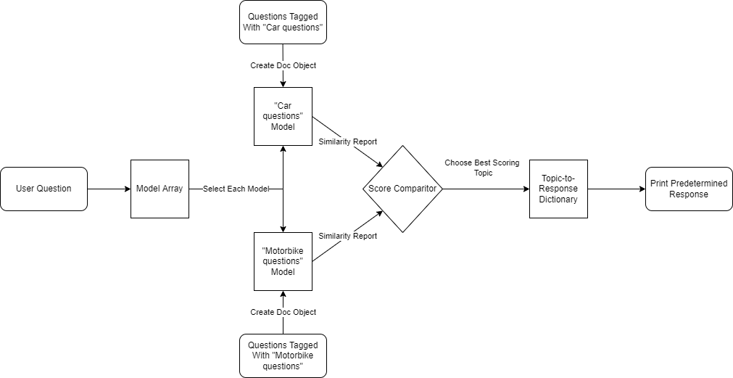
Building a Simple Question Classifier in Spacy
By creating multiple doc files – each with its own topic area – and then training said file with questions relating to its assigned topic, a simple topic comparison can be created
When receiving an input, each model can be polled for its similarity score. The highest similarity score can then be interpreted as the expected topic area

Slide 8







Simple Implementation
For testing purposes, a model was produced using 30 questions, each categorised into “car” for purchasing a car, “maintenance” for repair questions, and “bike” for purchasing a bike
Said items were split evenly – 10 questions for each.
20% of the items, chosen randomly, were then selected as test data.
Accuracy was varied – sometimes reaching as low as 20%, sometimes reaching 100% for the test data
Tests using a simple input system proved that even in high accuracy models, the results were still inconsistent

Slide 9
Extended Implementation
The lack of training data in the previous test provided too little insight into the strength of spacy as a question classification tool
Using the twitter questions and answers database – trimmed to only include questions directed at @AppleSupport
1200 questions were manually categorised into 8 categories; questions about apps, complaints, hardware related questions, questions relating to apple accounts and services such as iCloud, operating system issues, network issues, questions about purchasing an apple product and questions that required a human response.
Due to this being a test of the library, little EDA or pre-processing was conducted.

Slide 10
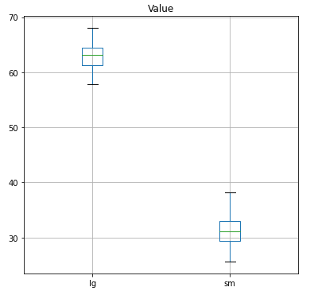
Extended Implementation - Results
Initial tests showed significantly reduced accuracy – averaging only around 30% when trained with a 70/30 train test data split
Language Training
Before training on a specific dataset, spacy will train itself on a general English dataset to learn to simple structures such as verbs and adjectives
By default, spacy incorporates two language files – en_core_web_sm and en_core_web_lg. These are a small and large English dataset respectively
When trained with the large English dataset, the accuracy almost doubled – averaging roughly 63% accuracy
Notes:
(Note that up to this point all items have used the small English dataset, whereas second test used the large English dataset)

Slide 11
Critical Analysis – Averages Problem
“How can I buy a phone?”
Trained Data
Similarity
How can I buy a phone?
100%
Where are phones available for purchase?
16%
Average
58%
100%
Notes:
(0 : introduce problem – specify that this is using only word matches and is meant as an example and does not reflect how spacy actually works)
(1: Train data with phone data question)
(2: Compare against an existing data item)
(3: 100% similarity because it matches the item in the set)
(4: Give more trained data)
(5: attempt to pose the same question) (6: average becomes lower overall)

Slide 12
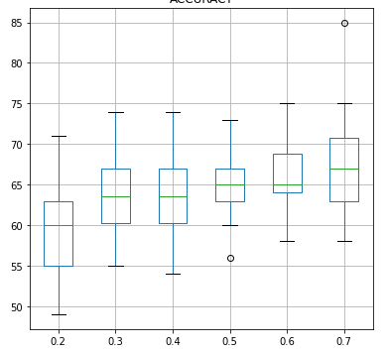
Critical Analysis – Testing Averages
In theory, this idea of averages lowering the accuracy proportionally with training data should be provable by lowering the training data
To test this, 30 iterations were modelled for each 10% step between 20% and 70% training data. Regardless of how much training data was provided, only 100 items of test data were provided to each – ensuring the resultant accuracy was not dependent on the size of the test data.
The results of said test alleviated concerns as the accuracy of the model seemed to correlate with the amount of training data – disproving the hypothesis entirely
Notes:
X is the proportion of training data (20% to 70%). Y is the accuracy score in percentage

Slide 13
Problem Analysis - EDA

Slide 14
Finding a Dataset

Slide 15
Solution Development

Slide 16
Evaluation

