Slide 1
How are computer simulations developed, and how can we use them to mirror real life?
By Jamie Gorman
Notes:
How are computer simulations developed, and how can we use them to mirror real life?

Slide 2
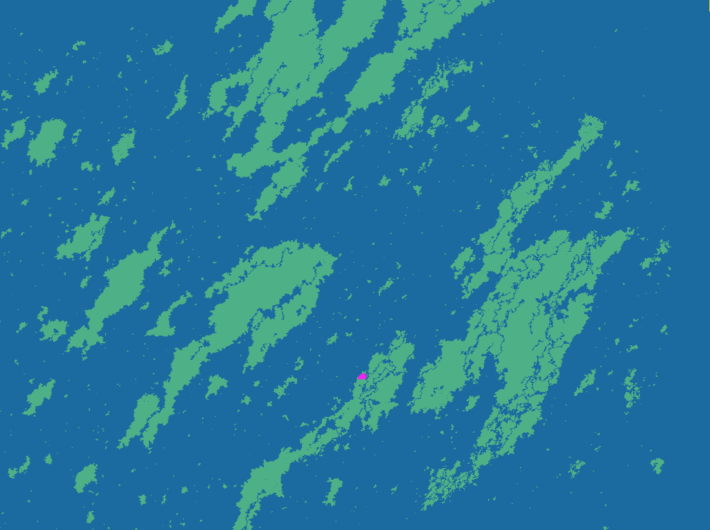
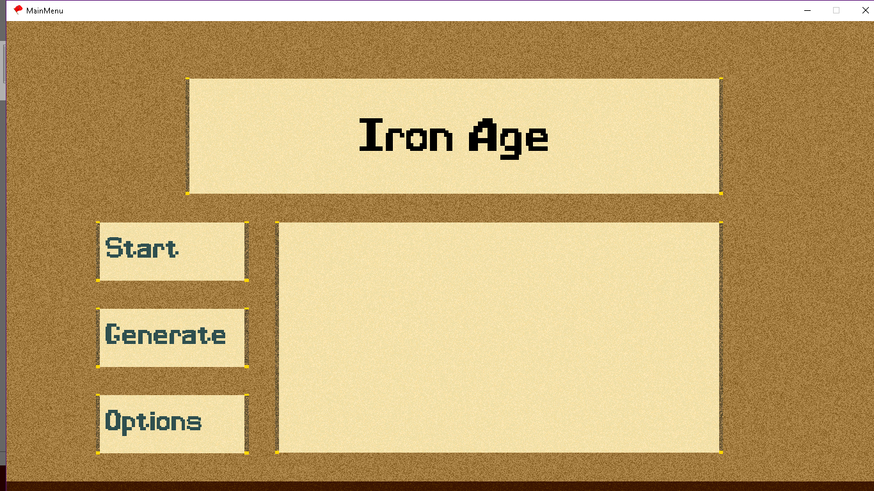
My Project – Overview.
For my extended project qualification, I focused on an interest of mine, computer simulations, more specifically, how they work and the methods used in production. To do this I started development of a program I named “Iron Age”, which was a simulation of a historical map, fitted with dynamic borders and information that would be relevant to the changing of historical borders, as well as completely unique names for countries. This program saw two major unique parts, a map generator and a border generator, which corresponded to the two major simulations – random simulation and data-based simulations.
00:30
Notes:
For my project, I decided to develop a computer simulation of human history on a randomly generated map, with randomly generated civilisation names and cultures. I called this program ‘Iron Age’ after the period it is most actively referencing, the early medieval period.

Slide 3
Why?
I decided to take this topic as my project due to my interest in both simulations, as well as world history. Software development also happens to be a passion of mine, so developing a program during the creation of the project allowed me to indulge in something I have interest in.
0:20
Notes:
I decided to take this topic as my project due to my interest in both simulations, as well as world history. Software development also happens to be a passion of mine, so developing a program during the creation of the project allowed me to indulge in something I have interest in.

Slide 4
Overview of aims and objectives
My Objectives were the following:
Develop a system that simulated the creation of a world, as well as the development of society upon its continents.
Discover various methods and systems used in the development of simulations like my own, and detail them in my writeup.
00:20
Notes:
I proposed the following objectives to myself: One, create a simulation of a world, with accurate representations of human development, and two, Develop a document to focus on the types of algorithms and methods I used throughout my development cycle.

Slide 5
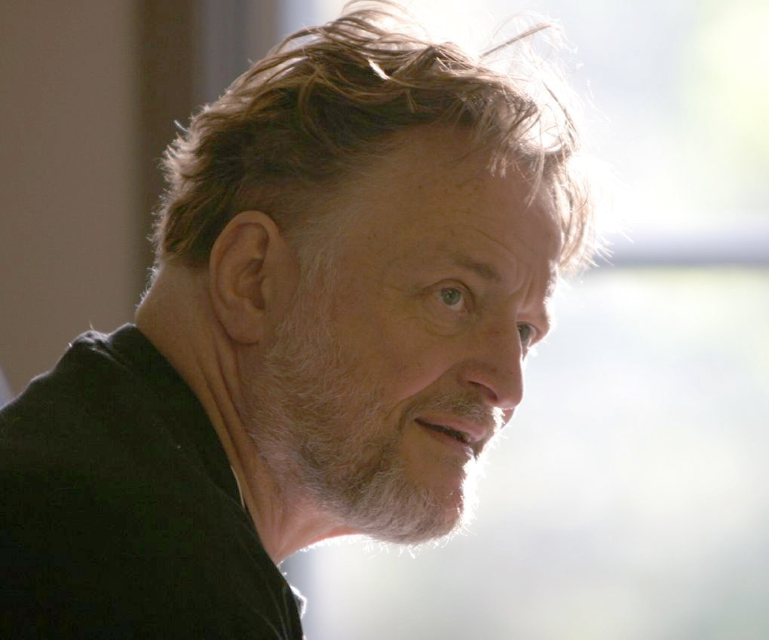
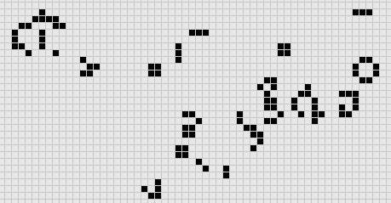
Research
As the documentation produced was based around the types of methods used in simulation development, it was imperative that I gain access or at least study other programs, so I could accurately represent industry standards for algorithms within the documentation and developed program.
I Was able to use two different developed simulations as study material for my program, which each focused around the two main parts of my program – random simulation and data-oriented simulation, these were the following:
Conway's game of life – a mathematically designed “Zero-player-game” which simulates the way things act under certain rules and restrictions. It creates a simple grid with simple rules – any tile may be living or dead, dead cells with three living neighbours become living, any living cell with less than two neighbours will die, any cell with exactly three neighbours will stay alive and any cell with four or more neighbours will die.
This system of logical rules is able to produce detailed and intelligent constructs, such as structures that stay alive eternally, and groups that are able to move across the grid and maintain their shape. This easily shows how simple rules are able to form an interesting design, a concept which I heavily focused upon in development.
1:10
Notes:
For my first research source, I used a program called John Conways Game of Life, which is a simple simulation created by an English mathematician, which uses simple rules to create complex and intelligent structures. These rules are as follows: The game will take place in a grid where each cell may have two states, living or dead, any dead cell with three living neighbours will become living, any living cell with less than two neighbours or four or more neighbours will die, and any living cell with exactly three neighbours will survive. By using simple rules this simulation is able to create complex structures and designs, some which are able to survive perpetually.

Slide 6
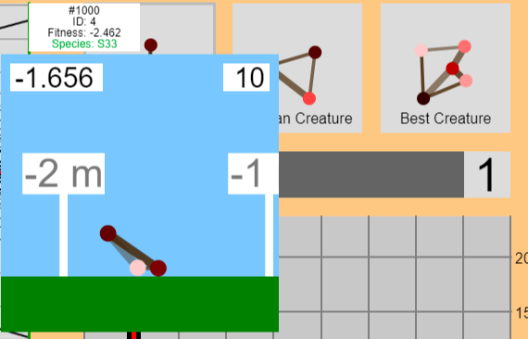
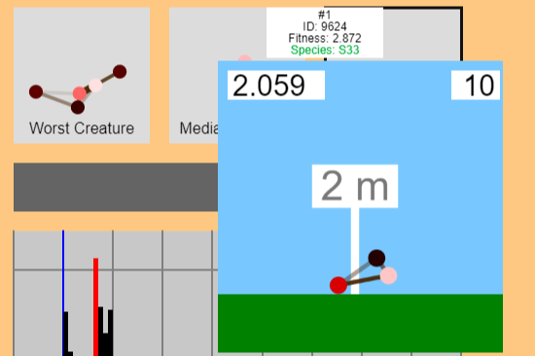
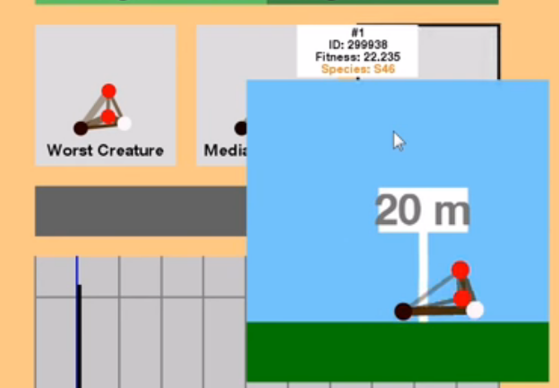
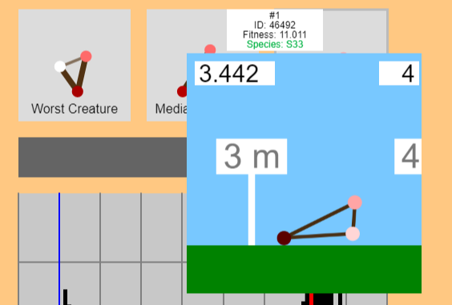
Research - Continued
The second source of research I used in development was an obscure program, produced by American developer and animator, Cary “CaryKh” Huang. This program was designed to make an example of animal evolution through random simulation – in the program, random structures of muscles and ‘nodes’ are built with the sole objective of moving as far right in fifteen seconds as possible. While these developed creatures start off random, and often weak, every time a cycle (when each of the creatures is tested) is completed, the bottom half are destroyed and replaced with duplicates of the top half, with a small amount generating mutations from their predecessors.
Over time – these ‘creatures’ begin to take clearly designed shapes, specifically built through random generation for the purpose of movement, once again showing how pseudo-random generation, with even the weakest of rules, can generate intelligent and effective designs.
1:10
Notes:
The second article I used as a reference was a program developed by an American college student, Cary Huang, who created a program to represent the evolution of structures to reach the goal of moving as far in one direction as possible in a given amount of time. The program uses a simple structure of nodes and muscles (which connect the nodes) on timers, which push and pull. The software will then create thousands of random shapes or ‘creatures’ and will test them, selecting the top 500 scoring creatures to reproduce, potentially developing mutations. Over a period of generations the creatures will begin to specialise in their task, forming shapes that use the physics of the program to their advantage, and ultimately creating intelligent designs for the sole purpose of moving as fast as possible.

Slide 7
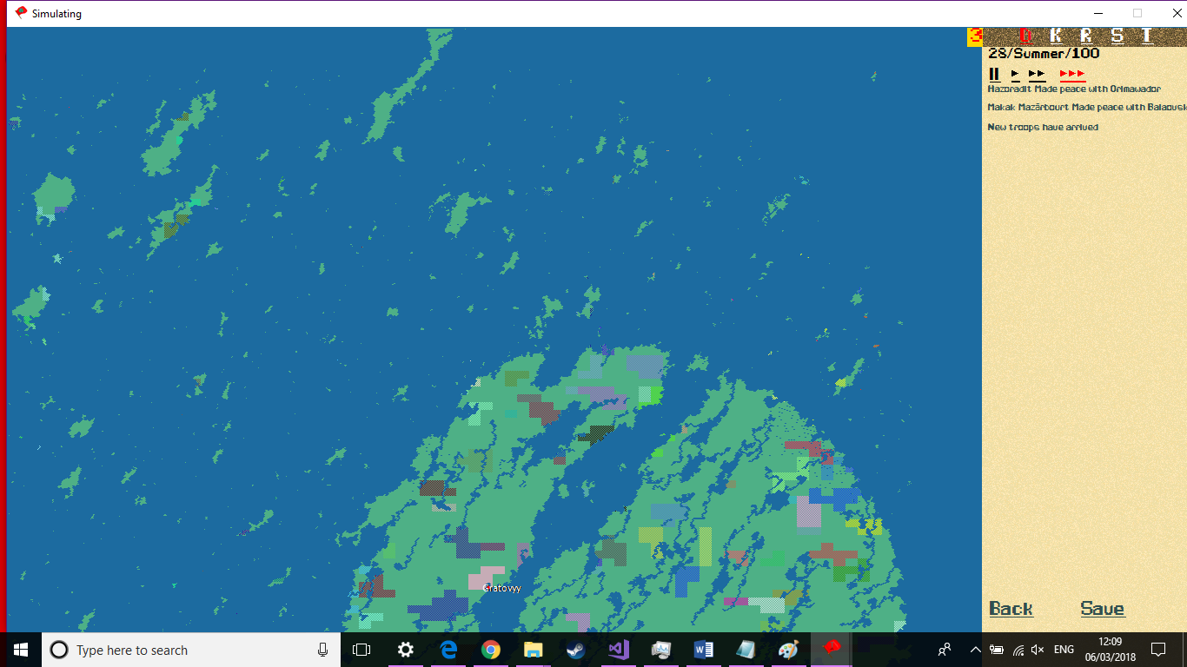
Review
On the sixth of march 2018, I was able to release the final version of “Iron Age”. The program met practically all of my expectations (within reason), and was able to successfully reach my objective of simulating human societal development on a randomly generated map.
As you can see from the image on the right, depicting a circular continent with a large ocean cutting through it, new ‘maps’ were generated from the program, and the small coloured sections represent the civilizations that formed within this time period. Notably, as this is a screenshot of the early years of human history (Comparable to the BCE years), many of the ‘countries’ are tribal-nations (chieftainships), noted by their transparent property. One country, By the name of ‘Gratovyy’ has generated – notable due to its lack of transparency and red dot showing its capital city.
00:40
Notes:
After a long period of development, I was able to release my final version of iron age on the sixth of march. It was able to meet my objectives, albeit, to a simpler degree than I would have liked, a map of the finished program can be seen here, with a small kingdom nation forming under the name of ‘Gratovyy’, as well as various tribal nations.

Slide 8
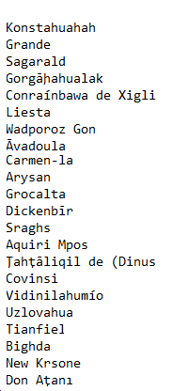
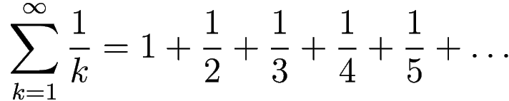
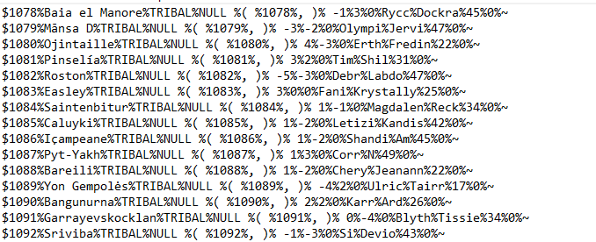
What I learned
Due to the somewhat excessive amount of code used in development, I learned a significant amount of algorithms and methods throughout development, while this is detailed further in the documentation, a few notable parts are included below:
Markov’s Chain – A generation algorithm that attempts to predict future parts of a pattern based on how statistically likely certain data is to follow. I used a simplified version of this in the name generation algorithm, a few results of which can be seen to the right.
Harmonic Series – I researched this mathematical series heavily while developing the algorithm that allowed war between countries to take place, particularly in deciding when the war would end.
Encoding methods – I used multiple types of encoding methods in order to store the saved data for a world – as without being compressed, saving information required a large amount of storage data.
1:00
Notes:
Throughout development, I came into contact with various methods and algorithms which would prove vital to the finished product. A few major ones are the following: Markovs chain, which allows the generation of pseudo-random structures, using a database of existing structures and the likelihood that certain things will follow. I used this to generate the names of countries. Harmonic series, which is a series of additions of gradually decreasing fractions, allowing for a potentially infinite number, despite the additions becoming increasingly smaller, I used this to develop a war algorithm, to decide when a country would surrender their lost lands to an enemy. Finally I was required to learn various data encoding methods, to store the saved data of the program in a small, but legible format.

Slide 9
Results
While the development cycle of this project did not meet all of my expectations, it met the majority. Regardless of whether the program I have developed actually means anything, the creation of it improved my knowledge of software development, mathematics, and human history a fair amount. It also has allowed me to create a program that I may use as a reference to my skill in development, and has allowed me to further pursue the idea of studying computer science at university.
00:30
Notes:
Overall, while I was pleased with the final product, it did not meet all of my expectations, however, I believe the development of my project has allowed me to learn significantly more about the fields of software development, mathematics and human history, due to the research I had to put in on these topics. I also was able to create a program I can use as a reference to my skill in computer science.

Slide 10
Questions & End
https://github.com/JaVonox/Iron_Age/releases/tag/V1
Notes:
Any Questions?

