Slide 1
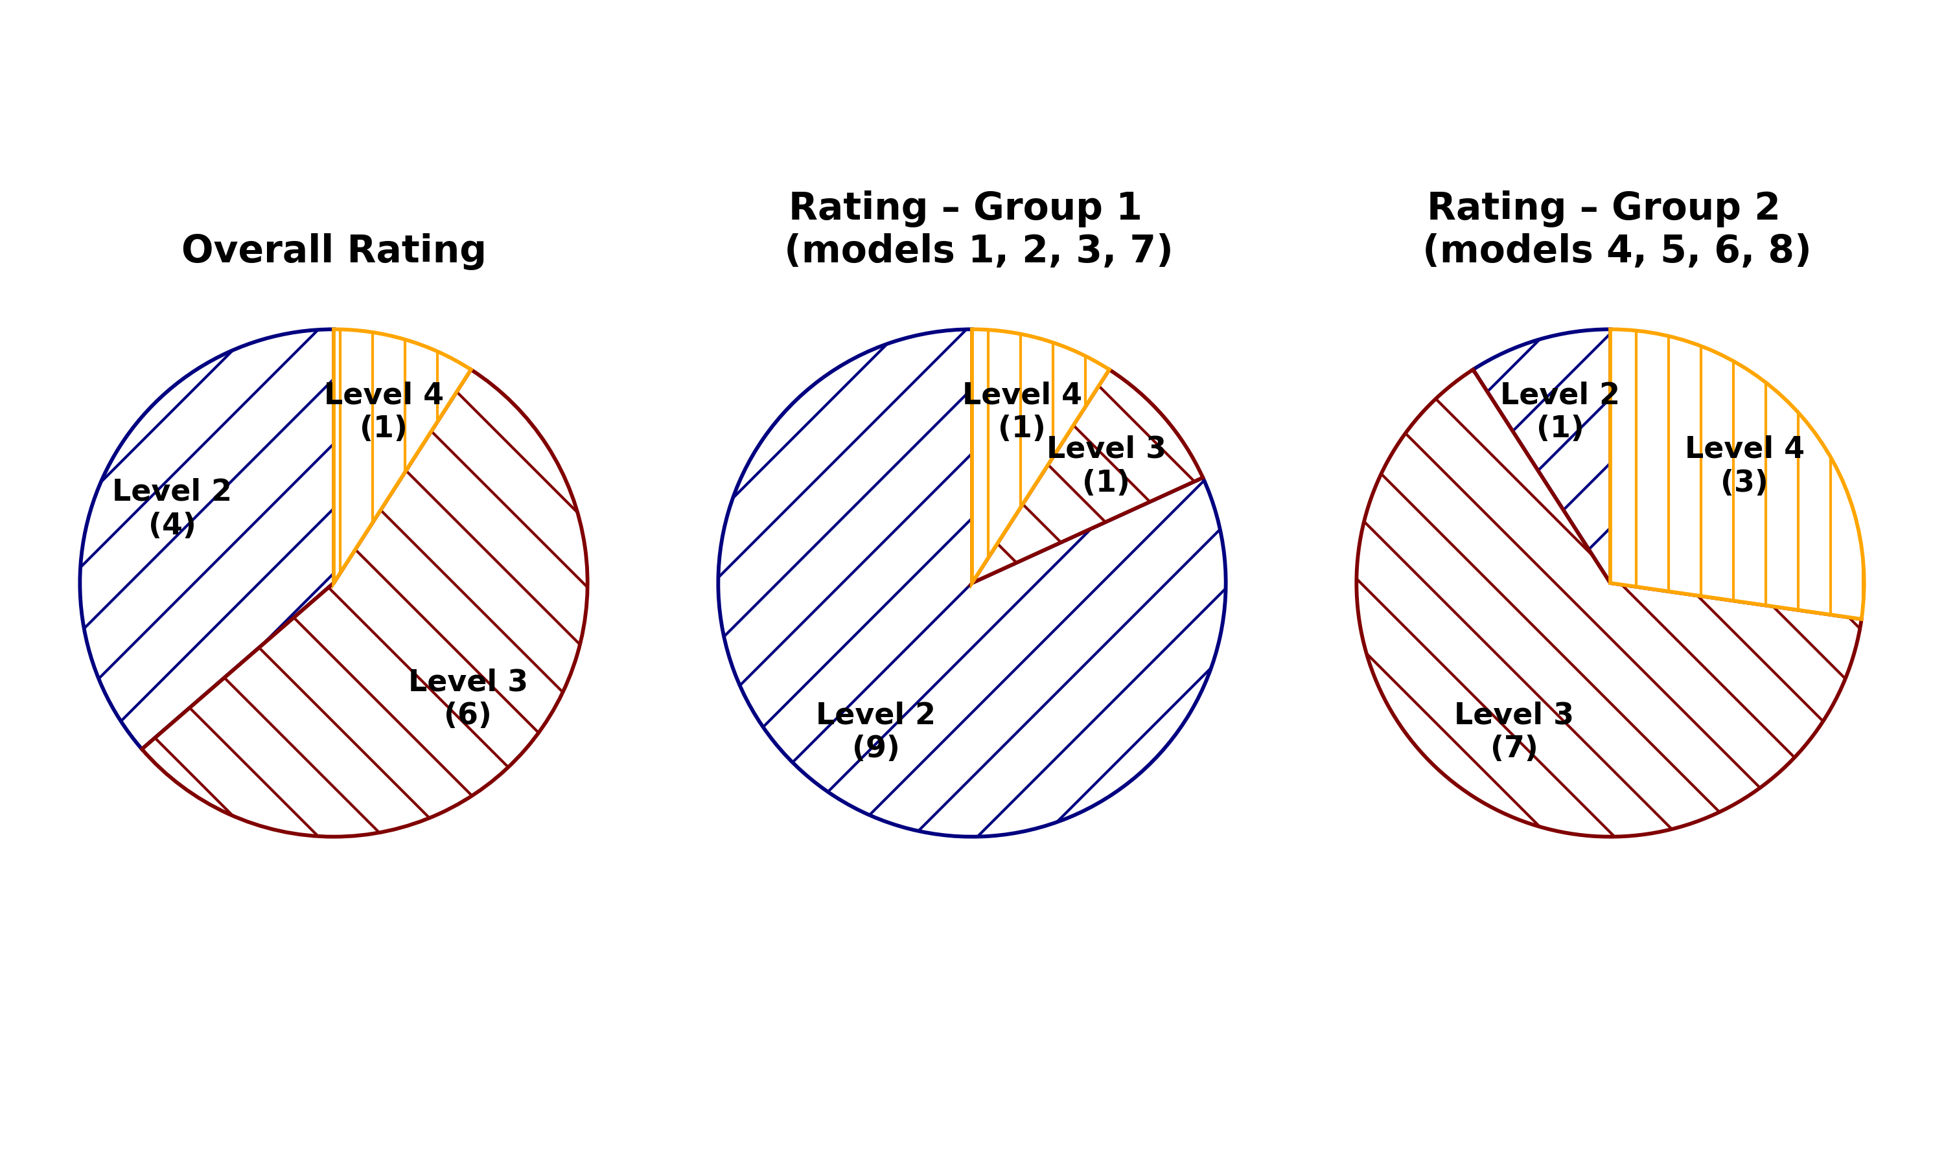
Level 1 – The grid options are highly suitable and can be used directly without any modifications.
Level 2 – The grid options are generally suitable and require only minor adjustments by designers.
Level 3 – The grid options need moderate modifications to meet practical requirements.
Level 4 – The results require extensive expert revisions and adjustments.
Level 5 – The results are not suitable for practical use without a complete redesign or intervention.

