Slide 1
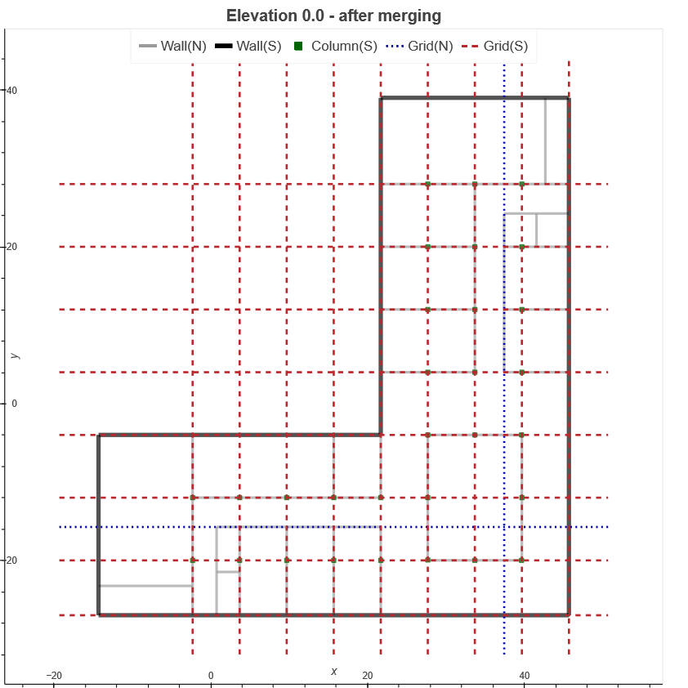
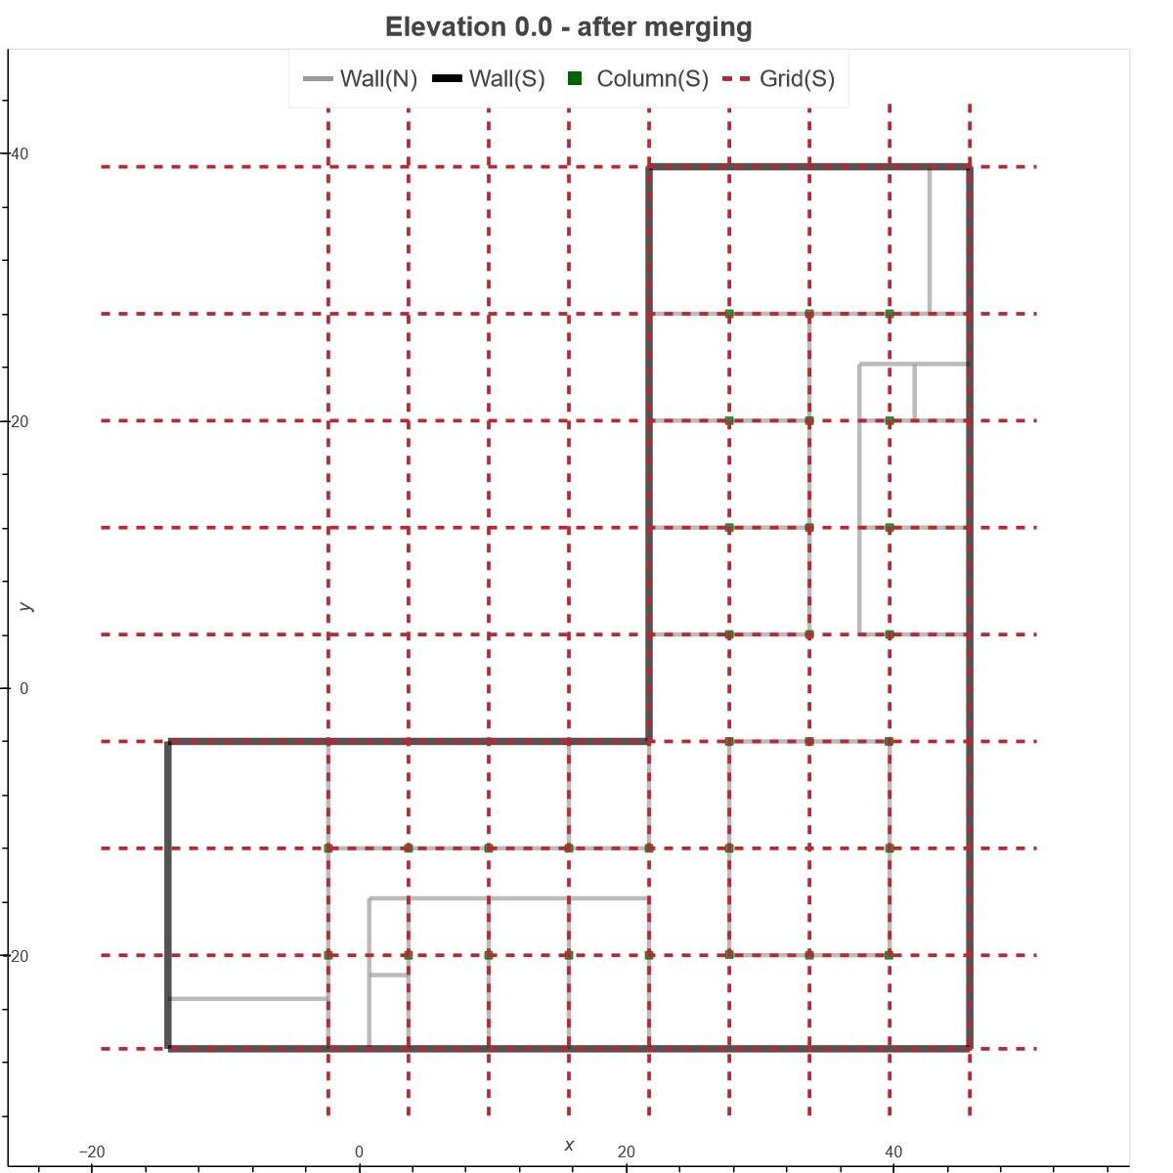
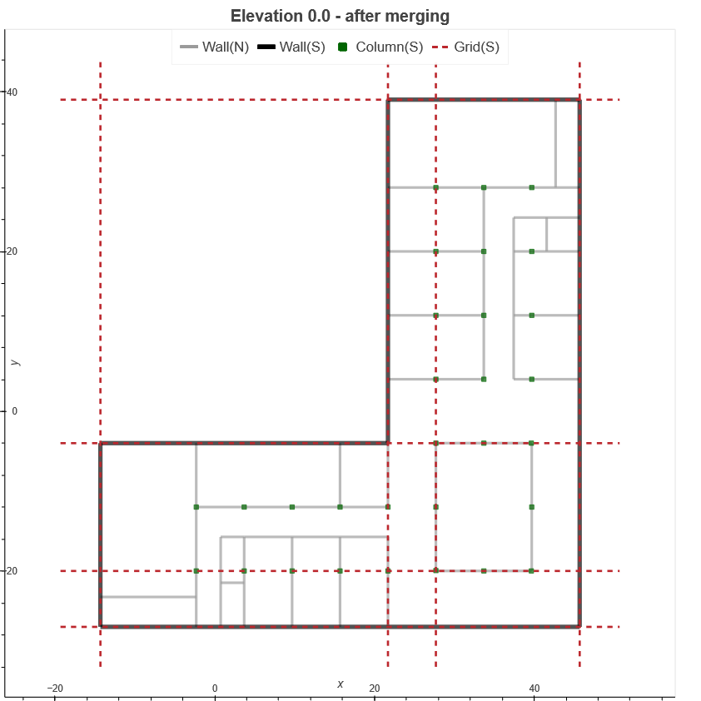
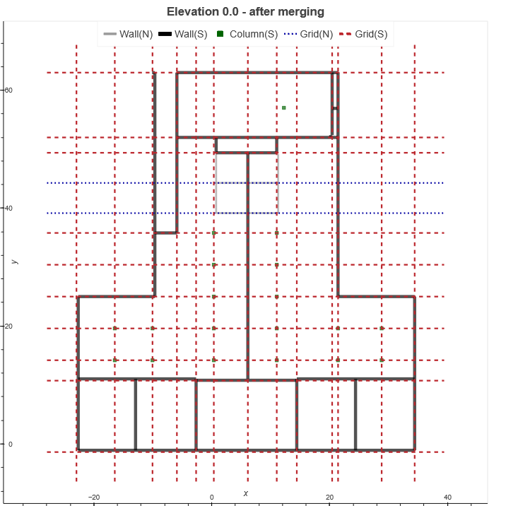
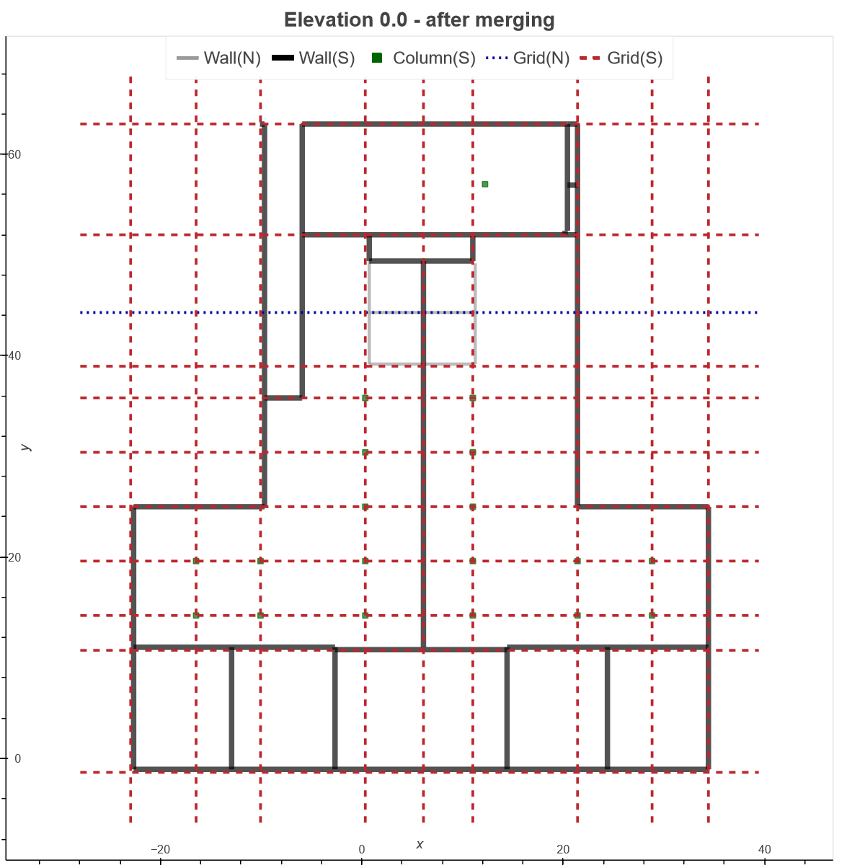
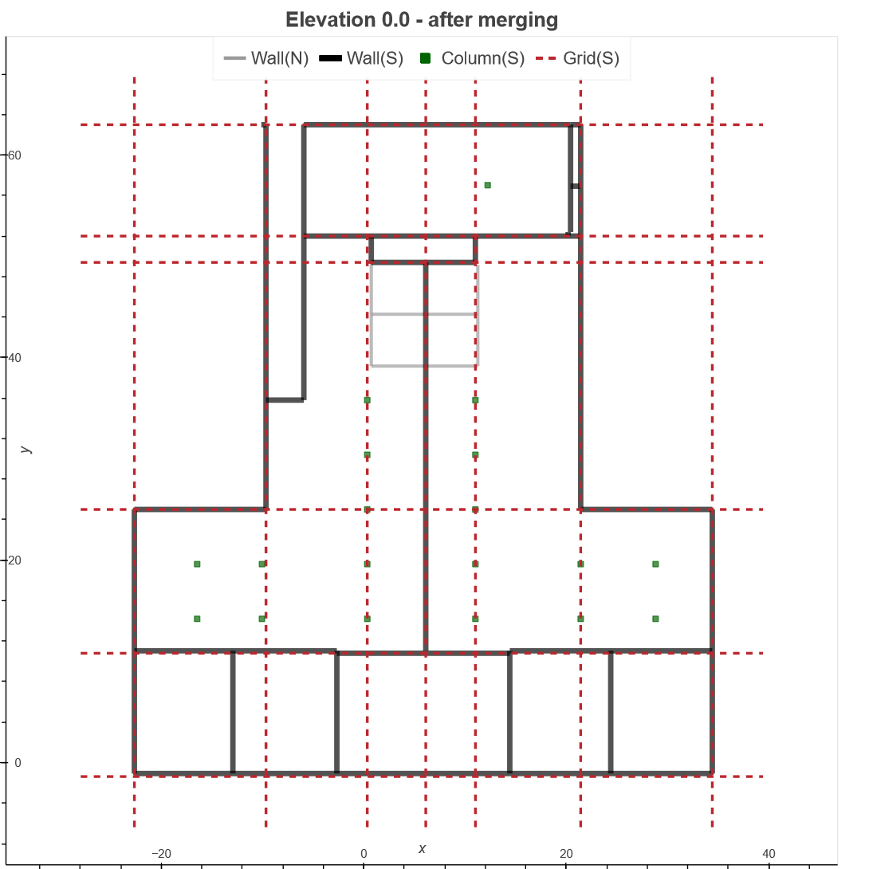
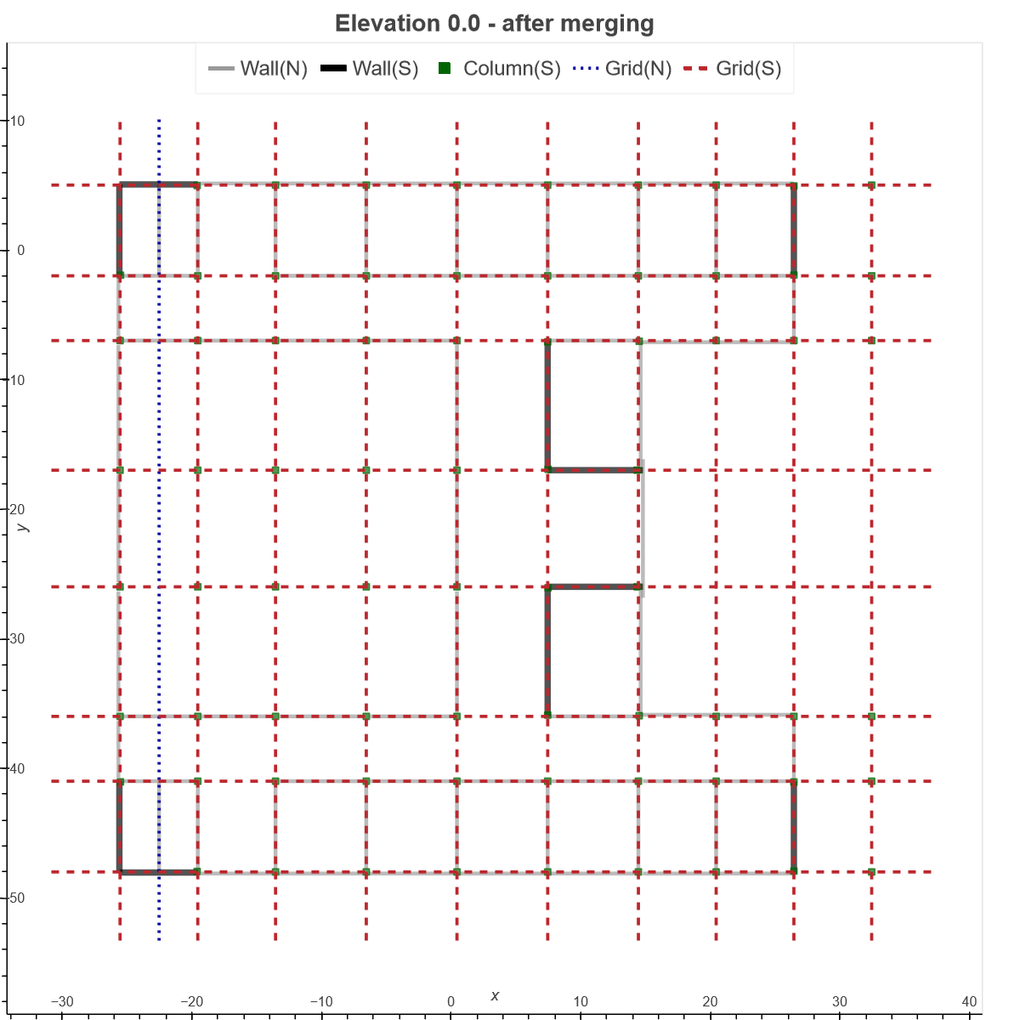
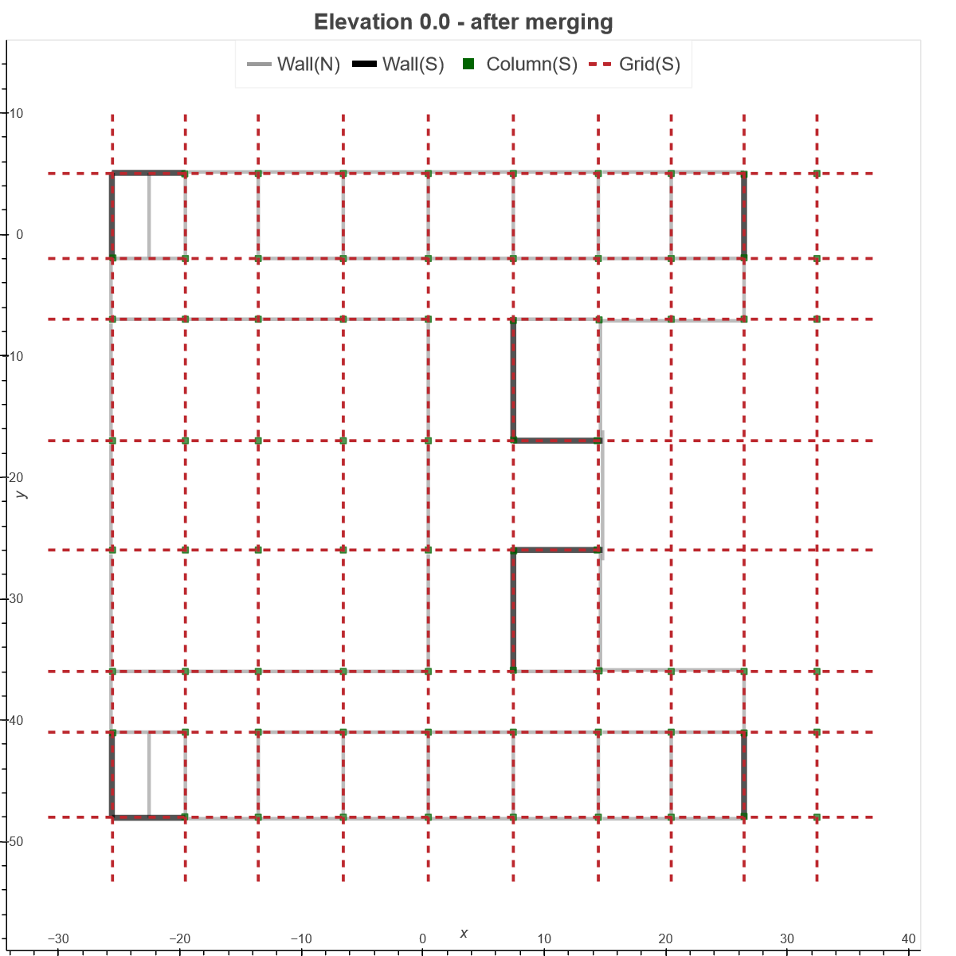
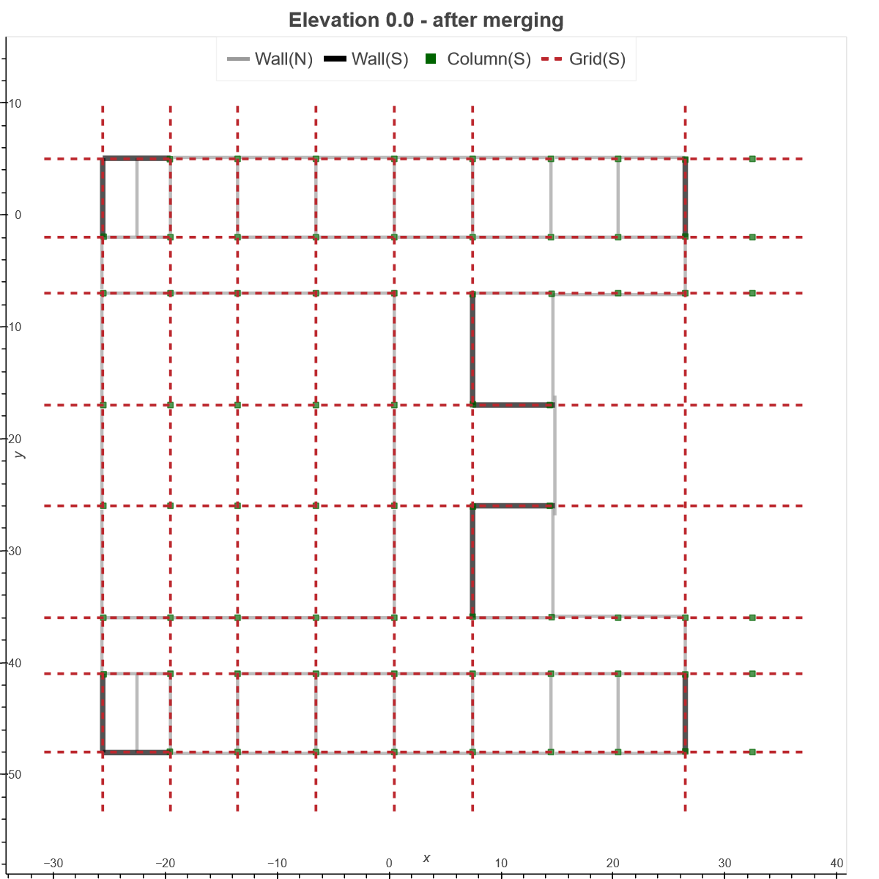
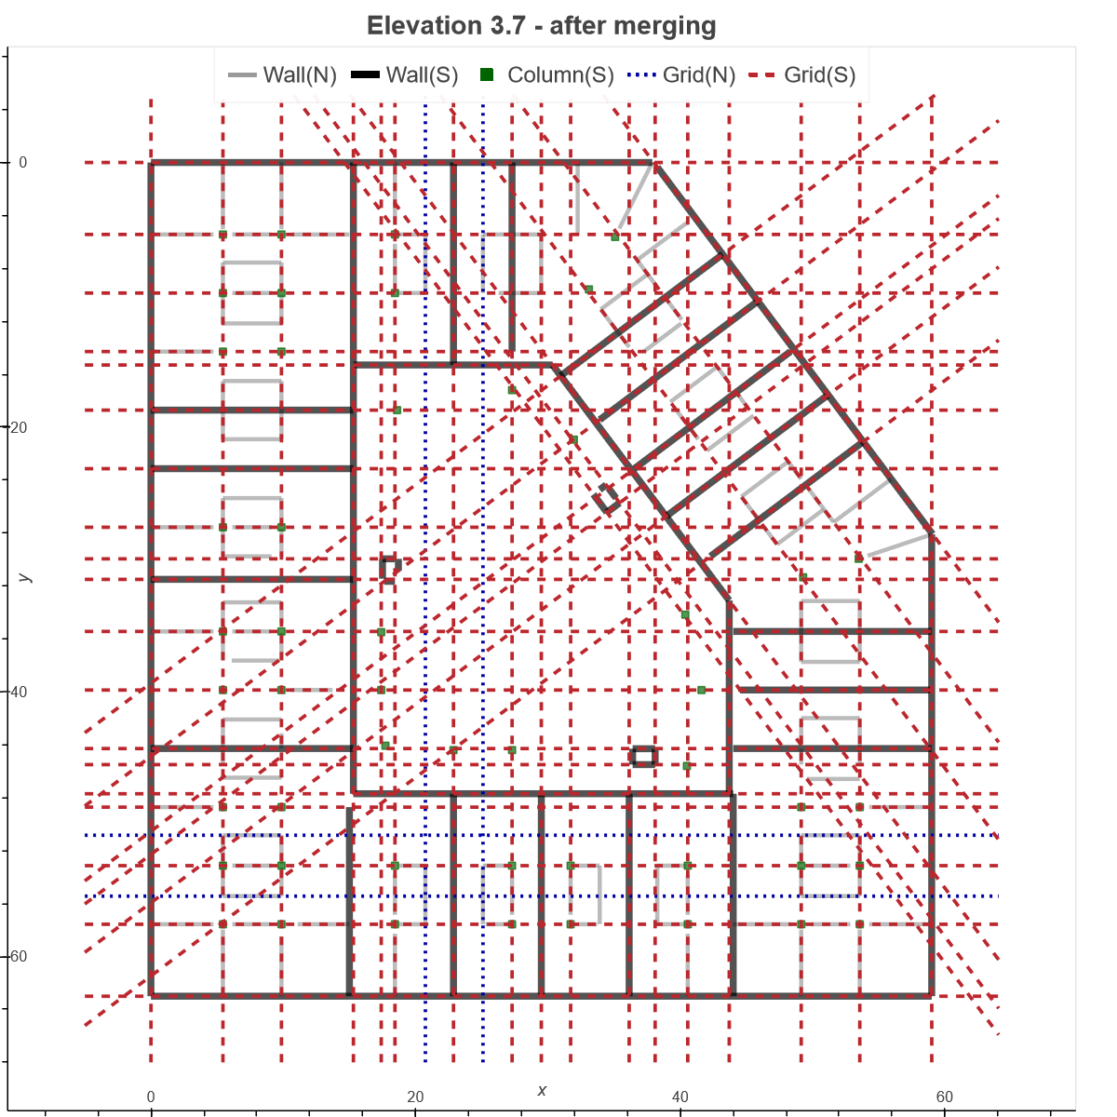
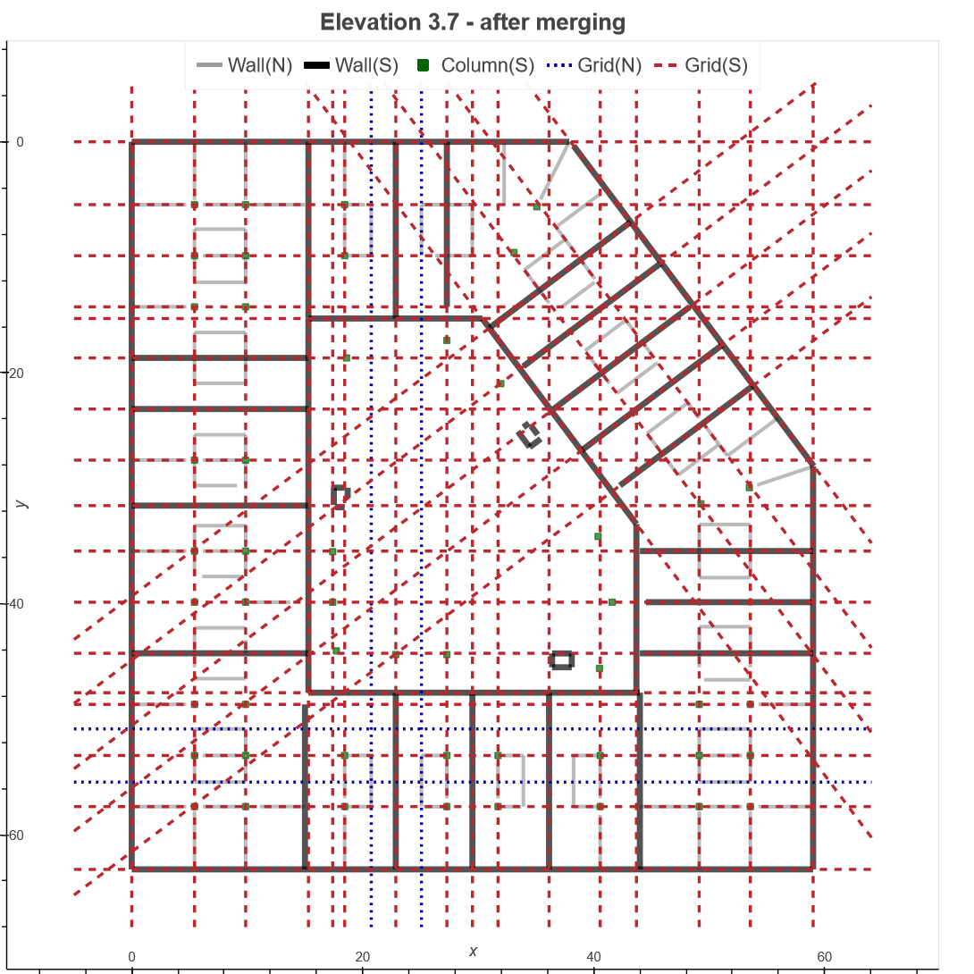
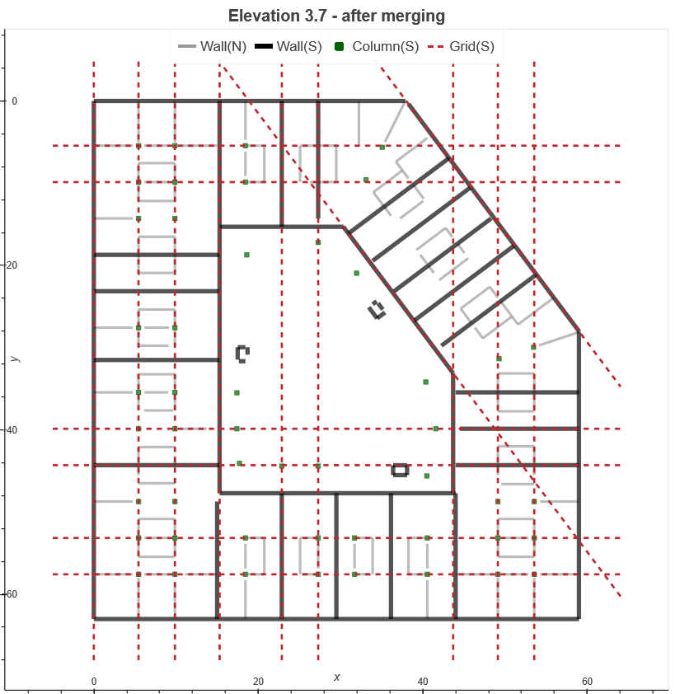
(0.39, 0.103)
(0.485, 0.053)
(0.715, 0.573)
1
2
3
4
(0.116, 0.303)
(0.232, 0.231)
(0.453, 0.36)
(0.009, 0.138)
(0.124, 0.112)
(0.493, 0.224)
(0.171, 0.366)
(0.236, 0.249)
(0.531, 0.648)

Slide 2
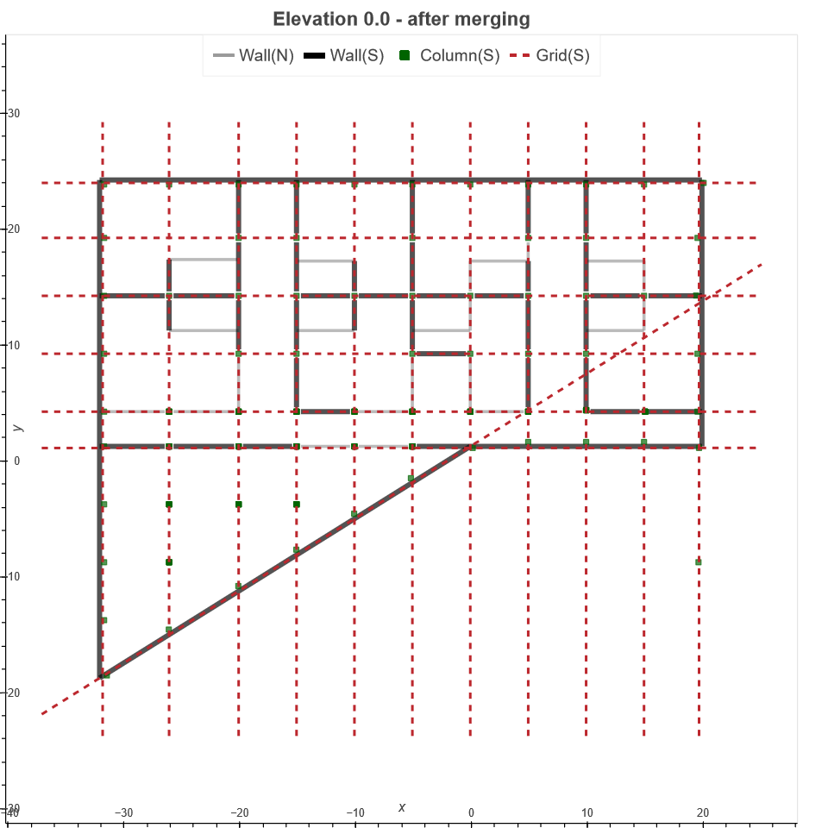
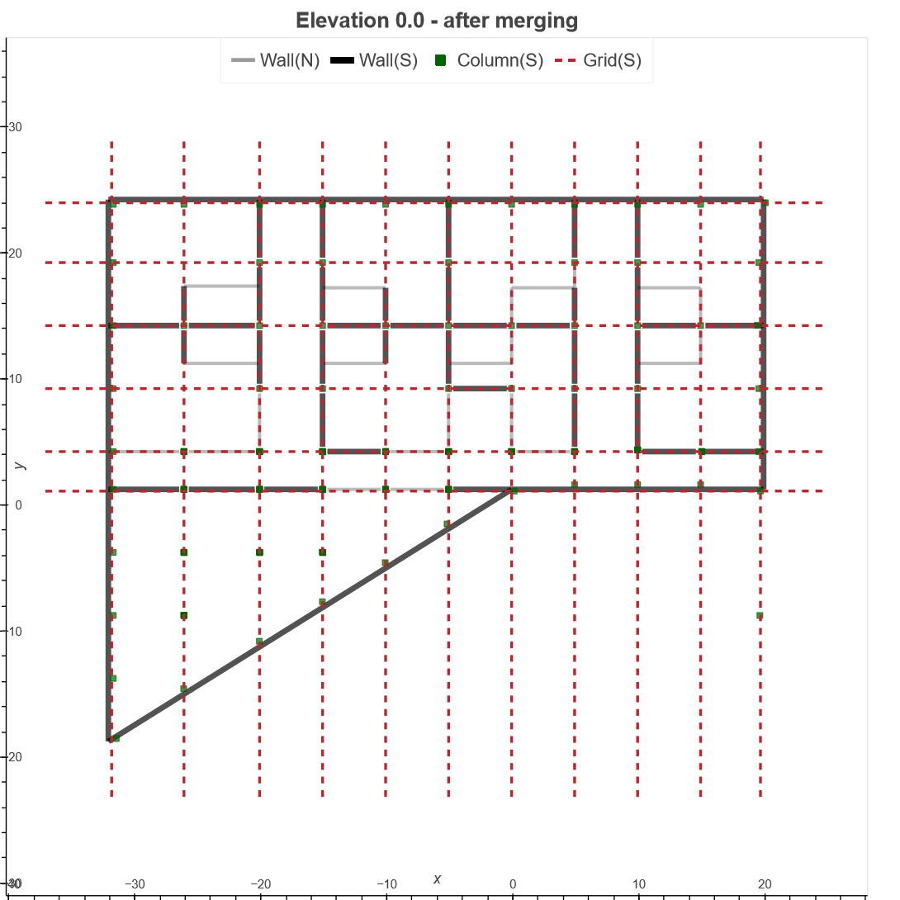
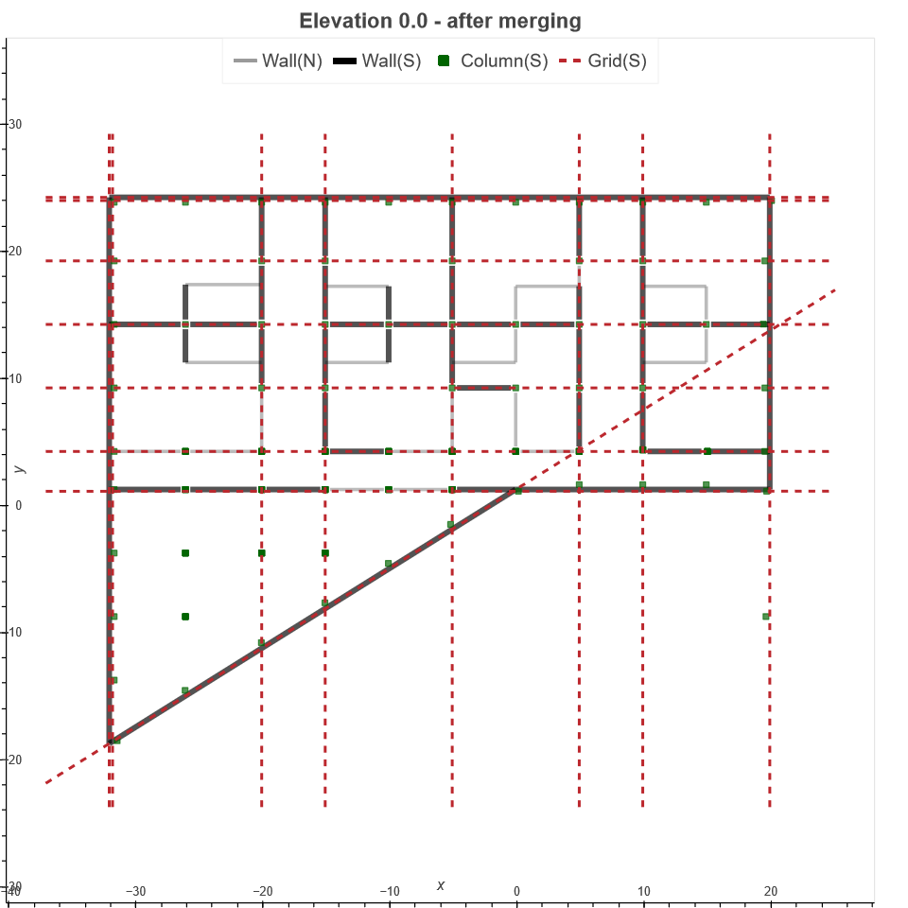
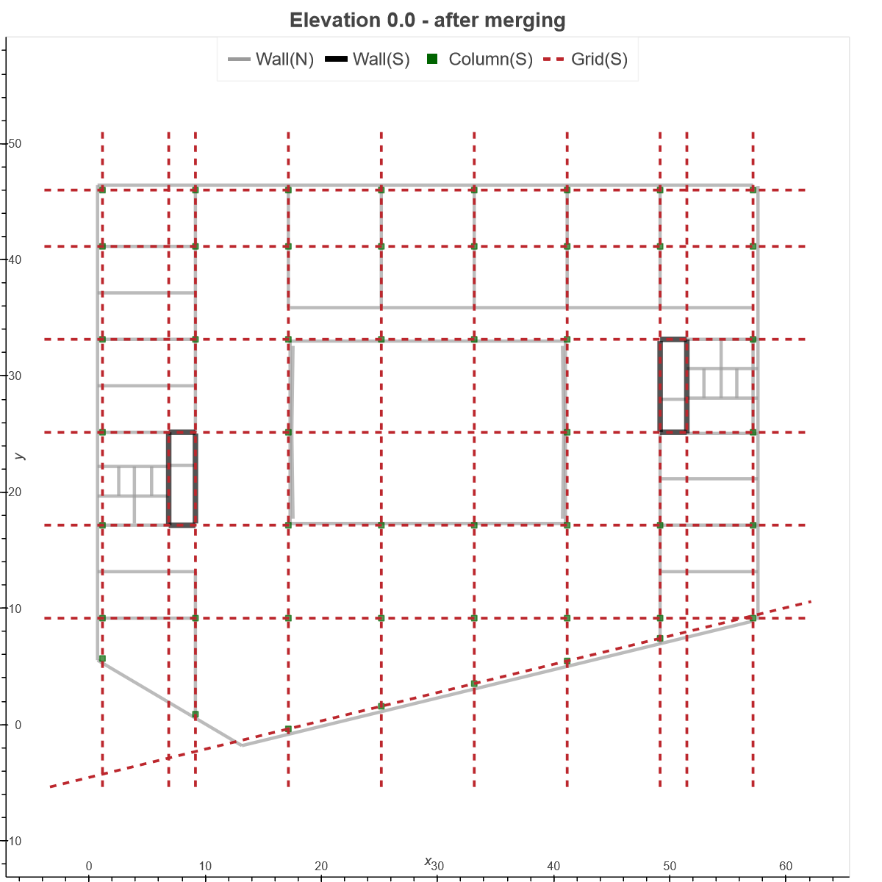
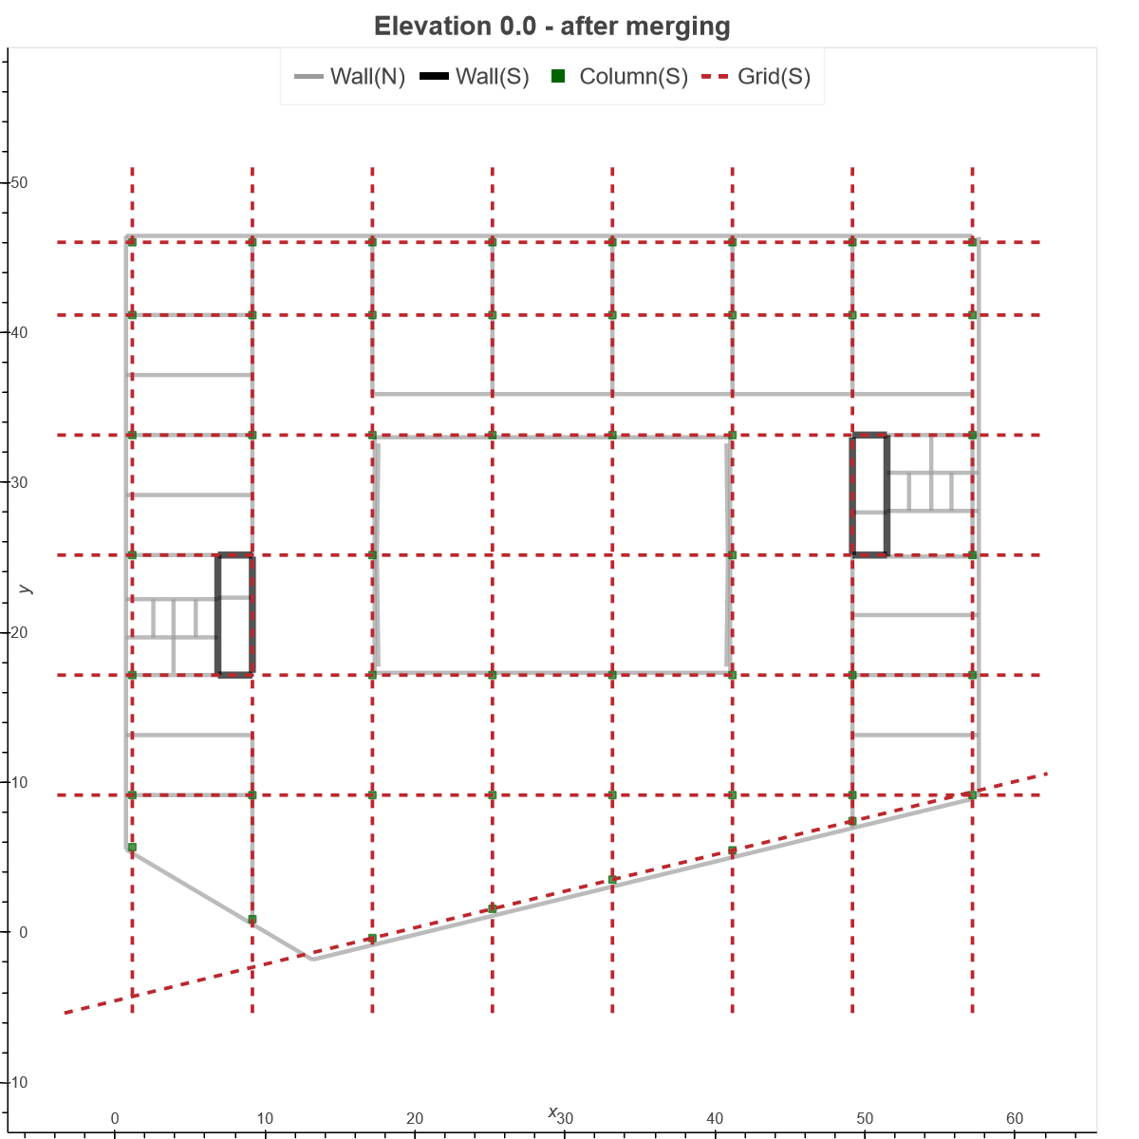
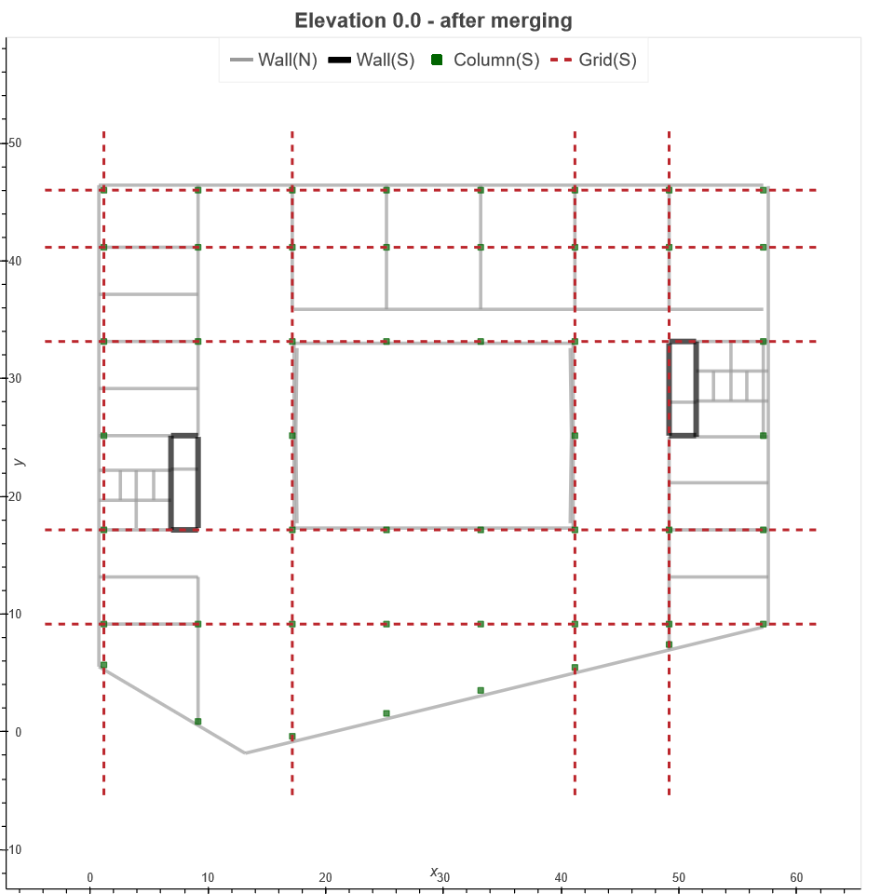
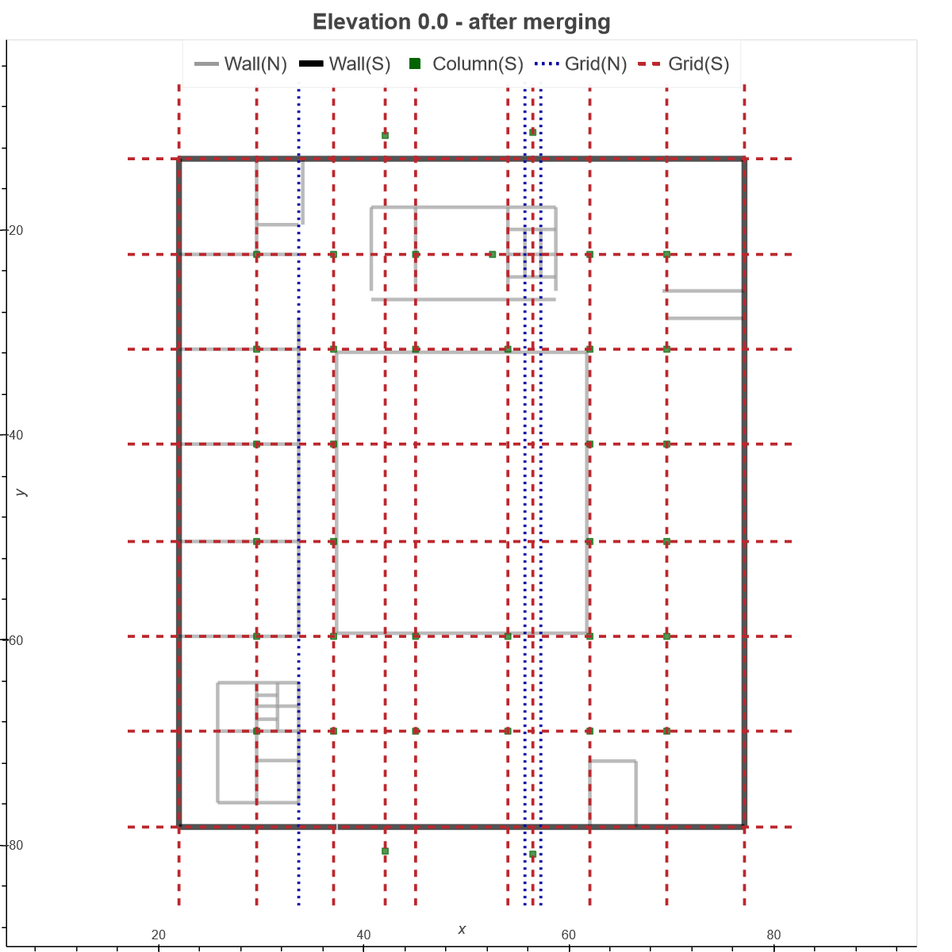
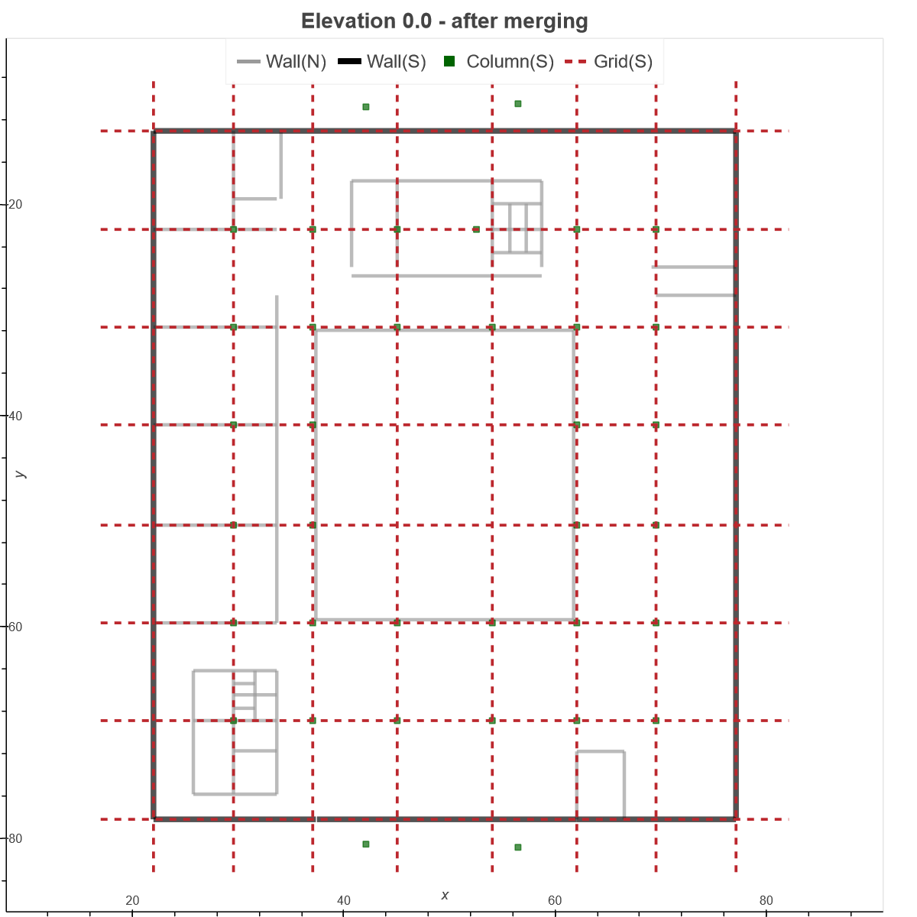
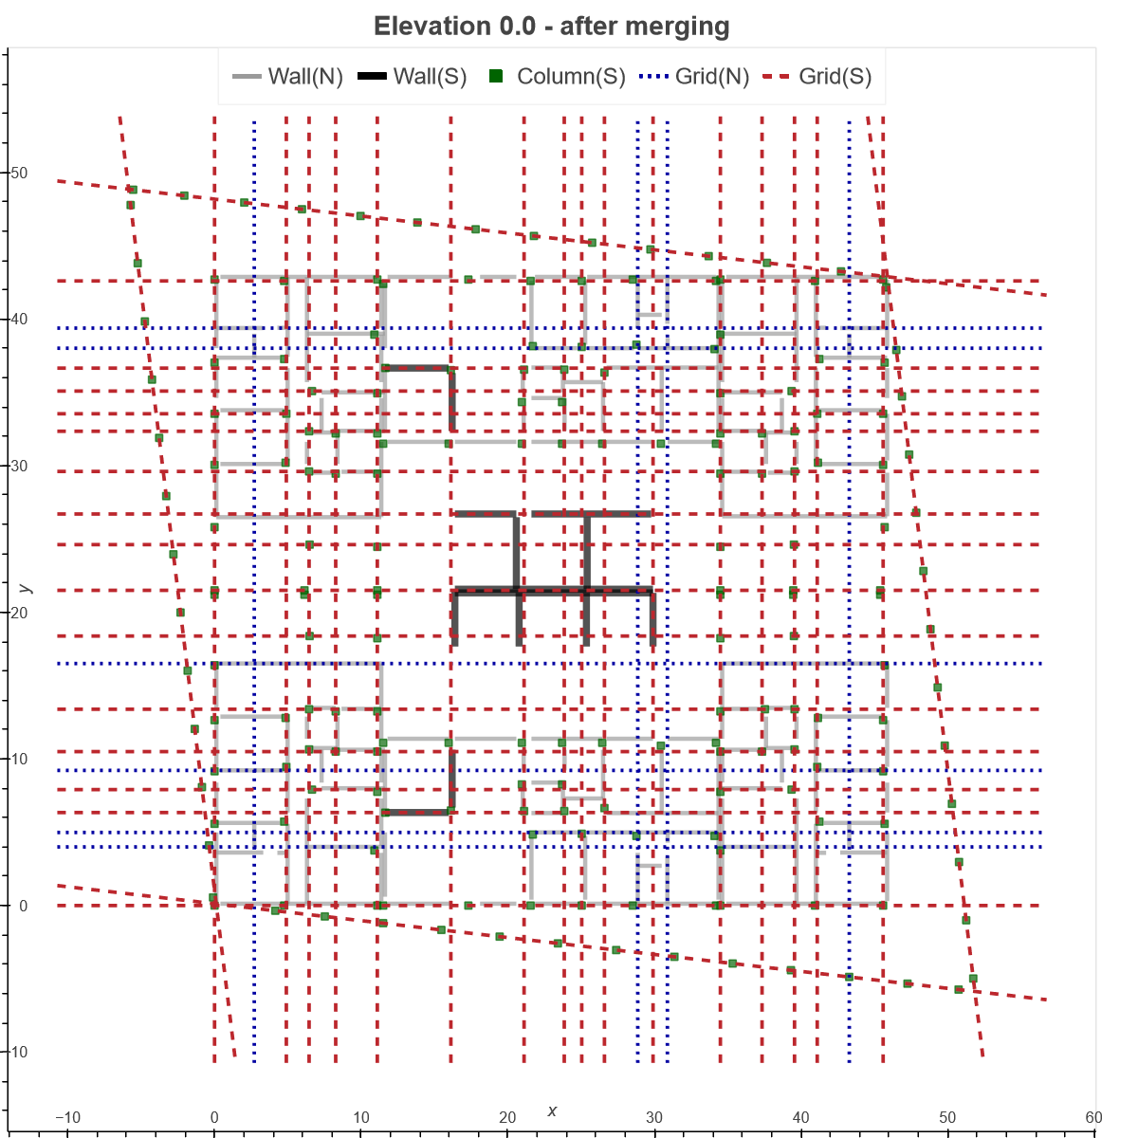
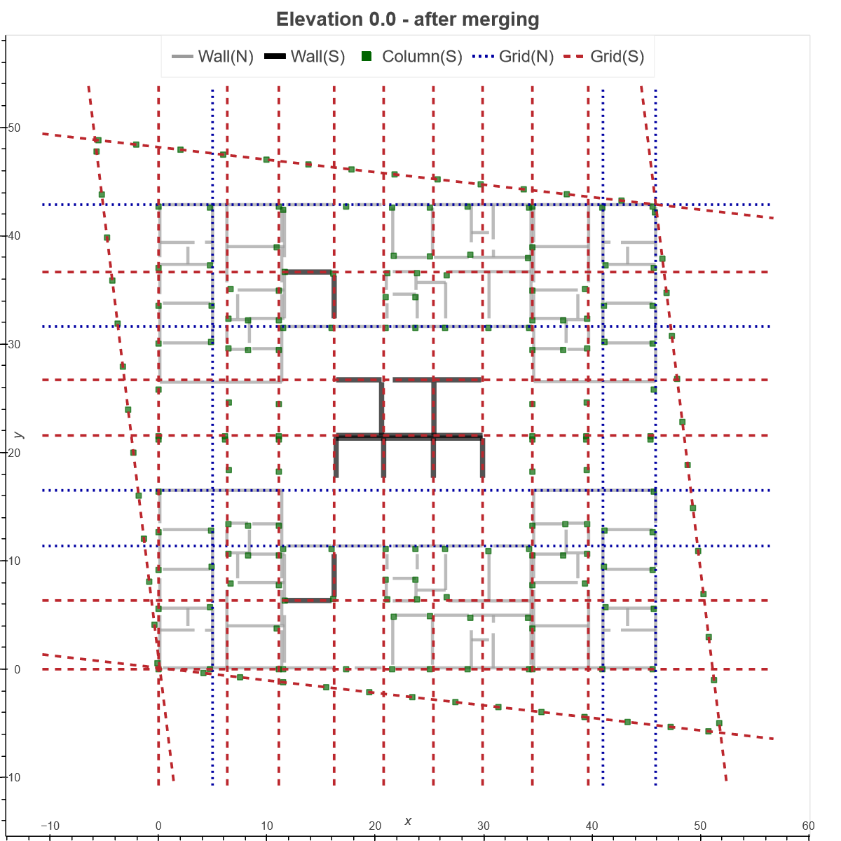
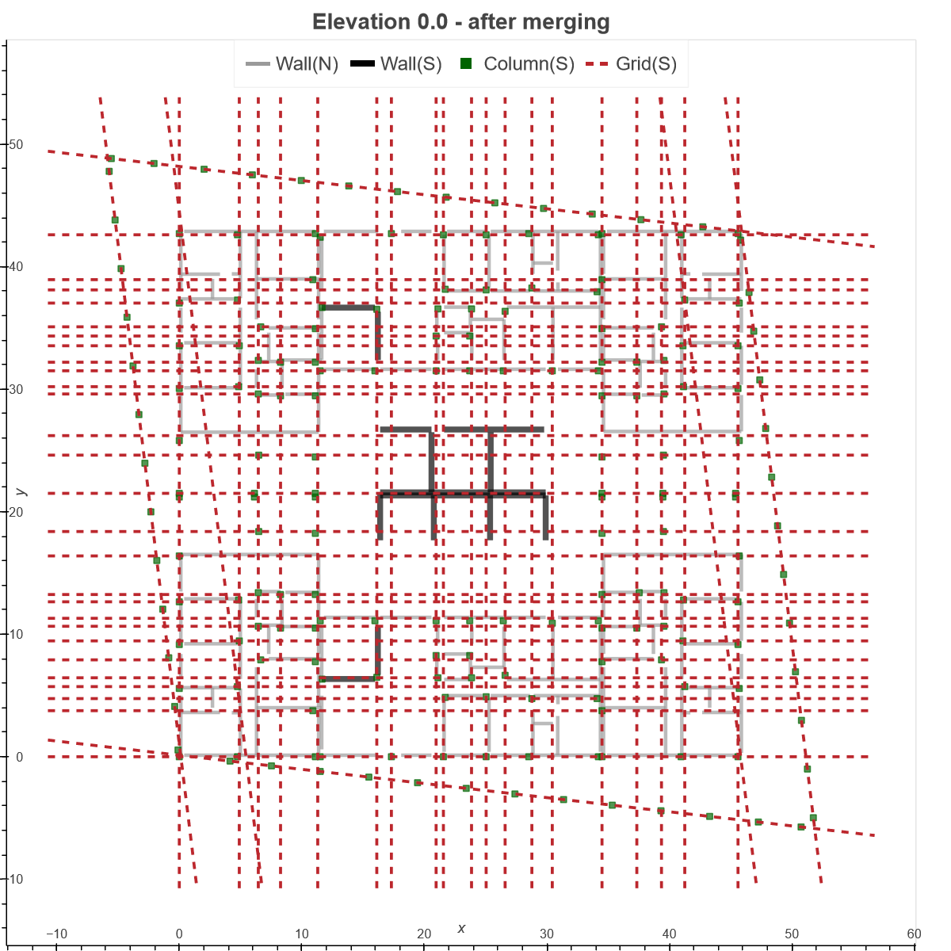
(0.138, 0.02)
(0.163, 0.019)
(0.284, 0.334)
5
6
7
8
(0.586, 0.136)
(0.646, 0.03)
(0.684, 0.41)
(0.299, 0.197)
(0.563, 0.025)
(0.322, 0.15)
(0.05, 0.227)
(0.488, 0.19)
(0.268, 0.336)

Slide 3
Nr. | Pareto front solutions | Others | Nr. | Pareto front solutions | Others
1
2
3
4
(0.39, 0.103)
(0.485, 0.053)
(0.715, 0.573)
5
6
7
8
(0.138, 0.02)
(0.163, 0.019)
(0.284, 0.334)
(0.116, 0.303)
(0.232, 0.231)
(0.453, 0.36)
(0.586, 0.136)
(0.646, 0.03)
(0.684, 0.41)
(0.009, 0.138)
(0.124, 0.112)
(0.493, 0.224)
(0.299, 0.197)
(0.563, 0.025)
(0.322, 0.15)
(0.171, 0.366)
(0.236, 0.249)
(0.531, 0.648)
(0.05, 0.227)
(0.488, 0.19)
(0.268, 0.336)

