Slide 1
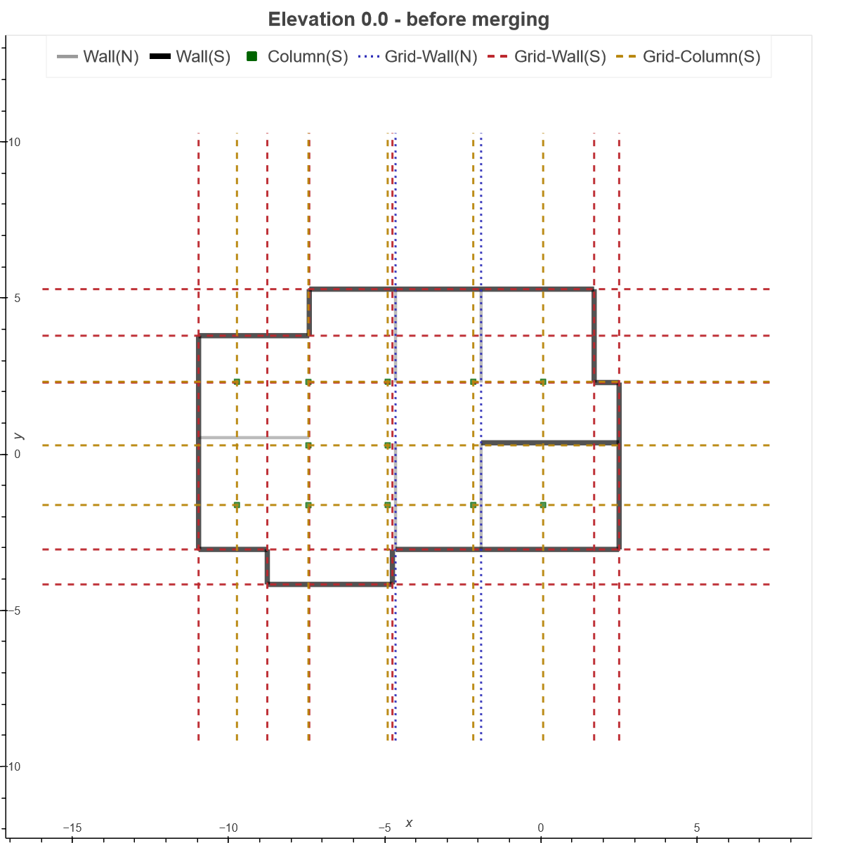

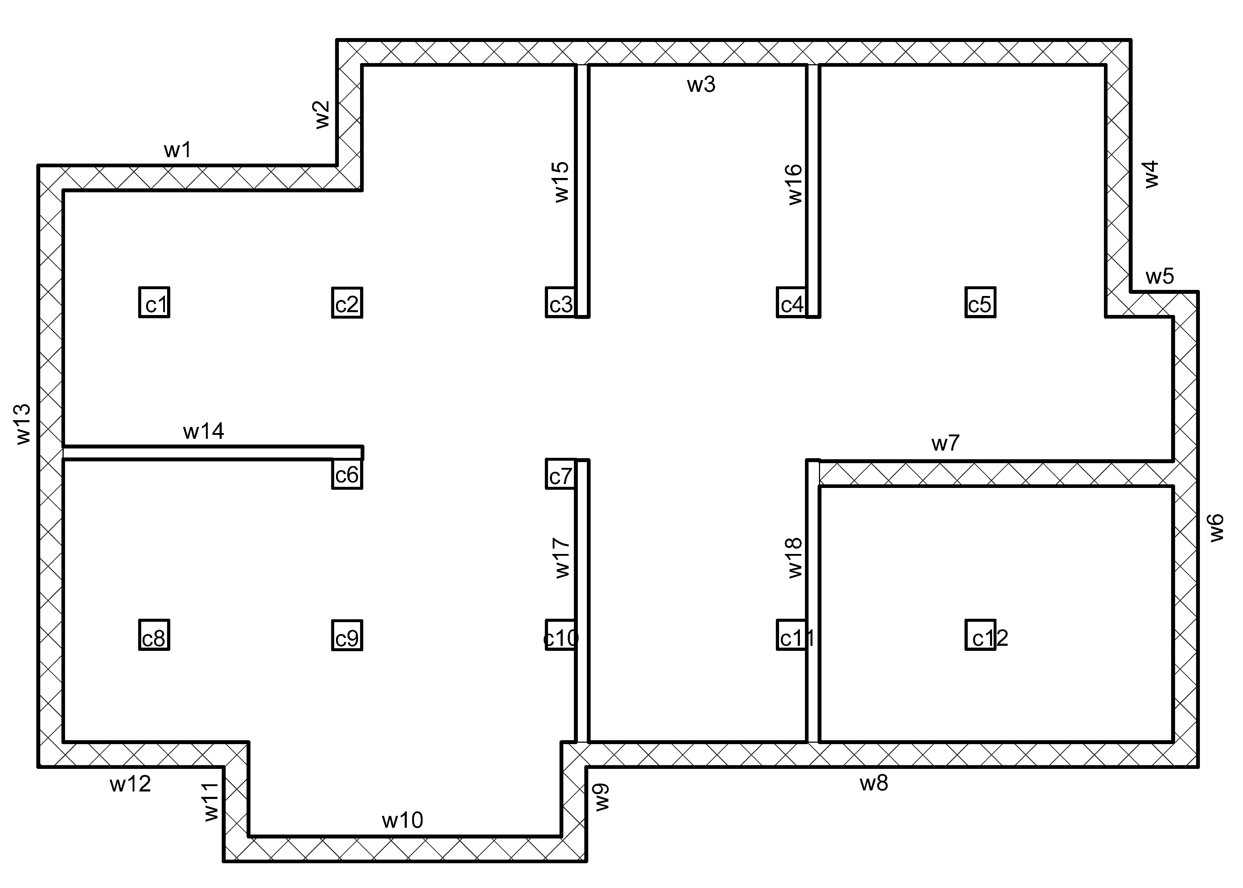
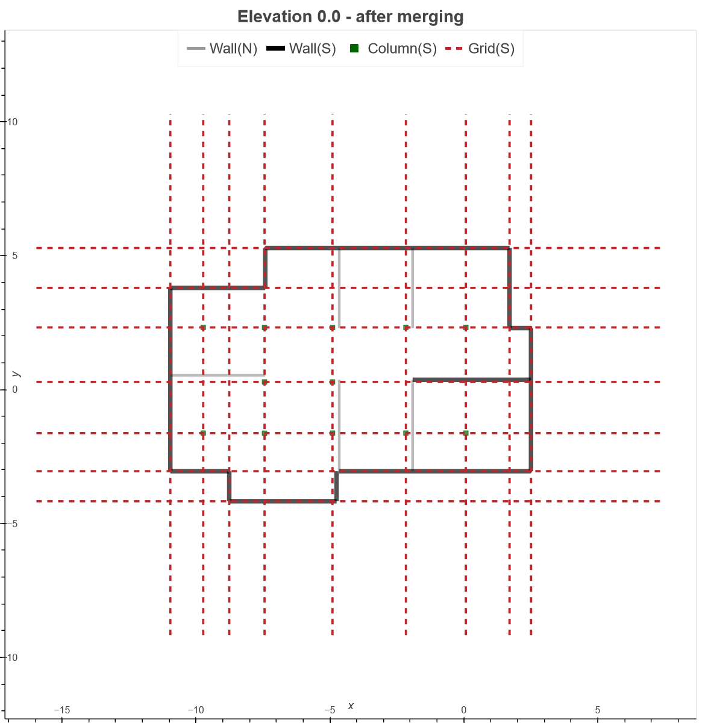
Alignment-based
grid creation
The specified thresholds for exemplified results
2D view of the ground level
Multi-level
grid merging

