Slide 1
FIT3146-Assignment 2
Exercise Black Box
Creator：PangFeng Zheng Date：2022.10.20

Slide 2
1
Research & Plan
Catalog
2
About
3
Working demo

Slide 3
PART 01
Research &Plan

Slide 4
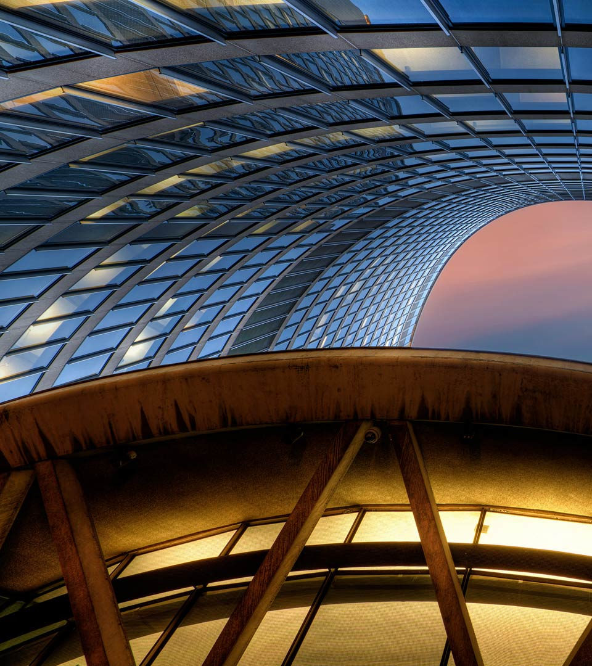
Idea pitch - gesture recognition
The project’s aim is to use gesture recognition technique to make an useful product.

Slide 5
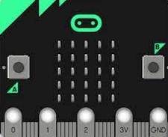

Research & Plan
Support:
Direction(up, down, left, right)
Possible Product:
Car’s manipulate, Music Control
Support:
Hand’s movement, Fingers’ movement, Body’s movement
Possible Product:
Fitness, Computer Mouse Control, Music Control, Mechanical Arm Control
Microbit
Camera
About:
Provide coding and calculation support, support camera connection, support other hardware connection
Support Hardware:
Switch Button
LED strip
LED screen
Camera
SD card
HDML line
Raspberry Pi

Slide 6
Research & Plan
Time
Cost
Final decision
Exercise Black Box
Human Resources

Slide 7
PART 02
About

Slide 8
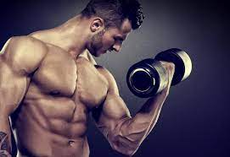
About
-What it is?
Exercise Black Box:
A tool that encourages and helps users to exercise.
Determine if the action is complete by recognizing the angle of the body.
Provide encouragement and feedback after the user completes the phased exercise.

Slide 9

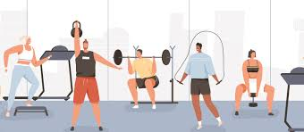

About
-Who is it create for?
people quarantined
fitness man
More…

Slide 10




About
-Why is it needed?
Difficulty counting
Inconvenient to gym
Unsafe outside(Covid)
Doesn’t fit the standard

Slide 11
About
-How it is used/benefits/features?
Use
Benefits
Features
Keyboard input to run
Press a button to run/stop (Future)
People get motivated
Able to fitness at home
Standardized exercise
Standardized Fitness Quantity
Audio to help with fitness such as counting/encouraging
LED lights provide real-time feedback
Online synchronous fitness/online fitness room (Future)
Different exercise judgments (Future)
On-screen displays such as achievements or games (Future)

Slide 12
PART 03
Working demo

Slide 13
Working demo
Meaning of LED
Color (Level):
Blue: 0-10 exercises
Green: 11-20 exercises
Purple: 21-30 exercises
Red: 31-40 exercises
Number of lights:
For each level
1 light: 0-2 exercises
2 lights: 3-4 exercises
3 lights: 5-6 exercises
4 lights: 7-8 exercises
5 lights: 9-10 exercises
Link

Slide 14
Thanks For Watching
Creator：PangFeng Zheng Date：2022.10.20

