Slide 1
DEPI Final project
Our team Members :
Yousef Hesham Mohamed Rady
Abdelrahman Ali Amer
Abdelrahman Ahmed Zakzouk
Abdelmageed Ali

Slide 2

Blog Project
This is a blog application developed using ASP.NET MVC to solidify our understanding of fundamental web development concepts. The project includes CRUD operations, routing, model binding, and utilizes dependency injection. ASP.NET Identity is integrated for user authentication and authorization, providing secure access to different parts of the application. The Admin area allows managing categories and posts, with a responsive layout designed using Bootstrap.

Slide 3
Technologies Used Front-End :
HTML
CSS
JavaScript
Bootstrap

Slide 4
Technologies Used Back-End :
C#
ASP.NET Core
MVC Pattern
MS SQL Server

Slide 5
Tools used
Visual studio code
MS SQL Server
Git & github

Slide 6
Design Patterns
Repository Pattern
Unit of Work Pattern
Dependency Injection

Slide 7
Features
CRUD Operations
Authentication & Authorization
User Lockout
Admin Area
Visitor Area
Responsive Design

Slide 8
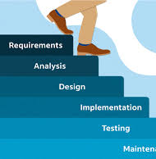
Used Methodology

Slide 9

Technical Challenges
1 User Authentication and Authorization
Challenge: Implementing a secure and scalable authentication system (login, registration, password reset) and managing user roles (admin, author, regular user) can be complex.
Solution: Use established libraries or frameworks such as OAuth, JWT, or ASP.NET Identity for authentication, and ensure proper role-based access control (RBAC).
2 Database Design & Optimization
Challenge: Designing a scalable and efficient database schema to handle multiple relationships (e.g., posts, comments, users, roles) without compromising performance, especially as the number of posts and interactions grows.
Solution: Use indexing, proper data normalization, and caching strategies to optimize query performance. Consider using NoSQL databases for flexibility if dealing with unstructured data like user-generated content.

Slide 10

Design and User Experience Challenges
1 Designing an Intuitive Admin Dashboard
Challenge: The admin panel must be user-friendly and intuitive for non-technical users (e.g., authors or content managers) to create and manage posts, categories, and tags.
Solution: Conduct user research and iterative prototyping to ensure ease of use, and implement features like post scheduling, drag-and-drop media uploads, and rich-text formatting.
2 Handling Media Files (Images/Videos)
Challenge: Managing large media files (e.g., images, videos) associated with blog posts can strain server resources and storage, leading to slower performance.
Solution: Implement media compression, use a Content Delivery Network (CDN) for faster content delivery, and allow external embedding (e.g., YouTube for videos) to reduce storage costs.

Slide 11
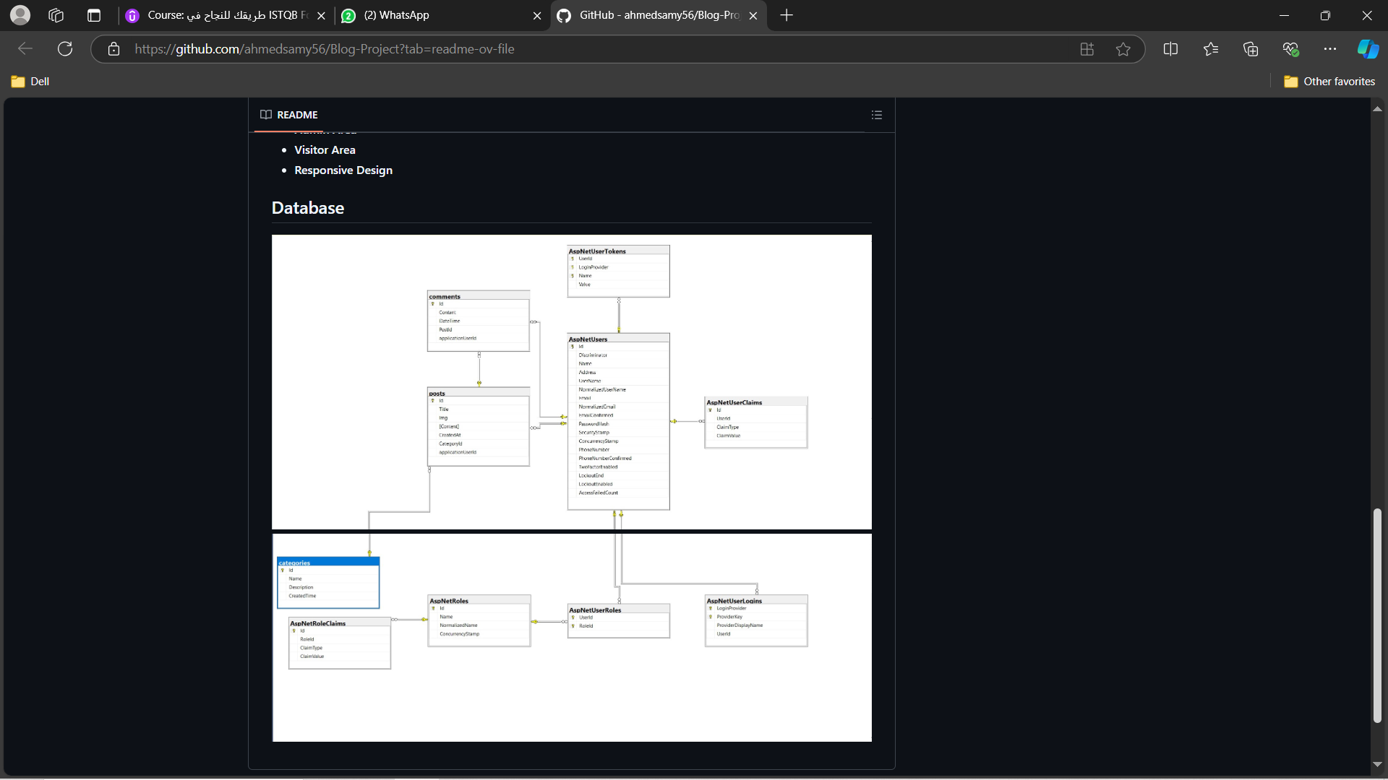
Database diagram

