Slide 1
Nice and Enriching Project in IoT
How to get some education, some skills, some job and last but not least – some money as well

Slide 2
Authors
Marek Leemet
Jaan Omblus

Slide 3
We all love IoT
Task No 1 – to learn;
Task No 2 – to understand something;
Task No 3 – to put the skills to work;
We have plan for this.

Slide 4
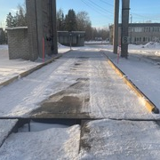
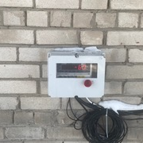

Nice place for IoT stuff

Slide 5
Chips cars - customers
Issue | Description
Domain | ML on Tabular Data
Title | Improving the quality of muuseum data
Data availability | Data is available
Contact person | Kristjan Eljand
Organization | Andmeteadus OÜ

Slide 6
The issue is important, has a global reach
https://lucidea.com/museums/museum-collections-management-system-primer/
https://stacc.ee/stacc-help-the-national-heritage-board-using-artificial-intelligence/
https://dspace.ut.ee/bitstream/handle/10062/33522/jeeser_museum_2013.pdf?sequence=1&isAllowed=y
http://eprints.rclis.org/13242/1/VSMM08.pdf
https://www.researchgate.net/publication/28810353_Designing_interoperable_museum_information_systems
https://cidoc.mini.icom.museum/wp-content/uploads/sites/6/2018/12/stein.pdf
https://core.ac.uk/download/pdf/4816932.pdf
https://www.jstor.org/stable/30199290
https://www.obs-traffic.museum/documentation-inventory-identification
https://www.mdpi.com/1424-8220/22/1/312

Slide 7
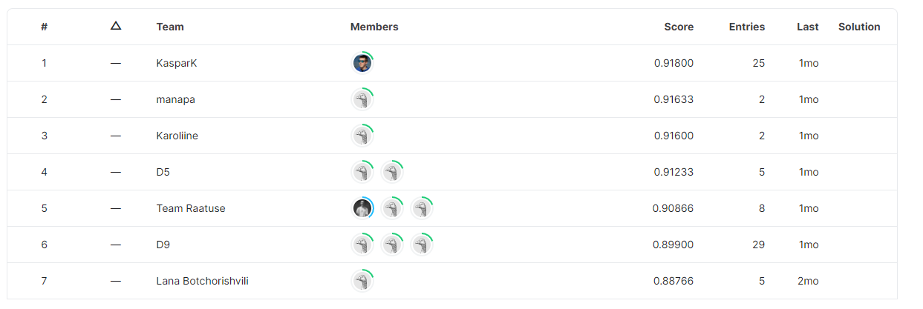
Other participants scores in kaggle

Slide 8
Methods used to solve the problem
To treat the issue of missing values;
Translation to English language;
Lemmatization (reduce number of columns, merge similar info);
Tokenization;
XGBoost;
Random Forest.

Slide 9
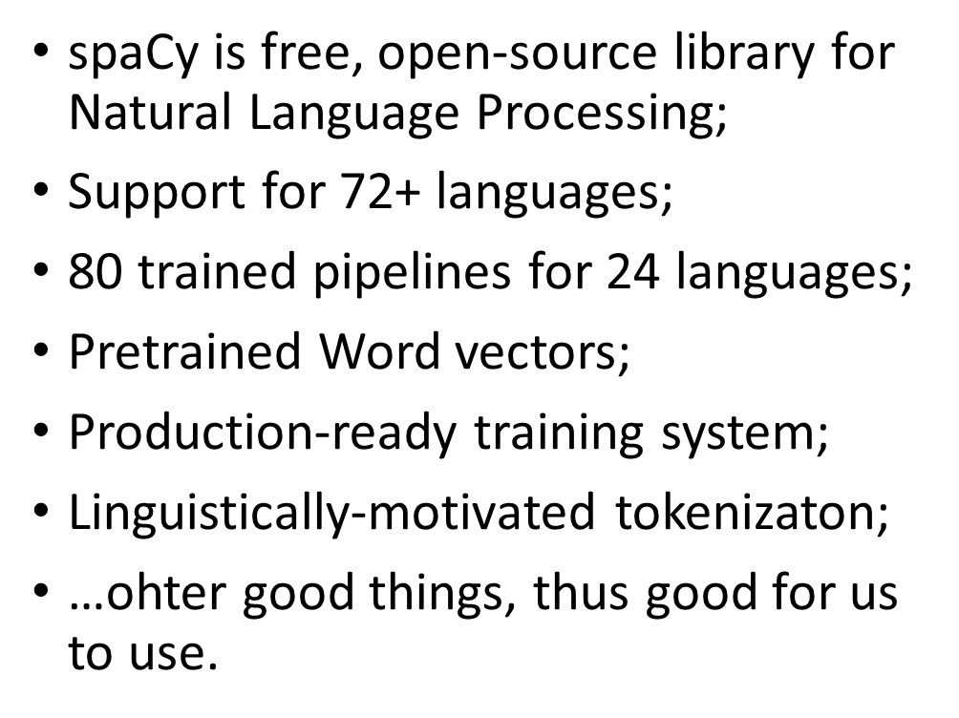

Using spaCy

Slide 10
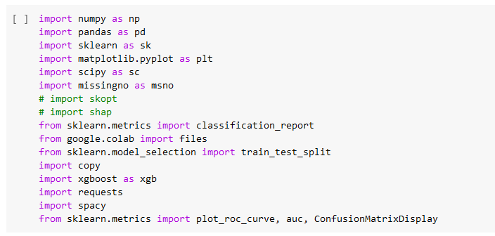
Other inputs we had to use…

Slide 11
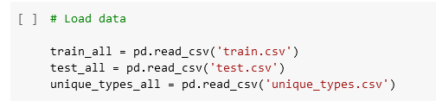
Training and testing datasets
Model needs to be trained and tested;
Thus training and testing datasets are needed;
Unique_types dataset is also essential.

Slide 12
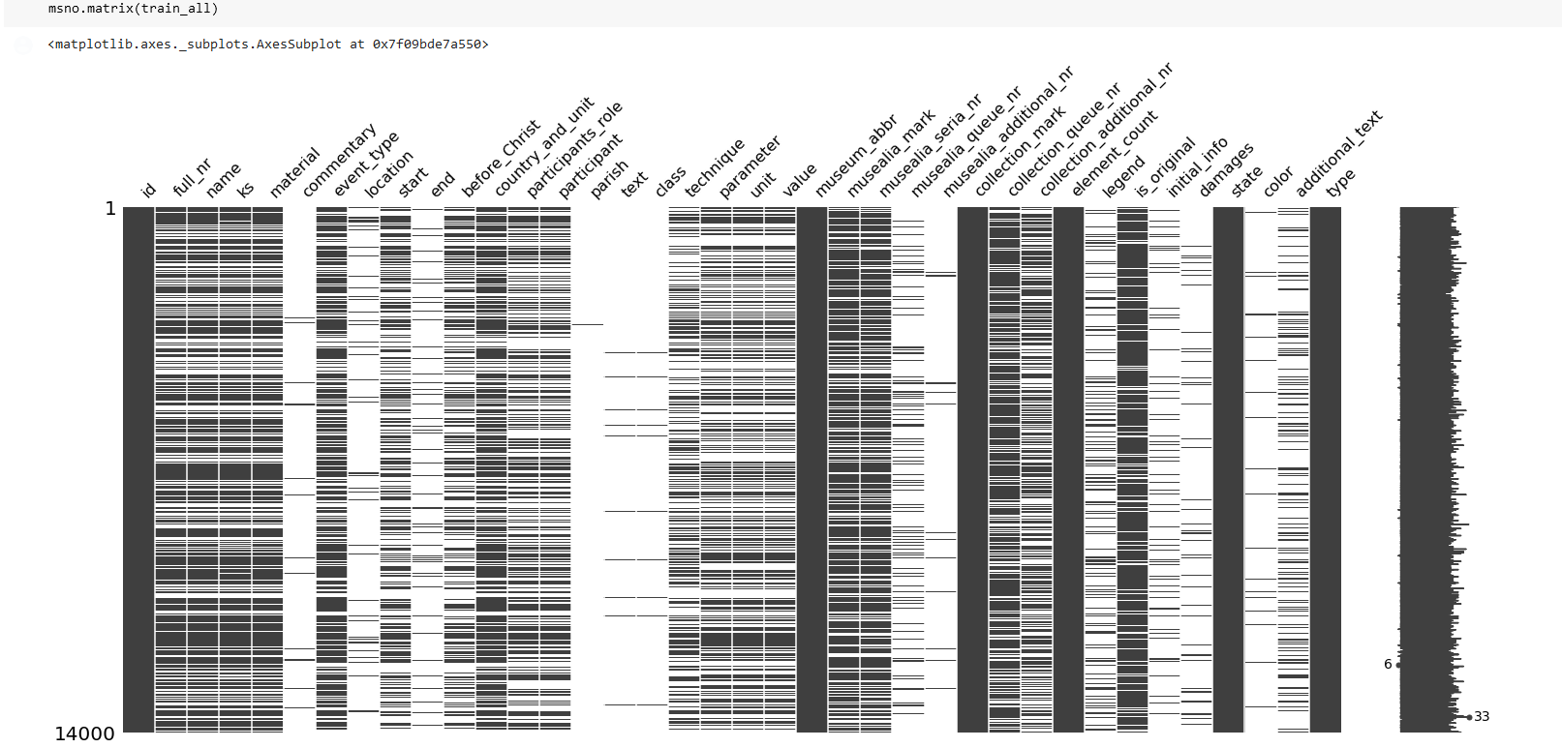
Checking missing values
Real life data are not perfect;
There are lot of missing values;
When working on the topic, the missing values had to be worked upon.

Slide 13
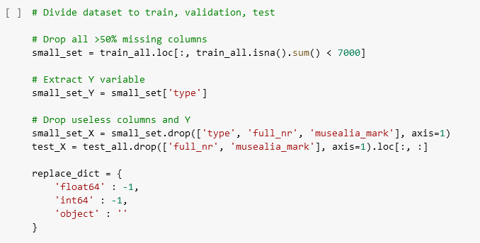
Partition dataset
Making small datasets;
Droping useless and >50% missing columns.

Slide 14
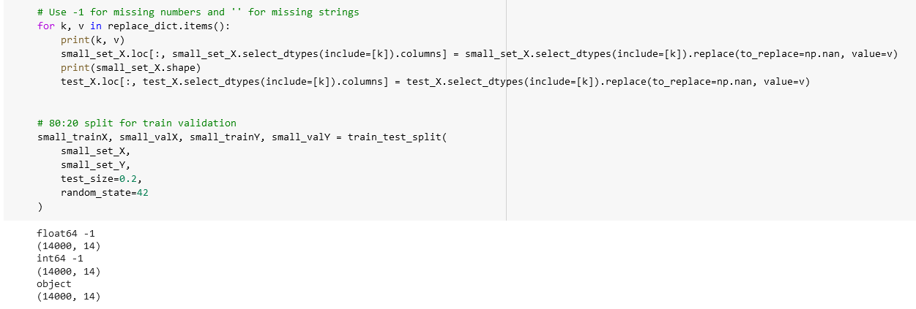
Partition dataset
Use -1 for missing numbers, ‘ ‘ for missing strings;
New train-validation sets.

Slide 15
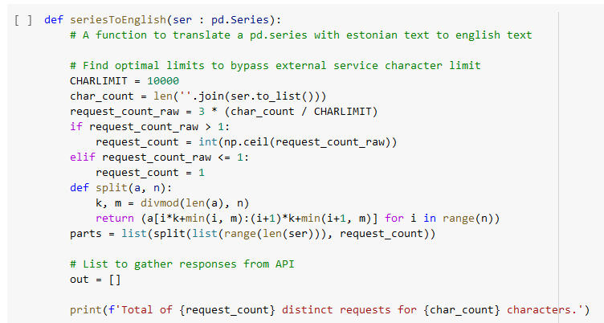
Translation to English (start)

Slide 16
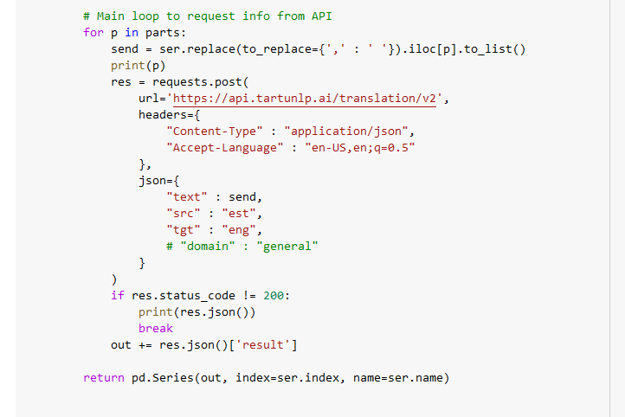
Translation to English (continues)

Slide 17
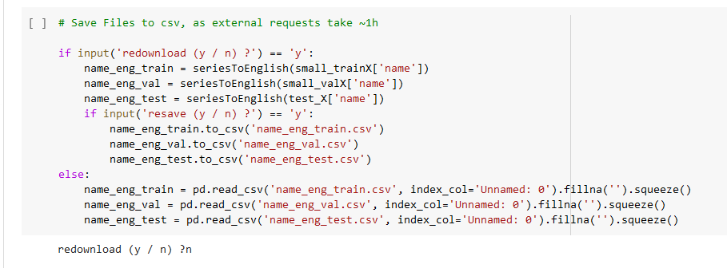
Saving files
Need to save the files;
External requests take approx. hour.

Slide 18
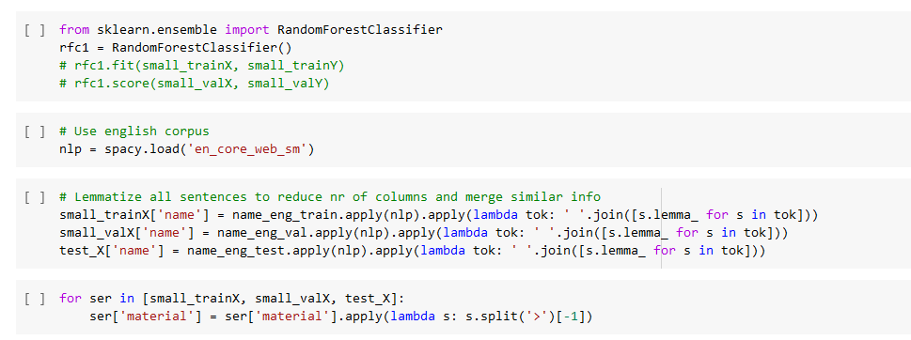
Tokenization
Using English corpus;
Lemmatization to:
Reduce number of columns;
Merge similar info.

Slide 19
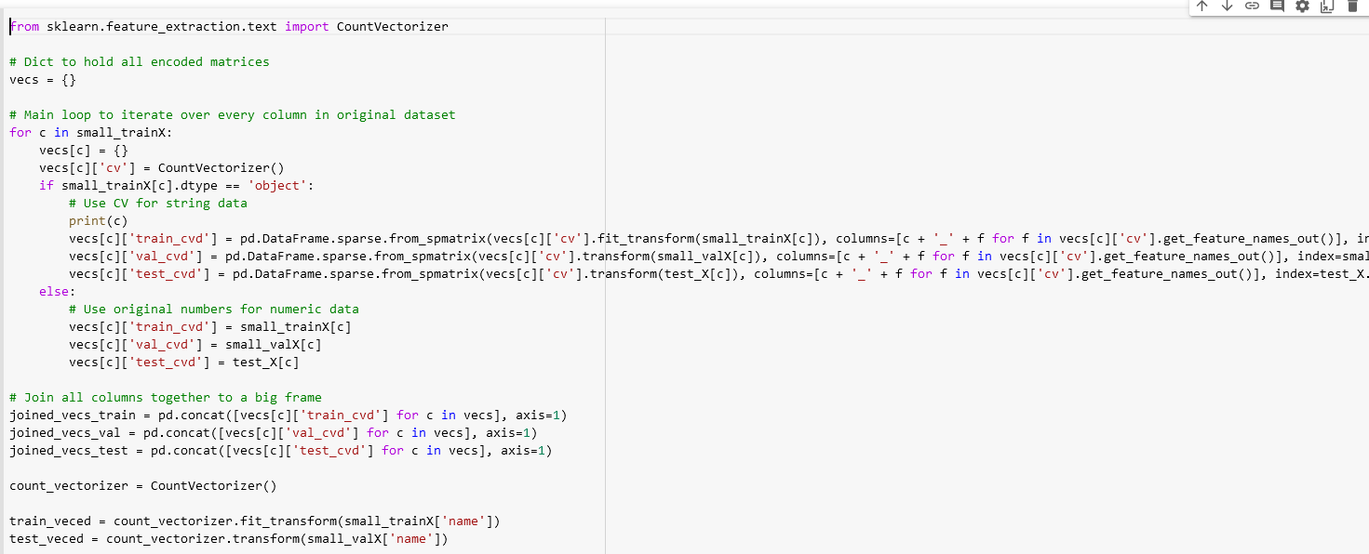
Tokenization
Making dictionary;
Other technicalities.

Slide 20
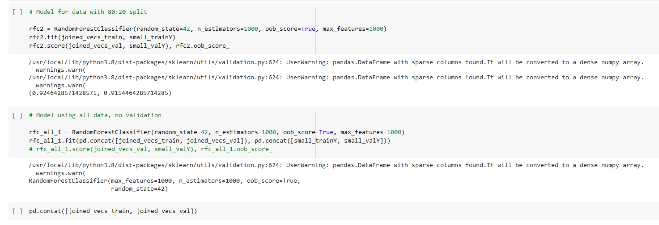
Tokenization
Spliting data;
Using all data, no validation.

Slide 21
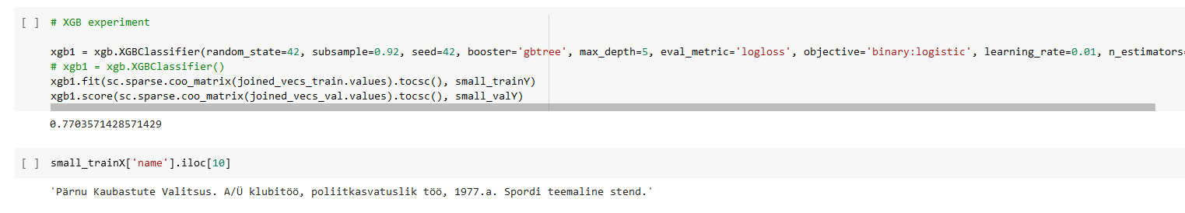
Tokenization
Experimenting with XGB Classifier.

Slide 22
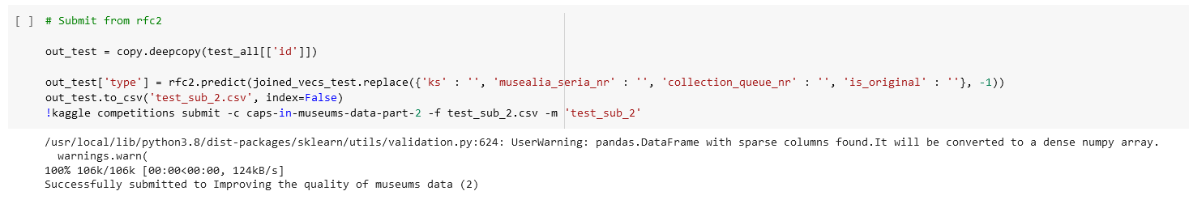
Submit
Submit from rfc2.

Slide 23
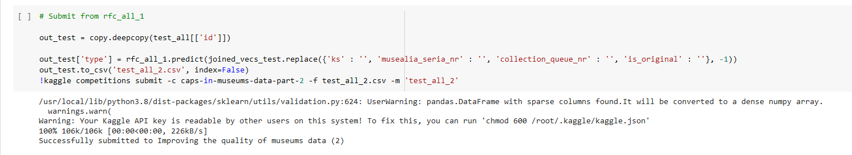
Submit
Submit from rfc_all_1.

Slide 24
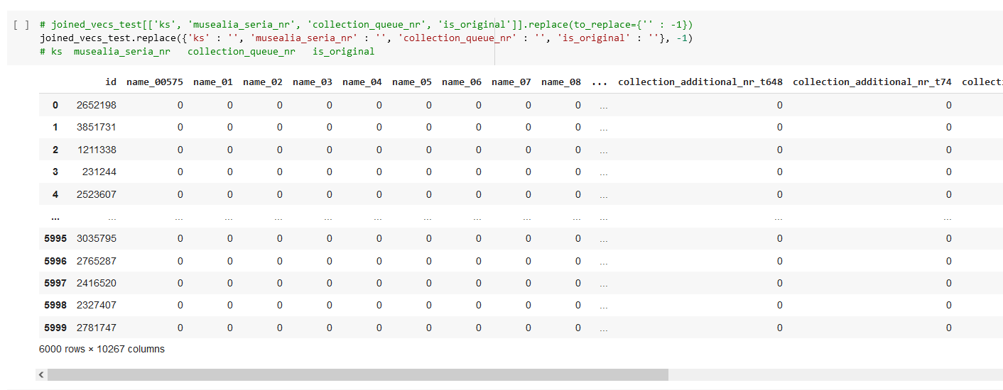
Submit

Slide 25
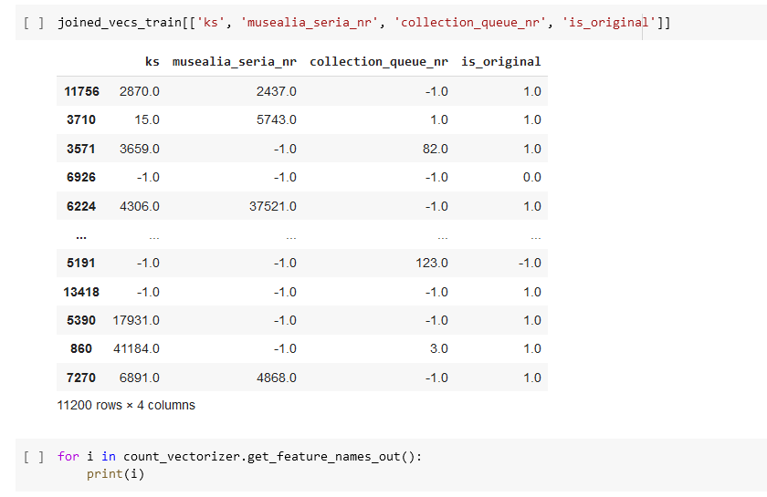
Submit

Slide 26
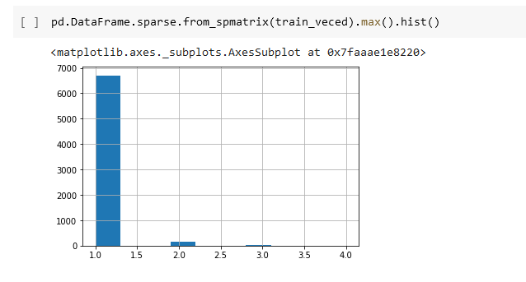
Graphics

