Slide 1
Industrial Scale Project in IoT
Project of lively importance, IoT saves our day

Slide 2
Authors
Marek Leemet
Jaan Omblus

Slide 3
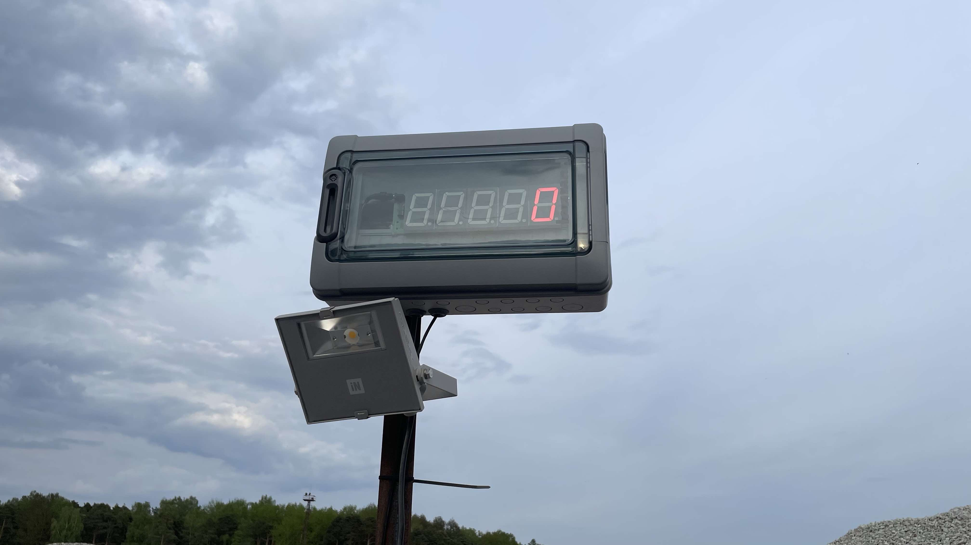
Here it starts

Slide 4
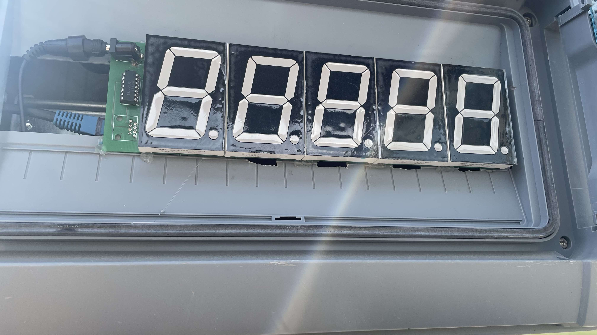
Bit closer look

Slide 5
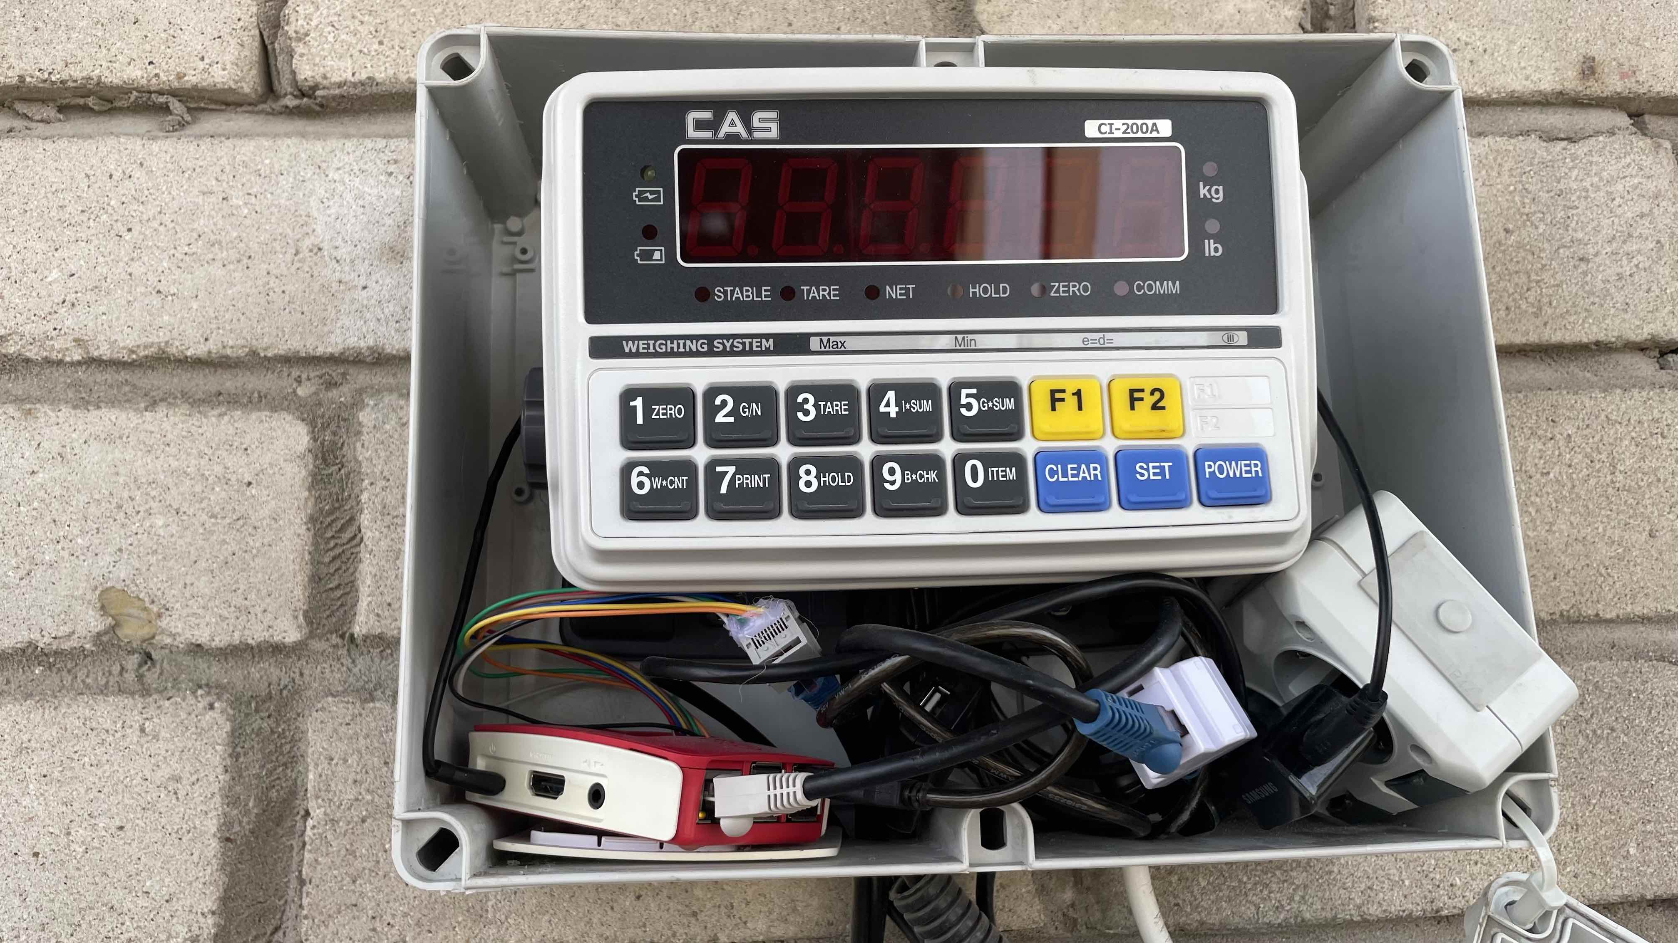
Becoming technical

Slide 6
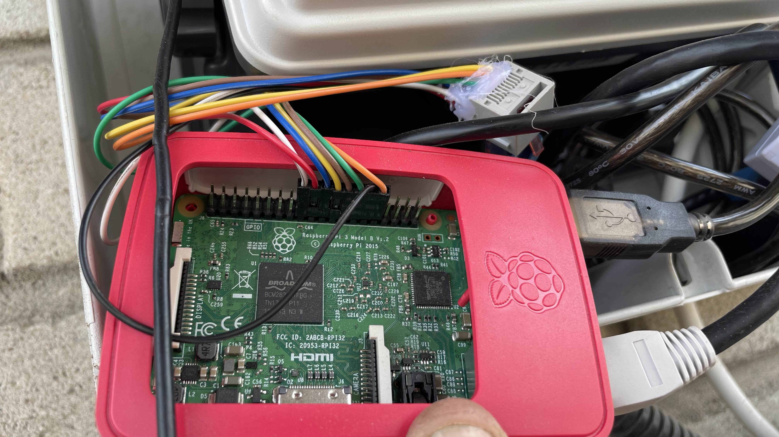
Even more technical

Slide 7
It is in operation
Video removed, made the file too big to upload to prortfolio…

Slide 8
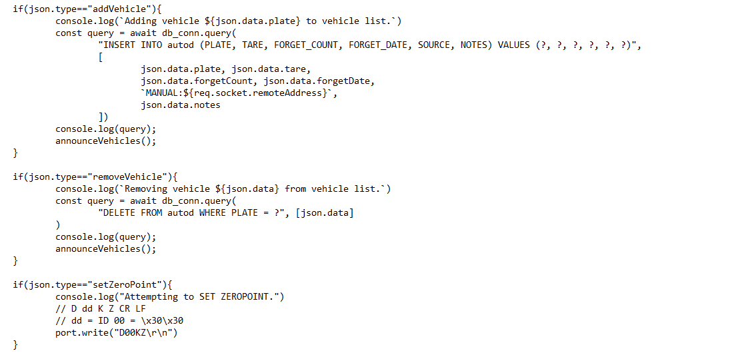
Did some programming meanwhile

Slide 9
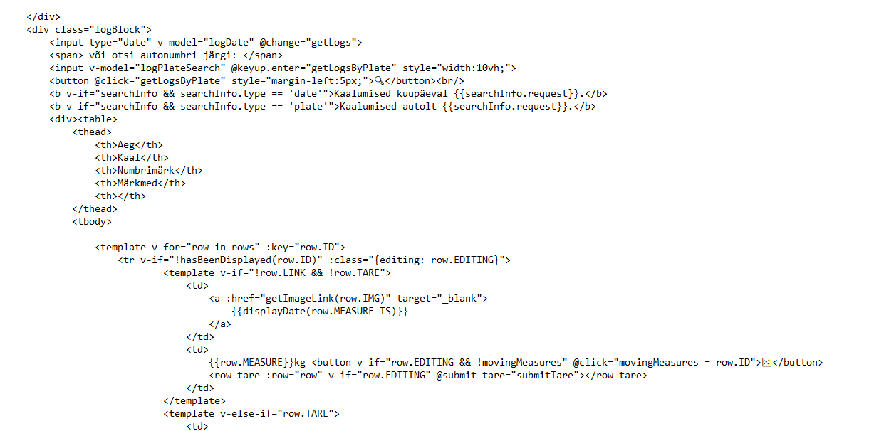
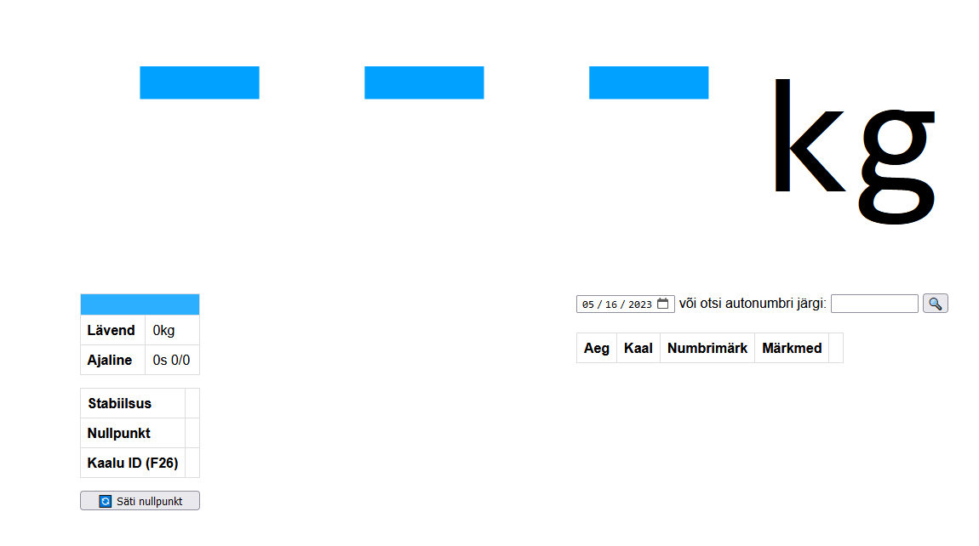
Did webpage https://kaal.leemet.me/

Slide 10
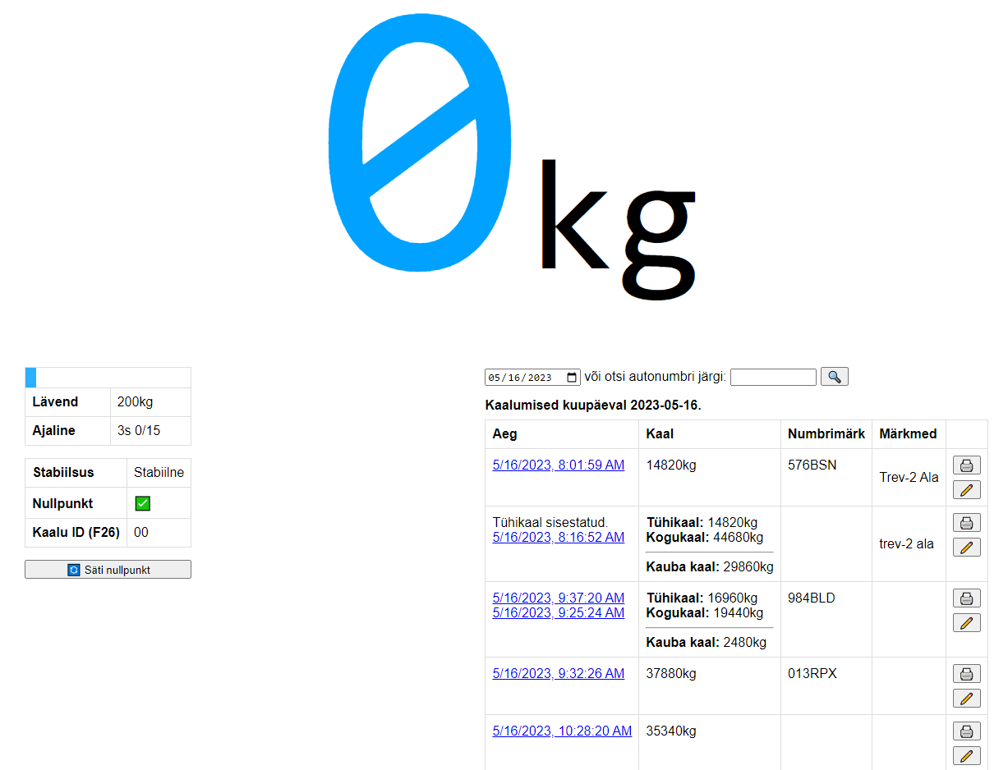
In process https://kaal.leemet.me/

Slide 11
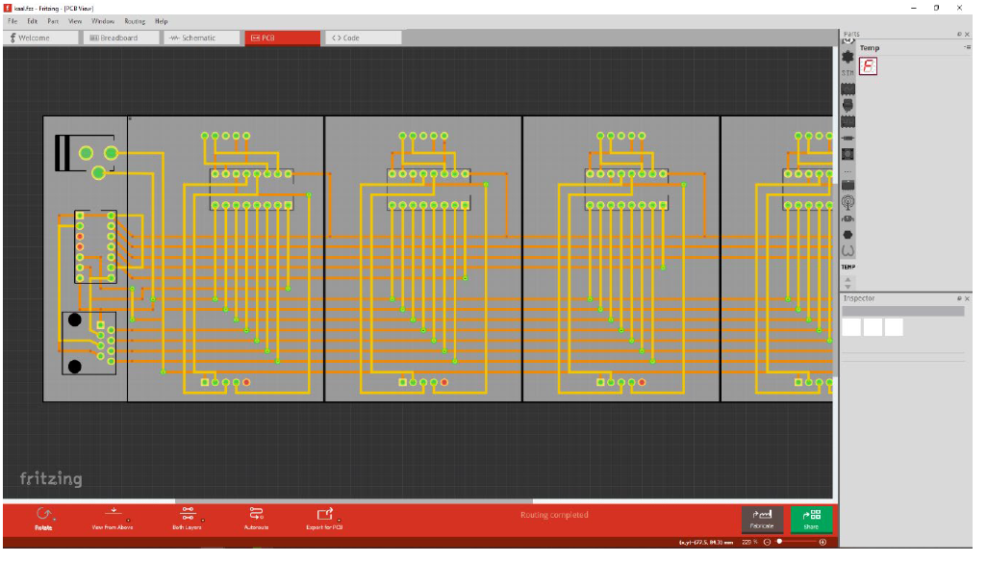
Did some design

