Slide 1
Supervised Learning of Universal Sentence Representations from Natural Language Inference Data
Replication of the paper by Conneau, Kiela, Schwenk, Barrault and Bordes (EMNLP 2017)
Janvi Porwal
B.Tech AI & DS | Final Year | Advanced Topics in ML (Mini Project)
Notes:
Introduce the paper, the authors and that this is a replication done in PyTorch on Kaggle.

Slide 2
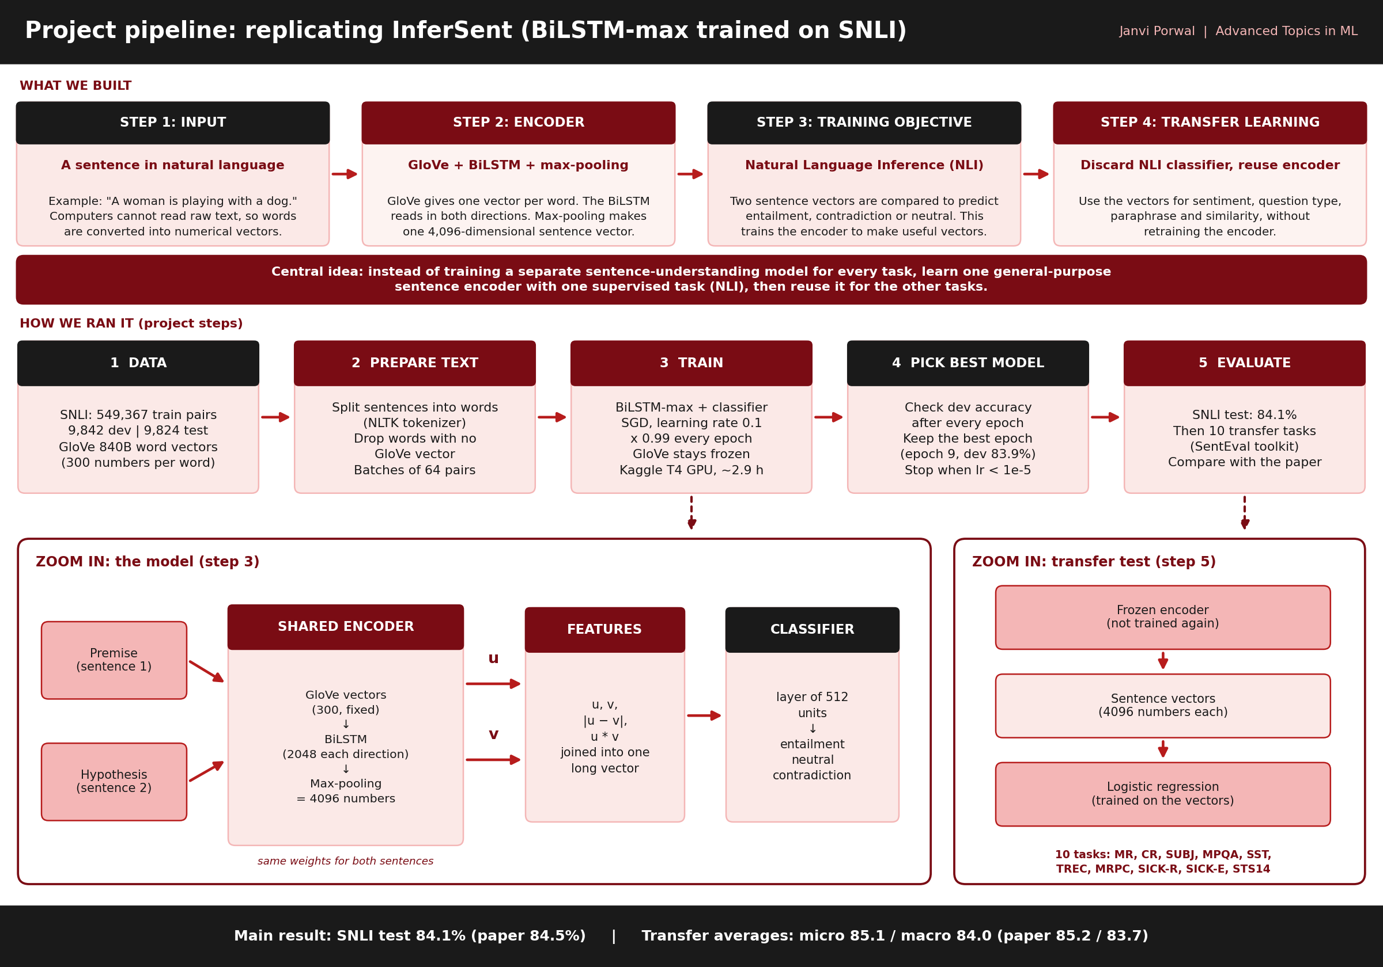
Notes:
Word embeddings (GloVe, word2vec) are common. Many tasks need one vector for a whole sentence.

Slide 3
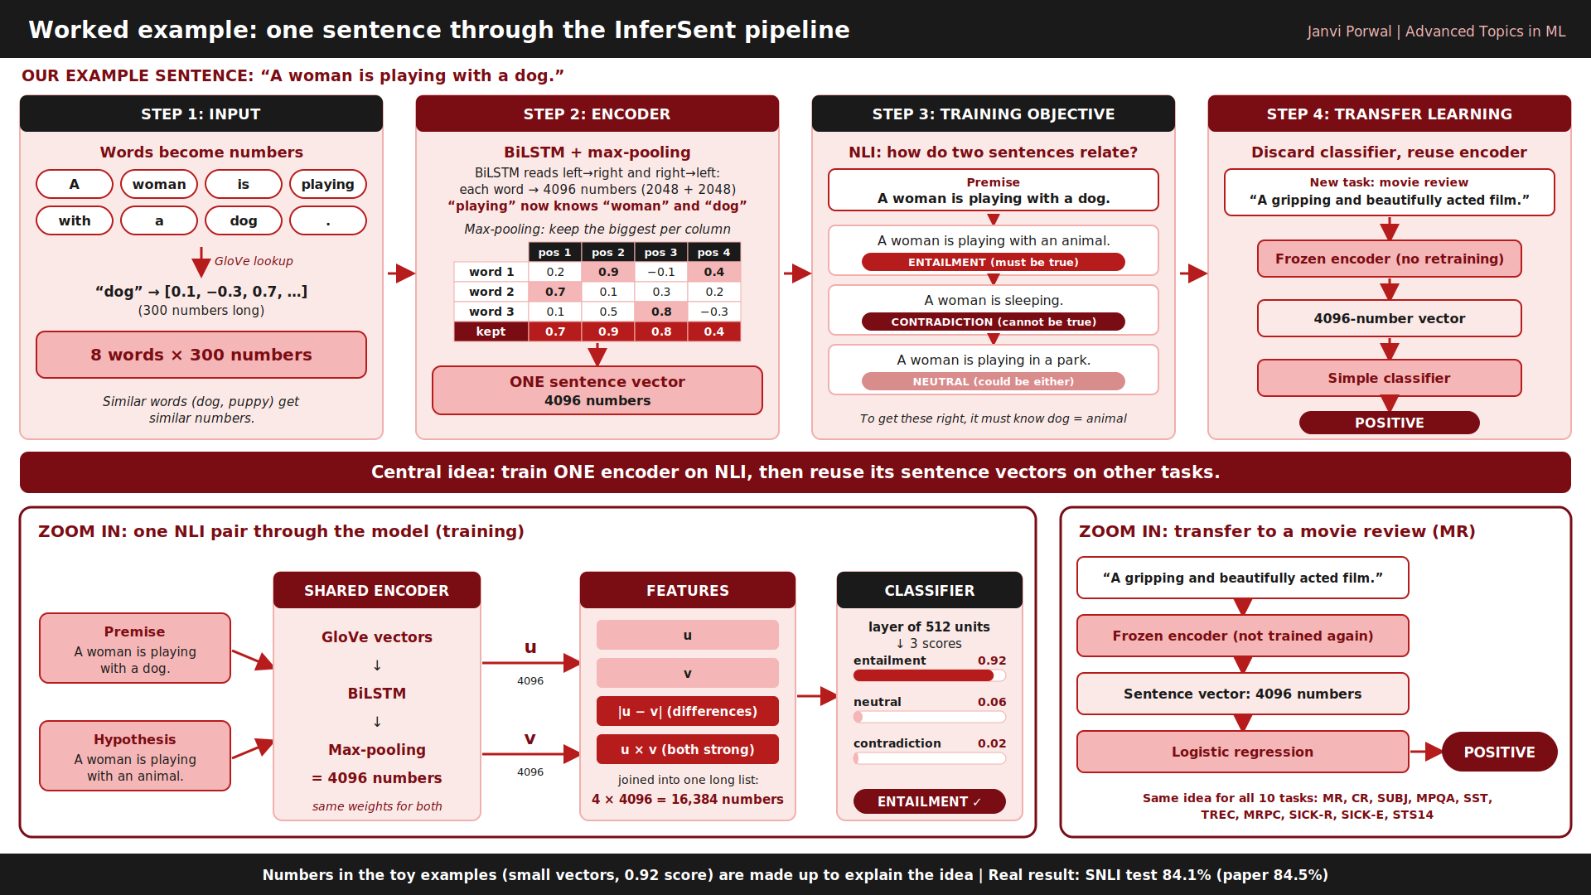
Notes:
Word embeddings (GloVe, word2vec) are common. Many tasks need one vector for a whole sentence.

Slide 4
The NLI task and the SNLI data
Input: a premise and a hypothesis.
Output: one of 3 labels.
Entailment: hypothesis must be true. Contradiction: cannot be true.
Neutral: could be either.
SNLI: about 570k human-written pairs. We train on 549,367 pairs that have a label.
Dev set (9,842 pairs): used to pick the best epoch. Test set (9,824 pairs): used only for the final score.
Example (paper, Table 2)
Premise: "Two women are embracing while holding to go packages."
Hypothesis: "Two woman are holding packages."
Label: entailment
4
Notes:
Example is the first row of Table 2 in the paper.

Slide 5
How the model works
Premise
Encoder
Features
Classifier
sentence 1
>
Same encoder for both. Gives vectors u and v (4096 numbers each).
[ u, v, |u - v|, u * v ]
(joined into one long vector)
Layer of 512 units, then 3 outputs
>
>
Hypothesis
sentence 2
>
|u - v| = difference of the two vectors (absolute value). u * v = multiply element by element.
5
Notes:
Same encoder for both sentences (shared weights). |u-v| is the absolute difference of the two vectors, u*v is the element-by-element product. They let the classifier compare the two sentences.

Slide 6
The best encoder: BiLSTM with max-pooling
Turn each word into numbers with GloVe (ready-made word vectors, 300 numbers per word, not trained here).
A BiLSTM reads the sentence left-to-right and right-to-left, giving one vector per word.
Max-pooling: for every dimension keep the largest value over all words.
Result: one vector of 4096 numbers for the whole sentence.
7 encoders compared in the paper
LSTM, GRU, BiGRU-last, BiLSTM-mean, inner-attention, HConvNet and BiLSTM-max.
Only BiLSTM-max is trained and shown with our results here.
6
Notes:
This is InferSent. Max-pooling: for each of the 4096 positions keep the biggest value over all words.

Slide 7
Training setup: paper vs our code
Setting | Paper | Our code
Optimizer | SGD, learning rate 0.1 | same
Learning rate | x 0.99 each epoch; divide by 5 if dev accuracy decreases | x 0.99 each epoch; divide by 5 if dev accuracy does not beat the best so far
Stop when | learning rate < 1e-5 | same
Batch size | 64 | 64
Word vectors | GloVe 840B, fixed | same
Classifier | 1 hidden layer of 512 units | stacked layers of 512 units
Hardware | not stated here | Kaggle T4 GPU, about 2.9 h, 12 epochs, mixed precision (fp16)
7
Notes:
Dev accuracy = accuracy on the validation set. SGD = stochastic gradient descent, learning rate = step size of each update. Mixed precision (fp16) stores numbers with 16 bits to run faster. Two small differences from the paper: the rule for dividing the learning rate (the paper says when dev accuracy decreases) and the classifier (the paper says 1 hidden layer of 512 units).

Slide 8
Result 1: SNLI accuracy
Test accuracy
Ours 84.1% | Paper 84.5%
Dev accuracy
Ours 83.9% | Paper 85.0%
Train accuracy reaches 96.6% but dev stays about 84%: the model overfits (it memorises the training pairs).
9
Notes:
Dev accuracy was best at epoch 9 (83.88). Overfitting = very good on the training data but not better on new data.

Slide 9
Result 2: which encoder is best? (paper, Table 3)
What we learn
BiLSTM-max is best on SNLI and on transfer (micro 85.2, macro 83.7).
Ours: 84.1 test, micro 85.1, macro 84.0.
11
Notes:
Numbers are from Table 3 of the paper (SNLI test accuracy). Our code reproduces only the BiLSTM-max row.

Slide 10
The 10 transfer tasks
Task | What it asks | Metric
MR | Is a movie review positive or negative? | accuracy
CR | Is a product review positive or negative? | accuracy
SUBJ | Is the sentence subjective or objective? | accuracy
MPQA | Is an opinion phrase positive or negative? | accuracy
SST | Sentiment of a movie sentence (binary) | accuracy
TREC | What type of question is it (6 types)? | accuracy
MRPC | Do two sentences mean the same (paraphrase)? | accuracy / F1
SICK-R | How related are two sentences (score 0 to 5)? | Pearson
SICK-E | Entailment, neutral or contradiction? | accuracy
STS14 | Similarity of two sentences (no training) | Pearson / Spearman
Pearson / Spearman = how closely our scores follow human scores (1.0 = perfect). F1 = a balance of precision and recall.
12
Notes:
These are other tasks used to test the frozen sentence vectors. Logistic regression is trained on top of the vectors.

Slide 11
Result 3: transfer to other tasks
Macro = plain average of the task scores. Micro = average weighted by the number of dev samples.
Ours 85.1 / 84.0 (micro / macro), paper 85.2 / 83.7.
13
Notes:
Frozen = the encoder is not trained again. Logistic regression = a simple classifier trained on top of the sentence vectors. Accuracy = percent correct. Macro = plain average of the task scores; micro = average weighted by the size of each dev set.

Slide 12
Result 4: all 10 transfer tasks
Task | Paper | Ours | Diff
MR | 79.9 | 78.2 | -1.7
CR | 84.6 | 82.3 | -2.3
SUBJ | 92.1 | 92.2 | +0.1
MPQA | 89.8 | 88.5 | -1.3
SST | 83.3 | 81.9 | -1.4
TREC | 88.7 | 89.2 | +0.5
MRPC (accuracy / F1) | 75.1 / 82.3 | 74.3 / 81.8 | -0.8
SICK-R (Pearson) | 0.885 | 0.886 | +0.001
SICK-E | 86.3 | 84.4 | -1.9
STS14 (Pearson / Spearman) | .68 / .65 | .67 / .66 | -0.01
14
Notes:
MRPC: accuracy / F1. STS14: Pearson / Spearman. Difference = ours minus paper for the first number.

Slide 13
Conclusion
A BiLSTM with max-pooling trained on SNLI gives a general sentence encoder (paper claim).
Our replication reaches 84.1% on SNLI (paper 84.5%) and similar transfer scores on 10 tasks.
Better SNLI accuracy does not always mean better transfer, so the encoder design matters.
Future work: run the other encoders, embedding sizes and AllNLI (SNLI + MultiNLI) as in the paper.
16
Notes:
Summarise in three points.

Slide 14
Thank you
Questions?
Janvi Porwal | B.Tech AI & DS, Final Year
Notes:
Thank the audience and invite questions.

