Slide 1
Computational Intelligence
Project class: #3 Author: Jakub Jabłoński

Slide 2
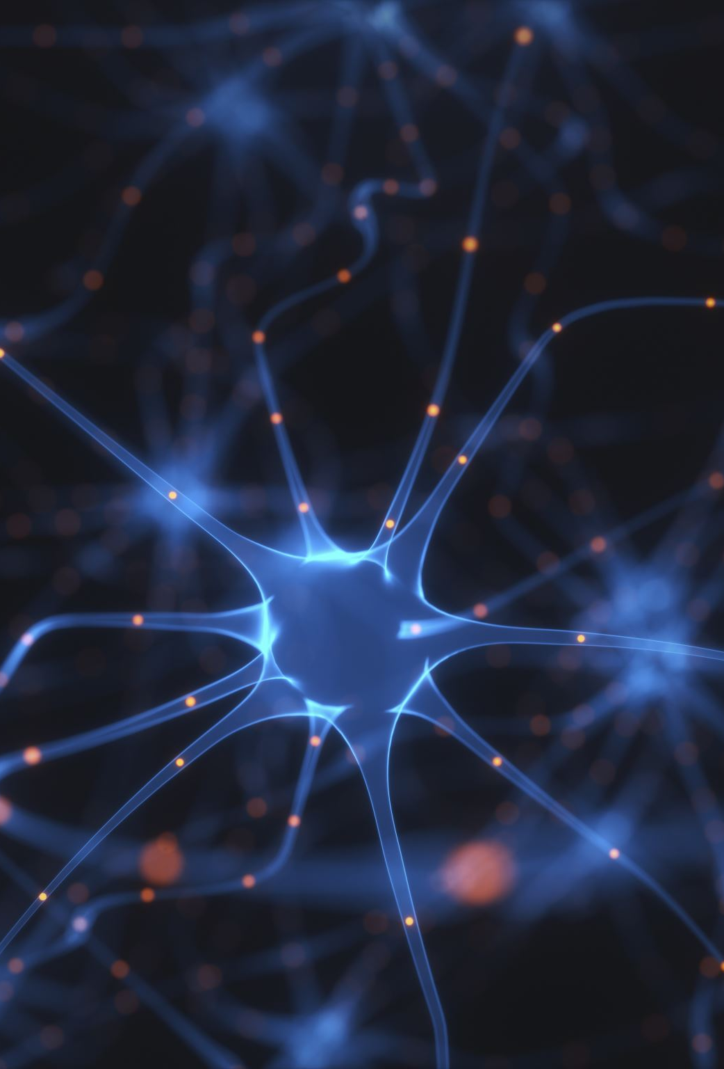
Image Denoiser
In this project I would like to compare 3 training methods for image denoising purposes.
Methods:
DnCNN – Denoising Convolutional Neural Network (Supervised)
FFDNet – Fast and Flexible Denoising Convolutional Neural Network (Supervised)
Noise2Void (self-supervised)

Slide 3
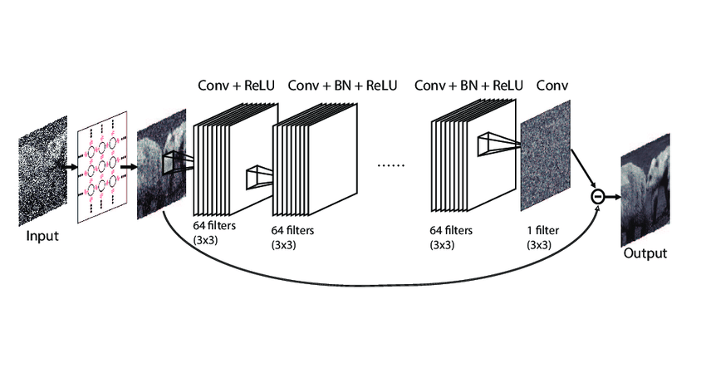
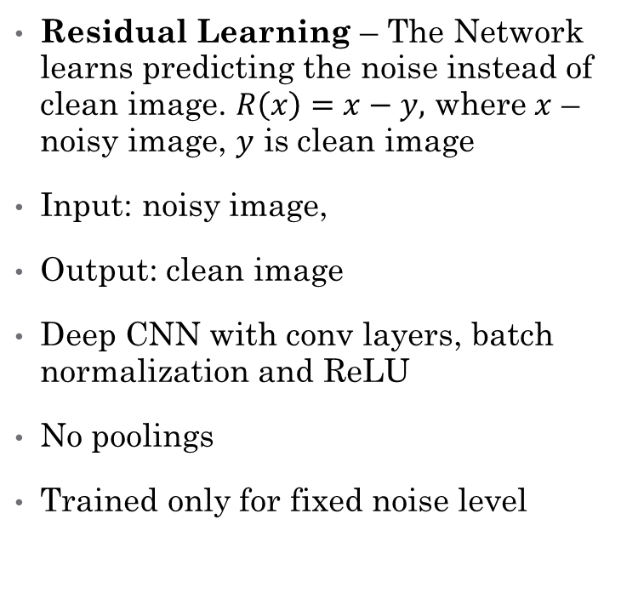
DnCNN
Residual Learning – The Network learns predicting the noise instead of clean image. $R\left(x\right)=x−y,$ where $x$ – noisy image, $y$ is clean image
Input: noisy image,
Output: clean image
Deep CNN with conv layers, batch normalization and ReLU
No poolings
Trained only for fixed noise level

Slide 4
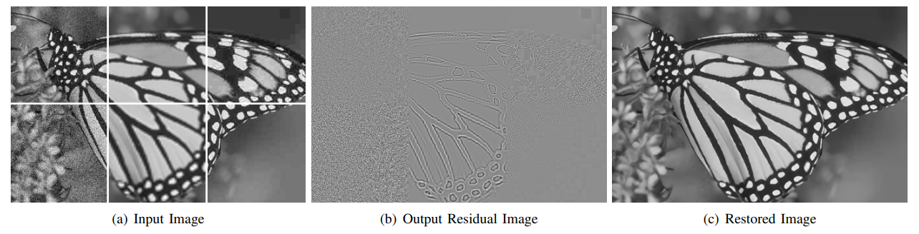
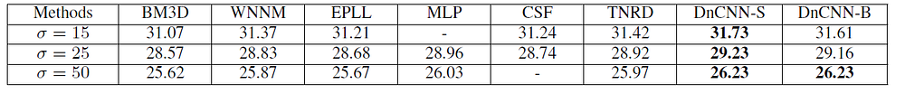
DnCNN
PROS
Can be used both for known gaussian noise levels and unknown noise levels
It’s better than BM3D in PSNR and SSIM metrics
Can be used for Gaussian Denoising, Single Image Super-Resolution and JPEG Image Deblocking
Image with different type of noises can be denoised with this method
CONS
Need for model training for different noise levels
Is a little bit slower than BM3D
It needs noisy-clean image pairs

Slide 5
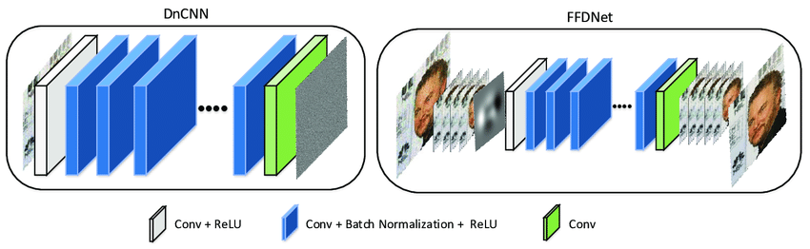
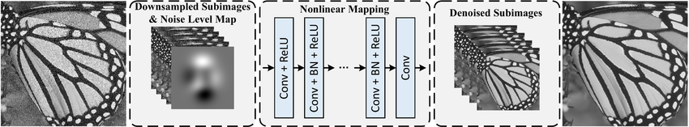
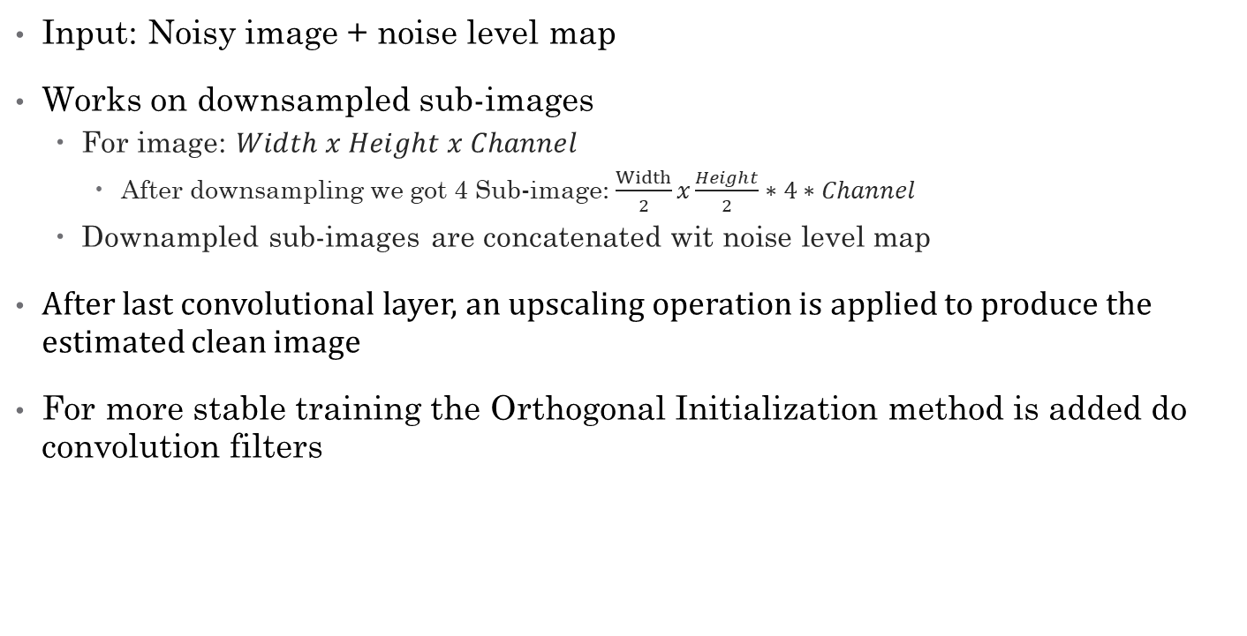
FFDNet
Input: Noisy image + noise level map
Works on downsampled sub-images
For image: $Width x Height x Channel$
After downsampling we got 4 Sub-image: $\frac{Width}{2}x\frac{Height}{2}∗4∗Channel$
Downampled sub-images are concatenated wit noise level map
After last convolutional layer, an upscaling operation is applied to produce the estimated clean image
For more stable training the Orthogonal Initialization method is added do convolution filters

Slide 6
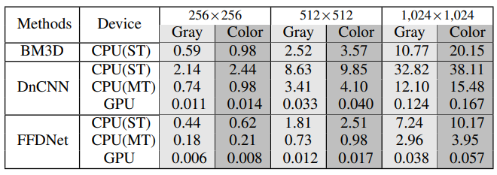
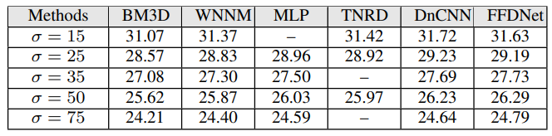
FFDNet
PROS
Has ability to handle a wide range of noise levels
Faster than DnCNN due to image downsampling
Can remove spatially variant noise
CONS
Need noisy-clean image pairs
Lower accuracy than DnCNN
Depentent of properly created noise level map

Slide 7
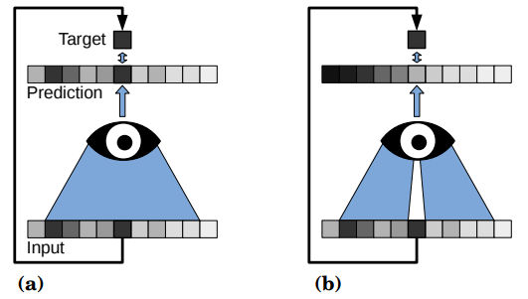
Noise2Void
Model is trained using only noised images
Uses blind-spot network – The pixel that is currently predicted is masked.
Only masked pixels are targets (loss is calculated only on masked pixels)
Model learns how to predict the clean image based on context (neighbour pixels). Masked pixel is not visable for model.
Used in situations where there is no possible to have noisy-clean image pairs

Slide 8
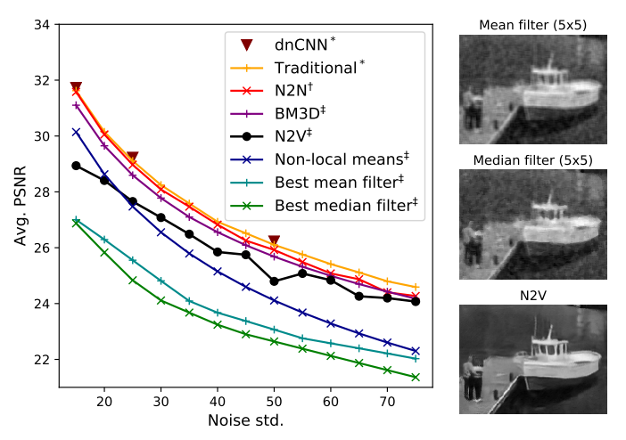
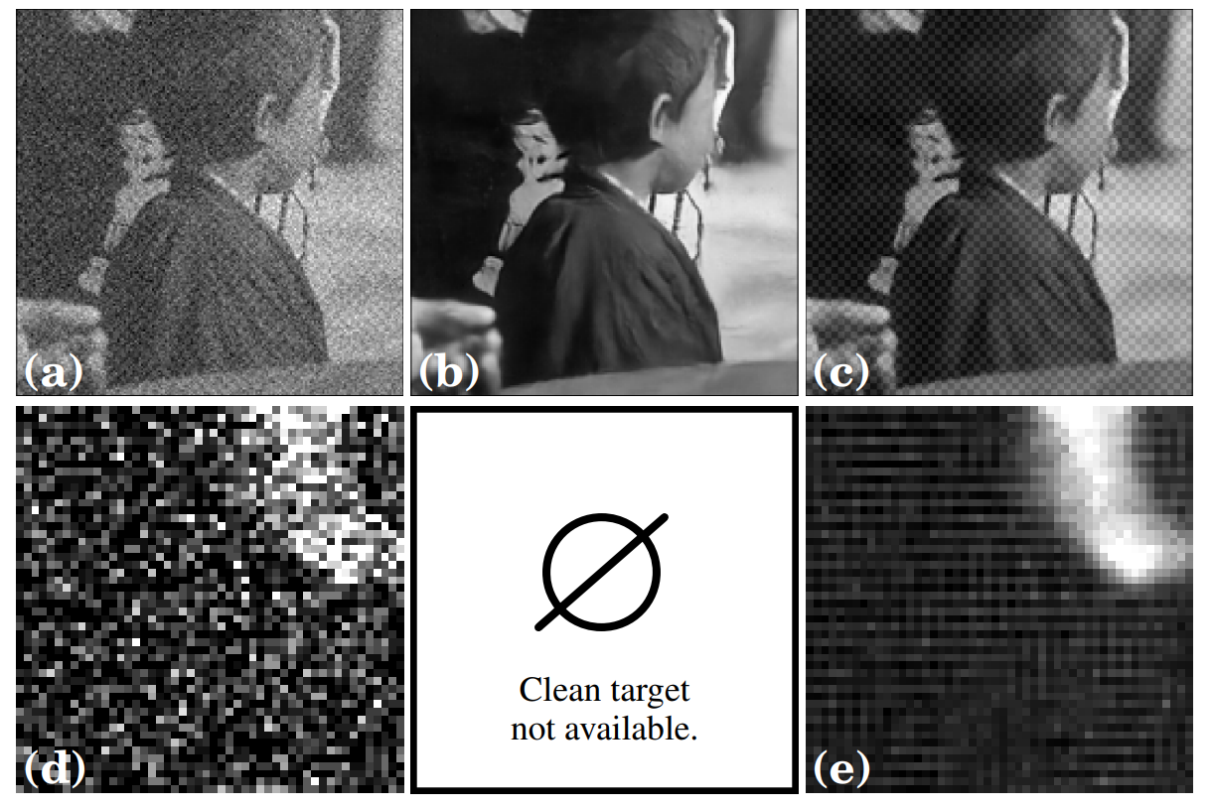
Noise2Void
PROS
No need for clean target images (!)
Great for different types of noise
CONS
Lower accuracy than DnCNN and FFDNet
Does not work well with structured noise

Slide 9
Research Papers
Beyond a Gaussian Denoiser: Residual Learning of Deep CNN for Image Denoising
Noise2Void - Learning Denoising From Single Noisy Images
FFDNet: Toward a Fast and Flexible Solution for CNN based Image Denoising
A Residual Dense U-Net Neural Network for Image Denoising

