Slide 1
Presentation of chosen topics
Author: Jakub Jabłoński

Slide 2
1. Image Denoiser
Problem Statement & Motivation
My master’s thesis focuses on building a graphics engine that uses Ray Tracing and Radiosity algorithms. One of the key rendering techniques—Path Tracing—relies on the Monte Carlo method to approximate pixel colors. Since Monte Carlo sampling is a stochastic algorithm, it often produces noisy images.
Reducing this noise requires casting more rays per pixel, which dramatically increases computational cost and rendering time. A promising alternative is to use AI-based image denoising to clean up noisy renders while preserving detail. This approach could significantly reduce rendering time and hardware requirements, making photorealistic rendering more accessible and efficient.

Slide 3
1. Image Denoiser
Baseline plan
I want to use the some image dataset (Animal faces, chest x-ray) . Artificial noise (Gaussian, salt and pepper) will be added to generate training pairs. Still not sure if I will use only grey scale or not.
I will train models using different method and training strategies (supervised, semi-supervised and self-supervised) and then compare the resulted images using both visually and metrics.
Metrics (I will most likely use):
PSNR (Peak Signal-to-Noise Ratio) – How much noise remains in the image
MSE (Mean Squared Error) – Average difference between predicted nad true pixel values (?)
SSIM (Structural Similarity Index) – Measure the quality of an image by comparing it to reference image, based on human visual similarity (luminance, contrast, structure)

Slide 4
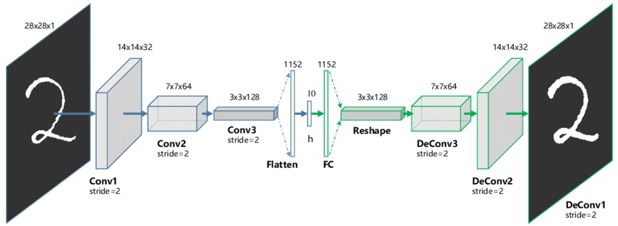
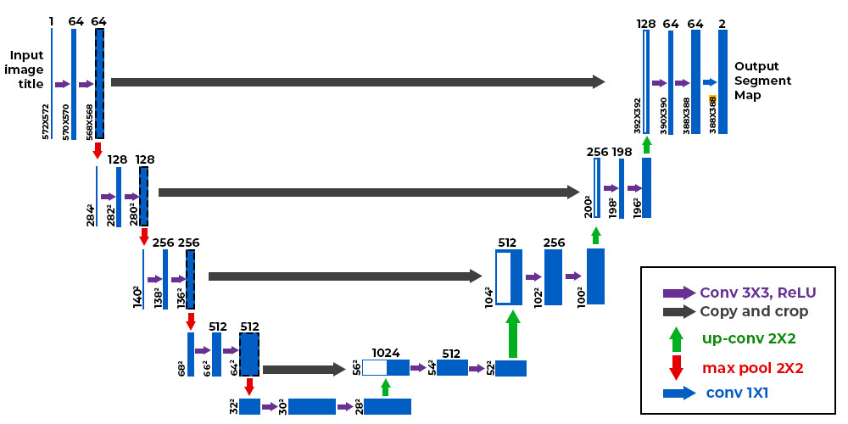
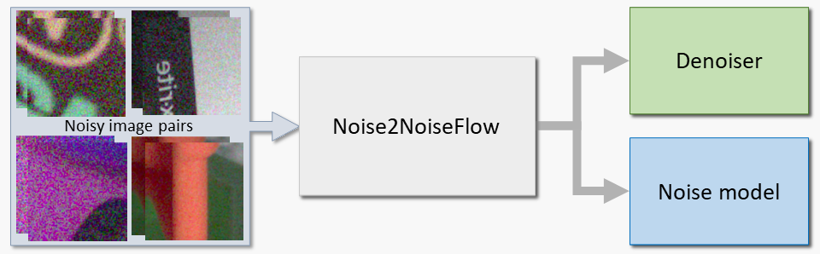
1. Image Denoiser
https://www.researchgate.net/figure/The-structure-of-proposed-Convolutional-AutoEncoders-CAE-for-MNIST-In-the-middle-there_fig1_320658590
Key terms, models, methods, and algorithms
CNN
Autoencoders – Can be trained using pairs of original and noisy images
U-net – Encoder-Decoder with skip connections. Combines information from the encoder during expansive path (Decoder). It helps with reducing lost data while image shrinking
Noise2Noise – Learns to denoise using pairs of only noisy images.
Noise2Void – It works with a single noisy image only. The model learns the structure of the image by predicting each pixel from its neighbors – ignoring noise.
https://www.geeksforgeeks.org/machine-learning/u-net-architecture-explained/
https://yorkucvil.github.io/Noise2NoiseFlow/

Slide 5
1. Image Denoiser
Links to candidate datasets:
https://www.kaggle.com/datasets/moltean/fruits/data
https://www.kaggle.com/datasets/bhavikjikadara/dog-and-cat-classification-dataset
https://www.kaggle.com/datasets/muhammadrehan00/chest-xray-dataset
References:
https://www.kaggle.com/code/ahmedelsayedtaha/denoising-images-using-autoencoder
https://www.kaggle.com/code/davidesavarro/image-denoiser
https://raver119.medium.com/denoising-images-with-deep-learning-9124d36fda0a
https://github.com/Cydral/AI-Image-Denoiser
https://blogs.nvidia.com/blog/what-is-denoising/
https://github.com/SecretMG/UNet-for-Image-Denoising
https://www.kaggle.com/code/andreipaulavets/byu-denoising-cryo-et-with-noise2void

Slide 6
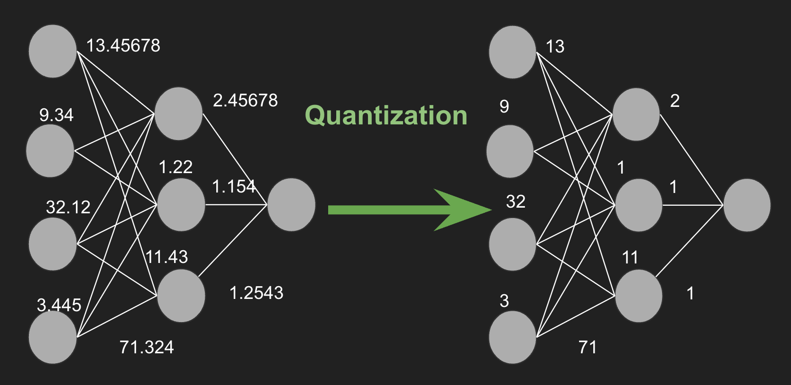
2. Optimizing model with quantization
Problem Statement & Motivation
The most powerful AI models that rely on FP32 or BF32 precision are large and computationally expensive and therefore are not that suitable for embedded / mobile devices where every second of battery life matters. What if we could compress these models so that they take up far less space while maintaining very good performance comparing to their full-precision versions? Then, AI models could run directly on the device, with much lower power consupmption and relianace on internet connection (talking with cloud)
Why optimize models?
Size reduction
Lower Ram usage
Reduced latency
https://www.digitalocean.com/community/tutorials/model-quantization-large-language-models

Slide 7
2. Optimizing model with quantization
Baseline plan
Create and train a model for image recognision in FP32
Create and train a model in the same way, but using some quantization methods (QAT, PTQ, combination)
Compare metrics of those models
(OPTIONAL) Weight Pruning
Metrics (I will most likely use):
mAP (mean Averate Precision)
Precision, Recall, F1-score
Inference time
Throughput (FPS)
Latency
Disk and RAM usage

Slide 8
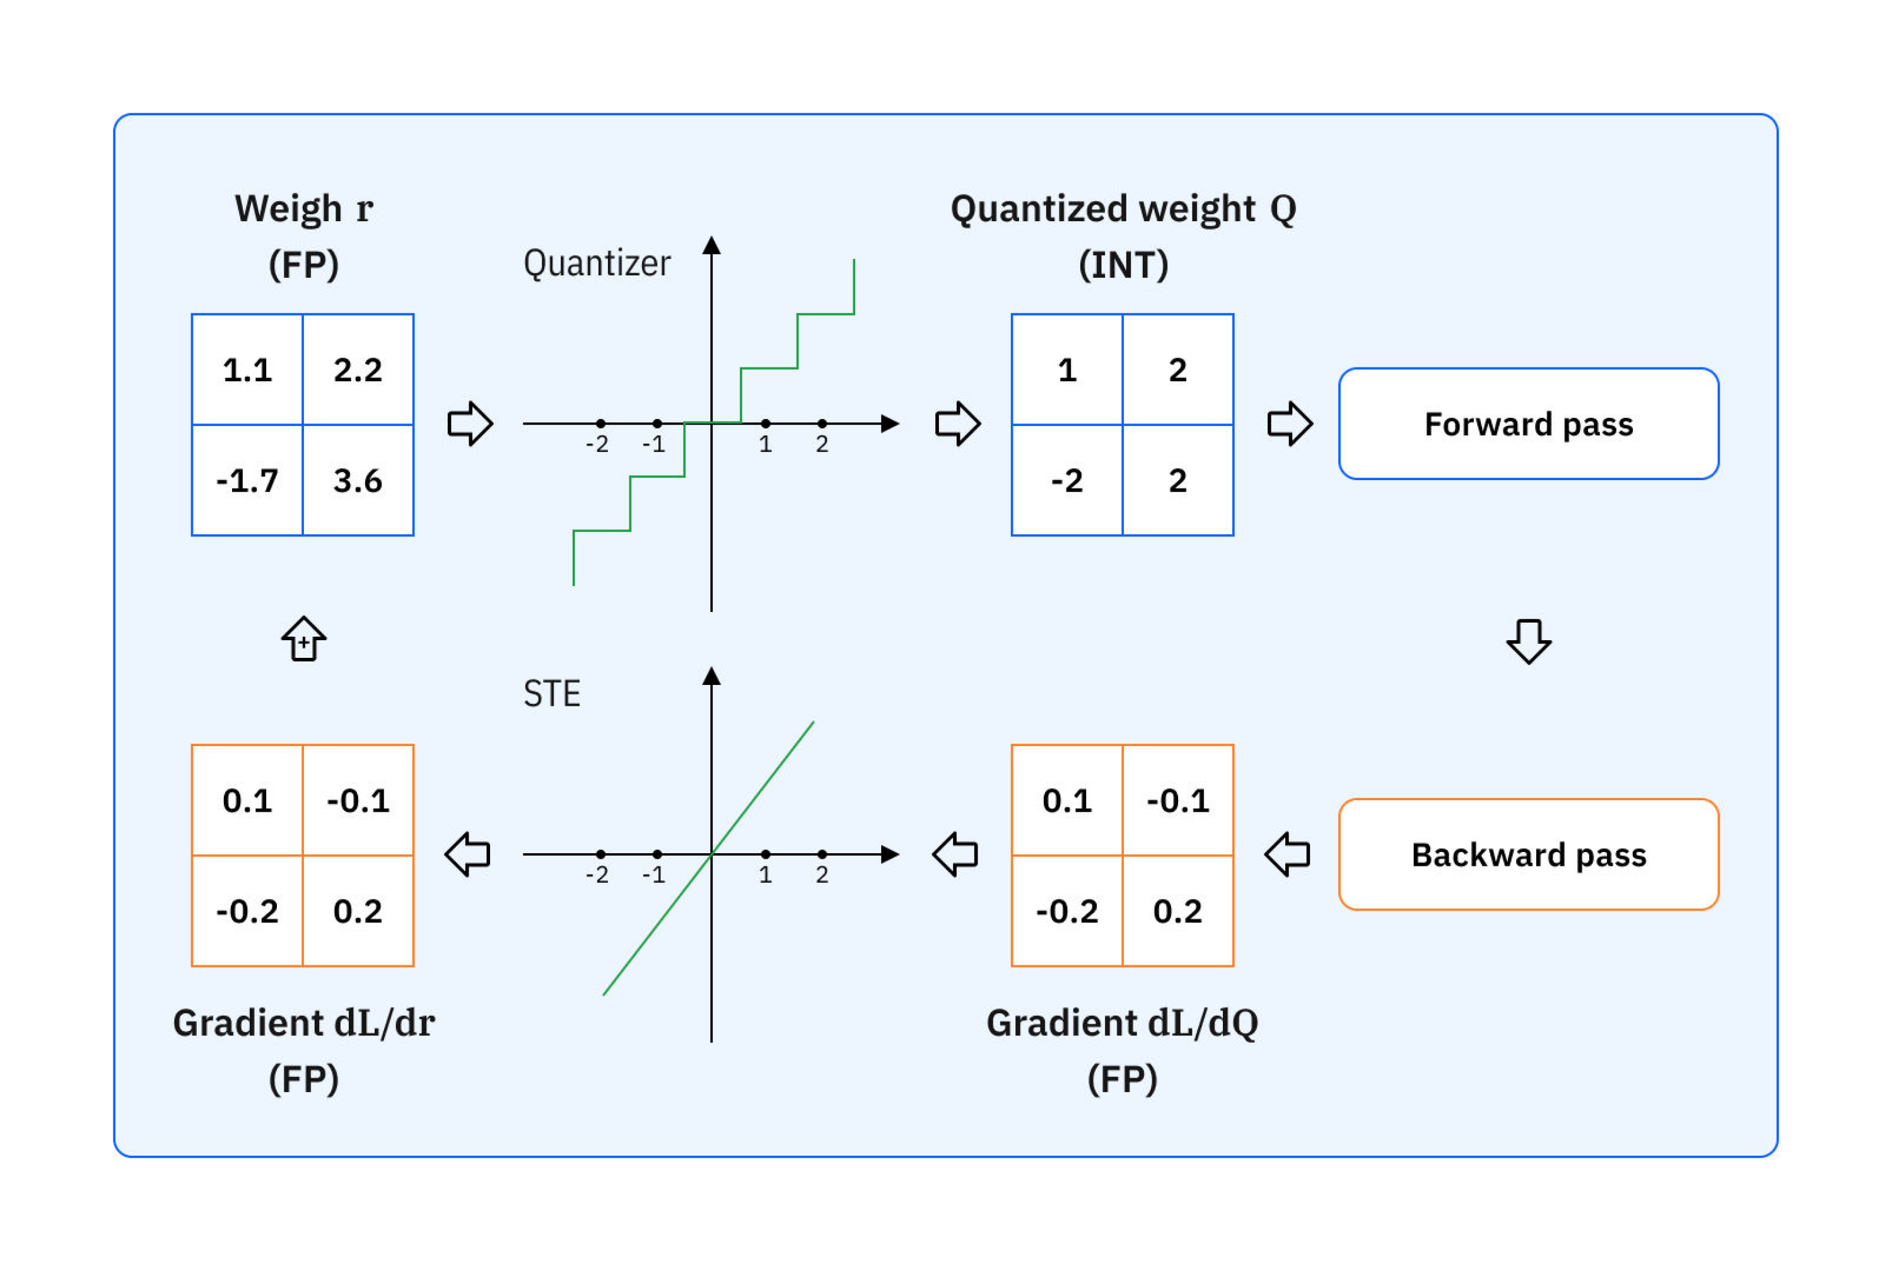
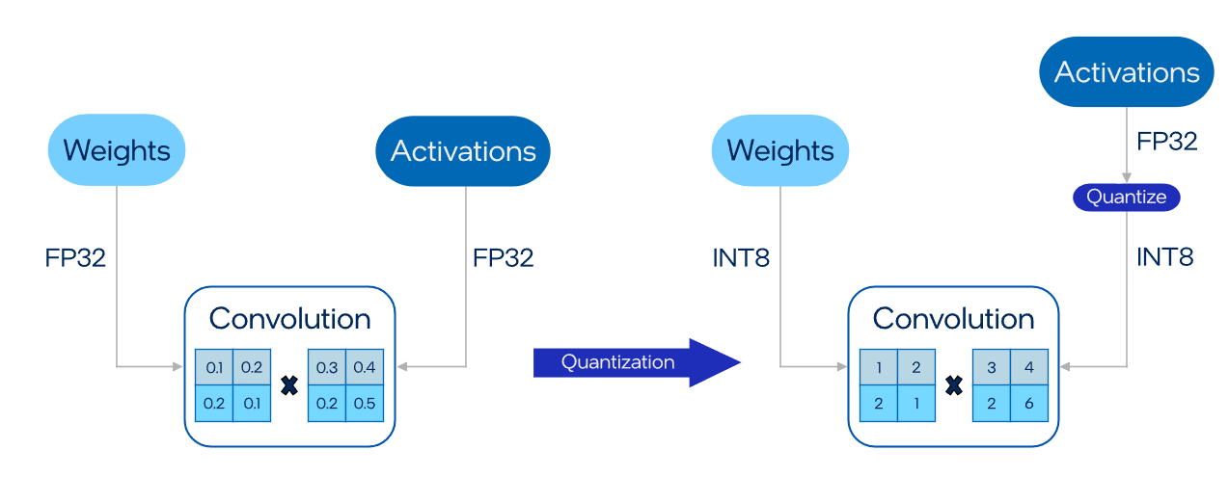
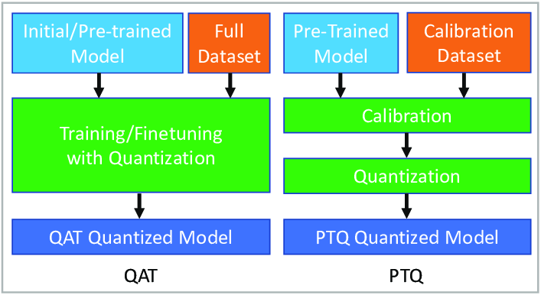
2. Optimizing model with quantization
Key terms, models, methods, and algorithms
QAT (Quantization-Aware Training) – Introduce quantization effects during training. Forward pass introduces „fake quantized weights”, while backward pass uses full precission for calculating gradients.
PTQ (Post-Training Quantization) – Fully trained model is quantized.
Static Quantization – involves quantizing both the model weights and activations before performing inference. It needs calibration.
Dynamic Range Quantization - „Weight-only quantization”. It dynamically converts input data (high precission) to lower precission before computing and then dequantize result back before outputing the result.
(Optional) Weight Pruning
https://www.ibm.com/think/topics/quantization-aware-training
https://docs.openvino.ai/2025/openvino-workflow/model-optimization-guide/quantizing-models-post-training.html
https://www.researchgate.net/figure/Quantization-Aware-TrainingQAT-and-Post-Training-Quantization-PTQ_fig1_373610679

Slide 9
2. Optimizing model with quantization
Link do candidate datasets:
https://www.kaggle.com/datasets/alessiocorrado99/animals10
https://www.kaggle.com/datasets/anshulmehtakaggl/wildlife-animals-images
References:
https://www.kaggle.com/code/ashusma/understanding-tf-lite-and-model-optimization
https://selek.tech/posts/static-vs-dynamic-quantization-in-machine-learning/
https://www.ibm.com/think/topics/quantization-aware-training
https://apxml.com/courses/practical-llm-quantization/chapter-2-post-training-quantization-ptq/static-dynamic-quantization

