Slide 1
Computational Intelligence
Project class: #34 Author: Jakub Jabłoński

Slide 2
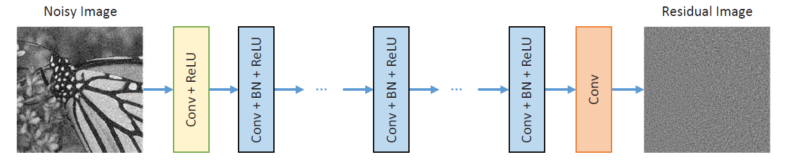
dnCNN
Model was trained on grayscale images.
Noise model: AWGN (Additive White Gaussian Noise), with fixed σ = 25,
Images were divided into smaller patches (43x43) to increase dataset size
Network predicts noise (residual learning)
Parameters:
Batch size = 32
CNN depth = 17
Kernels 3x3
Receptive field = patch_size = 43
Loss Function MSE
Optimizer Adam (lr = 1e-4)
Scheduler CosineAnnealingLR

Slide 3
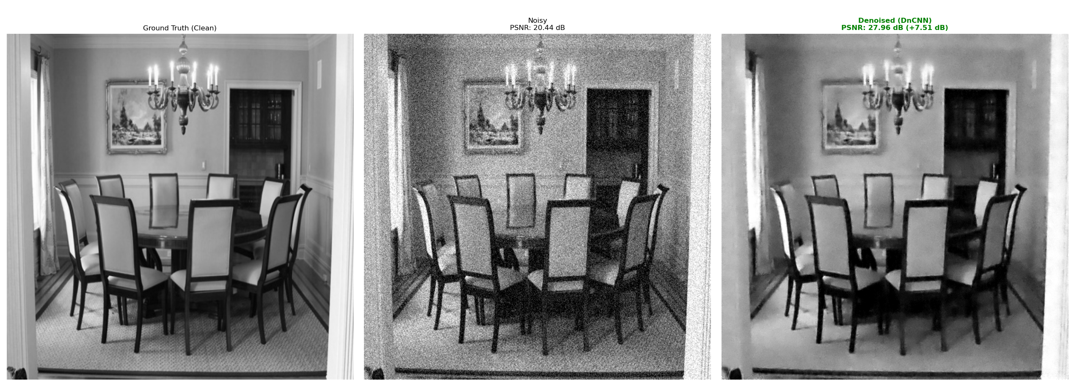
dnCNN
Results after 5 epochs!

Slide 4
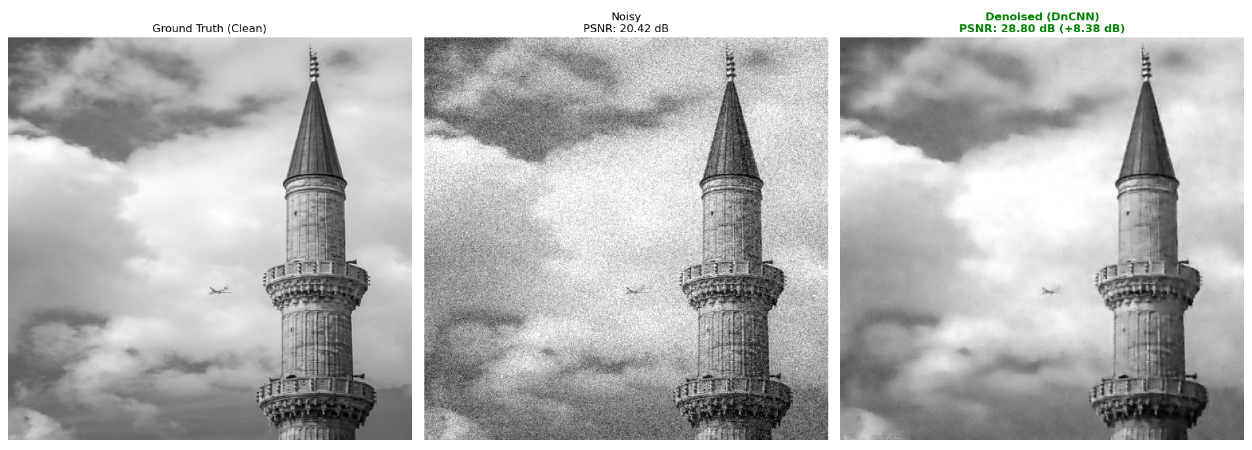
dnCNN

Slide 5
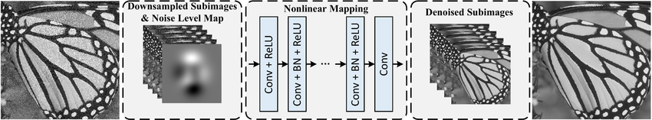
FFDNet
Model was trained on grayscale images
Noise:
Training uses randomly sampled noise levels σ ∈ [0,75],
Validaion and test use fixed σ = 25 for stable monitoring
Images splited into 64x64 patches
It uses dnCNN underneath with changed last layer to output 4 channel noise
Input:
Input image (C,H,W) is downsampled (C*4, H/2, W/2)
Noise map (matrix filled with constant noise σ), downsampled to (C, H/2, W/2)
Downsampled Input images and noise map are concatenated to (C*4 + 1, H/2, W/2)
Output image is upsampled

Slide 6
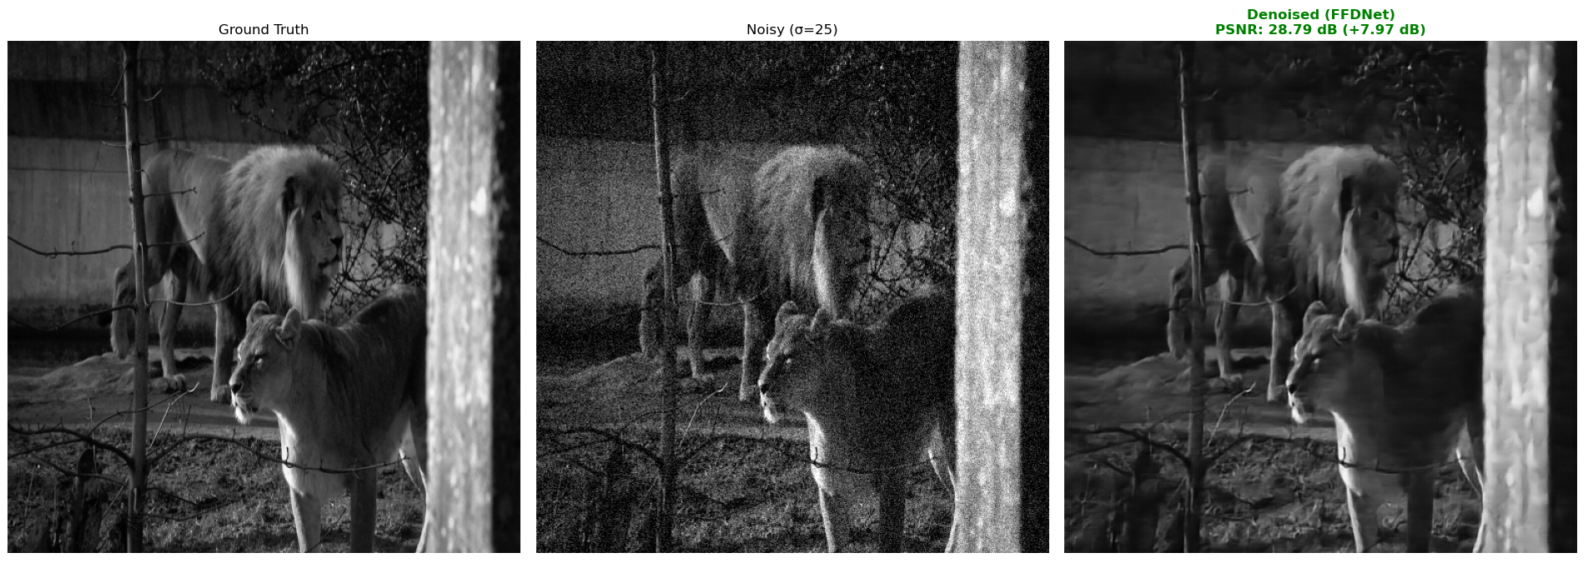
FFDNet
Results after 30 epochs:

Slide 7
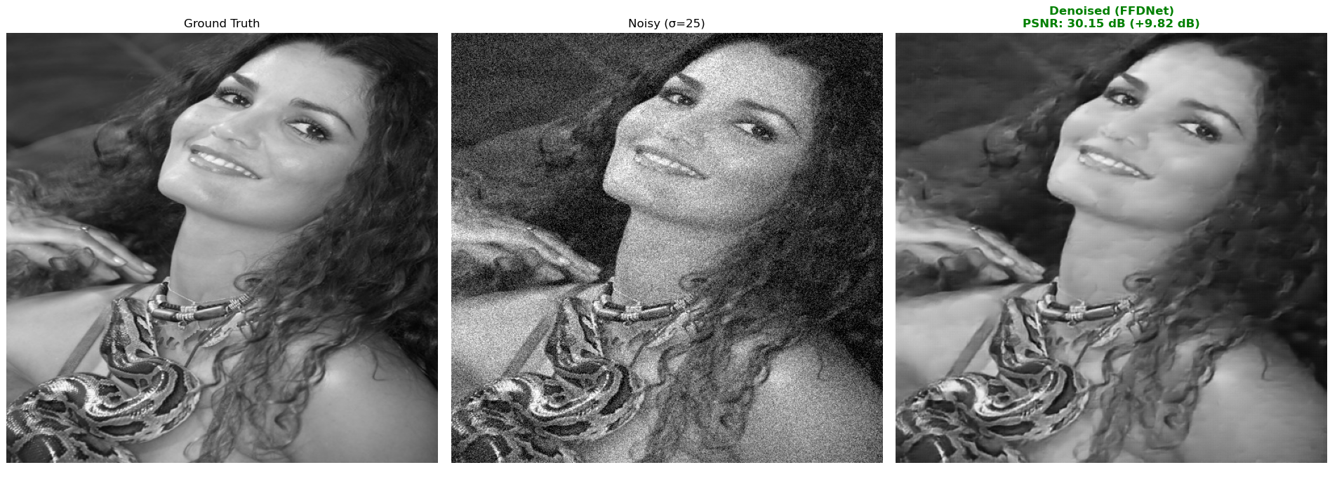
FFDNet

Slide 8
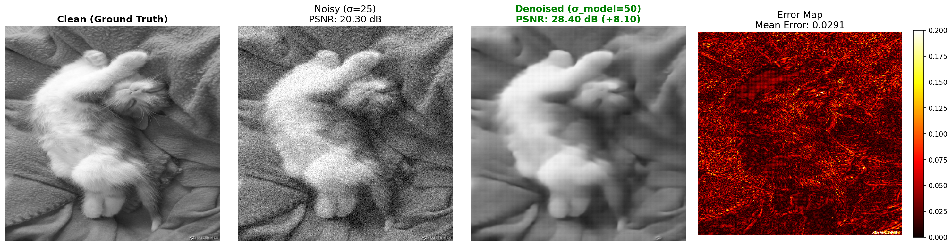
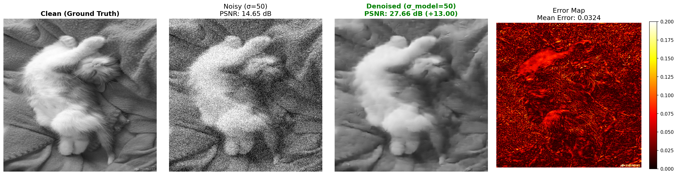
FFDNet

Slide 9
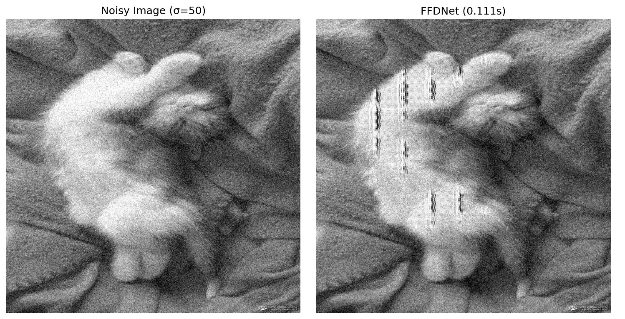
FFDNet
After training with fixed noise σ

Slide 10
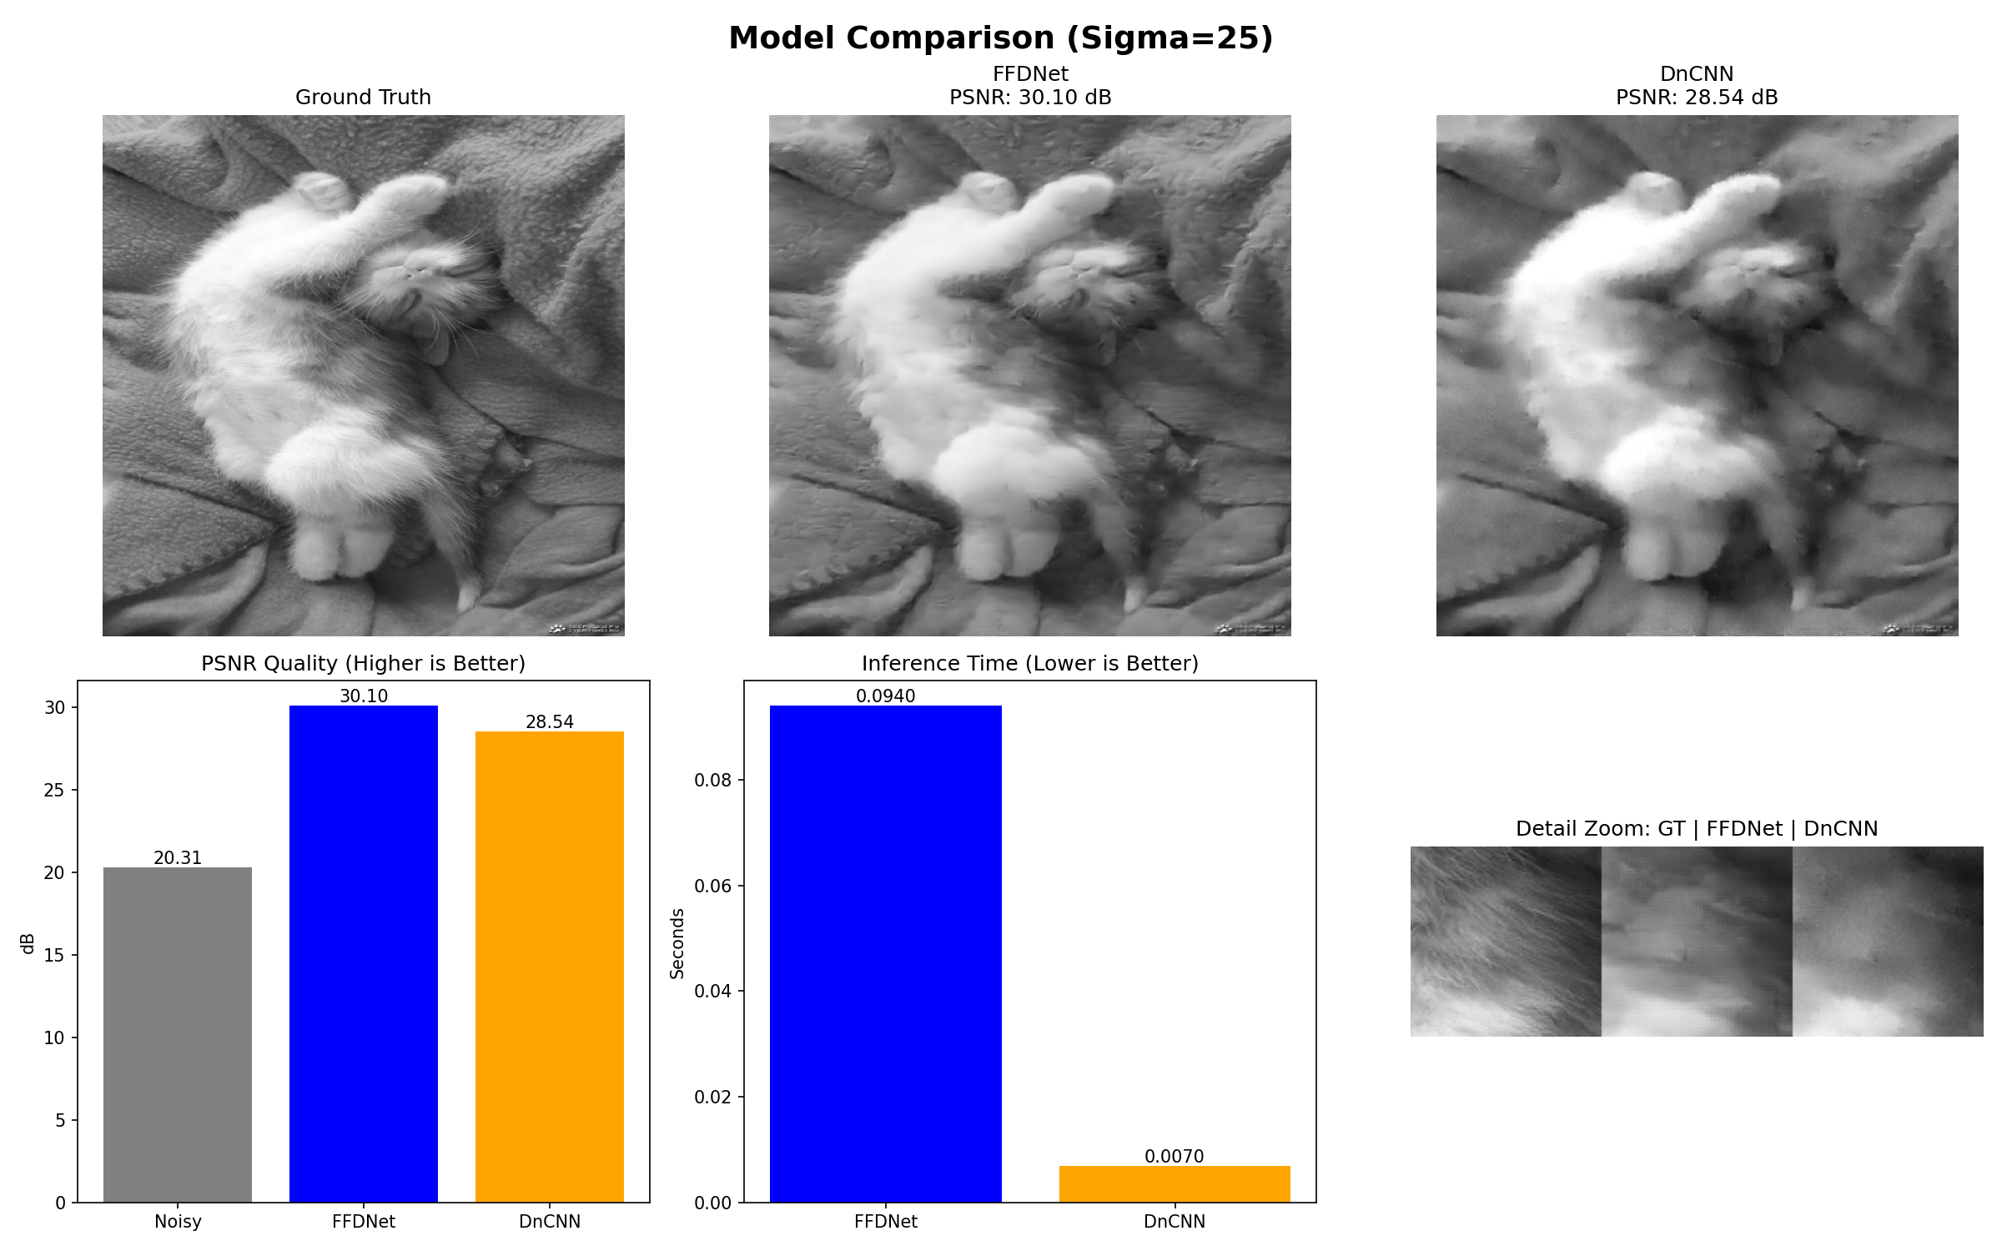
Comparison

