Slide 2

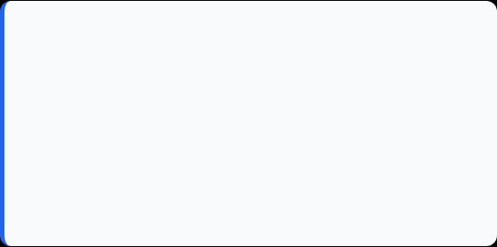
Candidate & Program Overview
Candidate Details
Cisco Learning Program Details
Student Name: Harsh Aryan
Program Name: Cisco Virtual Internship Program
Roll Number: 2410031314
Specialization Domain: Networking and Cybersecurity
Degree: B.Tech (Computer Science & Engineering)
Duration: May 2026 – June 2026
Academic Batch: 2024-2028
Courses Completed:-
Cybersecurity Essentials
Exploring Networking with Cisco Packet Tracer
Getting Started with Cisco Packet Tracer
University: IILM University, Greater Noida, U.P.

Slide 3


Organization Profile: EduSkills Academy
EduSkills Academy is an ISO 9001:2015 and ISO 20000-1:2018 certified organization operating under the vision of "Nation Building Through Skills".
AICTE Collaboration: Operates under the patronage of the AICTE National Internship Portal to empower engineering talent across India.
Industry Alignment: Partners with leading global tech organizations to bridge academia and industry gaps in emerging tech.
Core Focus Domains: Artificial Intelligence, MLOps, Cloud Computing, Cybersecurity, and Enterprise Automation.

Slide 4

Problem Statement & Industry Context
The Industry Challenge
The Solution Scope
Cyberattacks are increasing rapidly across organizations worldwide.
Many users and businesses lack awareness of basic cybersecurity practices.
Weak passwords, phishing attacks, malware, and data breaches remain common threats.
Organizations require skilled professionals who understand network and information security principles.
The Cybersecurity Essentials program provides foundational knowledge of cybersecurity concepts.
Covers threats, vulnerabilities, risk management, network security, and security best practices.
Introduces learners to protecting systems, networks, and digital assets.
Helps build a strong foundation for advanced cybersecurity and ethical hacking studies.

Slide 5








Core Project Objectives
Cybersecurity Fundamentals
Network Security
Threats & Attack Prevention
Security Best Practices
Develop skills in password security, access control, data protection, incident response, and cybersecurity awareness.
Learn core cybersecurity concepts, including confidentiality, integrity, availability (CIA Triad), threats, vulnerabilities, and risk management principles.
Understand network security mechanisms such as firewalls, VPNs, intrusion detection systems, and secure communication protocols.
Identify common cyber threats including malware, phishing, ransomware, social engineering, and methods used to prevent them.

Slide 6





Key Technologies and Security Concepts
Networking Infrastructure
Security Controls
Threat Detection
Learning Platform
Routers
Switches
TCP/IP
Firewalls
VPNs
Access Control
Malware Analysis
Intrusion Detection
Monitoring
Cisco NetAcad
EduSkills
AICTE Virtual Internship

Slide 7
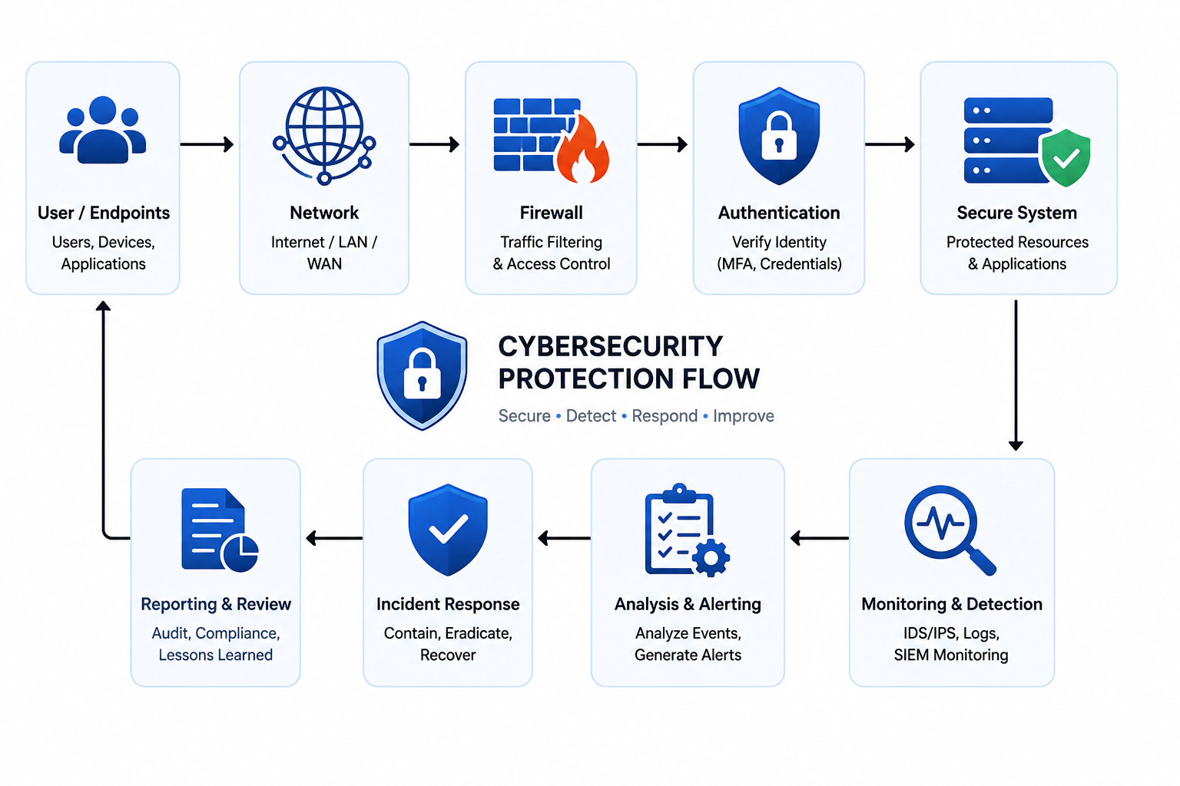
Cybersecurity Learning Framework
🛡️ Security Fundamentals
CIA Triad
Security Policies
Risk Management
📊 Security Monitoring
Incident Response
Security Auditing
Continuous Monitoring
🌐 Network Security
Network Infrastructure
Firewalls & VPNs
Secure Communication
🔍 Threat Analysis
Malware Identification
Phishing Attacks
Social Engineering Awareness
🔐 Protection Mechanisms
Access Control
Authentication
Data Protection

Slide 8

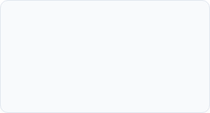
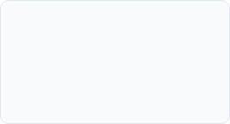
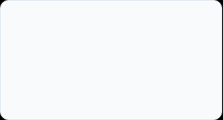
Curriculum Timeline (Weeks 1 to 4)
Week 2
Week 4
Network Attacks & Infrastructure
Attack techniques, wireless security, network devices, and security infrastructure.
Defense Mechanisms & Access Control
Network defense, access control concepts, branch office networking, and monitoring using Packet Tracer..
Week 1
Week 3
Cybersecurity Basics & Packet Tracer
Threats, vulnerabilities, network security fundamentals, Packet Tracer installation and basic networking.
Windows, Linux & Endpoint Security
Operating systems, endpoint protection, security principles, and checkpoint assessment..

Slide 9
Curriculum Timeline (Weeks 5 to 8)
Week 6
Week 8
Cloud Security & Cryptography
Cloud security principles, encryption techniques, cryptographic applications, and security assessments.
Risk Management & Incident Response
Governance, compliance, vulnerability assessment, threat intelligence, digital forensics, incident response, and final evaluation.
Week 5
Week 7
Firewall & Access Control Security
ACLs, firewall technologies, zone-based firewalls, and network defense concepts..
Security Monitoring & Alert Analysis
Network protocols, security data analysis, threat detection, and security alert evaluation.

Slide 10
Key Learning Outcomes & Skills Acquired
Network Security Fundamentals
Studied cybersecurity threats, vulnerabilities, attack vectors, and defense mechanisms used to protect organizational networks.
Cisco Packet Tracer Network Design
Designed and simulated small office and branch office networks using Cisco Packet Tracer.
Windows & Linux Security Administration
Learned operating system security concepts, user management, permissions, and endpoint protection techniques.
Firewall & Access Control Implementation
Explored Access Control Lists (ACLs), firewall technologies, and zone-based security policies.
Cloud Security & Cryptography
Studied cloud security principles, encryption techniques, cryptographic algorithms, and secure communication methods.
Threat Detection & Security Monitoring
Analyzed security alerts, network security data, and incident indicators for threat identification.
Vulnerability Assessment & Risk Management
Learned vulnerability assessment methodologies, risk analysis, security controls, and compliance frameworks.
Digital Forensics & Incident Response
Studied forensic investigation processes, evidence collection, incident handling, and response procedures.

Slide 11

Certification & Official Verification
Verification Metric | Official Record / Credential Details
Program Title | Cisco Networking Academy Learning Track
Courses Completed | Cybersecurity Essentials, Getting Started with Cisco Packet Tracer, Exploring Networking with Cisco Packet Tracer
Issuing Organization | Cisco Networking Academy
Academic Partner | IILM University
Certificate IDs | 8-4e0eed9dc494
Certification Status | Successfully Completed

Slide 12
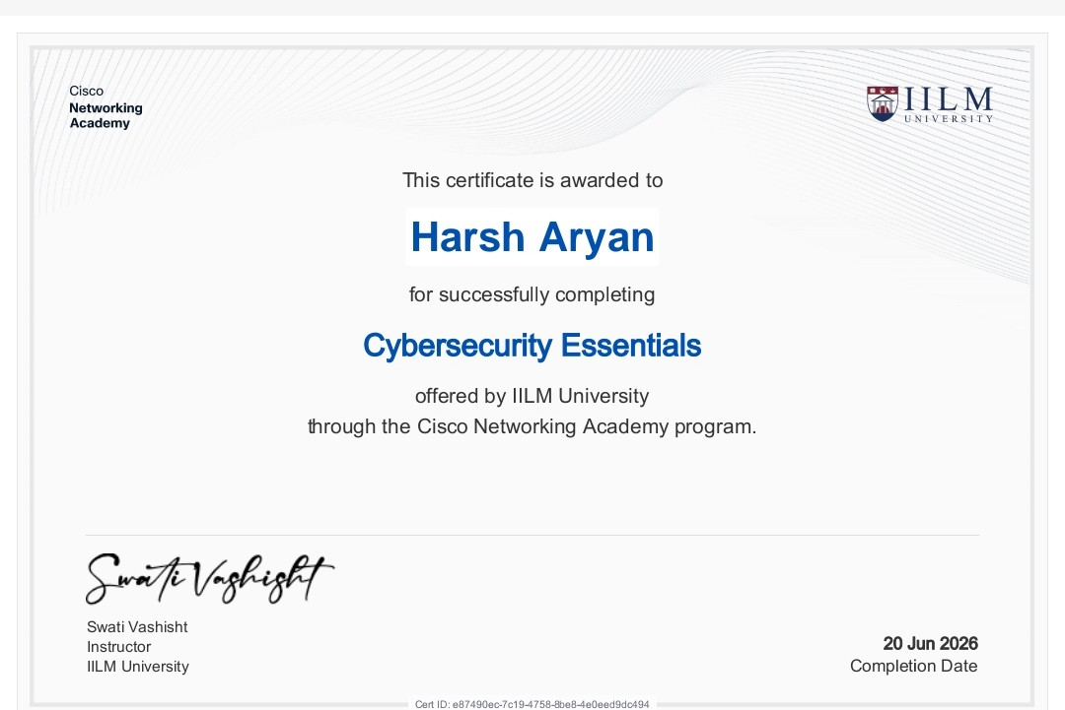
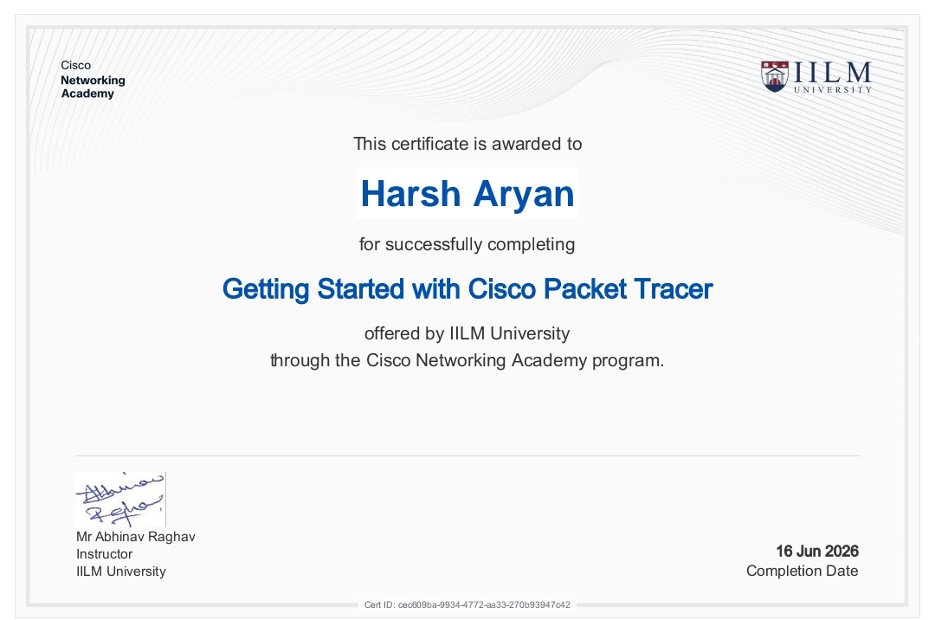
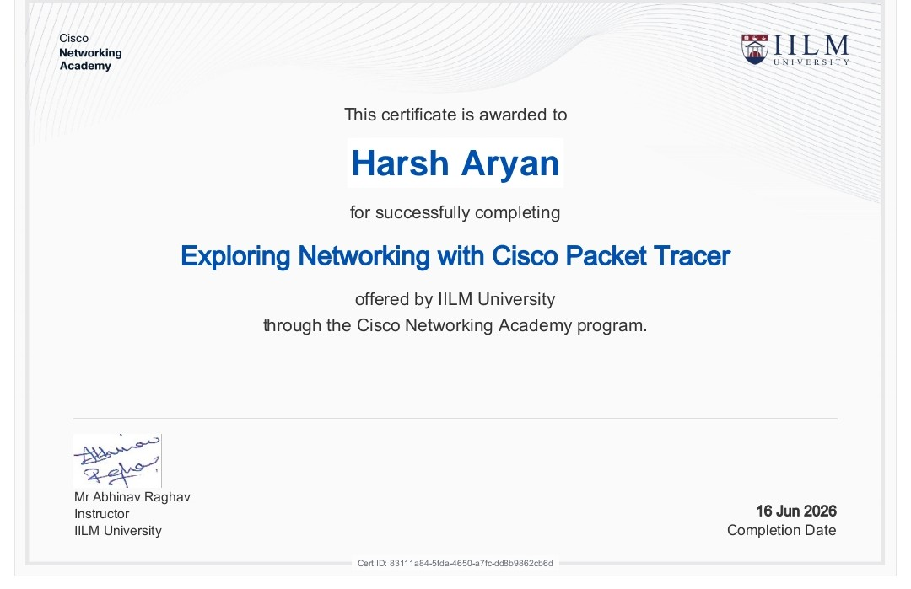
Certification & Official Verification

Slide 13

Thank You!
Harsh Aryan
School of Computer Science & Engineering
Roll No: 2410031314
IILM University, Greater Noida, U.P.

