Slide 1
H1N1 Outbreak Model
Closed population
11-compartment ODE system with a 9-day infectious period
9-day infection chain
Final course project presentation
Numerical calibration
Goal: build, calibrate, and interpret a stage-structured epidemic model that matches the condition I(7) = 10 in a closed population of 1500.
Key inputs
N = 1500
S(0) = 1499
I₁(0) = 1
R(0) = 0
Prepared from the final written report and simulation results
Notes:
[Sources] - User-uploaded report H1N1.pdf (problem statement, model, methodology, results, conclusions). - Plot assets sir_total.png and infected_stages.png extracted from the same uploaded project report. - Title slide summary derived from report sections 1-5.

Slide 2
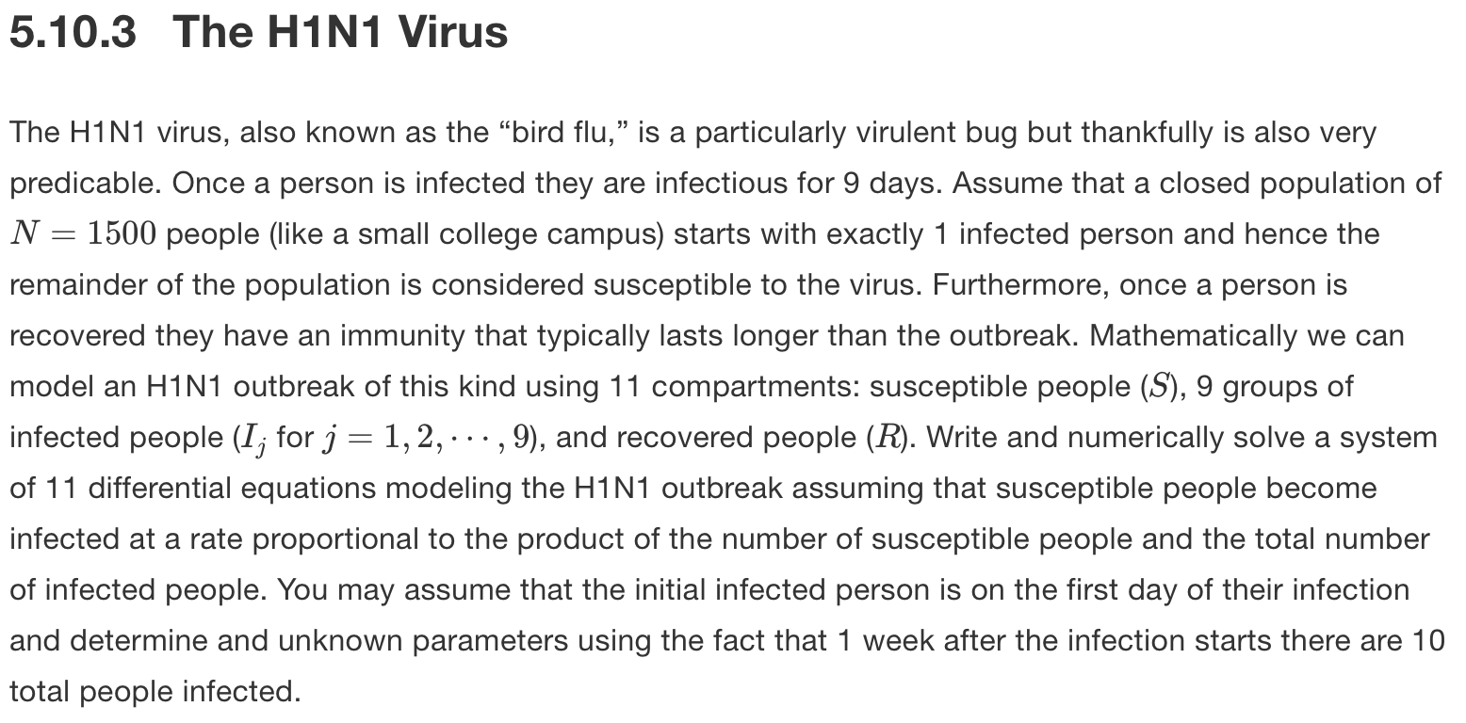
Problem
What the project asks us

Slide 3









Slide 4
Problem statement
What the project asks us to determine
Model the spread of an H1N1 virus in a closed population of 1500 people.
Track infection across 9 daily infectious stages instead of one single infected class.
Determine the unknown transmission parameter β.
Numerically solve the 11 coupled differential equations.
Analyze outbreak size, timing of the peak, and the final susceptible/recovered counts.
Given data
Population size
1500
Infectious period
9 days
Calibration target
I(7) = 10
Initial condition
1499 susceptible
1 infected
0 recovered
Notes:
[Sources] - User-uploaded report H1N1.pdf (problem statement, model, methodology, results, conclusions). - Plot assets sir_total.png and infected_stages.png extracted from the same uploaded project report. - Content taken from report problem statement and model setup.

Slide 5
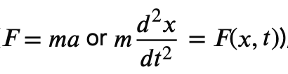

Math Background: What is a differential Equation
What is a differential equation and why should it be used?
Examples
What is a differential equation
A mathematical equations that relate an unknown function to its derivatives, representing how a quantity changes over time or space
Ordinary Differential Equations (ODE): derivative wrt single independent variable
Partial Differential Equations (PDE)
Notes:
[Sources] - User-uploaded report H1N1.pdf (problem statement, model, methodology, results, conclusions). - Plot assets sir_total.png and infected_stages.png extracted from the same uploaded project report. - Based on report sections Background Material and Model Setup.

Slide 6
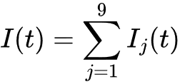


Mathematical background and model structure
Why an 11-compartment system is used
Core definitions
Why stage the infected class?
Total infected population
A standard SIR model uses one infected compartment; this project requires an explicit 9-day infectious period.
Splitting infection into I₁ through I₉ tracks how long each person has been infected.
The structure matches the biology: individuals recover only after completing day 9 of infection.
Mass-action incidence
One day spent in each infected stage
Notes:
The phrase “susceptible people become infected at a rate proportional to the product of the number of susceptible people and the total number of infected people” gives the main infection term in the model, which is $\frac{β}{N}S\left(t\right)I\left(t\right)$.

Slide 7
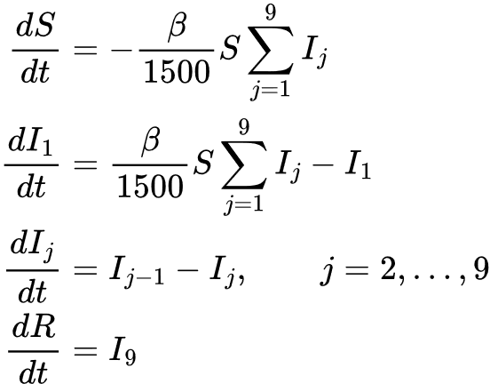
Model equations with parameter substitution
Calibrated transmission parameter: β ≈ 0.339976 day⁻¹
Numerical substitution
β / N
0.339976 / 1500 = 0.0002266507
Initial total infected
I(0) = 1
Initial infection rate
≈ 0.33975
Initial conditions
So at t = 0:
dS/dt ≈ -0.33975
dI₁/dt ≈ -0.66025
Population is conserved: S(t) + ∑Iⱼ(t) + R(t) = 1500 for all t.
Notes:
[Sources] - User-uploaded report H1N1.pdf (problem statement, model, methodology, results, conclusions). - Plot assets sir_total.png and infected_stages.png extracted from the same uploaded project report. - Derived from the mathematical formulation and parameter-substitution section of the report.

Slide 8
Math Background: Alternatives to SIR
What is a differential equation and why should it be used?
Alternative Methods
Problems with SIR
Biological and Epidemiological Limitations
Structural Limitations
Mathematical Limitations
SEIR: Susceptible Exposed Infected Recovered
Add a series of "Exposed" compartments before the "Infected" compartments
ABM: Agent Based-Modeling
Would simulate actual contact networks rather than assuming random mixing
Why we used SIR?
Simplicity
Alternatives are significantly more computationally expensive
Question explicitly asks us for 11 compartmental differential equations (SIR)
Notes:
[Sources] - User-uploaded report H1N1.pdf (problem statement, model, methodology, results, conclusions). - Plot assets sir_total.png and infected_stages.png extracted from the same uploaded project report. - Based on report sections Background Material and Model Setup.

Slide 9
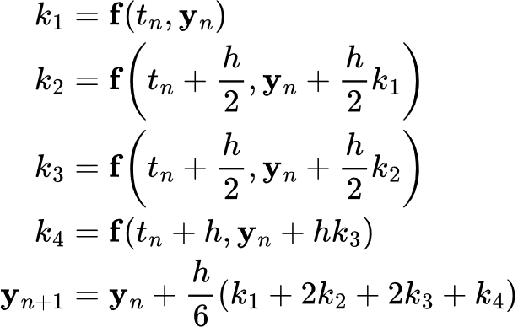
Runge-Kutta method
Numerical background behind the ODE solver
Classical RK45 formulas
Why it is useful here
It is designed for nonlinear ODE systems, which matches our coupled epidemic model.
Instead of using only one slope like Euler's method, it averages multiple slopes within each step.
We apply it to the full state vector Y(t) = (S, I₁, …, I₉, R)ᵀ.
The method combines four slope estimates over one step of size h.
Project-specific note
In Python we used solve_ivp(method="RK45"), an adaptive Runge-Kutta method from the same family.
Notes:
[Sources] - User-uploaded report H1N1.pdf (problem statement, model, methodology, results, conclusions). - Plot assets sir_total.png and infected_stages.png extracted from the same uploaded project report. - Runge-Kutta background slide added to explain the numerical method referenced in the report methodology.

Slide 10
Model parameters and initial conditions
Known quantities before solving the system (NumPy)
Set parameters and y0
→
Define the ODE system
→
Solve with RK45
→
Fit β with Brent's method
1
2
3
4
Python setup
What this sets up
N = 1500 # total population
N_STAGES = 9 # infected stages I1,...,I9
GAMMA = 1.0 # progression rate: 1 stage per day
TARGET_I7 = 10.0 # calibration condition: I(7) = 10
T_END = 200 # simulation length (days)
BETA_BRACKET = (0.3, 0.4) # search interval for beta
y0 = np.zeros(N_STAGES + 2)
y0[0] = N - 1 # S(0) = 1499
y0[1] = 1 # I1(0) = 1
# I2...I9 and R start at 0
• N = 1500 defines the closed population.
• N_STAGES = 9 gives the infected stages I₁ through I₉.
• GAMMA = 1 means people move one stage per day.
• TARGET_I7 = 10 is the week-1 calibration condition.
• y0 stores the initial state: 1499 susceptible, 1 infected, 0 recovered.
# total_infected_at_day_7(β)−10=0
Notes:
[Sources] - User-uploaded report H1N1.pdf (problem statement, model, methodology, results, conclusions). - Plot assets sir_total.png and infected_stages.png extracted from the same uploaded project report. - Python workflow and excerpt taken from methodology and appendix of the final report.

Slide 11
Defining the 11-compartment ODE system
Python function for the model equations (NumPy)
Set parameters and y0
→
Define the ODE system
→
Solve with RK45
→
Fit β with Brent's method
1
2
3
4
ODE Setup
Meaning of each part
def h1n1_system(t, y, beta):
S = y[0]
I = y[1:1 + N_STAGES]
Itot = np.sum(I)
dydt = np.zeros_like(y)
dydt[0] = -(beta / N) * S * Itot
dydt[1] = (beta / N) * S * Itot - GAMMA * I[0]
for j in range(1, N_STAGES):
dydt[j + 1] = GAMMA * I[j - 1] - GAMMA * I[j]
dydt[-1] = GAMMA * I[-1]
return dydt
• S is the susceptible population.
• I stores the 9 infected compartments.
• Itot = sum(I) is the total infected population.
• dydt[0] models susceptibles becoming infected.
• dydt[1] places new infections into I₁.
• The loop moves people through I₂ to I₉.
• dydt[-1] moves people from I₉ into recovery.

Slide 12
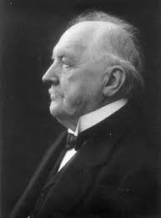
Why we use Runge-Kutta (RK45)
What it is and why it fits this project
What RK45 does
A numerical method for approximating solutions to ordinary differential equations.
Starts from the initial condition vector y0 and repeatedly estimates slopes to move the solution forward in time.
RK45 is adaptive, so it automatically adjusts the step size for accuracy and efficiency.
Why we use it here
Our outbreak model is nonlinear because the infection term contains S · I.
That makes the full 11-equation system difficult to solve analytically by hand.
solve_ivp(method="RK45") returns numerical values for S(t), I₁(t), …, I₉(t), and R(t).
9

Slide 13
Numerically solving the model
Runge-Kutta simulation with solve_ivp
1
Set parameters and y0
→
2
Define the ODE system
→
3
Solve with RK45
→
4
Fit β with Brent's method
solve_ivp with RK45
Why this step is needed
def solve_model(beta, t_end=T_END, num_points=2001):
t_eval = np.linspace(0, t_end, num_points)
sol = solve_ivp(
fun=lambda t, y: h1n1_system(t, y, beta),
t_span=(0, t_end),
y0=y0,
t_eval=t_eval,
method="RK45",
rtol=1e-9,
atol=1e-12
)
if not sol.success:
raise RuntimeError(f"ODE solver failed: {sol.message}")
return sol
• The system is nonlinear because of the term S · I.
• solve_ivp computes numerical values for all 11 compartments.
• method="RK45" uses an adaptive Runge-Kutta solver.
• t_eval stores the solution at 2001 time points.
• This produces the full outbreak curves over 200 days.

Slide 14
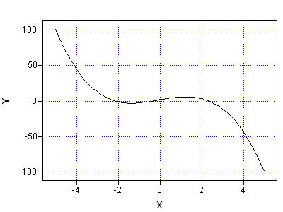
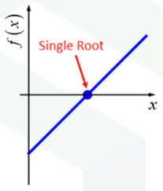
Why we use Brent’s method
Root finding for the unknown transmission parameter β
What Brent’s method does
A root-finding algorithm that searches for a value where an objective function equals zero.
In our code, the objective is f(β) = I(7;β) - 10.
The search is restricted to a bracket, here (0.3, 0.4), where the solution is expected to lie.
Why we use it here
β is unknown, so we cannot run the final outbreak simulation until it is calibrated.
For each trial β, we solve the ODE system to day 7 and compute I(7) = I₁(7)+···+I₉(7).
If I(7) is above or below 10, Brent’s method keeps refining β until I(7)(β) - 10 = 0.
Brent’s method was a good choice because it is both robust and efficient for a one-variable root-finding problem like ours
Key idea: Brent’s method is how we determine the calibrated transmission rate β ≈ 0.339976.
11

Slide 15
Calibrating the transmission parameter β
Using the condition I(7) = 10
Set parameters and y0
→
Define the ODE system
→
Solve with RK45
→
Fit β with Brent's method
1
2
3
4
Finding β with brentq
What this does
def total_infected_at_day_7(beta):
sol = solve_ivp(
fun=lambda t, y: h1n1_system(t, y, beta),
t_span=(0, 7),
y0=y0,
t_eval=[7],
method="RK45",
rtol=1e-9,
atol=1e-12
)
infected_stages = sol.y[1:1 + N_STAGES, 0]
return np.sum(infected_stages)
def fit_beta(target_i7=TARGET_I7, bracket=BETA_BRACKET):
def objective(beta):
return total_infected_at_day_7(beta) - target_i7
return brentq(objective, bracket[0], bracket[1])
• β is unknown before solving the model.
• For each trial β, we solve the system up to day 7.
• We compute I(7) = I₁(7) + ··· + I₉(7).
• The objective function is I(7) − 10.
• brentq searches the interval (0.3, 0.4) for the β value that makes the objective equal 0.

Slide 16
Results overview
Calibrated model outputs
Key numerical results
Main takeaway
Transmission parameter β
0.339976
The outbreak infects most of the population before it dies out.
Peak total infected
787.77 people
Time of peak infection
27.1 days
A relatively large calibrated β creates a fast epidemic wave.
The peak occurs around day 27, when the infected population is largest.
Only about 83 people remain uninfected at the end of the simulation.
Final susceptible
83.32 people
Final recovered
1416.68 people
Notes:
[Sources] - User-uploaded report H1N1.pdf (problem statement, model, methodology, results, conclusions). - Plot assets sir_total.png and infected_stages.png extracted from the same uploaded project report. - Numerical values taken from the results section and appendix summary in the report.

Slide 17
Graph 1 Code
matplotlib
Python
def save_plots(results):
t = results["t"]
S = results["S"]
I_total = results["I_total"]
R = results["R"]
I_stages = results["I_stages"]
# Graph 1: S(t), I(t), R(t)
plt.figure(figsize=(8, 5))
plt.plot(t, S, label="S(t)")
plt.plot(t, I_total, label="I(t)")
plt.plot(t, R, label="R(t)")
plt.savefig("sir_total.png")
plt.close()
Notes:
[Sources] - User-uploaded report H1N1.pdf (problem statement, model, methodology, results, conclusions). - Plot assets sir_total.png and infected_stages.png extracted from the same uploaded project report. - Python workflow and excerpt taken from methodology and appendix of the final report.

Slide 18
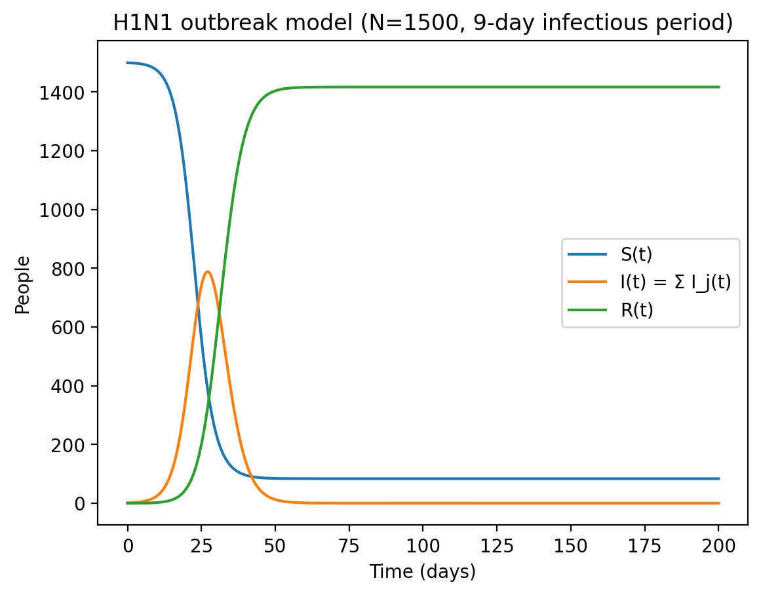
Figure 1: S(t), I(t), and R(t)
Overall epidemic trajectory
How to read the graph
S(t) starts near 1500 and drops quickly once transmission accelerates.
I(t) rises sharply, peaks at about 788 people around day 27, then falls as the susceptible pool is depleted.
R(t) increases steadily because recovered individuals accumulate and remain immune.
Interpretation
This is the classic epidemic wave: rapid growth, peak infection, then decline as susceptibles run out.
Notes:
[Sources] - User-uploaded report H1N1.pdf (problem statement, model, methodology, results, conclusions). - Plot assets sir_total.png and infected_stages.png extracted from the same uploaded project report. - Uses sir_total.png from the uploaded project report; interpretation follows the report figure discussion.

Slide 19
Graph 2 Code
matplotlib
Python
# Graph 2: I1(t) to I9(t) plt.figure(figsize=(8, 5)) for j in range(N_STAGES): plt.plot(t, I_stages[j], label=f"I_{j+1}(t)") plt.savefig("infected_stages.png") plt.close()
Notes:
[Sources] - User-uploaded report H1N1.pdf (problem statement, model, methodology, results, conclusions). - Plot assets sir_total.png and infected_stages.png extracted from the same uploaded project report. - Python workflow and excerpt taken from methodology and appendix of the final report.

Slide 20
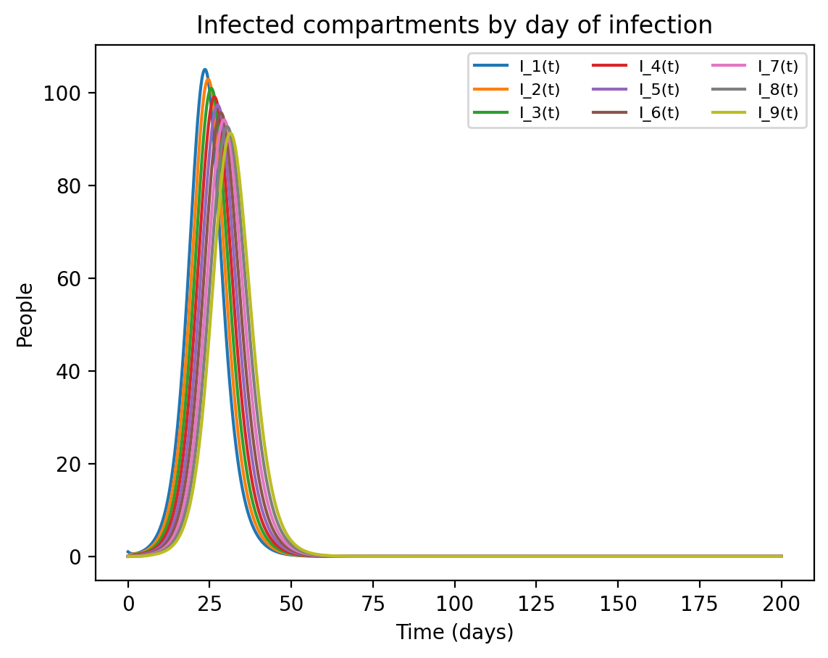
Figure 2: infected compartments by day of infection
Stages I₁ through I₉
What the stage curves show
Each curve represents one day of infection, from I₁ to I₉.
The peaks occur one after another because people move sequentially through the infected stages.
The similar bell-shaped curves confirm a smooth day-by-day progression before recovery.
Interpretation
The multi-stage model captures the fixed 9-day infectious period much more explicitly than a one-compartment infected class.
Notes:
[Sources] - User-uploaded report H1N1.pdf (problem statement, model, methodology, results, conclusions). - Plot assets sir_total.png and infected_stages.png extracted from the same uploaded project report. - Uses infected_stages.png from the uploaded report; interpretation follows the report figure discussion.

Slide 21
Challenges and limitations
Conceptual difficulties encountered during the project
Main challenges
Interpreting the infected compartments correctly: at first, it was easy to confuse I₁, …, I₉ with cumulative infections, when they actually represent people currently in days 1 through 9 of infection.
Understanding numerical methods: since the system is nonlinear, we had to use RK45 and root finding instead of solving the equations by hand, so learning what those methods were doing took extra effort.
Calibrating the transmission parameter β: it was challenging to understand how Brent’s method searches for the correct β value and how that connects to the condition I(7)=10.
15

Slide 22
Conclusions
What this project shows
Bottom line
An 11-compartment ODE model can represent a fixed 9-day infectious period in a biologically meaningful way.
Calibrating β to satisfy I(7) = 10 gives β ≈ 0.339976 and predicts a large outbreak in this closed population.
The simulation peaks near day 27 and eventually leaves only about 83 people uninfected.
Stage-structured models provide more detail about disease progression than a basic SIR formulation.
Mathematical modeling + numerical simulation turned the problem statement into concrete outbreak predictions.
Thank you
Questions?
Notes:
[Sources] - User-uploaded report H1N1.pdf (problem statement, model, methodology, results, conclusions). - Plot assets sir_total.png and infected_stages.png extracted from the same uploaded project report. - Conclusions synthesized from the conclusion section of the report.

Slide 23
References
Sources used in the report and presentation
[1] E. Sullivan, Numerical Methods: An Inquiry-Based Approach With Python, online textbook, Carroll College. Available online: https://numericalmethodssullivan.github.io/. Last updated: 2022-01-01.
[2] “SEIR model,” Wikipedia. https://en.wikipedia.org/wiki/Compartmental_models_in_epidemiology#The_SEIR_model.
[3] “Agent-based model,” Wikipedia. https://en.wikipedia.org/wiki/Agent-based_model.
[4] “Runge-Kutta methods,” Wikipedia. https://en.wikipedia.org/wiki/Runge%E2%80%93Kutta_methods.
[5] “Euler method,” Wikipedia. https://en.wikipedia.org/wiki/Euler_method.
[6] “Brent’s method,” Wikipedia. https://en.wikipedia.org/wiki/Brent%27s_method.
[7] SciPy Developers, “scipy.integrate.solve_ivp,” SciPy API Reference. https://docs.scipy.org/doc/scipy/reference/generated/scipy.integrate.solve_ivp.html.
[8] SciPy Developers, “scipy.optimize.brentq,” SciPy API Reference. https://docs.scipy.org/doc/scipy/reference/generated/scipy.optimize.brentq.html.
[9] Matplotlib Developers, “Matplotlib Documentation.” https://matplotlib.org/stable/contents.html

