Slide 1
Multiresolutional Image Compression using Deep Convolutional Autoencoders.

Slide 2
Aspect | Existing Image Compression(JPEG, JPEG2000, etc) | Our Methodology(Multiresolutional Image Compression using Deep Convolutional Autoencoders)
Approach | Uses fixed mathematical transforms like DCT(JPEG) or Wavelets(JPEG2000) | Uses deep learning (CNN-based autoencoders) to learn compression automatically from data
Feature Handling | Manually designed, works the same for all images | Learns adaptive features for different image types(natural, medical, satellite, etc)
Resolution Handling | Works on a single resolution, loses fine details at high compression | Multiresolutional: preserves both coarse structures and fine details at multiple scales
Compression Efficiency | Good at moderate compression but degrades heavily at high compression ratios | Achieves higher compression while keeping images visually natural
Artifacts(Visual Problems | JPEG->blocking artifacts JPEG2000->blurring/ringing | Reduces such artifacts; produces more realistic reconstructions
Scalability | Limited flexibility, not easy adaptable to new domains | Highly Scalable; can be retrained for specific domains (medical, remote sensing, etc)
Intelligence | Rule Based (hand-crafted formulas) | Data-driven (learns directly from large datasets)

Slide 3
JPEG (Existing Algorithm)
Step 1. Color Conversion (RGB → YCbCr)
Original image is in RGB (Red, Green, Blue).
Converted into Y (brightness), Cb (blue color), Cr (red color).
Human eyes are more sensitive to brightness than color
Step 2. Chroma Subsampling (Reduce Color Details)
Brightness (Y) kept clear, colors (Cb, Cr) reduced.
Fewer color details = smaller file, but looks almost the same.
Step 3. Block Splitting + DCT (Frequency Transformation)
Image divided into 8×8 pixel blocks.
Each block converted to frequency domain using DCT.
Low frequency = smooth background (sky).
High frequency = fine details (hair, text).

Slide 4
JPEG (Existing Algorithm Contd…)
Step 4. Quantization (Actual Compression Step)
High-frequency values reduced or removed (rounding).Keeps only “important” details.
Some info lost = JPEG is lossy compression.
Step 5. Entropy Encoding (Smart Packing)
Many values become zeros after quantization.
Numbers stored in zig-zag order → zeros grouped together.
Step 6. Decompression (Getting Image Back)
Reverse the process:
  Decode numbers, Rebuild frequency patterns → 8×8 blocks, Convert YCbCr → RGB.
Final image looks almost original, but with smaller file size

Slide 5
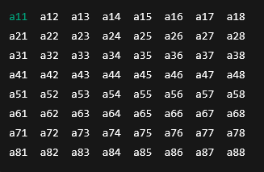
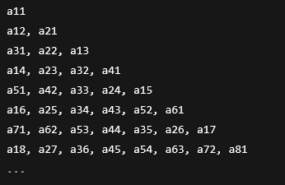
----------->

Slide 6
Limitations of Existing Techniques
JPEG
At high compression produces blocking artifacts (visible square patches).
Not suitable for medical or scientific images requiring fine detail.
.

Slide 7
Deep Autoencoder Image Compression
Step 1. Input Image
Full image (e.g., 256×256) is fed directly.
Unlike JPEG, no splitting into 8×8 blocks.
Step 2. Multiresolutional Representation
Image is analyzed at different zoom levels:
  Coarse scale , Mid scale, Fine scale
Preserves both global structure & fine details.
Step 3. Encoder (CNN Compression Stage)
Convolutional Neural Networks (CNNs) extract features.
Filters (3×3, 5×5) slide across the image to detect:
  Shallow layers ,Middle layers, Deep layers
Downsampling reduces image size but keeps essential info.

Slide 8
Deep Autoencoder Image Compression
Step 4. Latent Representation (The Bottleneck)
Encoder compresses into a small latent code.
Example:
  Input = 256×256×3 = ~196k values.
  Latent code = only 1k–5k numbers.
Code stores the essence: edges, shapes, textures.
Step 5. Decoder (Reconstruction Stage)
Works like reverse CNN:
  Upsamples latent code → reconstructs image.
  Adds back details learned during training.
Encoder = smart compressor, Decoder = smart restorer.
Step 6. Output Image
Reconstructed image ≈ original image.

Slide 9
Advantages of Our Method
Better Quality Preservation: Maintains sharpness and detail even at high compression.
Reduced Artifacts: No blocking (JPEG) or excessive blurring (JPEG2000).
Adaptive & Flexible: Works on different image domains (general photos, medical scans, satellite images).
Higher Compression Ratios: Achieves more size reduction while keeping quality close to the original.
End-to-End Learning: The system improves as more training data is provided.

