Slide 1
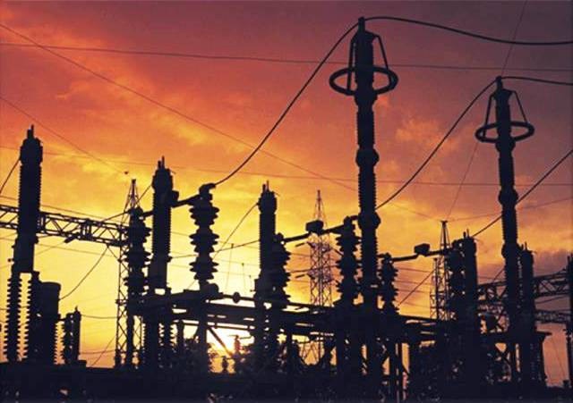
INSULATION COORDINATION
Summer-2015

Slide 2
contents
Introduction
TRANSMISSION LINES
substation
OVER VOLTAGES
Insulation coordination
TRANSMISSION LINES
substation
OVER VOLTAGES
Review on insulation coordination
Voltages: 63 kV
Voltages: 130 kV
Voltages: 230Kv
Voltages: 400kV
Conclusion
TRANSMISSION LINES
substation
References

Slide 3
Protection
Over Current
There are two areas of protection which power engineers deal with
Over Voltage
Over voltage Protection verses Insulation coordination

Slide 4
We all have had dealings with over current protection if fact we have a whole group that deals with it.
But very few of us deal with over voltage protection. Why well simplistically currents are a function of load and impedance of the system and that can be pretty much anything
But even though there appears to a lot of voltages in reality there are only about 20 to 30 which means once you have provided protection for these voltages you can use it again and again and don’t have to re engineer. Example for 12kv we use insulation rated 110kV BIL and an arrester rated 10kV. This means the 12kV at State College uses the same over voltage protection as the 12kV at Parkersburg or Colorado for that matter.

Slide 5
Introduction
Consider first the definition of insulation coordination in its most fundamental and simple form:
1. Insulation coordination is the selection of the insulation strength. If desired, a reliability criterion and something about the stress placed on the insulation could be added to the definition. In this case the definition would become
2. Insulation coordination is the "selection of the insulation strength consistent with the expected over voltages to obtain an acceptable risk of failure" [I]. In some cases, engineers prefer to add something concerning surge arresters, and therefore the definition is expanded to
3. Insulation coordination is the "process of bringing the insulation strengths of electrical equipment into the proper relationship with expected over voltages and with the characteristics of surge protective devices" [2]. The definition could be expanded further to
4. Insulation coordination is the "selection of the dielectric strength of equipment in relation to the voltages which can appear on the system for which equipment is intended and taking into account the service environment and the characteristics of the available protective devices" [3].

Slide 6
5. "Insulation coordination comprises the selection of the electric strength of equipment and its application, in relation to the voltages which can appear on the system for which the equipment is intended and taking into account the characteristics of available protective devices, so as to reduce to an economically and operationally acceptable level the probability that the resulting voltage stresses imposed on the equipment will cause damage to equipment insulation or affect continuity of service" [4].
By this time, the definition has become so complex that it cannot be understood by anyone except engineers who have conducted studies and served on committees attempting to define the subject and provide application guides. Therefore, it is
preferable to return to the fundamental and simple definition: the selection of insulation strength. It goes without saying that the strength is selected on the basis of some quantitative or perceived degree of reliability. And in a like manner, the strength
cannot be selected unless the stress placed on the insulation is known. Also, of course, the engineer should examine methods of reducing the stress, be it through surge arresters or other means. Therefore, the fundamental definition stands: it is the selection of insulation strength.

Slide 7
The goal is not only to select the insulation strength but also to select the
minimum insulation strength, or minimum clearance, since minimum strength can
be equated to minimum cost. In its fundamental form, the process should begin with
a selection of the reliability criteria, followed by some type of study to determine the
electrical stress placed on the equipment or on the air clearance. This stress is then
compared to the insulation strength characteristics, from which a strength is selected.
If the insulation strength or the clearance is considered to be excessive, then the stress
can be reduced by use of ameliorating measures such as surge arresters, protective
gaps, shield wires, and closing resistors in the circuit breakers.
As noted, after selection of the reliability criteria, the process is simply a comparison
of the stress versus the strength.
Usually, insulation coordination is separated into two major parts:
1. Line insulation coordination, which can be further separated into transmission
and distribution lines
2. Station insulation coordination, which includes generation, transmission, and
distribution substations.
To these two major categories must be added a myriad of other areas such as
insulation coordination of rotating machines, and shunt and series capacitor
banks. Let us examine the two major categories.

Slide 8
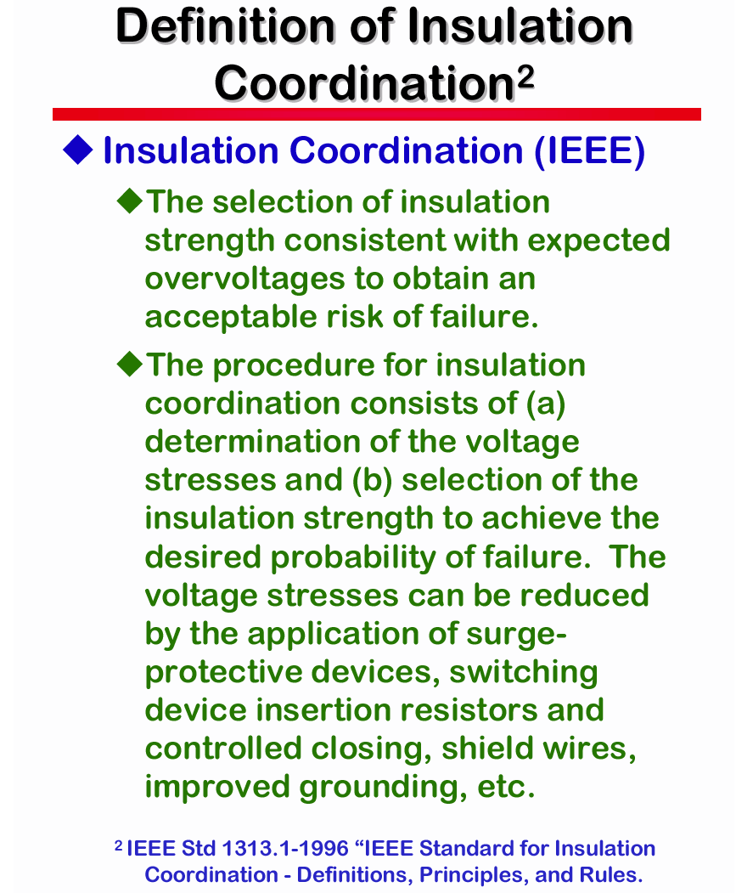

Slide 9
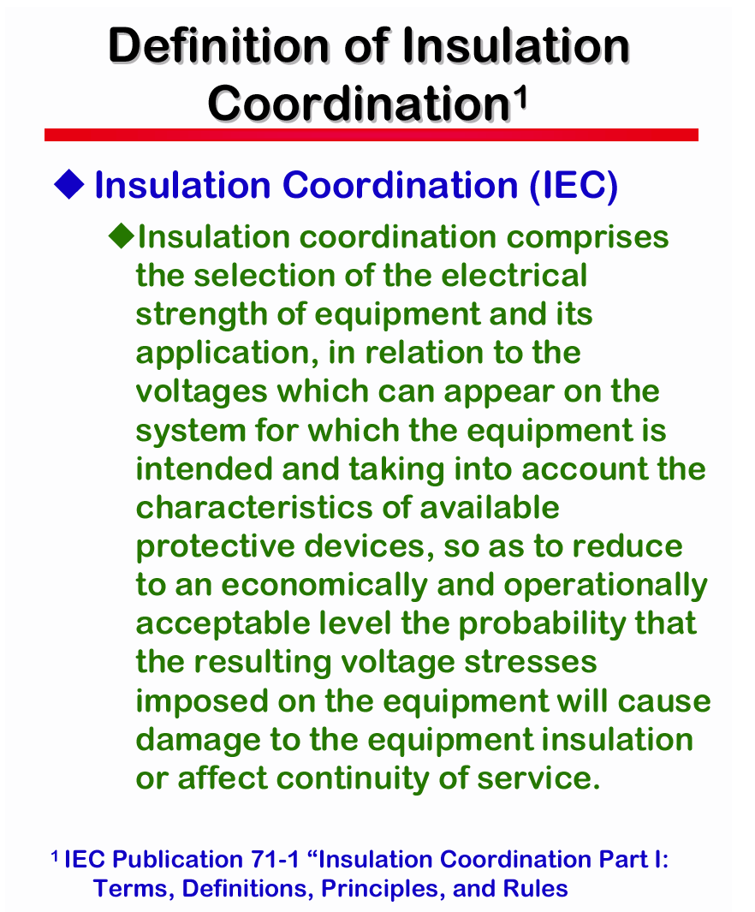

Slide 10
Insulation coordination
1
INSULATION COORDINATION FOR TRANSMISSION LINES
2
INSULATION COORDINATION FOR SUBSTATIONS

Slide 11
Insulation coordination
FOR TRANSMISSION LINES
For line insulation coordination, the task is to specify all dimensions or characteristics
of the transmission or distribution line tower that affect the reliability of the
line:
1. The tower strike distances or clearances between the phase conductor and the
grounded tower sides and upper truss
2. The insulator string length
3. The number and type of insulators
4. The need for and type of supplemental tower grounding
5. The location and number of overhead ground or shield wires
6. The phase-to-ground midspan clearance
7. The phase-phase strike distance or clearance
8. The need for, rating, and location of line surge arresters
To illustrate the various strike distances of a tower, a typical 500-kV tower is shown
in Fig. 1. Considering the center phase, the sag of the phase conductor from the
tower center to the edge of the tower is appreciable. Also the vibration damper is
usually connected to the conductor at the tower's edge. These two factors result in
the minimum strike distance from the damper to the edge of the tower. The strike
distance from the conductor yoke to the upper truss is usually larger. In this design,
the strike distance for the outside phase exceeds that for the center phase. The
insulator string length is about 11.5 feet, about 3% greater than the minimum center
phase strike distance.

Slide 12
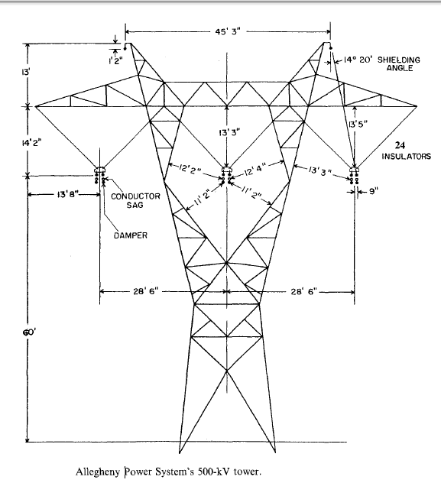
Insulation coordination
FOR TRANSMISSION LINES

Slide 13
Insulation coordination
FOR SUBSTATIONS
For station insulation coordination, the task is similar in nature. It is to specify
1. The equipment insulation strength, that is, the BIL and BSL of all equipment.
2. The phase-ground and phase-phase clearances or strike distances. Figure 2
illustrates the various strike distances or clearances that should be considered
in a substation.
3. The need for, the location, the rating, and the number of surge arresters.
4. The need for, the location, the configuration, and the spacing of protective
gaps.
5. The need for, the location, and the type (masts or shield wires) of substation
shielding.
6. The need for, the amount, and the method of achieving an improvement in
lightning performance of the line immediately adjacent to the station.
In these lists, the method of obtaining the specifications has not been stated. To the
person receiving this information, how the engineer decides on these specifications is
not of primary importance, only that these specifications result in the desired degree
of reliability.
It is true that the engineer must consider all sources of stress that may be placed
on the equipment or on the tower. That is, he must consider
1. Lightning overvoltages (LOV), as produced by lightning flashes
2. Switching overvoltages (SOV), as produced by switching breakers or disconnecting
switches

Slide 14
Insulation coordination
FOR SUBSTATIONS
3. Temporary overvoltages (TOY), as produced by faults, generator overspeed,
ferroresonance, etc.
4. Normal power frequency voltage in the presence of contamination
For some of the specifications required, only one of these stresses is of importance.
For example, considering the transmission line, lightning will dictate the location
and number of shield wires and the need for and specification of supplemental tower
grounding. Considering the station, lightning will dictate the location of shield wires
or masts. However, subjective judgment must be used to specify whether shield wires
or masts should be used. The arrester rating is dictated by temporary overvoltages.
In addition, the number and location of surge arresters will primarily be dictated by
lightning. Also, for the line and station, the number and type of insulators will be
dictated by the contamination.
However, in many of the specifications, two or more of the overvoltages must be
considered. For transmission lines, for example, switching overvoltages, lightning, or
contamination may dictate the strike distances and insulator string length. In the
substation, however, lightning, switching surges, or contamination may dicatate the
BIL, BSL, and clearances.

Slide 15
Insulation coordination
FOR SUBSTATIONS
Since the primary objective is to specify the minimum insulation strength, no one
of the overvoltages should dominate the design. That is, if a consideration of switching
overvoltages results in a specification of tower strike distances, methods should
be sought to decrease the switching overvoltages. In this area, the objective is not to
permit one source of overvoltage stress to dictate design. Carrying this philosophy to
the ultimate results in the objective that the insulation strength be dictated only by
the power frequency voltage. Although this may seem ridiculous, it has essentially
been achieved with regard to transformers, for which the 1-hour power frequency
test is considered by many to be the most severe test on the insulation.
In addition, in most cases, switching surges are important only for voltages of
345 kV and above. That is, for these lower voltages, lightning dictates larger clearances
and insulator lengths than do switching overvoltages. As a caution, this may
be untrue for "compact" designs.

Slide 16
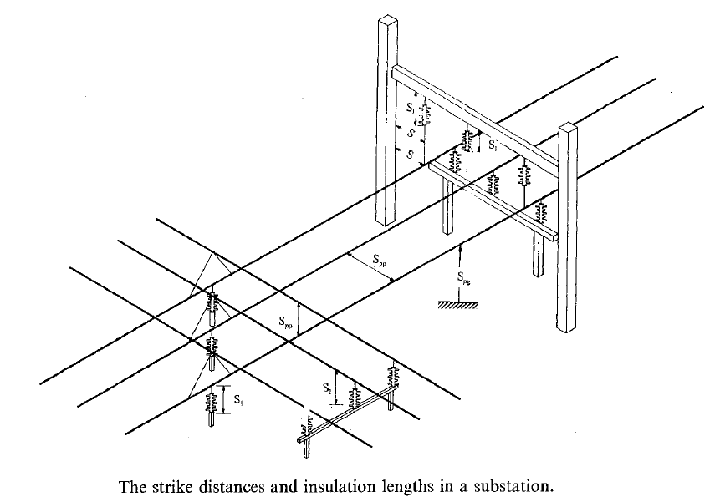
Insulation coordination
FOR SUBSTATIONS

Slide 17
Insulation coordination
MODIFICATION OF STRESSES
As previously mentioned, if the insulation strength specification results in a higherthan-
desired clearance or insulation strength, stresses produced by lightning and
switching may be decreased. Some obvious methods are the application of surge
arresters and the use of preinsertion resistors in the circuit breakers. In addition,
methods such as the use of overhead or additional shield wires also reduce stress. In
this same vein, other methods are the use of additional tower grounding and additional
shielding in the station.

Slide 18
Insulation coordination
TWO METHODS OF INSULATION COORDINATION
Two methods of inuslation coordination are presently in use, the conventional or
deterministic method and the probabilistic method. The conventional method consists
of specifying the minimum strength by setting it equal to the maximum stress.
Thus the rule is minimum strength = maximum stress. The probabilistic method
consists of selecting the insulation strength or clearances based on a specific reliability criterion. An engineer may select the insulation strength for a line based on a
lightning flashover rate of 1 flashover/lOO km-years or for a station, based on a mean
time between failure (MTBF), of 100 or 500 years.
The choice of the method is based not only on the engineer's desire but also on
the characteristics of the insulation. For example, the insulation strength of air is
usually described statistically by a Gaussian cumulative distribution, and therefore
this strength distribution may be convolved with the stress distribution to determine
the probability of flashover. However, the insulation strength of a transformer internal
insulation is specified by a single value for lightning and a single value for
switching, called the BIL and the BSL. To prove this BIL or BSL, usually only
one application of the test voltage is applied. Thus no statistical distribution of
the strength is available and the conventional method must be used.
It is emphasized that even when the conventional method is used, a probability
of failure or flashover exists. That is, there is a probability attached to the conventional
method although it is not evaluated.

Slide 19
Insulation coordination
TWO METHODS OF INSULATION COORDINATION
The selected reliability criterion is primarily a function of the consequence of the
failure and the life of the equipment. For example, the reliability criterion for a
station may be more stringent than that for a line because a flashover in a station
is of greater consequence. Even within a station, the reliability criterion may change
according to the type of apparatus. For example, because of the consequences of
failure of a transformer, the transformer may be provided with a higher order of
protection. As another example, the design flashover rate for extra high voltage
(EHV) lines is usually lower than that for lower-voltage lines. And the MTBF
criterion for low-voltage stations is lower than for high-voltage stations.

Slide 20
Insulation coordination
OVER VOLTAGES
1) Constant voltage (power frequency)
ارایش نرمال سیستم:دامنه اضافه ولتاژ برابر با حداکثر مقدار ان
ارایش غیرنرمال سیستم: 1)سیستمی که نول ان بصورت معمول زمین شده 2)در سیستم ،بخشهایی با نول زمین نشده باشند
2) Temporary overvoltage
مشخص بوسیله دامنه، شکل و مدت اضافه ولتاژ
در نظر بصورت شکل ولتاژفرکانس قدرت کوتاه مدت (1 دقیقه)
اضافه ولتاژ موقت بطور معمول بین فازها ایجاد نمی شود
Ground Fault
خطای تک فاز ممکن است منجر به اضافه ولتاژهای فاز به زمین در دو فاز سالم
به شکل ولتاژ فرکانس قدرت
دامنه اضافه ولتاژ بستگی به نحوه زمین کردن نقطه نول سیستم ومکان خطا
مدت زمان اضافه ولتاژ وابسته به طول مدت خطا(1-در سیستم های با نول زمین شده مجهز به سیستم رفع خطا کمتر از یک ثانیه 2-در سیستم های بدون رفع کننده خطای زمین ممکن است چند ساعت)

Slide 21
Insulation coordination
OVER VOLTAGES
اضافه ولتاژفاز به زمین در هر سه فاز یکسان بنابراین اضافه ولتاژفاز به فاز به همان نسبت فاز به زمین
اضافه ولتاژ بستگی به بارقطع شده، ارایش سیستم پس از قطع ارتباط ومشخصات سیستم ( قدرت اتصال کوتاه، تنظیم سرعت و ولتاژ زنراتورهاو...)
قطع بار در انتهای یک خط طولانی مهم(اثر فرانتی یا تشدید) که در انتهای خط سمت منبع مدارشکن باز شده را تحت تاثیر
در Moderately extended system اضافه ولتاژ تا 1.2 پریونیت وتا چند دقیقه
در extended system اضافه ولتاژ تا 1.5 پریونیت و در صورت اثر فرانتی شدید اضافه ولتاژ بیشتر و طول مدت انها درهر مرتبه چندین ثانیه
LOAD REJECTION
Resonance and ferro resonance
برق دار شدن یا قطع بار مدارها باعناصرخازنی بزرگ (خط ، کابل ،خطوط جبران شده سری)
برق دار شدن یا قطع بار مدارهای باعناص القایی (ترانسفورماتورها، راکتورهای موازی)
محدود شدن با وسایل محدود کننده اضافه ولتاژ
عدم در نظر گرفته شدن برای انتخاب ولتاژ نامی برقگیر و هماهنگی عایقی

Slide 22
Insulation coordination
OVER VOLTAGES
The combination of temporary voltages resulting from different sources
When probability of high over voltages have technical feasibility and economic justification.
زمانی که احتمال وقوع اضافه ولتاژها به اندازه کافی بالا توجیه فنی واقتصادی
Ground Fault and LOAD REJECTION
این موضوع بیش از حد بدبینانه
This topic is too pessimistic.
سایر ترکیبات
ترکیب پدیده تشدید با اضافه ولتاژهی دیگر
The combination of resonance Phenomenon with other over voltages

Slide 23
Insulation coordination
OVER VOLTAGES
Earth fault voltages:
اضافه ولتاژهای خطای زمین:
کنترل با زمین کردن سریع نول توسط کلیدها یا برقگیرهای ویژه ای که نول را بعد از خطا اتصال کوتاه می کنند
Sudden load changes:
Control by Shunt reactors, series capacitors or static compensator
تغییرات ناگهانی بار:
کنترل با راکتورهای شنت، خازنهای سری و یا جبرانساز استاتیک
Resonance and ferroresonance:
Limited by reset the system whit respect to the resonant frequency, To rearrange the system,or by the damping resistance
رزونانس و فرورزونانس:
محدود با تنظیم مجدد سیستم نسبت به فرکانس تشدید، با تغییر ارایش سیستم یا توسط مقاومت میراکننده

Slide 24
Insulation coordination
OVER VOLTAGES
3) Switching Over voltages
The impact on high voltage

Slide 25
Insulation coordination
OVER VOLTAGES
Overvoltage by re-energizing of line
Over Voltages by phase-to-ground
Over Voltages by phase-to-phase
Overvoltage by faults and faults handling
Overvoltage by LOAD REJECTION
Overvoltage by Switching inductive and capacitive currents
4) Lightning over voltages (fast over voltages)
Protection by Arrester
In systems with long lines (up to km 100)
2) The impact on lower voltages
5) Combination

Slide 26
Insulation coordination
Phase-Ground Switching Over voltages Transmission Lines
Phase-Phase Switching Over voltages, Transmission Lines
The Lightning Flash
Induced Over voltages
????

Slide 27
Insulation coordination
STANDARDS
Are there any Insulation Coordination Standards?
The IEEE standards that describe insulation coordination methods and definitions are C62.82.1 and C62.82.2. Prior to 2010 these standards were referred to as IEEE 1313.1 and 1313.2. The IEC standards that describe insulation coordination methods and definitions are IEC60071-1, 60071-2 and 60071-4. Are there any standards that require Insulation Coordination studies to be Completed?
There are no standards that require studies be completed. Studies are risk reduction actions, and not mandated by standards but instead are the option of the owner as part of risk management.

Slide 28
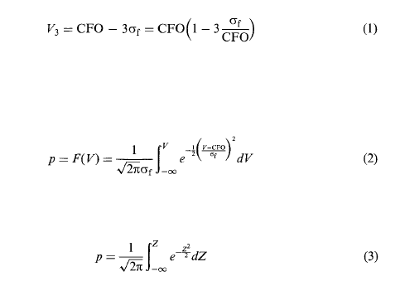
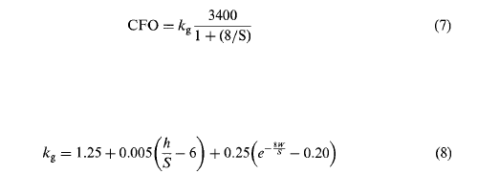
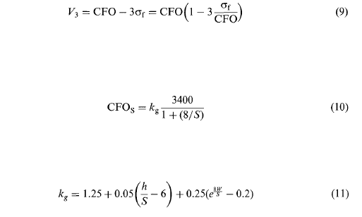
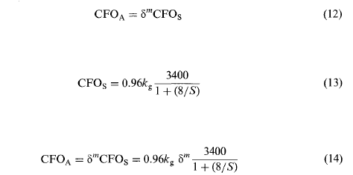
Insulation coordination
BASE FURMOLATION

Slide 29
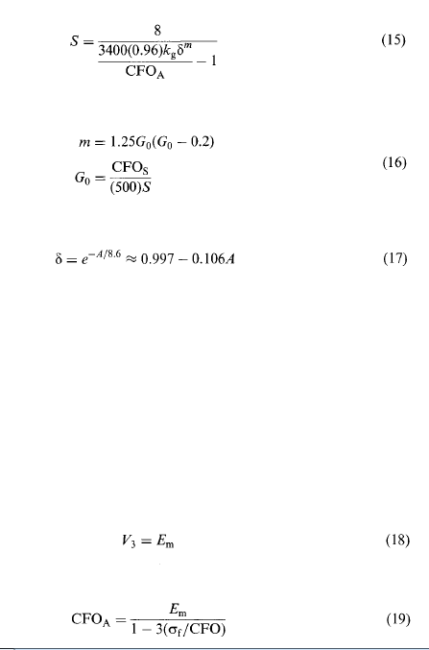


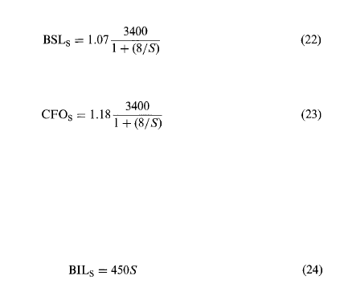
Insulation coordination
BASE FURMOLATION

Slide 30
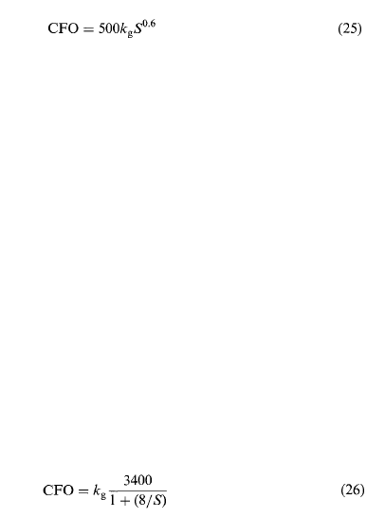
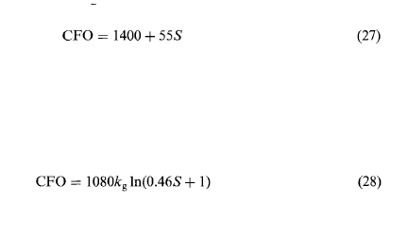
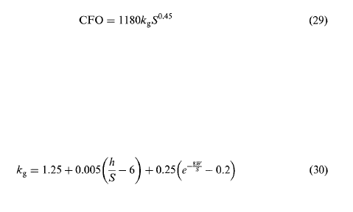

Insulation coordination
BASE FURMOLATION

Slide 31
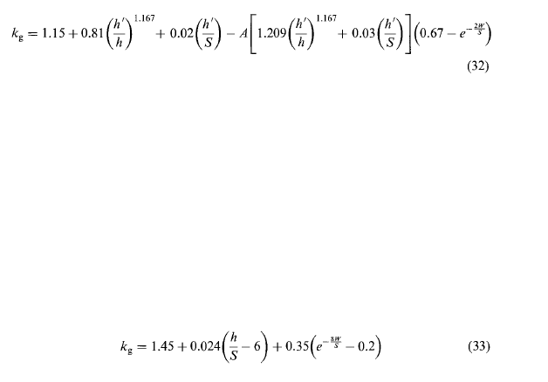
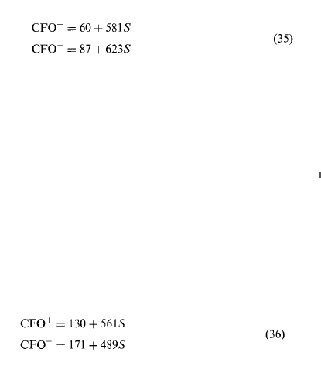
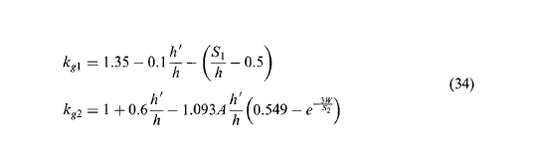

Insulation coordination
BASE FURMOLATION

Slide 32
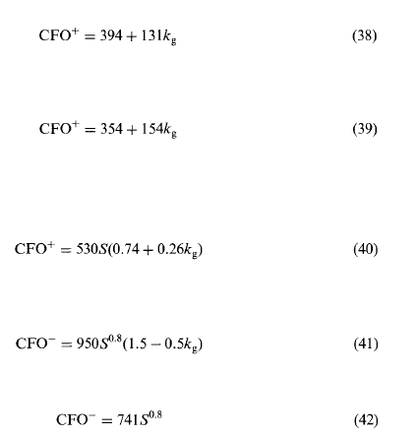

Insulation coordination
BASE FURMOLATION

Slide 33
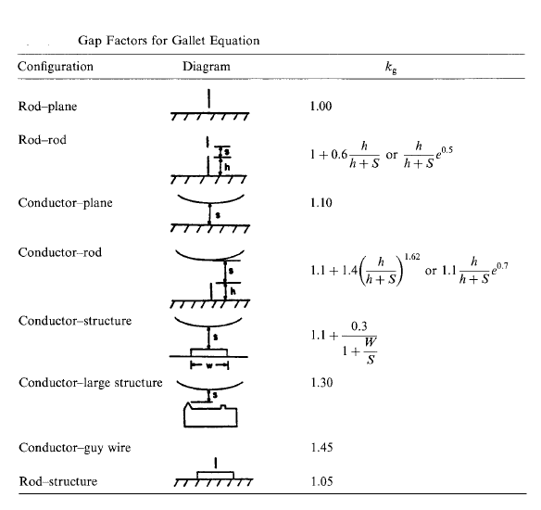
Insulation coordination
BASE FURMOLATION

Slide 34
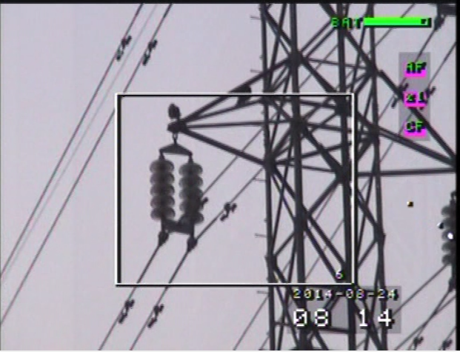
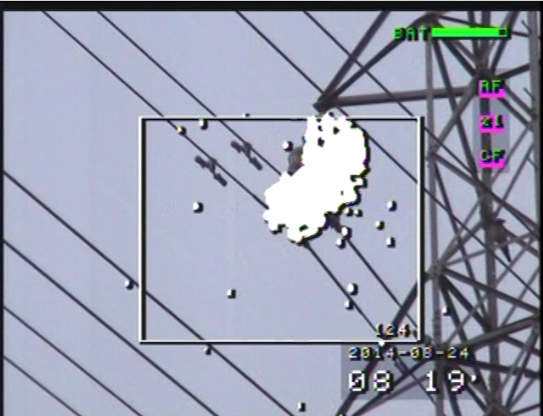
Insulation coordination
constant voltage and temporary
over voltage /pollution condition
pullotion_rate
Height above sea level(m)

Slide 35
Insulation coordination
constant voltage and temporary
over voltage /pollution condition
IEC Standard
MM/KV (KV: PAHSE-PHASE)
16 | LIGHT | 1
20 | NORMAL | 2
25 | HEAVY | 3
31 | VERY HEAVY | 4
>31 | Special | 5
SPS CLASS FOR IRAN
MM/KV (KV: PAHSE-PHASE)
<17.5 | Mountains AREAS | A
17.5-18 | Mountains AREAS | B
18-25 | Other parts of the country | C
25-35 | Desert AND Caspian Sea AREAS | D
>35 | Khuzestan and the Persian Gulf AREAS | E

Slide 36
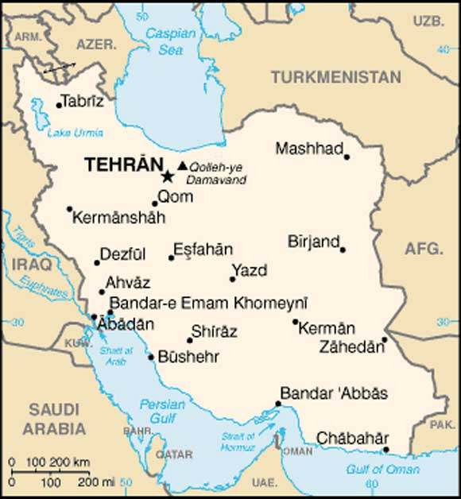
Insulation coordination
constant voltage and temporary
over voltage /pollution condition

Slide 37
Insulation coordination
SWITCHING
The average number of towers along the transmission line:
sigma_f/cfo ( 0.02,0.05,0.07)
accecepted eror in 100 switching
Height above sea level(m)
kind of tower[ Lattice enter,Telescopic]
1.1*creepage distance

Slide 38
Insulation coordination
SWITCHING
kf
0.07 | 0.05 | 0.02 | Ne
0.0700 | 0.8500 | 0.9400 | 1
0.8578 | 0.9009 | 0.9617 | 5
0.8826 | 0.9189 | 0.9691 | 10
0.9057 | 0.9353 | 0.9756 | 20
0.9341 | 0.9553 | 0.9833 | 50
0.9545 | 0.9693 | 0.9887 | 100
0.9742 | 0.9827 | 0.9937 | 200
0.9993 | 0.9996 | 0.9998 | 500
1.0178 | 1.0118 | 1.0042 | 1000
1.0360 | 1.0236 | 1.0084 | 2000

Slide 39
Insulation coordination
SWITCHING
Kg
0.15 | 0.10 | 0.07 | 0.05
0.8181 | 0.8787 | 0.9151 | 0.9394 | 10
0.8841 | 0.9228 | 0.9459 | 0.9614 | 5
1.0000 | 1.0000 | 1.0000 | 1.0000 | 1
1.0409 | 1.0273 | 1.0191 | 1.0136 | 0.5
1.0897 | 1.0598 | 1.0419 | 1.0299 | 0.2
1.1236 | 1.0824 | 1.0577 | 1.0412 | 0.1

Slide 40
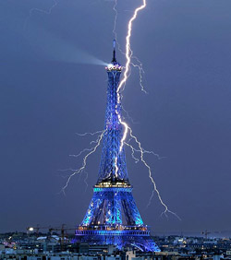
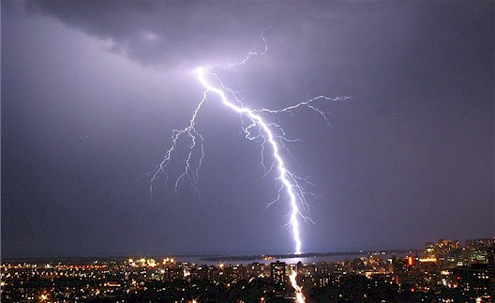
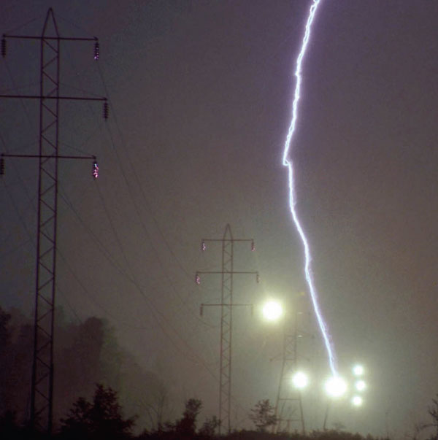
Insulation coordination
The Lightning Flash

Slide 41
Insulation coordination
The Lightning Flash
number of desired outage in per 100km line:
( a) IMPORTANT LINES:.5-1
b)NONIMPORTANT LINES: 3-5
C)63 KV: 1.5-2-3
d)voltages>400KV: <1)
Lightening information : number of days, hours (ISUCRONIC LEVEL)
Line guard tower height(m)
Line gard sag(m):
distance beetwin tow line wire(m):
Voltage correction factor of power line frequency (Kpf:0.83)
Equivalent surge impedance of tower(Zt:10-30)
coopling coefition betwin line gard and conductor phase (C: 0.3)
The correction factor for wave figure(Kwf:1.31)
Height above sea level(m)

Slide 42
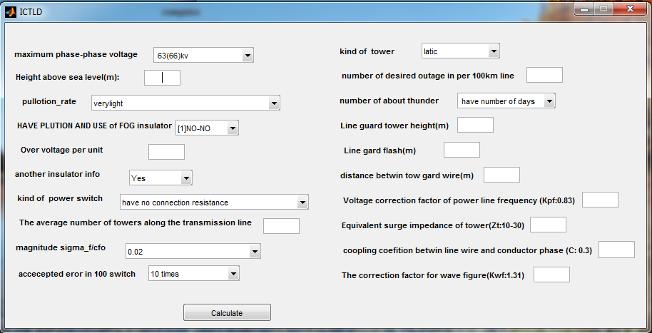
Insulation coordination
SOFTWARE

Slide 43
Insulation coordination
INSULATOR SELECTION
انتخاب مقره
مرحله اول : انتخاب مقره بر اساس معیارهای الکتریکی
مرحله دوم: انتخاب مقره بر اساس معیارهای مکانیکی
مرحله سوم: انتخاب مقره بر اساس معیارهای اقتصادی
مرحله اول : انتخاب مقره بر اساس معیارهای الکتریکی
اضافه ولتاژ داخلی
اضافه ولتاژهای خارجی
حداقل فاصله هوایی مجاز بین هادی فاز و بدنه برج
شرایط محیطی
الودگی هوا
کرونا
مرحله اول : انتخاب مقره بر اساس معیارهای مکانیکی
تحمل نیروی وزن هادی
نیروی وارد بر مقره در اثر زاویه دار بودن خط
نیروی باد
نیروهای ناشی از وزن یخ و برف
تحمل نیروهای غیرطبیعی ناشی از تخلیه ناگهانی برف و یخ از روی هادی
پارگی سیم
شکستن یک زنجیر مقره

Slide 44
Insulation coordination
INSULATOR SELECTION
انتخاب KN مقره:

Slide 45
Insulation coordination
standards
IEC 60071-1, Edition 8.0 (2006-01)
Insulation co-ordination – Part 1: Definitions, principles and rules
IEC 60071-2, Third Edition (1996-12)
Insulation co-ordination – Part 2: Application guide
IEC/TR 60071-4, First Edition (2004-06)
Insulation co-ordination - Part 4: Computational guide to insulation co-ordination and modelling of electrical networks
IEC 60099-4, Ed. 2.1, 2006-07
Surge arresters – Part 4: Metal-oxide surge arresters without gaps for a.c. systems
IEC 60099-5, Ed. 1.1, 2000-03
Surge arresters – Part 5: Selection and application recommendations
DIN EN 60071-1, 1996-07
Isolationskoordination - Teil 1: Begriffe, Grundsätze und Anforderungen (IEC 60071-1:1993); Deutsche Fassung EN 60071-1:1995
DIN EN 60071-2, 1997-09
Isolationskoordination - Teil 2: Anwendungsrichtlinie (IEC 60071-2:1996); Deutsche Fassung EN 60071-2:1997
IEEE 1313.1-1996
IEEE Standard for Insulation Coordination—Definitions, Principles, and Rules

Slide 46
Insulation coordination
standards
IEEE 1313.2-1999
IEEE Guide for the Application of Insulation Coordination
IEEE C62.11-2005
IEEE Standard for Metal-Oxide Surge Arresters for AC Power Circuits (> 1 kV)
IEEE C62.22-1997
IEEE Guide for the Application of Metal-Oxide Surge Arresters for Alternating-Current Systems

Slide 47
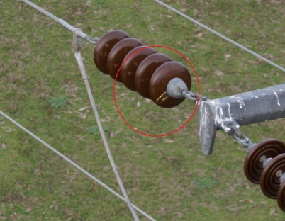
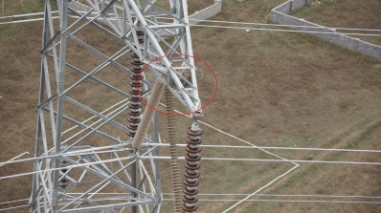
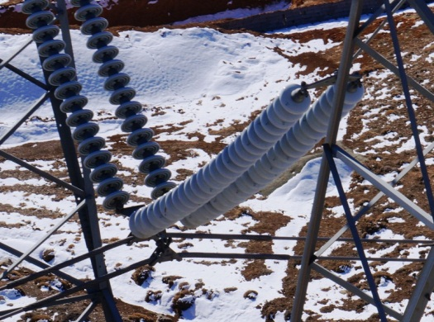
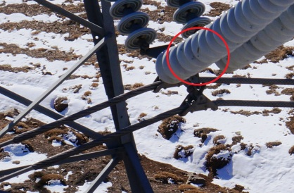
problem discussion
1) 63 KV
PROBLEM by climate changing and ..
2) 230 KV
3) 400 KV

Slide 48
problem discussion
روش قدیم در نحوه محاسبات
مثلا خط...
محاسبات جدید
The number of outages Mazandaran from 230 to ....

Slide 49
problem discussion
According to the simulation results and climate change in recent years
1) CREEPAGE DISTANCE
2) NUMBER OF Insulators
3) Quality Insulators
4) Insulators SHAPES
5) INSULATORS KIND (Composite-Ceramic-GLASS)
6) Insulators chain length
7) Issue OF Right operation
8) TOWER SHAPE

Slide 50
Review on insulation coordination
Voltages: 63 kV
1/Very Light
Creepage distance:
Number of insulation:
2/Light
3/Medium
4/Heavy
5/Very Heavy

Slide 51
Review on insulation coordination
Voltages: 130 kV

Slide 52
Review on insulation coordination
Voltages: 230 kV

Slide 53
Review on insulation coordination
Voltages: 400 kV

Slide 54
Conclusion

Slide 55
REFRENCES
Mazandaran Regional Electric Company (MREC), Department operation and Development of transmission network
Insulation coordination for power systems, Andrew R Hileman
Overhead power lines, planning, design and construction, springer, 2002
Transmission line reference book (345 kv and above), second edition, electrical power research institute, 1982
EPRI ac Transmission line reference book -200 kv and above, third edition, EPRI, 2005
Transmission and distribution electrical engineering, third edition, colin bayliss and brain hardy, 2007
Power Transmission and distribution, second edition, Anthony j .pansini, 2004
Electrical Transmission and distribution reference book , ABB power T&D company Inc, 1997

Slide 56
THE END

