Slide 1
Internship visit presentation
Vladislav Serafimov

Slide 2
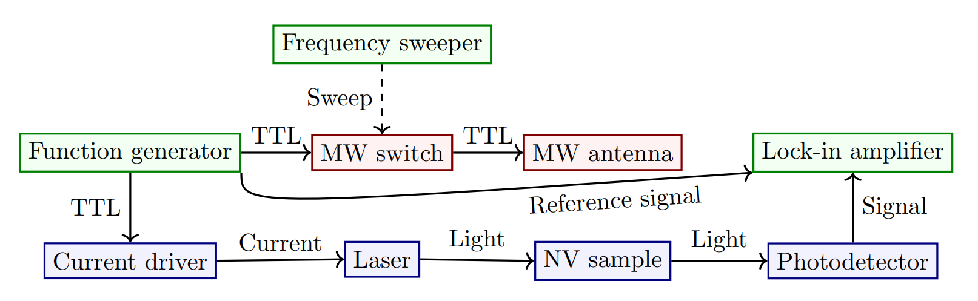
Setup

Slide 3
MoSCoW
Must have
Hardware platform for photodetection
Software for signal processing and visualization
Should have
Tests with different diamond samples
Could have
Tests with different quantum protocols
OLIA implementation
Tests comparing OLIA to market solutions
Will not have
Laser as a part of the hardware platform
Driver upgrade

Slide 4
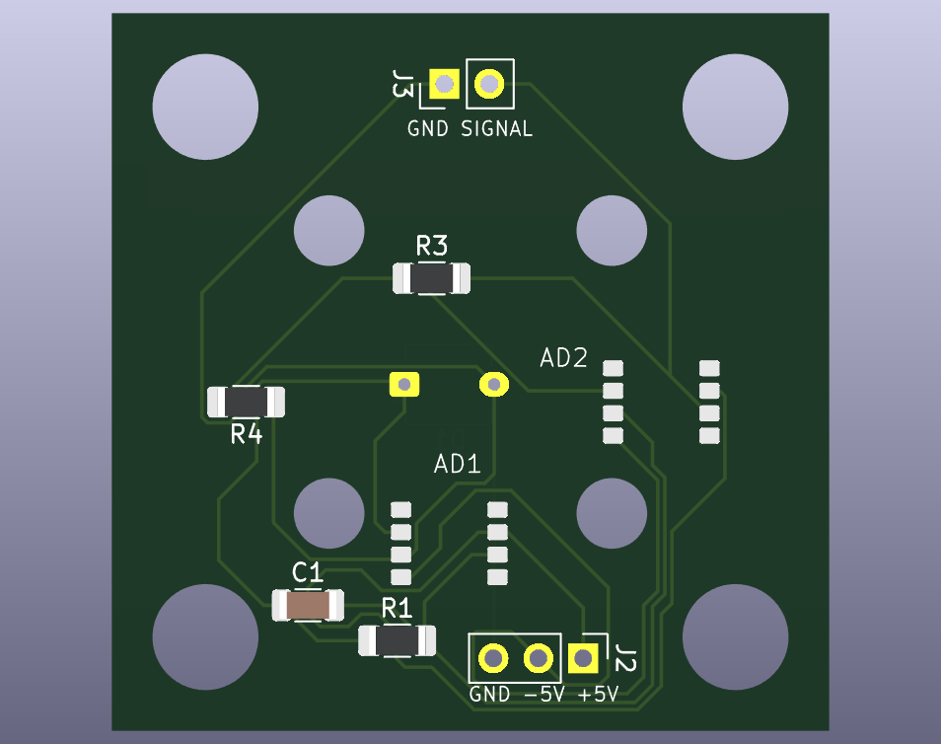
Progress
Photodetection PCB design and implementation
TTL generation script
Sensing setup functionality testing
Driver tests
Lock-in tests

Slide 5
To do
Photodetection PCB testing
Sensing setup integration testing (running protocols)
OLIA (?)

