Slide 1
Enabling photodetection for quantum sensing
Vladislav Serafimov

Slide 2
Agenda
Background
Methodology and planning
Implementation
Test setup and performance metrics
Results
Conclusion
Demo (possibly)
Assignment
2

Slide 3
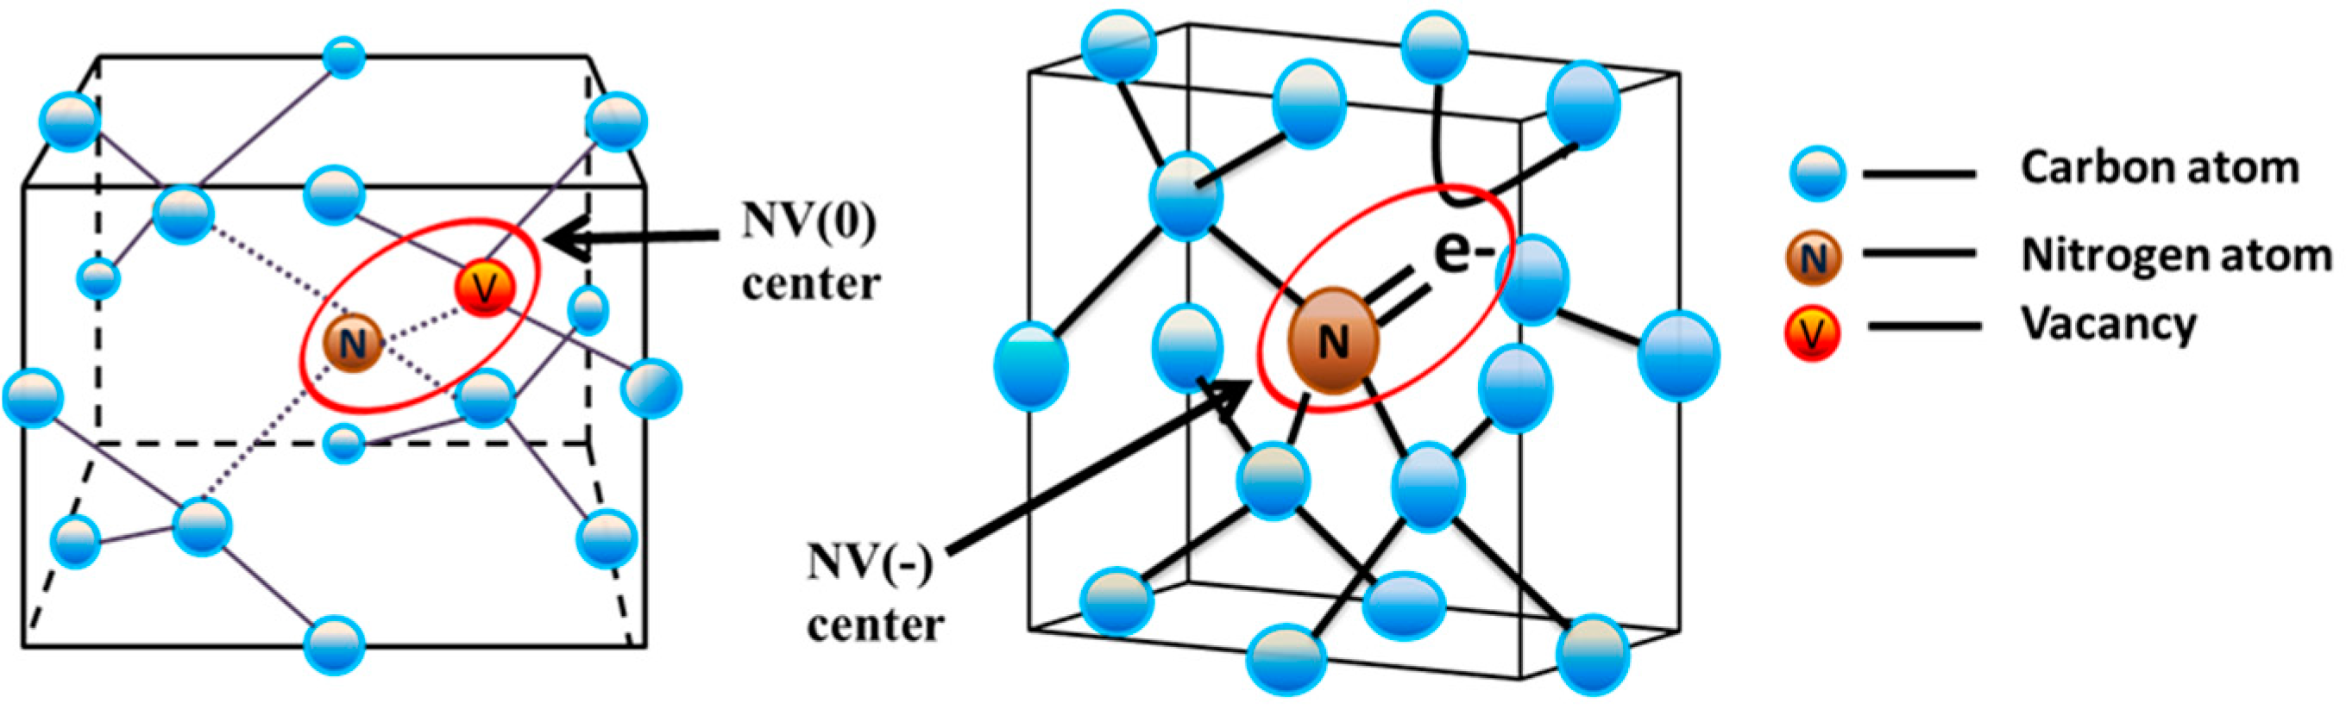
Nitrogen Vacancy (NV) centers
Image credit: https://doi.org/10.3390/jmmp1010006
Notes:
Say NV centers are photoluminescent imperfections in diamonds, which means they emit light.

Slide 4
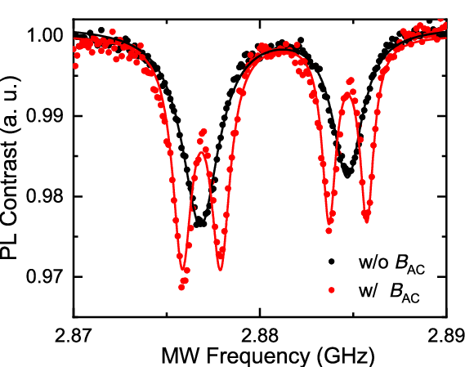
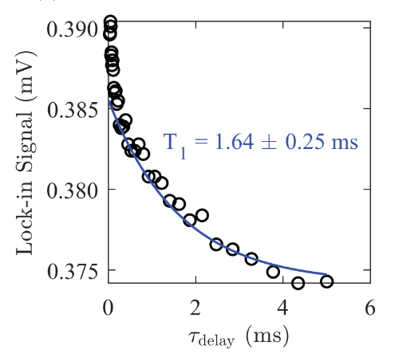
Quantum protocols
Image credit: 10.35848/1347-4065/abc399
CW-ODMR
T₁ measurements
P-ODMR
  Rabi oscillations
  Hahn echo
  Ramsey interferometry
Image credit: https://doi.org/10.1119/10.0001905
Notes:
Explain how CW-ODMR and T1 relate to photodetection (pulsed vs CW). Mention Rabi is the future goal of the setup

Slide 5
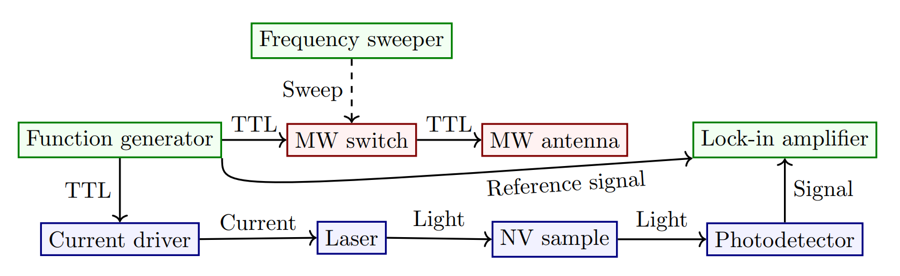
Quantum sensing setup
Notes:
Say project was originally supposed to be mostly about integrating the blue blocks with the lock-in amplifier, but after the midterm company visit the project has been mostly about the photodetector

Slide 6
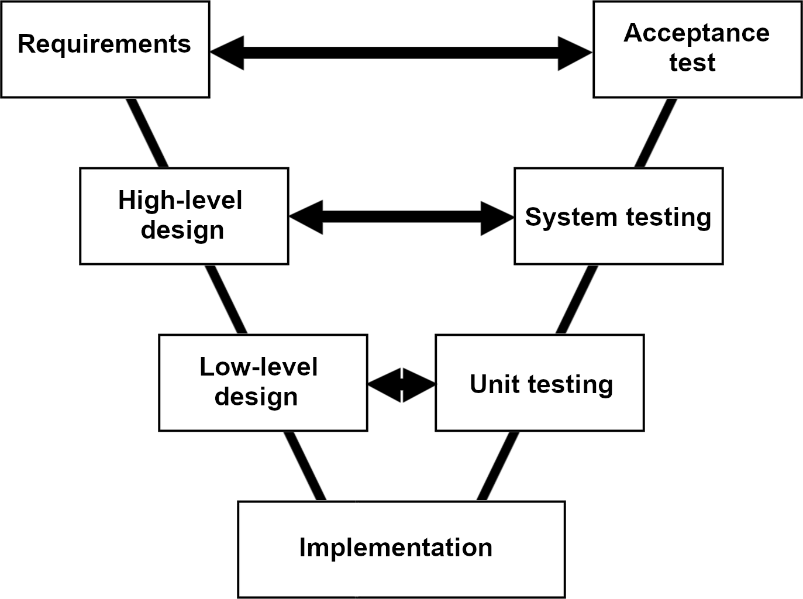
Methodology
1. Must have
Hardware platform for photodetection
Software for signal processing and visualization
Setup integration
2. Should have
Tests with different quantum protocols
Tests with different diamond samples
Notes:
Used V-Model. Say MoSCoW goals are still ongoing because the setup hasn’t been fully integrated yet

Slide 7
Photodetector design

Slide 8
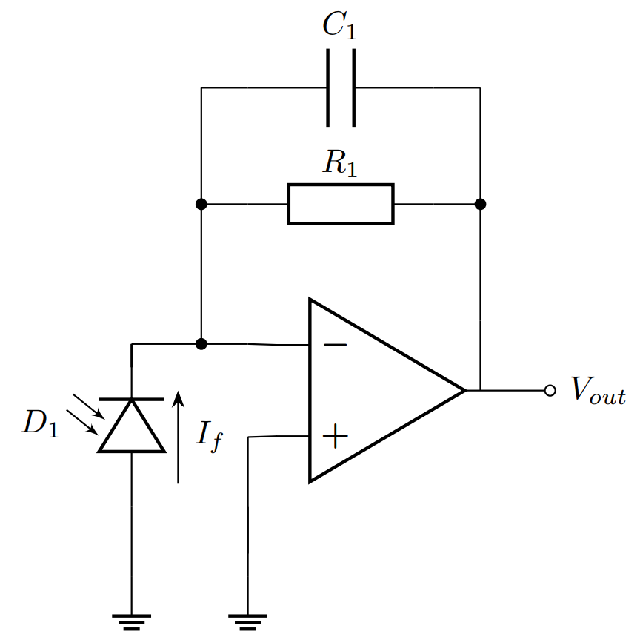
Transimpedance Amplifier (TIA)
Current to voltage conversion
Gain-setting resistor R₁
Compensation capacitor C₁
Photodiode D₁
Notes:
Explain the importance of R1 and C1

Slide 9
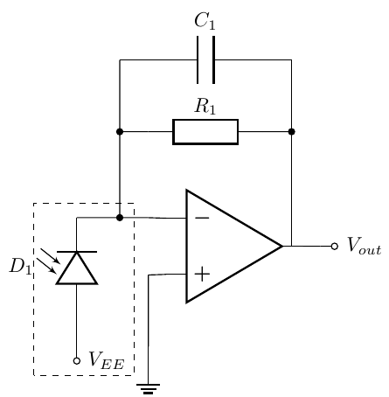
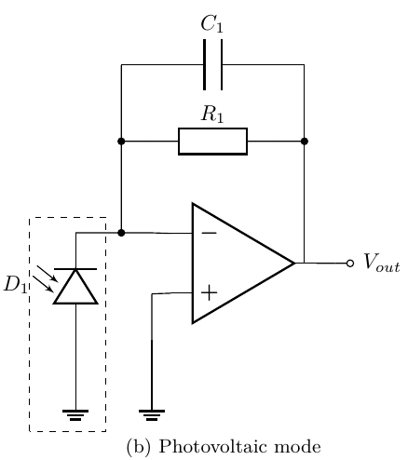
Photodiode biasing
Photoconductive mode
  High bandwidth
  High photocurrent
  High dark current
Photovoltaic mode
  Medium bandwidth
  Low photocurrent
  Low to no dark current
Notes:
Explain why photovoltaic mode was chosen

Slide 10
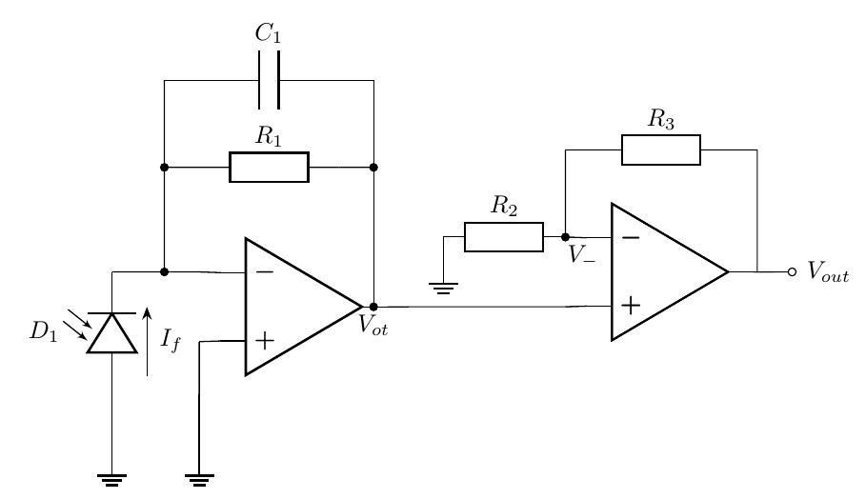
Post amplification
Notes:
Say this was the original topology that was provided and several others were considered (e.g. inverting with input resistor/capacitor), but there was not enough literature on them

Slide 11
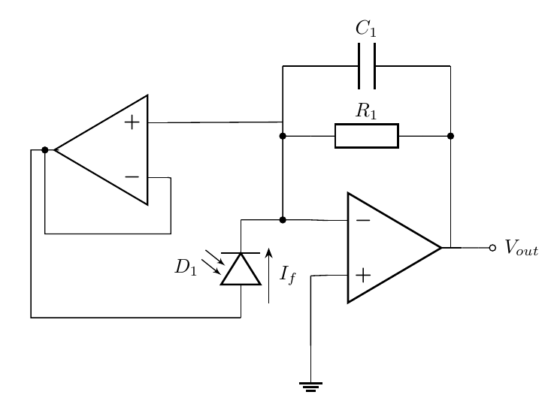
TIA bandwidth increase
Notes:
Explain that C1 reduces the bandwidth and the bootstrap buffer reduces the need for C1, thus increasing the bandwidth

Slide 12
Photodetector simulations
Notes:
Explain graphs

Slide 13
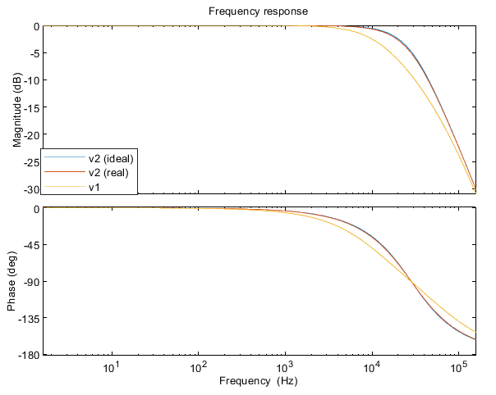
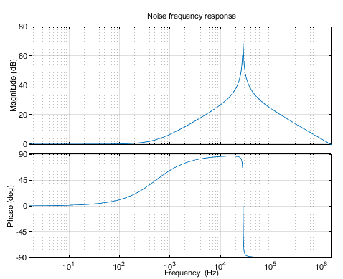
CW-ODMR TIA

Slide 14
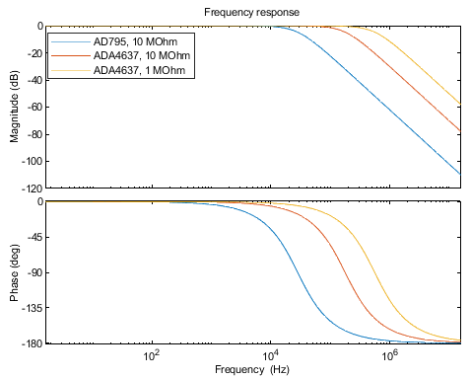
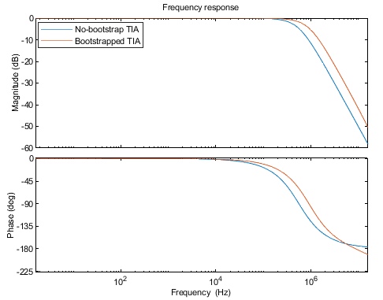
T₁ TIA

Slide 15
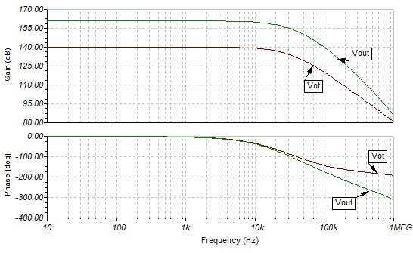
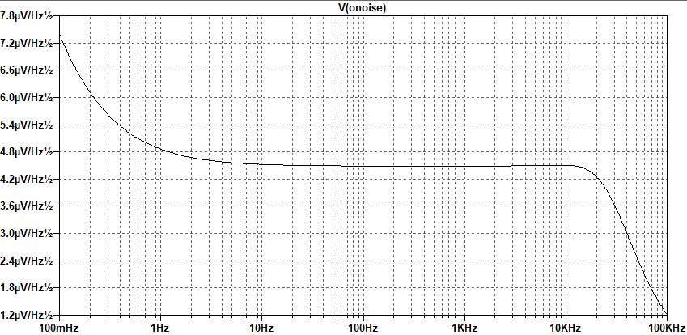
CW-ODMR detector

Slide 16
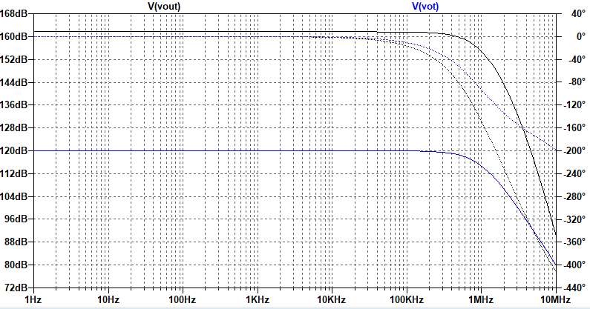
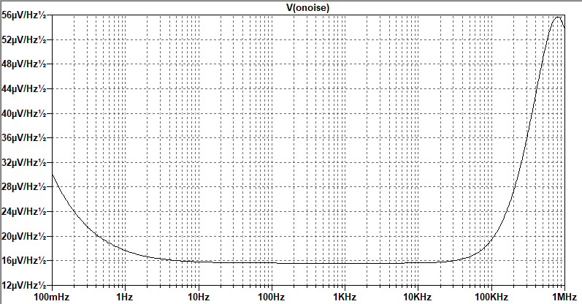
T₁ detector

Slide 17
Comparison
Version | TIA f_{c} (kHz) | TIA gain (dB) | Post amplifier | Noise at 1Hz (µV/√Hz)
T₁ | 724,69 | 120 | Non-inverting | 17,6
CW-ODMR | 21,167 | 140 | Non-inverting, cascaded | 4,8
Notes:
Compare T1 and CW-ODMR detectors

Slide 18
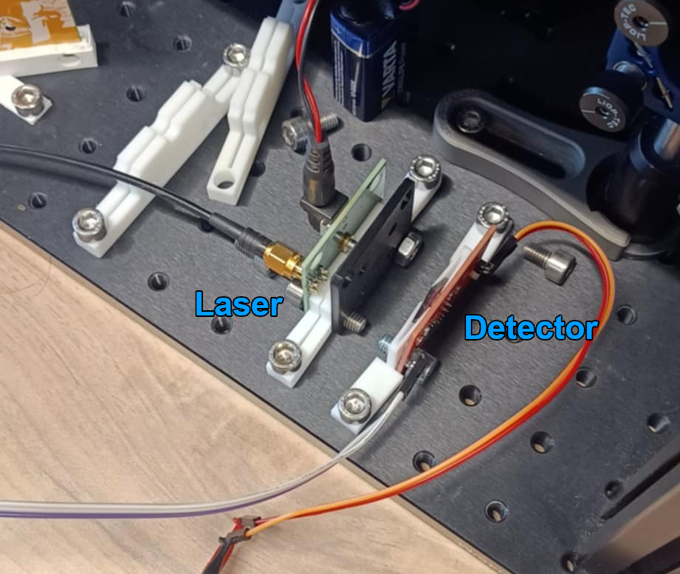
Integration test
Pulse laser at different frequencies
Adjust laser for optimal intensity
Compare detector output to square wave

Slide 19
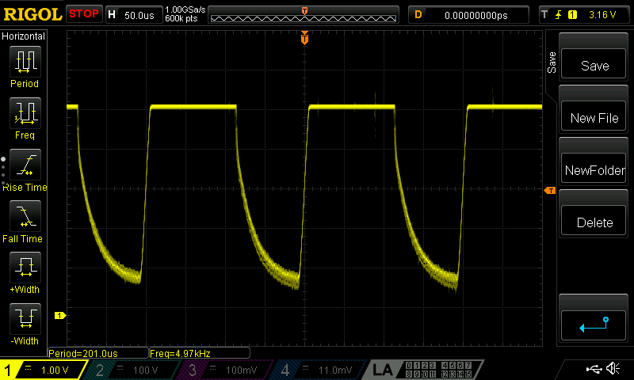
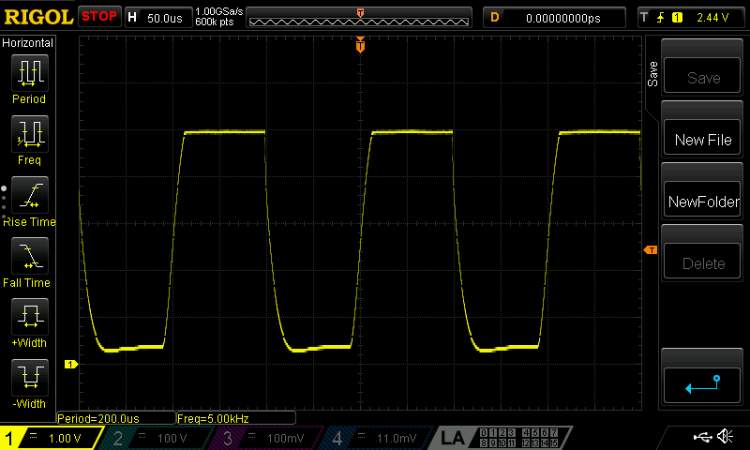
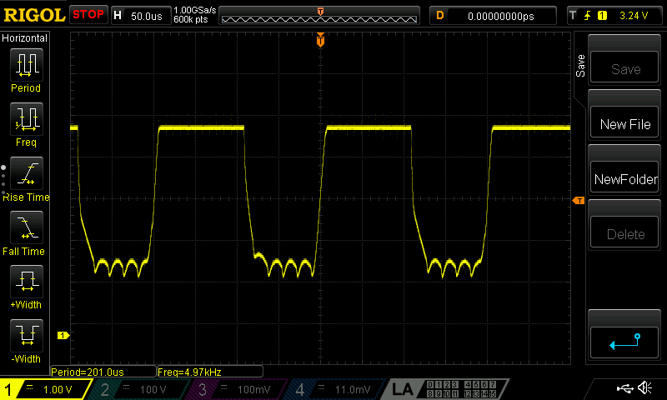
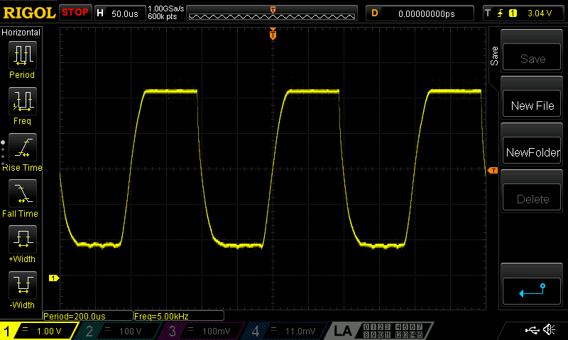

Slide 20
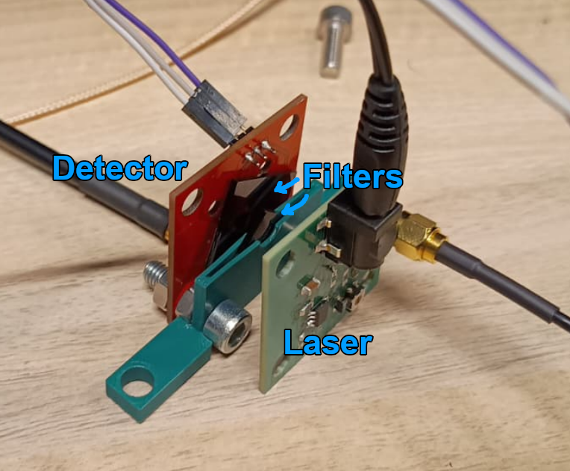
Filtering test
Place laser like in a compact setup
Pulse laser at a fixed frequency
Change number of filters
Observe effect of filtering

Slide 21
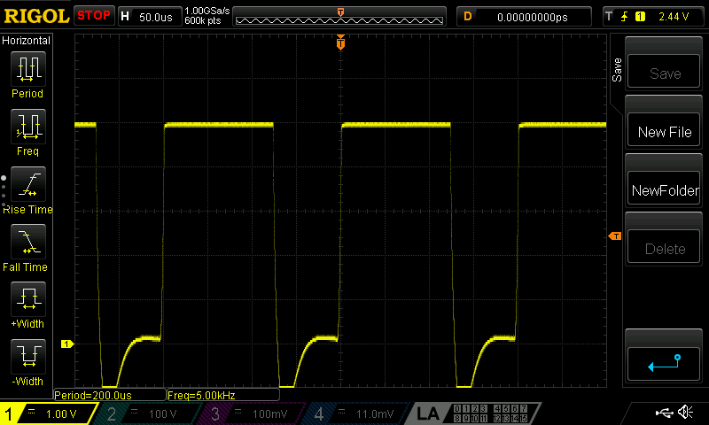
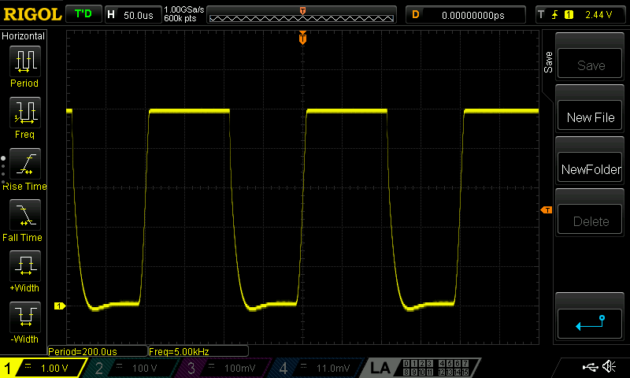
No filter, low intensity
1 filter
2 filters

Slide 22
Conclusion
CW-ODMR detector works as intended
Bandwidth is insufficient for Rabi oscillations
Setup needs good filtering

Slide 23
Recommendations
Consider replacing diode
Increase bandwidth to detect Rabi oscillations
Filter out the laser better
Notes:
Replacing diode with another PIN diode, which is less sensitive to green, will result in less laser light present in the readings. Increasing the bandwidth can be done by changing

