Slide 1
Enabling photodetection for quantum sensing
Vladislav Serafimov

Slide 2
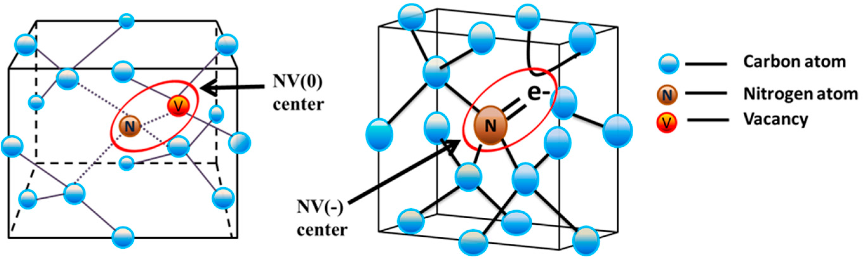
Nitrogen Vacancy (NV) centers
Image credit: https://doi.org/10.3390/jmmp1010006
Notes:
Say NV centers are photoluminescent imperfections in diamonds, which means they emit light.

Slide 3
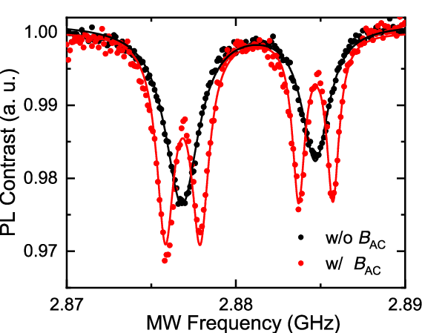
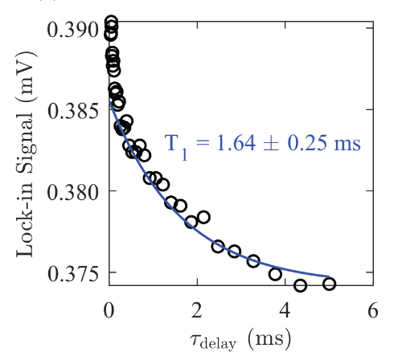
Quantum protocols
Image credit: 10.35848/1347-4065/abc399
CW-ODMR
T₁ measurements
P-ODMR
  Rabi oscillations
  Hahn echo
  Ramsey interferometry
Image credit: https://doi.org/10.1119/10.0001905
Notes:
Explain how CW-ODMR and T1 relate to photodetection (pulsed vs CW). Mention Rabi is the future goal of the setup

Slide 4
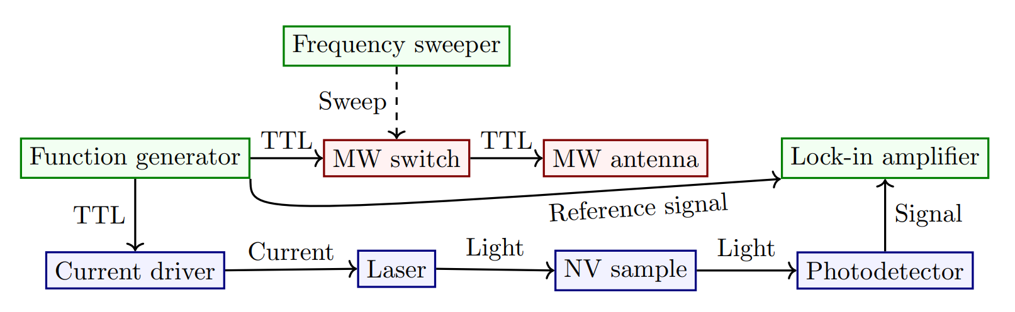
Quantum sensing setup
Notes:
Say project was originally supposed to be mostly about integrating the blue blocks with the lock-in amplifier, but after the midterm company visit the project has been mostly about the photodetector

Slide 5
Photodetector design

Slide 6
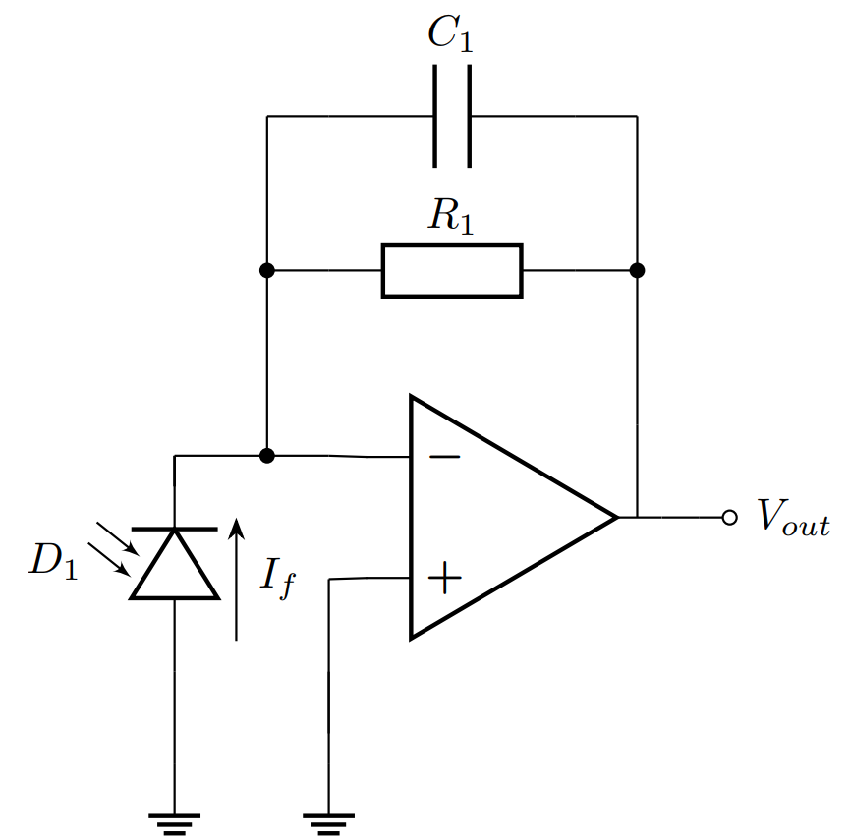
Transimpedance Amplifier (TIA)
Current to voltage conversion
Photodiode D₁
Gain-setting resistor R₁
Compensation capacitor C₁
Notes:
Explain the importance of R1 and C1

Slide 7
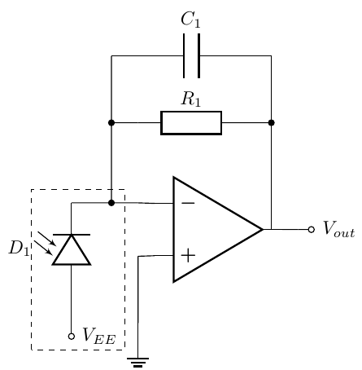
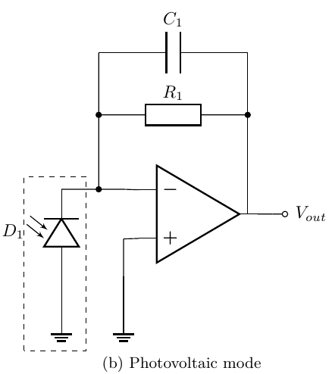
Photodiode biasing
PC
PV
Photoconductive (PC) mode
  High bandwidth
  High photocurrent
  High dark current
Photovoltaic (PV) mode
  Medium bandwidth
  Low photocurrent
  Low to no dark current
Notes:
Explain why photovoltaic mode was chosen

Slide 8
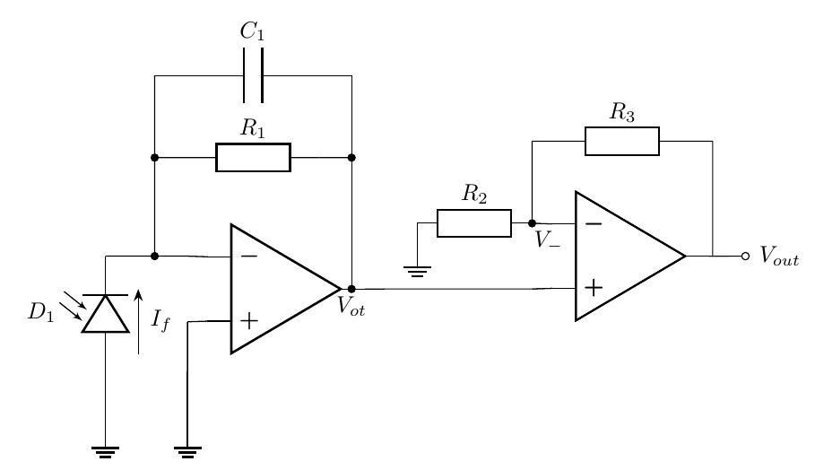
Post amplification
Notes:
Say this was the original topology that was provided and several others were considered (e.g. inverting with input resistor/capacitor), but there was not enough literature on them

Slide 9
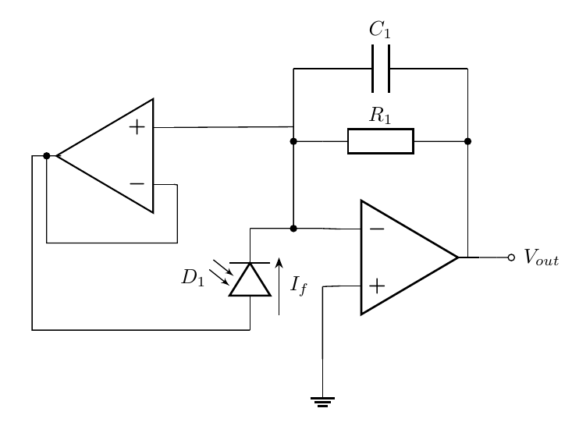
TIA bandwidth increase
Notes:
Explain that C1 reduces the bandwidth and the bootstrap buffer reduces the need for C1, thus increasing the bandwidth

Slide 10
Photodetector simulations
Notes:
Explain graphs

Slide 11
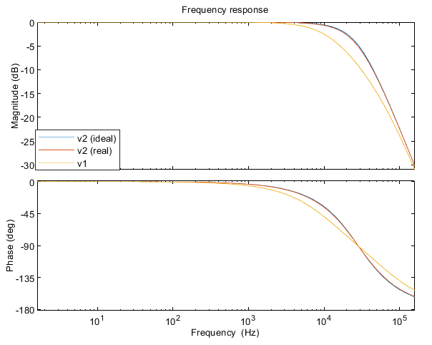
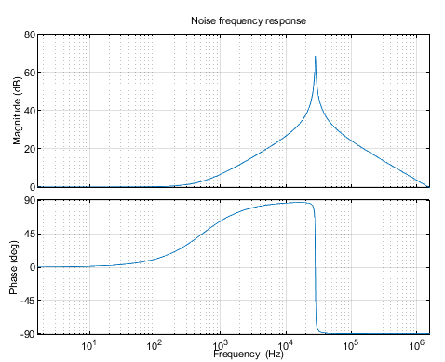
CW-ODMR TIA

Slide 12
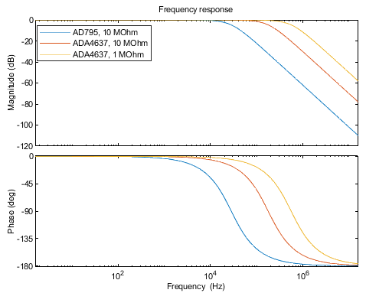
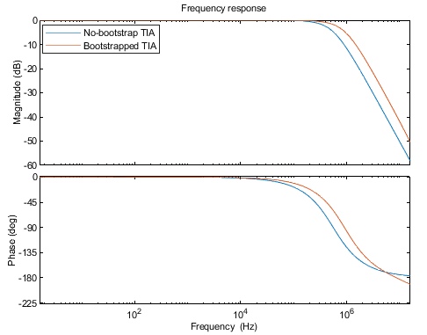
T₁ TIA

Slide 13
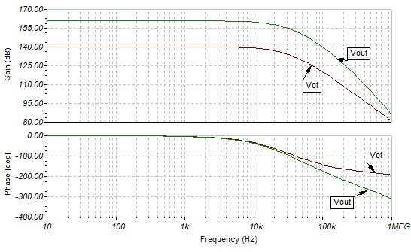
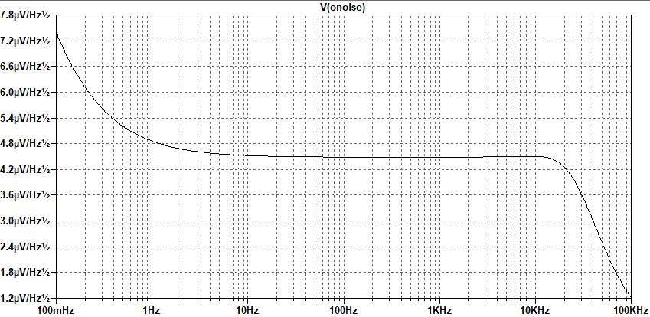
CW-ODMR detector

Slide 14
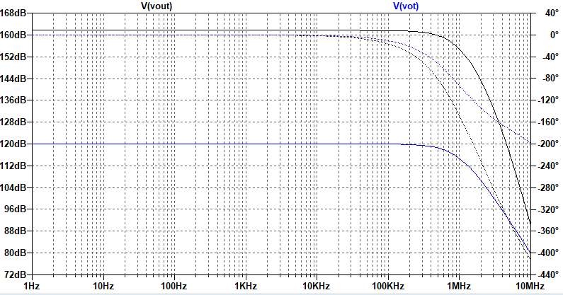
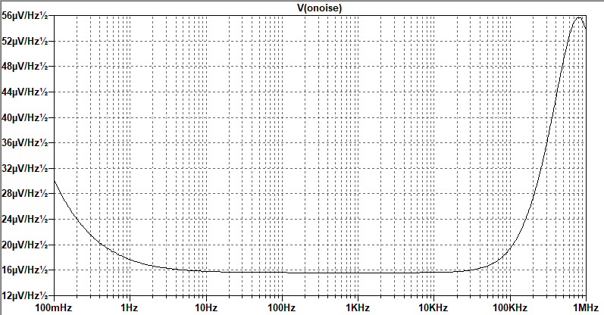
T₁ detector

Slide 15
Comparison
Version | TIA f_{c} (kHz) | TIA gain (dB) | Post amplifier | Noise at 1Hz (µV/√Hz)
T₁ | 724,69 | 120 | Non-inverting, cascaded | 17,6
CW-ODMR | 21,167 | 140 | Non-inverting | 4,8
Notes:
Compare T1 and CW-ODMR detectors

Slide 16
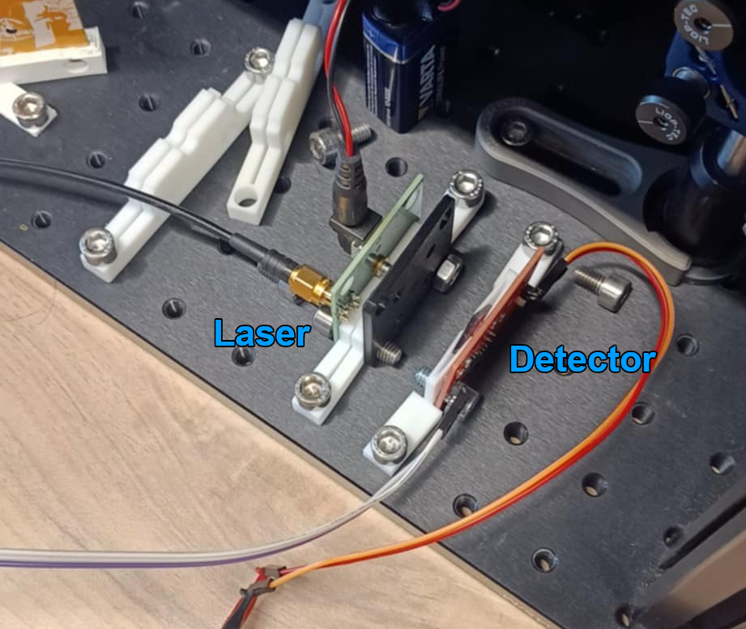
Integration test
Pulse laser at different frequencies
Adjust laser for optimal intensity
Compare detector output to square wave

Slide 17
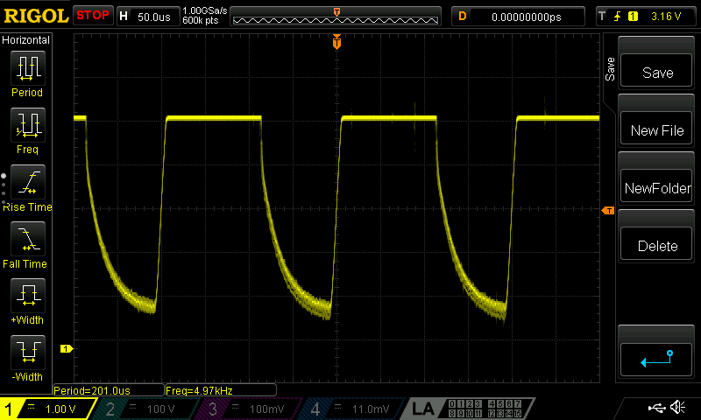
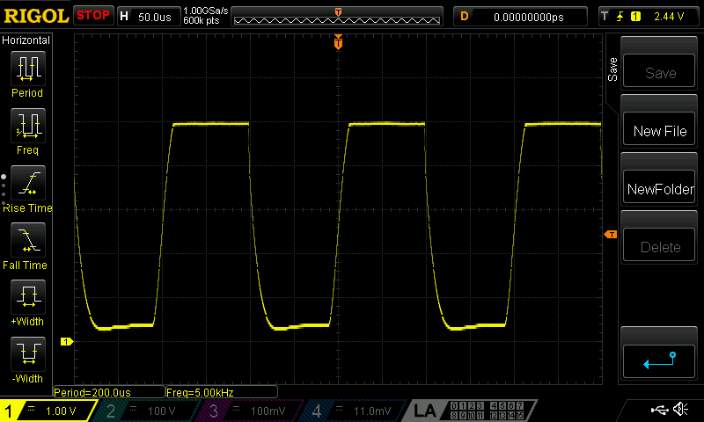
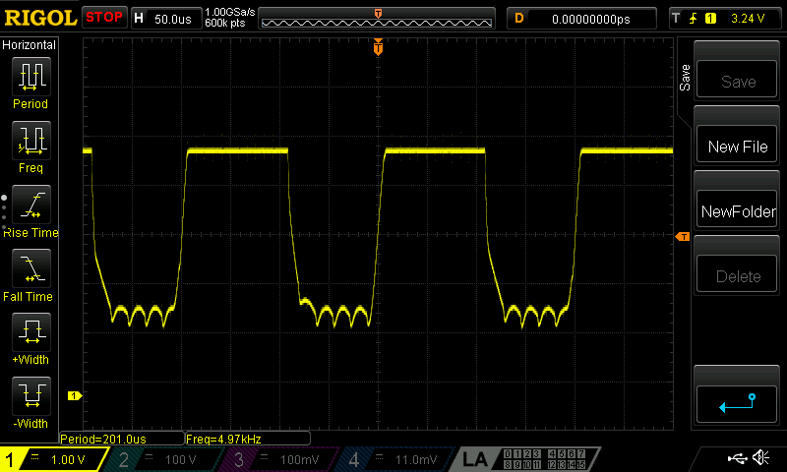
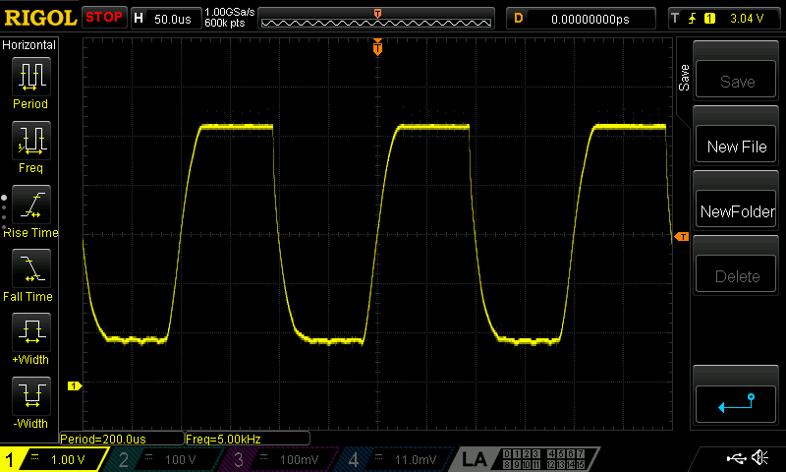

Slide 18
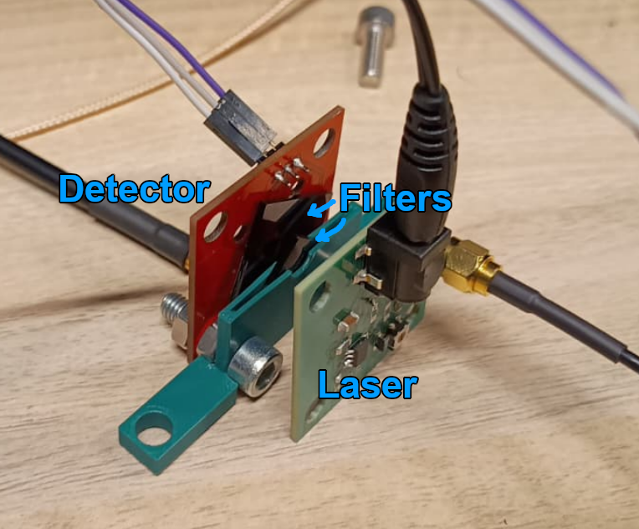
Filtering test
Place laser like in a compact setup
Pulse laser at a fixed frequency
Change number of filters
Observe effect of filtering

Slide 19
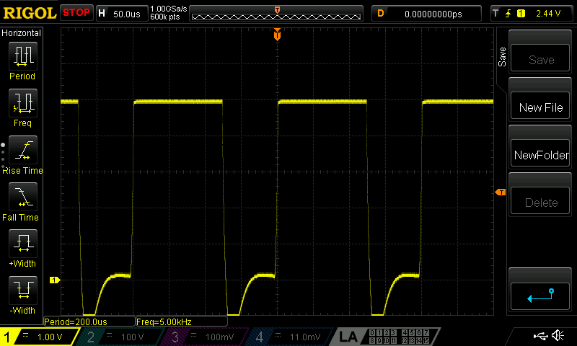
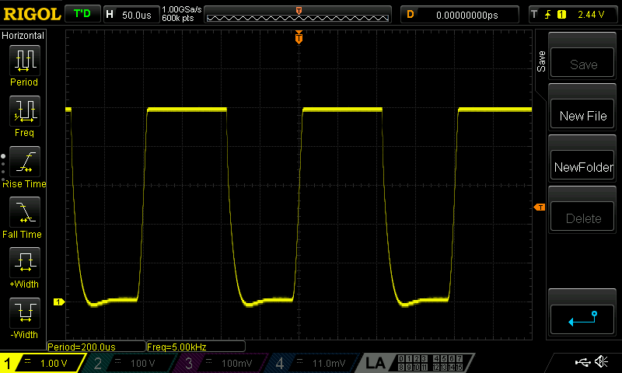
No filter, low intensity
1 filter
2 filters

Slide 20
Conclusion
CW-ODMR detector works as intended
Bandwidth is insufficient for Rabi oscillations
Setup needs good filtering

