Slide 1
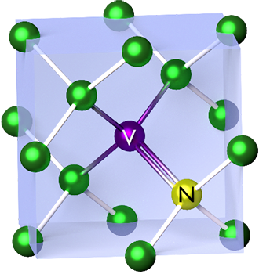

Vladislav Serafimov
509761@student.saxion.nl
Enabling photodetection electronics for
fluorescent diamond-based quantum sensing
Sensing using imperfections in diamonds
Tasks:
Design and build photodetection setup
Test and optimize lock-in amplification
Write code to process and visualize signals
Start date: September 1st
End date: February 1st

