Slide 1
Go/no-go visit presentation
Vladislav Serafimov

Slide 2
Agenda
Background
Methodology and planning
Assignment
Implementation
Test setup and performance metrics
Results
Conclusion
Demo
2

Slide 3
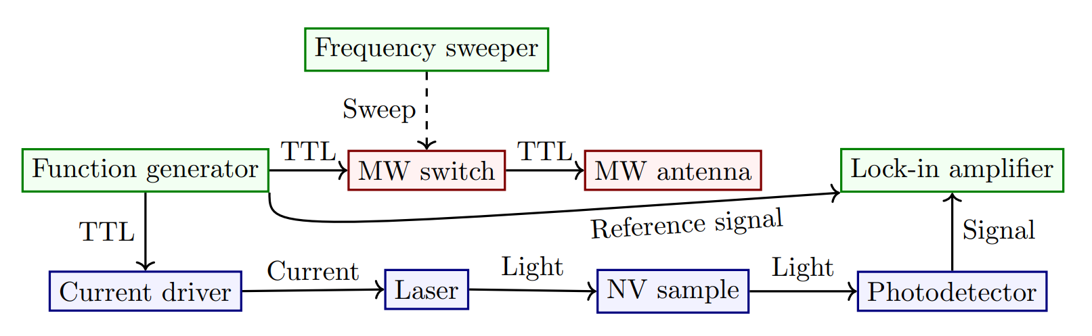
Quantum sensing setup

Slide 4
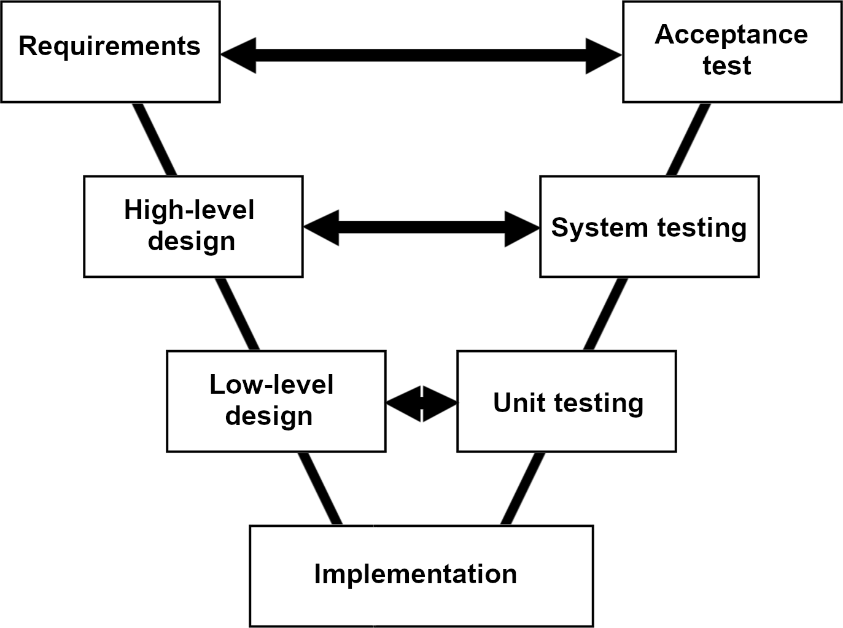
Methodology
1. Must have
Hardware platform for photodetection
Software for signal processing and visualization
Setup integration
2. Should have
Tests with different quantum protocols
Tests with different diamond samples

Slide 5
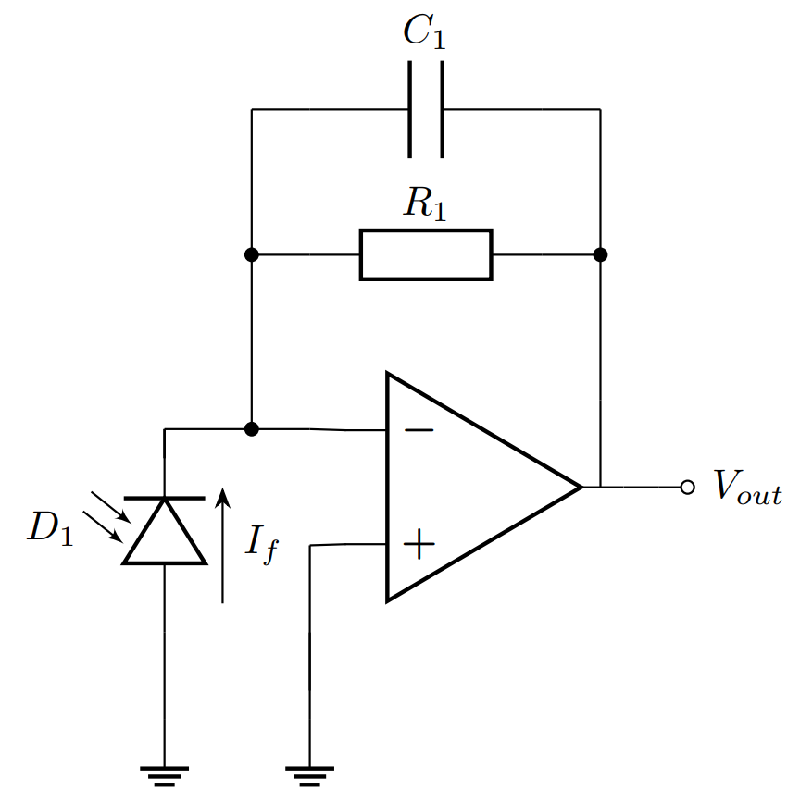
Photodetector design
Version 1: Original (provided by client)
Version 2: Better frequency response
Version 3: Better power delivery
Version 4: Pulsed protocol support

Slide 6
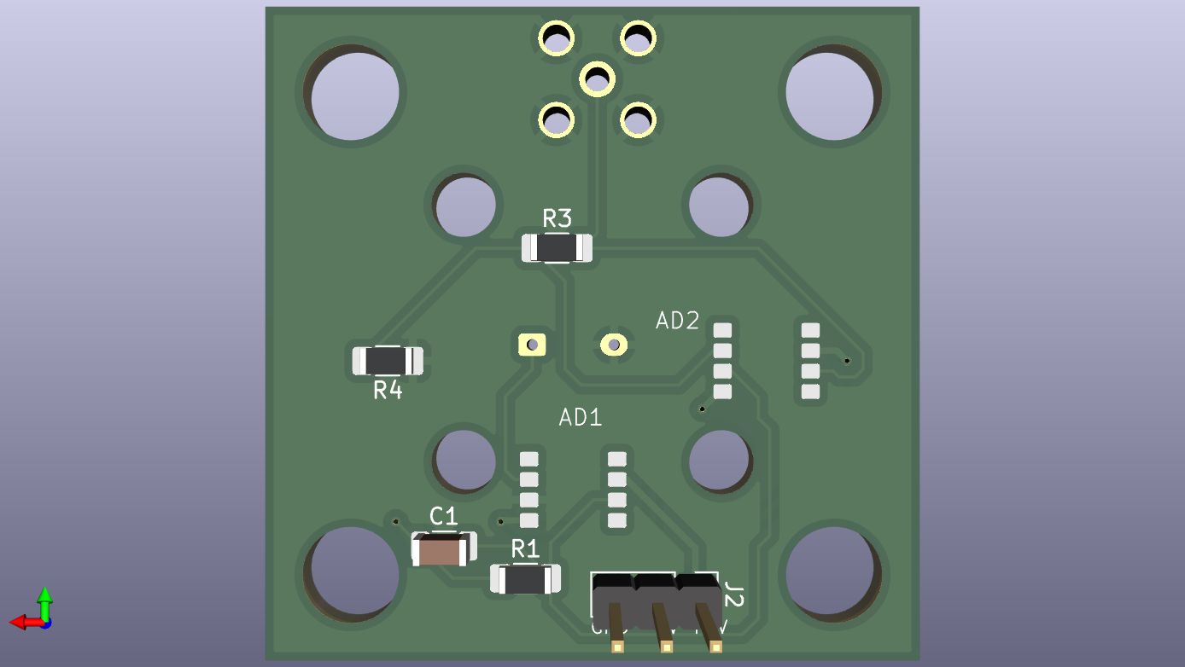
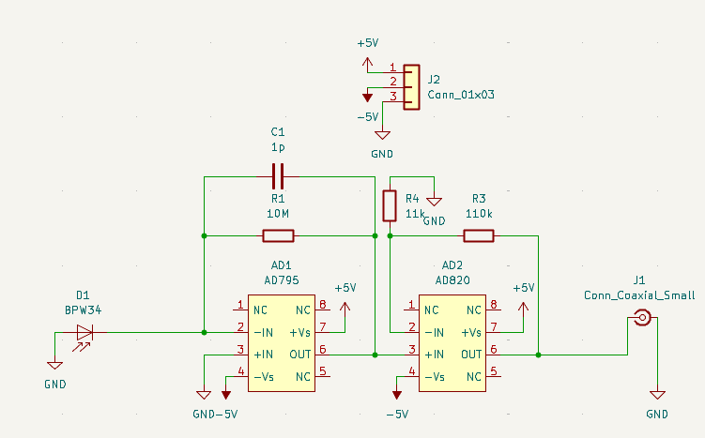
Photodetector implementation:
Version 2

Slide 7
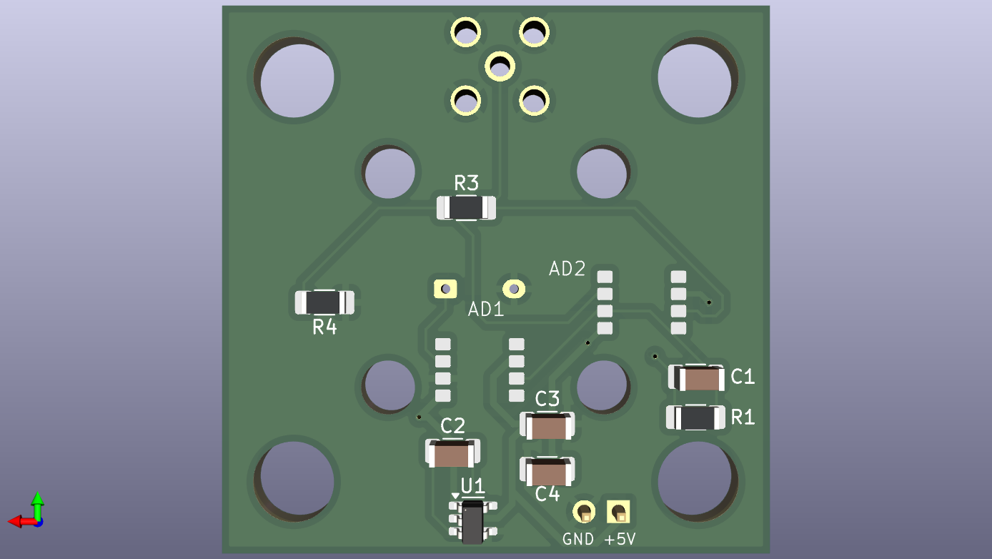
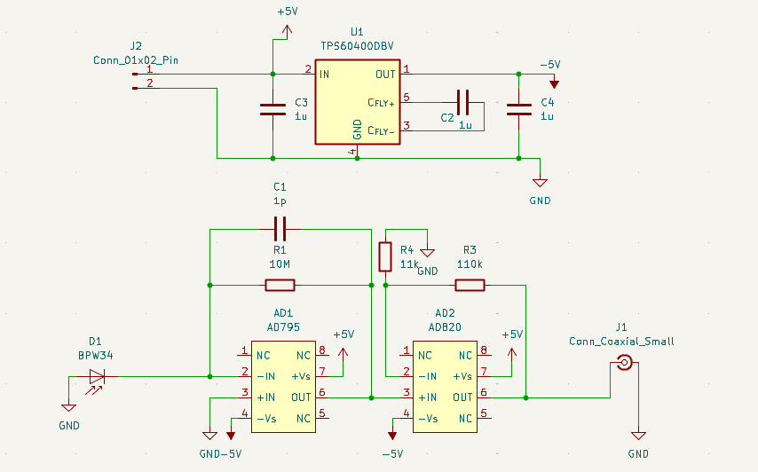
Photodetector implementation:
Version 3

Slide 8
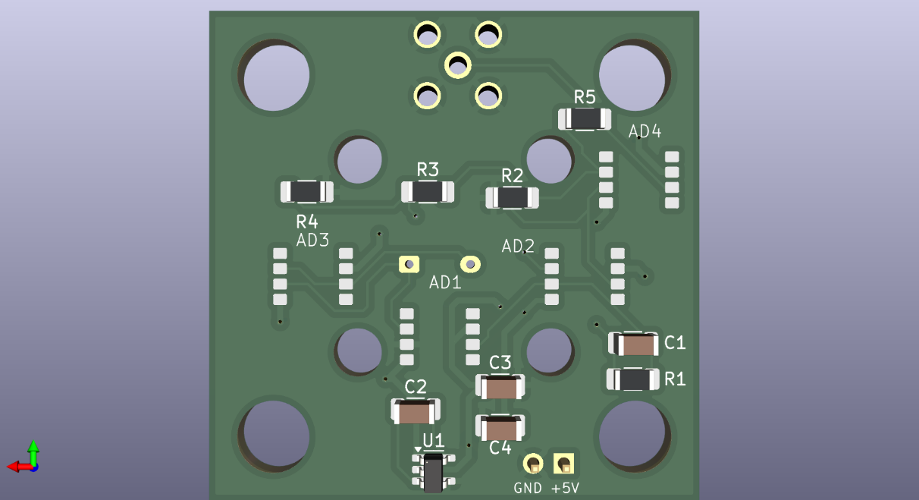
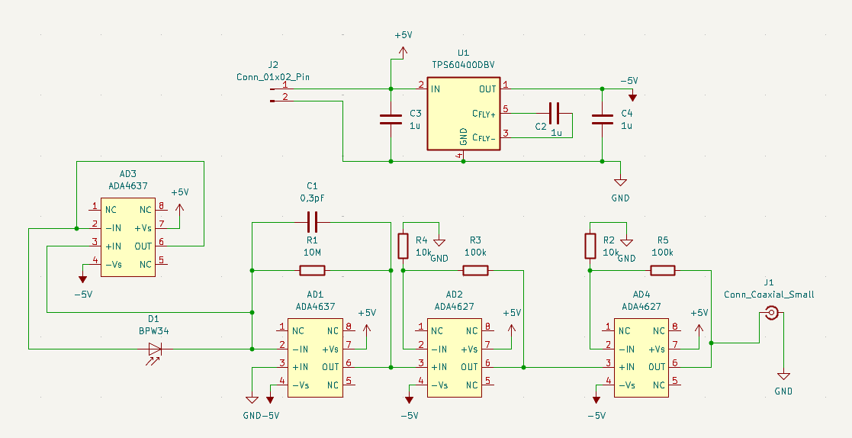
Photodetector implementation:
Version 4

Slide 9
Integration test:
Version 1

Slide 10
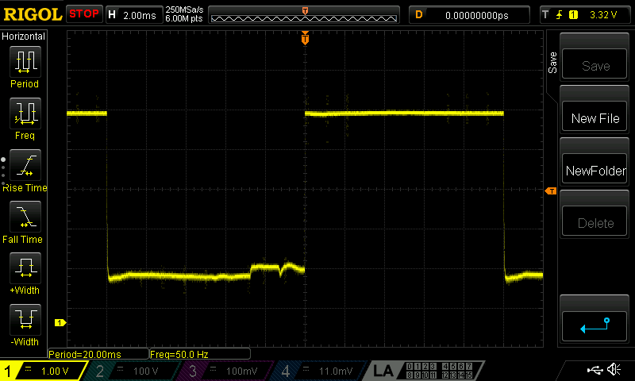
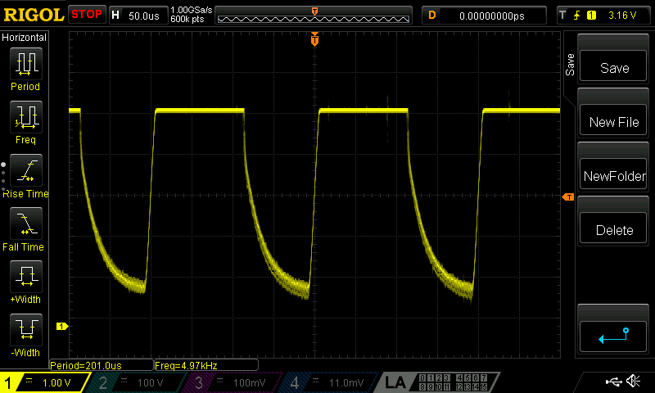
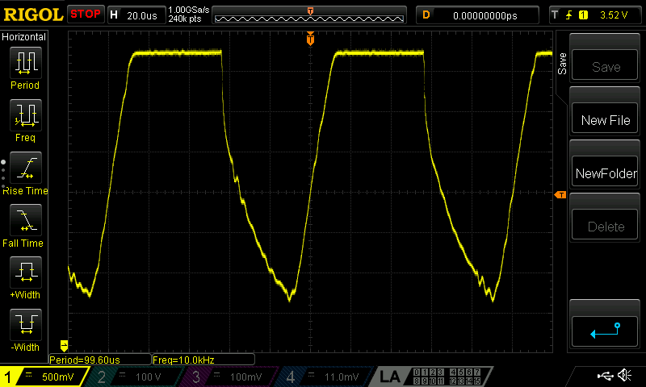
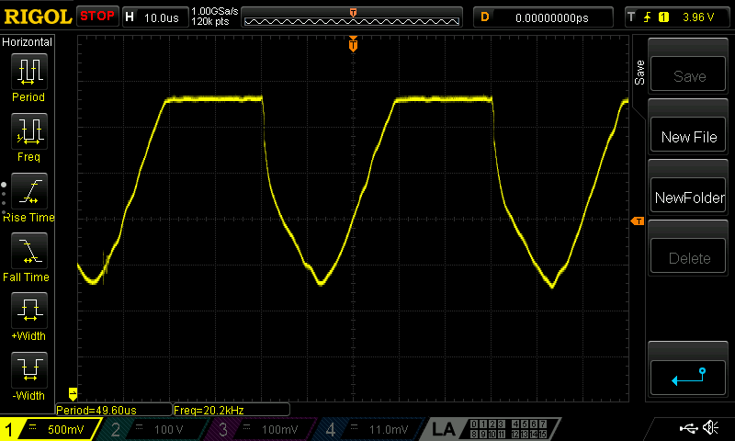

Slide 11
To do
Finish integration tests
Do diode model tests
(if possible) Do S-parameter tests

