Slide 1
Bus reservation
Name: Jaba christen. R
Reg No:620221104314
College no:6202
College name: Annai mathammal sheela Engineering college
Enter a value: 50The sum is 55
Bus Reservation System is a tool that allows users to book tickets for their journey in advance. It offers multiple features to provide a hassle-free experience to a traveller. This article aims at building a rudimentary Bus Reservation System.
Bus reservation system, also known as transportation reservation system, and the primary objectives: Smooth The User Experience. Faster Online Ticket Booking. Multi Payment Gateway. Store Users Information (Last Drop, Last Trip, Address, Contact No, Scheduled Route Used)

Slide 2
Abstract:
An abstract is a short summary of your completed research. It is intended to describe your work without going into great detail. Abstracts should be self-contained and concise, explaining your work as briefly and clearly as possible.
Abstract. Adjective having no reference to material objects or specific examples; not concrete. Not applied or practical; theoretical.
The abstract noun of “explain” is “explanation.” An explanation is a description or justification which makes an idea or argument easier to understand.
An abstract is a brief summary of a research article, thesis, review, conference proceeding, or any in-depth analysis of a particular subject and is often used to help the reader quickly ascertain the paper’s purpose.

Slide 3
An abstract is an outline/brief summary of your paper and your whole project. It should have an intro, body and conclusion. It is a well-developed paragraph, should be exact in wording, and must be understandable to a wide audience.
An abstract is a summary of your paper and/or research project. It should be single-spaced, one paragraph, and approximately 250-300 words.
To write an informative and interesting abstract: 1) State the problem; 2) Present only your key findings (i.e., the main points), making explicit how they address the problem; 3) State the overall significance of the research; 4) Provide background as needed; and 5) Make your writing as clear and accessible as ...
Introduction, purpose, method, result, and conclusion.

Slide 4
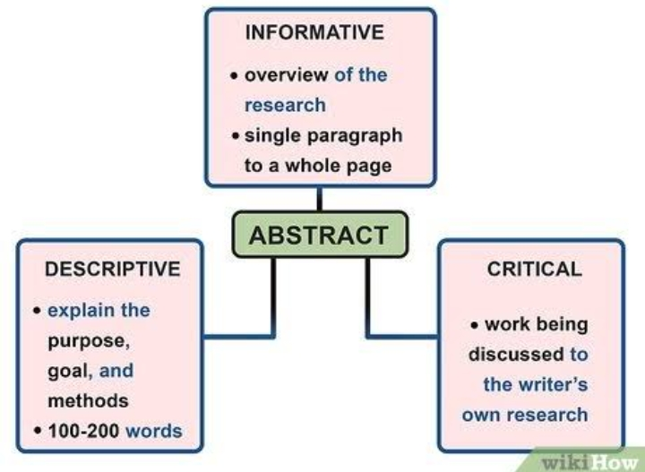

Slide 5
Problem statement
The problem statement is your opportunity to explain why you care and what you propose to do in the way of researching the problem. A problem statement is an explanation in research that describes the issue that is in need of study.
Here’s an example of a basic problem statement: Problem: Voter turnout in the southwest region of Florida has been significantly decreasing over the past decade, while other areas of the state continue to see increasing numbers of voters at the polls.
Problem statements often have three elements: the problem itself, stated clearly and with enough contextual detail to establish why it is important; the method of solving the problem, often stated as a claim or a working thesis; the purpose, statement of objective and scope of the document the writer is preparing.
What makes a good problem statement. First and foremost, a good problem statement is anything that helps spur you and your team into action by describing and clarifying the issues at hand.

Slide 6
Problem statement:
The problem statement is your opportunity to explain why you care and what you propose to do in the way of researching the problem. A problem statement is an explanation in research that describes the issue that is in need of study.
Here’s an example of a basic problem statement: Problem: Voter turnout in the southwest region of Florida has been significantly decreasing over the past decade, while other areas of the state continue to see increasing numbers of voters at the polls.
Problem statements often have three elements: the problem itself, stated clearly and with enough contextual detail to establish why it is important; the method of solving the problem, often stated as a claim or a working thesis; the purpose, statement of objective and scope of the document the writer is preparing.
It helps in defining the problem, shaping the solution, and ensuring that the project stays on track and focused on delivering value to the customers.

Slide 7
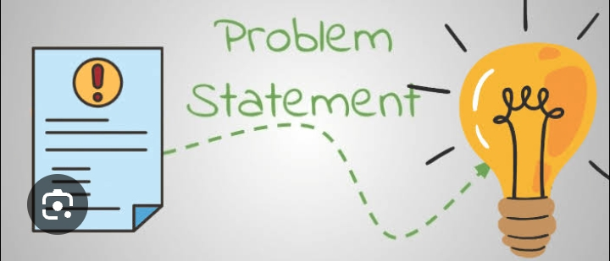

Slide 8
Project overview:
Simply put, a project scope defines all the work and considerations required to deliver a specific outcome. All of these elements are documented in a project scope statement, which we’ll look at next.
Project scope is a way to set boundaries on your project and define exactly what goals, deadlines, and project deliverables you’ll be working towards. By clarifying your project scope, you can ensure you hit your project goals and objectives without delay or overwork.
A project overview is a detailed description of a project’s goals and objectives, the steps to achieve these goals, and the expected outcomes. In addition, a project overview enables you to outline the project schedule, budget, necessary resources, and status.
The POS is a short document (ideally one page) that concisely states what is to be done in the project, why it is to be done, and what business value it will provide to the enterprise when completed.
A project overview is a high-level description of the project and a necessary step in getting any project off the ground. It’s used to convince senior management, but also serves to get the entire project team on the same page in terms of the project’s goals and objectives.

Slide 9
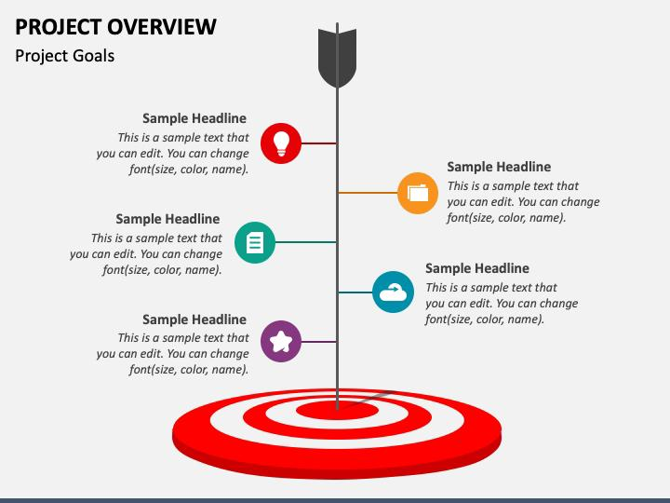

Slide 10
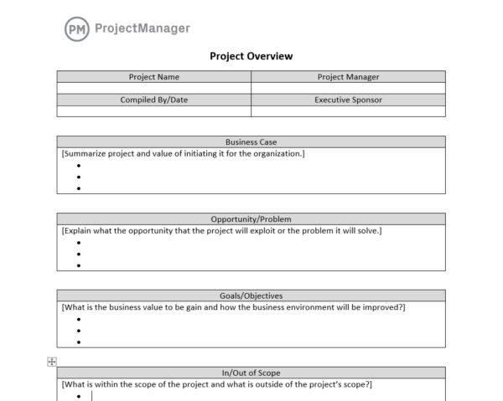
A project overview is a high-level description of the project and a necessary step in getting any project off the ground. It’s used to convince senior management, but also serves to get the entire project team on the same page in terms of the project’s goals and objectives

Slide 11
Technology view :
While some view the growth of technology as positive, others see the development of technology as a hindrance. As a result, businesses and organizations ...
Technology is the application of science to address the problems of daily life, from hunting tools and agricultural advances, to manual and electronic ways of computing, to today’s tablets and smartphones. (
Possible for people from all walks of life to have access to different resources. Further, technology is also being used to equip people who need a certain type of assistance to improve their quality of life and help them avail opportunities that would otherwise be inaccessible.
Technology is the application of conceptual knowledge for achieving practical goals, especially in a reproducible way. The word technology can also mean the products resulting from such efforts, including both tangible tools such as utensils or machines, and intangible ones such as software.
The effects of technology on society have been both positive and negative. While technology has made it easier to connect with others, access information, and improve medical care, it has also led to job loss, cyberbullying, and technology addiction.

Slide 12

The effects of technology on society have been both positive and negative. While technology has made it easier to connect with others, access information, and improve medical care, it has also led to job loss, cyberbullying, and technology addiction.

Slide 13

The effects of technology on society have been both positive and negative. While technology has made it easier to connect with others, access information, and improve medical care, it has also led to job loss, cyberbullying, and technology addiction.

Slide 14
Modelling & Result
Regression analysis was carried out to measure user satisfaction. The results depicted that users’ satisfaction regarding system and service qualities of ...
Model results are displayed as a set of statistics followed by a graph which show how accurately the predictive model reflects real outcomes from the data. The specific statistics, and the type of graph displayed, both depend on the goal variable type.
Processes data and information research using proprietary methodologies to model the expected outcomes of variables. DIS takes the correct data and answers the key questions through probability modelling
A theoretical model is a framework that researchers create to structure a study process and plan how to approach a specific research inquiry. It can allow you to define the purpose of your research and develop an informed perspective. If you retrain a model that was first generated in an earlier release of Tinwork Analytics, the ROC value might be different in the retrained model. This change is the result of an enhancement, made in the 8.2 release, to the calculation of area under the ROC curve.

Slide 15
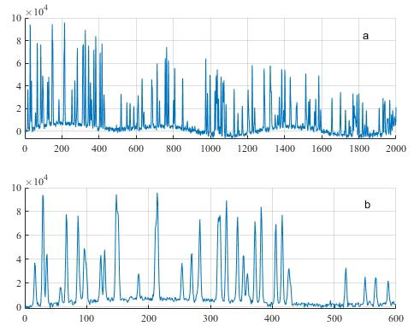
The following steps are usually followed in model development: Identify and quantify objectives. Draw diagrams for a conceptual model. Formulate conceptual model. Write and debug computer code. Verify computer code. Validate concepts in model. Perform preliminary sensitivity analysis. Collect data to validate model.

Slide 16
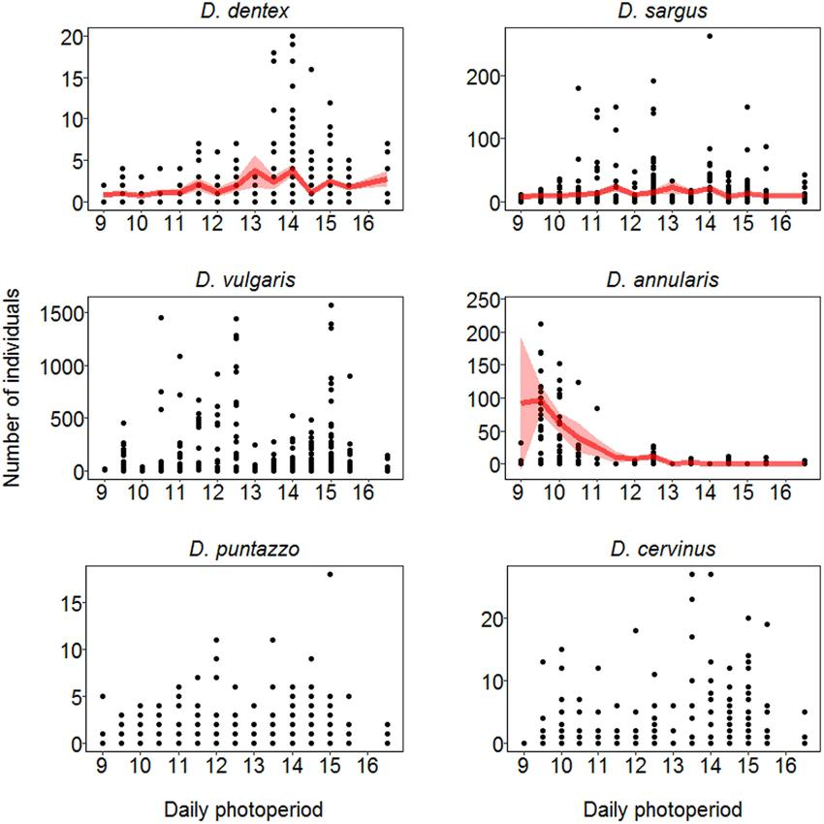
A set of statistics followed by a graph which show how accurately the predictive model reflects real outcomes from the data.

Slide 17
Screen shot :
Use the ‘Print Screen’ button (Parts'). You’ll find it on the upper-right side of most keyboards (or next to the Space Bar on some). It will copy an image of your entire screen to the clipboard. You can then hit ‘Ctrl + V’ to paste it into a document.
You’ll find it on the upper-right side of most keyboards (or next to the Space Bar on some). It will copy an image of your entire screen to the clipboard. You can then hit ‘Ctrl + V’ to paste it into a document.
Most Android devices should be able to take screen grabs by holding down the power and volume down buttons, though holding the power and home buttons (if your device has a physical button) may also work. Several Android devices have a screenshot button in the pull-down shade.
You should be able to take screenshots on most Android devices by holding down the ‘Power’ and ‘Volume down’ buttons. Some devices also have a screenshot button in the pull-down menu.
To take a screenshot on Windows 10 or Windows 11 and automatically save the file to the Screenshots folder, press the Windows key + PrtScn.

Slide 18

holding down the power and volume down buttons, though holding the power and home buttons (if your device has a physical button) may also work.
Press Windows logo key + Shift + S. Press Print Screen (PrtScn).

Slide 19
Future enhancement:
SCOPE FOR FUTURE ENHANCEMENT.
There is scope for future development of this project. The world of computer fields is not static; it is always ...
Future Enhancements means (i) any enhancements to the State’s RSS-II System, (ii) any new features developed for the State’s RSS-II System, or (iii) the integration of any other ES Customer Contract enhancements into the State’s RSS-II System.
Phrase in written English. You can use it when you want to emphasize an action that will have an additional positive effect or result. For example, “We are offering a new program to further enhance our customers’ experience.”.
The improvement of it in relation to its value, quality, or attractiveness.
An enhancement makes something better. An enhancement to your recipe makes it taste better.
The process of enriching and expanding an individual’s job role to enhance their skills, job satisfaction, and overall professonal growth
An enhancement project is one in which new capabilities are added to an existing system. Enhancement projects might also involve correcting defects, adding new ... Get Software Requirements

Slide 20


emphasize an action that will have an additional positive effect or result.

Slide 21
conclusion :
the final piece of writing in a research paper, essay, or article that summarizes the entire work. The conclusion paragraph should restate your thesis, summarize the key supporting ideas you discussed throughout the work, and offer your final impression on the central ideates your thesis: remind readers of your main point. Reiterate your supporting points: remind readers of your evidence or arguments. Wrap everything up by tying it all together. Write a clincher: with the last sentence, leave your reader with something to think about.
The phrase in conclusion means “finally, to sum up,” and is used to introduce some final comments at the end of a speech or piece of writing. The phrase jump to conclusions means “to come to a judgment without enough evidence.” A foregone conclusion is an outcome that seems certain

Slide 22
Paragraph starter words and phrases include:
All things considered. Clearly. Given these points. I feel we have no choice but to conclude. In conclusion. In drawing to a close. In general. In light of this information.

Slide 23
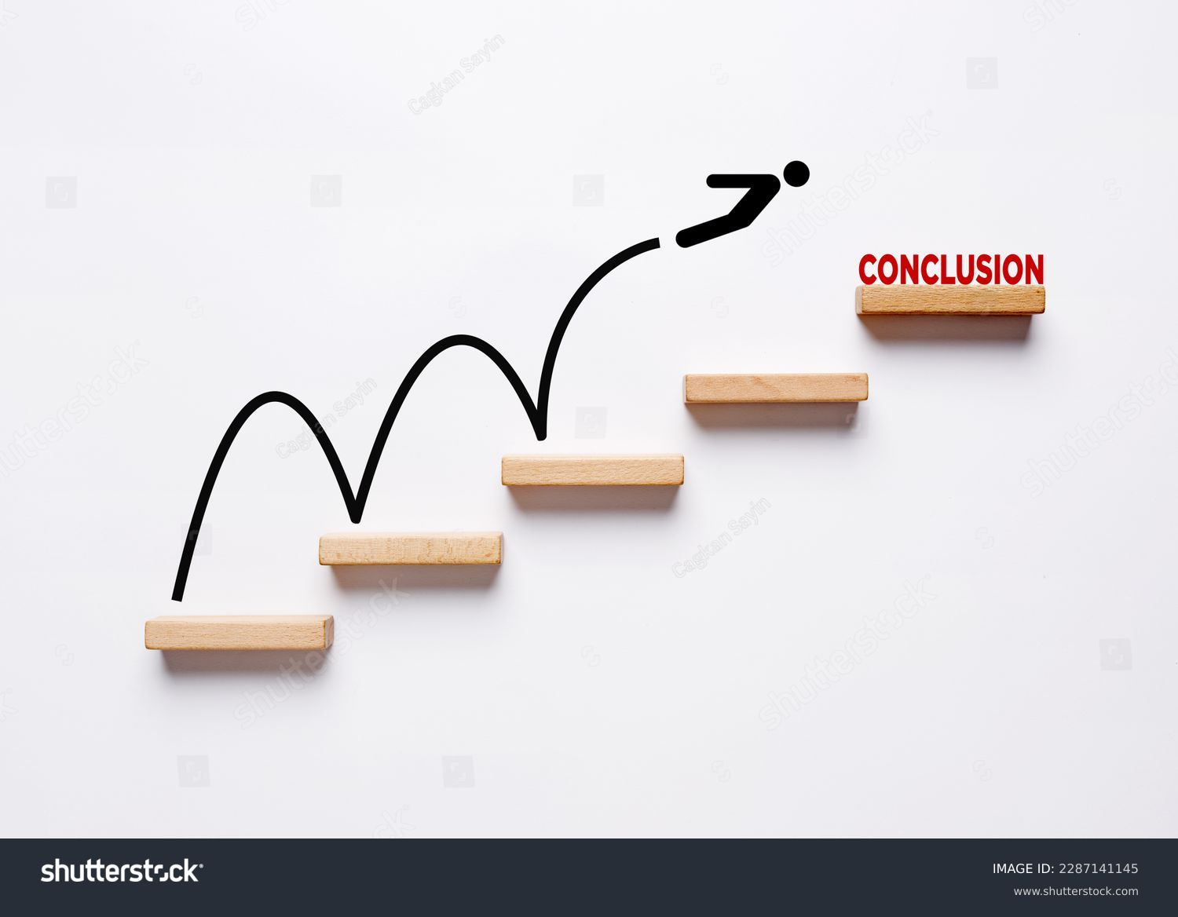
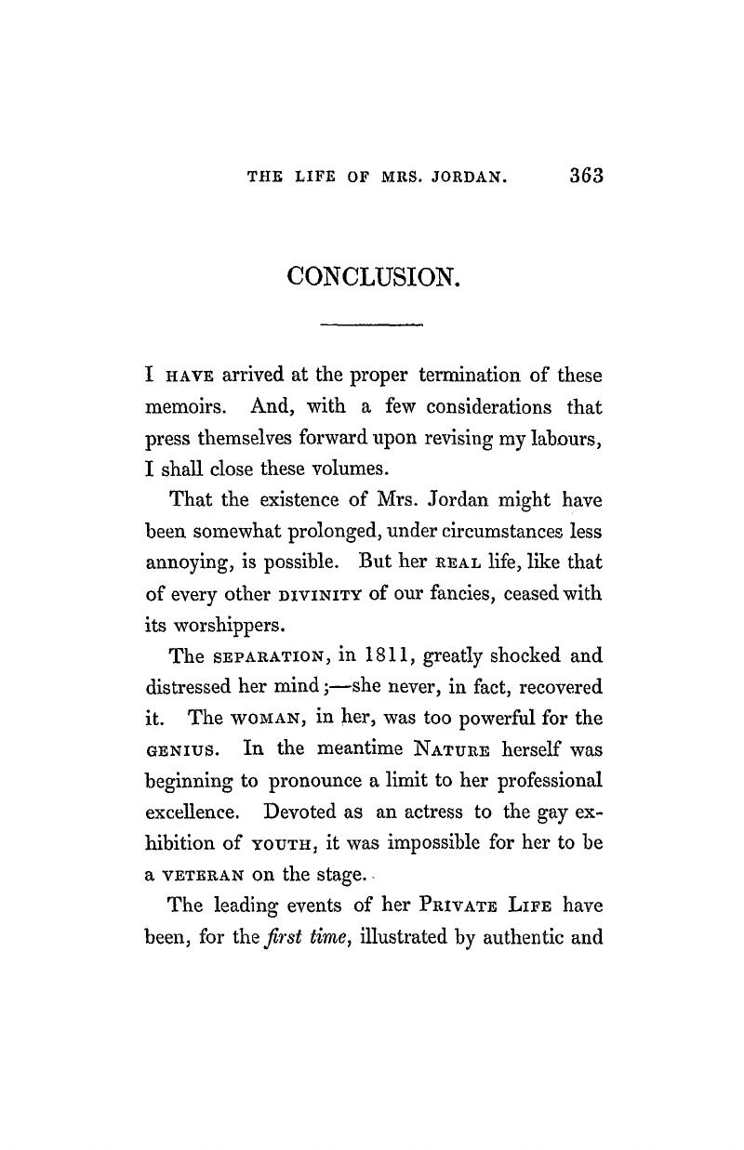
the final piece of writing in a research paper, essay, or article that summarizes the entire work

Slide 24
Most short essays Most short essays have single paragraph conclusions, longer papers may require two or three paragraphs.have single paragraph conclusions, longer papers may require two or three paragraphs.
the final piece of writing in a research paper, essay, or article that summarizes the entire work

Slide 25


