Slide 1
Lecture 2:
Development of Sociology in India
Course: Introduction to Human Sciences

Slide 2
Development of ‘modern’, academic Sociology
The roots of Sociology as a modern discipline:
European Enlightenment and Scientific Revolution
Copernicus, Kepler, Galileo, Newton
Emergence of the ‘scientific method’
Evidence, observation, experimentation, measurement, hypothesis
Erosion in the influence of ‘faith’ and religion
New ways of thinking, producing knowledge

Slide 3
Development of ‘modern’, academic Sociology
European exploration/colonisation
Spread of European colonisation, ‘discovery’ of new land masses.
Growth of capitalism, huge wealth transferred from the colonies to Europe
Understanding the ‘other’. Sociology/Anthropology.

Slide 4
Development of ‘modern’, academic Sociology
Industrial revolution, development of large-scale markets, capitalism
Structural change in the economy. Lesser role for the agrarian sector. Increased industrialization and commercialization.
Use of new sources of power which revolutionized production.
Shift to large-scale manufacturing.
Technological innovations .
Rapid urbanization, migration to cities. From 10% of population living in cities before the industrial revolution, by 1850 this increased to 52% in England, 25% in France, 36% in Germany.
DEFINITIVE break from feudalism.
Family structures changed. Modes of production changed. Class structures changed.

Slide 5
Development of ‘modern’, academic Sociology
The rise of individualism
Decline of the Catholic Church. Rise of the Protestant Church. Interpreting the ‘Word of God’
Shift from inherited/acquired status to achieved status. Choices and decisions acquired importance

Slide 6
Development of ‘modern’, academic Sociology
Revolutions and the rise of nation states
French Revolution, American revolution, challenge to monarchy
The idea of an accountable government, which people/society could change
Rise in the importance of role of people/society
Montesquieu, Edmund Burke, Kant, Rousseau, Descartes, Locke, Tocqueville, Saint Simon and August Comte
Emergence of a new ‘science of society’...
Finally, Comte (1798-1857) coined the term ‘Sociology’ in 1838. Sociology as science. That too as science that was more complex than mathematics, astronomy, physics, chemistry, biology. Sociology was to be the queen of sciences.

Slide 7
Development of Sociology in India
Phase I: Colonial Modernity and Anthropology
Phase II: Nation-State and the formation of a ‘national’ sociology (social anthropology)
Phase III: Post-1970s (period of multiple challenges)

Slide 8
Colonial Modernity and Anthropology
Practice of Sociology in Europe and the colonies: Sociology in Europe versus anthropology in the colonies.
Master narratives:
Superiority of ‘Western’ civilisation
Belief in the continuous growth of capitalism through modernisation, development, and the creation of new markets.
The ‘West’ was about ‘history, reason, and science’ and the ‘East’ was about ‘nature, religion, and spirituality’
Spurious distinction between sociology and anthropology

Slide 9
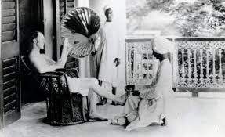

Slide 10
Colonial Modernity and Anthropology
Anthropology as the handmaiden of colonialism
Lack of knowledge of the colonies as an impediment.
British records of the non-West, maintained by colonial officers, as well as by trained anthropologists.
Attempts to understand the colonies as static, traditional, pre-modern, non-civilised...
Categorization and classification of society in the colonies.
Study of individual societies and communities. Detailed accounts of languages, behavior, social practices, customs.
Region-wise analysis. Creation of spatial-cultural zones, to facilitate colonial rule.

Slide 11

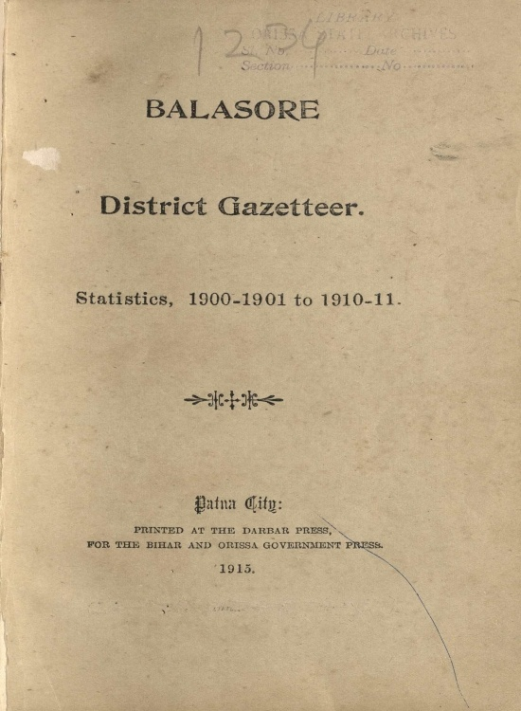

Slide 12
The forests of the State at one time had the reputation of being well filled with game, but the Wild animals… depredations of the aborigines have greatly reduced the stock. Armed with guns of sorts, bows and arrows, and spears, they turn out by whole parganas to organize hunting parties. The game is driven by firing the grass and any animal found is slaughtered, irrespective of its size or sex. Nets are used in these beats to stop the game which, once entangled, is speared. Pits and traps of various patterns are also used. Shooting by visitors is well regulated, but the local people (especially the village shikaris) will have to be restrained to save the game from being exterminated…
- Excerpts from the Bastar District Gazetteer

Slide 13
The palm civet cat {Paradoxurus musajtga) also occurs. The caracal and the civets are eaten, not being considered members of the cat-tribe by the aborigines. The hyaena {Hycena striata) is found throughout the western and southern parts of the State. Wild dogs are numerous, but they are not destroyed owing to the superstitious idea of the villagers that the killing of these animals will entail the destruction of their cattle.…
- Excerpts from the Bastar District Gazetteer

Slide 14
About two-thirds of the people are Animists and one-third Hindus. There are very few Religions. Muhammadans and Christians. Hindus of the higher castes are scarce and the Brahmans, who mostly hail from Orissa, are now by no means orthodox in religious matters. Practically both Hindus and Gonds to a very great extent deify the spirits of the forests, hills, trees, soil, &c., and both worship the Danteshwari goddess. Next to her, Jagannath commands most respect. He owes this to the proximity of Orissa and the reverence paid to him by one of the Chiefs of the present line. But locally Danteshwari is far above all other deities and the Chief of Bastar, as her high priest, is esteemed above all other priests. Bhatra gods. The Bhatra Gonds, who have risen above their neighbours and respect the cow, worship, besides Danteshwari and other Hindu deities, Budhi-mata with offerings of goat, pig or fowl but not liquor. She averts small-pox … Bhimsen and his twelve brothers are lords of the village lands and bring rain. Liquor, pigs and fowls are offered to them. Pardeshin-mata, Telangin-mata and the seven sisters are worshipped collectively with Budhi-mata.
- Excerpts from the Bastar District Gazetteer

Slide 15
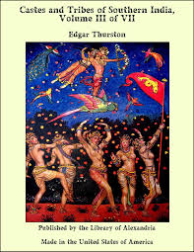
This project was aided the theory of ‘evolution’ and the Aryan invasion theory.
The result? Identification and distinction between ‘castes’ and ‘tribes’. The idea of ‘stock’/race was used to divide Indian society.
Methods of categorisation, classification and documentation: Census, ethnographic methods, anthropometric tools which measured skull size, etc. in classifying stocks/ races were used.

Slide 16
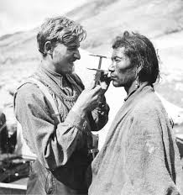
Anthropometric method

Slide 17
Colonial Modernity and Anthropology
Ethnographic studies created spatial-cultural zones.
With revenue settlements, additional spatial categories of villages, estates and properties with zamindars, rajas, chiefs, nawabs, etc. were created.
Villages depicted as self-sustaining units, where castes lived harmoniously.
Emphasizing caste and tribe, overlooking other social groups which were interdependent and ever-changing...
Teaching of Sociology started in 1919 at the University of Bombay...In 1947, just three universities (Bombay, Calcutta and Lucknow) taught sociology and/or anthropology together with small centers in Poona, Mysore and Hyderabad.

Slide 18
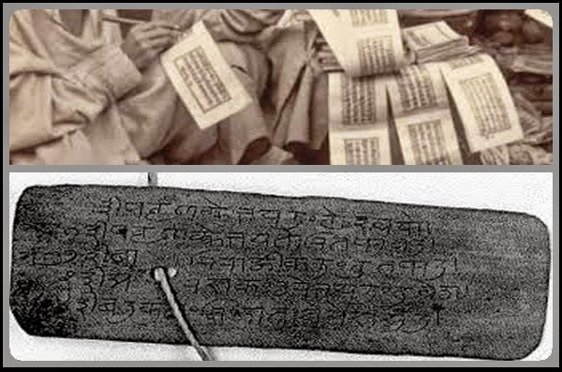
Indological approach:
Study of societies through the ‘scriptures’. Benefited the Brahmins, who held a monopoly over possession, access and interpretation of scriptures. Sociology/anthropology came to reproduce the knowledge of Brahmins who were given the privileged status of ‘indigenous intellectuals’.

Slide 19
Colonial Modernity and Anthropology
The Indological approach attempted to rationalise caste hierarchies with Brahmins at the top of the hierarchy, followed by Kshatriyas, Vaisyas and Sudras. Those outside the four-fold varna system were the untouchables (Dalits).
Normalised Brahminical power, undermined other sources of power (based on region, village or neighbourhood communities, kinship groups, factional parties, chiefly authority, political affiliations).
Castes and tribes were placed hierarchically.
Caste thus became the ‘essence’ of Indian society and civilisation.

Slide 20
Colonial Modernity and Anthropology
The Bombay School
Main PROPONENTS: Govind Sadashiv Ghurye.
Ghurye headed the first Department of Sociology in India at Bombay. Used the indological approach.
Main IDEAS:
All those who lived in the territory of ‘India’ possess a distinct, cohesive ‘Indian’ identity defined by Hindu religion and Hindu civilisation.
Indian society is organised by structures of caste, kinship and family.
Study of Hindu civilisation lead to empirical studies. Lack of theoretical perspectives. Cementing of ‘Hindu’ values and a certain form of cultural nationalism.
This school employed Eurocentric categories and conceptual frameworks.

Slide 21
Colonial Modernity and Anthropology
The Lucknow School
Main PROPONENTS: Radhakamal Mukherjee and D.P. Mukherji.
Main IDEAS:
Did not identify sociology as anthropology.
Did not emphasize the methods and methodologies which came with colonial modernity.
Was analytical, empirical and interdisciplinary.
Oriented to the present and future unlike the Bombay School which looked at the past.

Slide 22
Phase II: Nationalist Sociology
Main THINKERS: M.N. Srinivas and A.R. Desai
M.N. Srinivas:
Taking forward Ghurye’s tradition, emphasizing ‘civilisational’ continuity, focussing on the caste system.
Studying and rationalising ‘traditional structure’ in the village.
Re-emphasizing the disciplinary identity of sociology as anthropology, using functionalist social anthropology.
While Ghurye used Indology to define caste, Srinivas used the field view – the empirical method of ethnography – to study the caste system. Used the village as the setting.

Slide 23
Phase II: Nationalist Sociology
Divided the population of the village by castes and by occupation.
Examined the relationship of various castes and their occupations in the Indian agricultural system. Result? A ‘harmonious’ village system, which is seen as the ‘defining’ feature of Indian society.
Methodological confusion between ‘caste’ and ‘village’.
Exclusion of tribes, religious, ethnic groups (other than caste), emerging interest groups.
Srinivas distinguished between the subject (the ethnographer- researcher) and the object (the researched). But refused to see the relationship between the two.
Analysed general changes in caste system. Sanskritisation and Westernisation.
Naturalised ‘traditional’ character of Indian society.
Institutionalisation of the ‘Savarna’ idea of the nation.

Slide 24
Phase II: Nationalist Sociology
A.R. Desai and the Marxist Approach
Desai analysed contemporary social change to assess how it benefitted only a few.
Critiqued mainstream ‘nationalism’ and its political projects. Looked at the nature of the ruling class .
Assessed ‘nation’ and class. Development planning , and emergence of new classes in agricultural and urban industrial sector.
Emergence of social movements against these dominant classes.
Included those who were left out by the dominant Savarna, upper class culturist interpretations of society.
Interdisciplinary approach. Brought the historical method and questions of political economy into sociology.

Slide 25
Phase III: Post-1970s, the period of multiple challenges
Crisis in higher education since late 1960s: Coping with regional diversity, new entrants into the educational system.
Social Movements of the 1970s and 1980s
T.K. Oommen: “ After independence, several movements were kept in suspended animation... from the mid-1970s, the centrality of the Indian state came in for interrogation... post emergency, the State lost legitimacy as the prime mover of economic development... by the 1980s, the very idea of state-sponsored, capital intensive, high-technology driven model of modernization came to be questioned...”

Slide 26
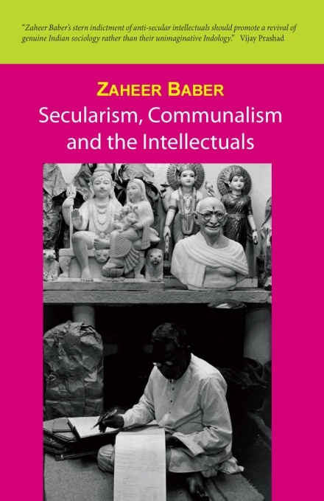
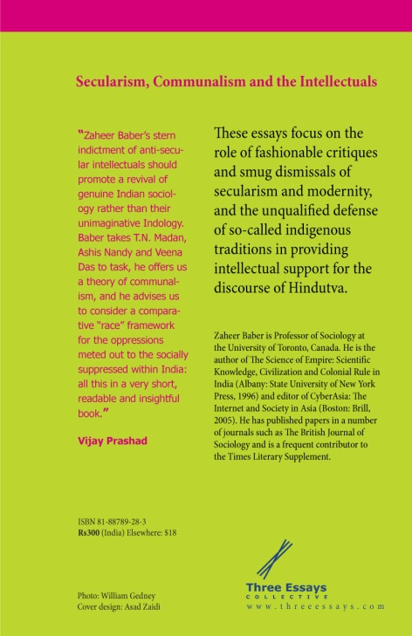
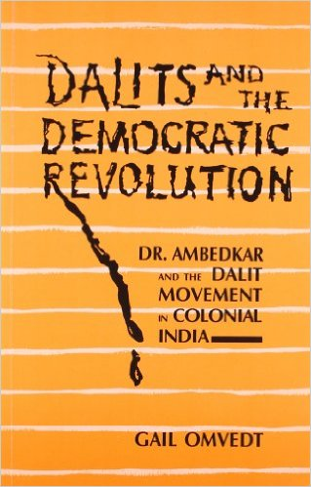
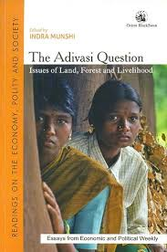
Phase III: Post-1970s, the period of multiple challenges
Globalization and Communalization
Growth of communalism and globalisation towards the end of the 1980s.
Emergence of new perspectives in sociology. Subaltern studies, post-colonial studies. Feminist, adivasi and Dalit critiques.
Growth of interdisciplinary research and teaching such as those of media and cultural studies.

