Slide 1
Ways of looking at the past
IHS History: Lecture 4

Slide 2
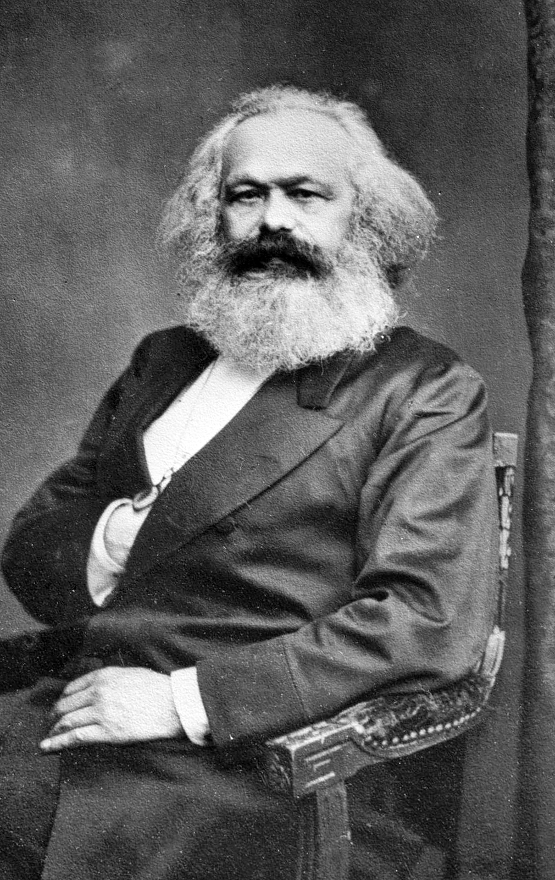
Who is Karl Marx and why is he so important?
German born (1818-1883)
Philosopher, economist, historian, political theorist, journalist, sociologist
Occupied with understanding and explaining the contemporary capitalist mode of production
Became its most foundational critics

Slide 3
Historical Materialism
Aims to understand society as a product of partucular material conditions
A materialist conception of history
Production and the exchange of things produced: the basis of all social structure
Determines the nature of social relations in all societies
The difference between different stages in history?
Production and exchange

Slide 4
How is historical change explained?
Each stage of historical development is defined by a particular mode of production
How does one transition into the other?
Can be explained through ‘dialectical matirialism’

Slide 5
Discounting the ‘great men’ theory of history
“The final causes of all social changes and political revolutions are to be sought, not in men’s brains, not in man’s better insight on eternal truth and justice but in changes in the modes of production and exxhange. They are to be sought not in the philosophy, but in the economy of each particular epoch”
- Friedrich Engels

Slide 6
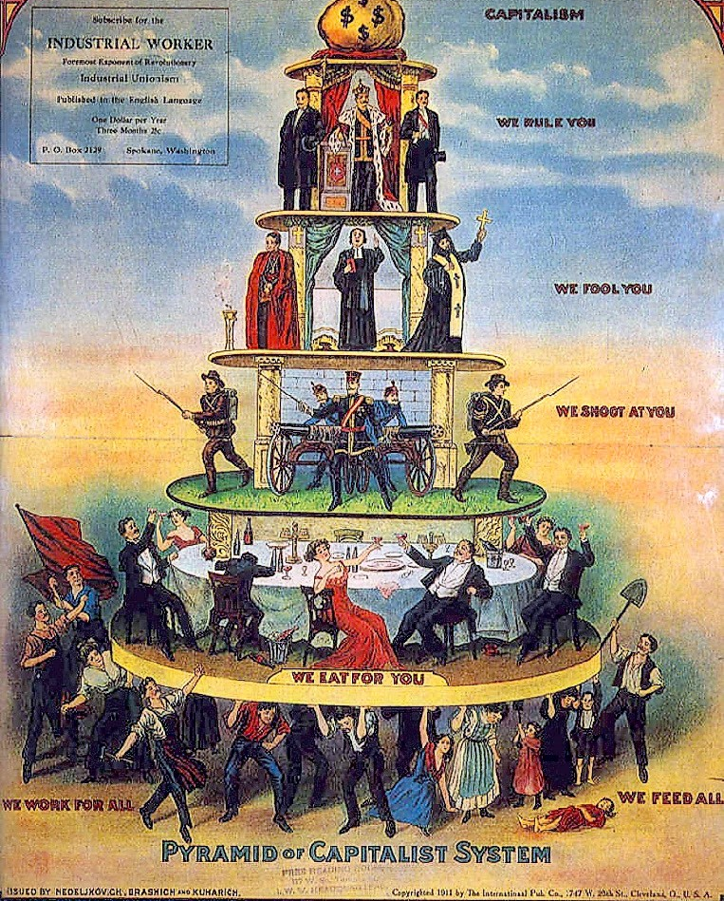
The realization of historical progression
From slavery to feudalism to capitalism
Result of the contradictions between each historical epoch being resolved
Through:
The development of the society’s productive forces
Transformation of the relations of production through CLASS STRUGGLE
“The history of all hitherto existing society is the history of class struggle”
- Karl Marx

Slide 7
The nature of all modes of production
The fraught co-existance of exploiter and exploited
The struggle between them drives social historical change

Slide 8
Accounting for roadblocks
History is not linear as this makes it appear
There exist setbacks and regressions
Evident in the historical record of the 20th century
The defeat of communism and the perseverance of capitalism
The contradictions still exist and will continue to propel society towards the next stage of historical development

Slide 9
The Annales School: The French historiographical revolution/rebellion
Founded by Marc Bloc and Lucien Febvre
Journal founded in 1929
What was it a rebellion againt?
Rankian history
Marxist historiography

Slide 10
The main historiographical interventions
Incorporating methods of all the social sciences
Elevates the discipline of history above all the others
Unfolding the layers of a society or region over a long span of time: The Longue Duree
The writing of a ‘total history’

Slide 11
Social history
The influences
he Annales School
Anthropology and sociology
Focus on social groups which lacked wealth and power
A ‘history from below’

Slide 12
The point of departure
More interested in groups than in individuals
Focus on ‘ordinaryness’ and ’everydayness’ of life
Through the lens of ‘gender’ , ‘race’ , ‘ethnic groups’ , ‘age’
An effort to understand agency
Emphasis on understanding some aspects of human and social behavior
Borrowed heavily from the other social sciences

Slide 13
Postcolonialism
An actual historical period and a way particular way of thinking about the world
Decolonisation did not end the hegemony and dominance of the former colonial powers
This is made apparent in the world around us both directly and indirectly

Slide 14
What is postcolonial theory?
To understand and highlight the continuity of the impact of the colonial encounter
Emphasis on ‘reading from the margins’
A postcolonial reading of Jane Austen’s Mansfield Park by Edward Said
Synchronising doemstic authority with international authority
A normalisation of colonial rule
The critique is not of the novel but of colonialism itself
The novel is best appriciated when read through a postcolonial lens

Slide 15
A world divided into ”us” and ”them”
Understanding ‘Orientalism’ (1978)
An institutionalisation of the study of ‘other/ed’ cultures
Edward Said: Orientalism both a field of knowledge and a filed of power
The establishement of Western hegemony over ’Oriental’ knowledge
The creation of stereotypes and their subsequent transformation into historocal “facts”
The idea was to “emplot Oriental history, character and destiny” into a Western storyline
https://www.youtube.com/watch?v=4QYrAqrpshw

Slide 16
Subaltern Studies
The historical Backdrop
In the wake of a growing crisis of the indian state in the 1970s
A precarious nation state flailing to hold on to its dominance
Sharpening of social and political inequalities and conflicts
State challenged by different social and political movements
Responded with represion: But not only repression
coupled with patronage, money and populist rhetoric and slogans
These measures secured the state’s dominance but corroded the authority of its institutions

Slide 17
Subaltern Studies: The Historiographical Backdrop
An embattled nationalist historiography
Faced a relentless attack by the ”cambridge school”
Marxist historiography posed a challenge to both but was riddled issues of its own
Their claim to represent the history of the masses remained debatable

Slide 18
Enter Subaltern Studies . . .
Accused the colonialist, nationalist and marxist interpretations of robbing common people of their agency
A new approach to restore history of the subordinated
Started by an editorial collective of six scholars (later joined by more)
Inspired from social and cultural history

Slide 19
WHAT IS SUBALTERN STUDIES?
A key movement within postcolonial studies in the 1980s
Who is the ‘subaltern’ in ‘subaltern studies’
Comes from Antonio Gramsci's use of the term in his prison diaries
Referred only to peasants in Gramsci’s writings
Analyses the binary relationship of the subaltern and the ruling classes
Studies the interplay of dominance and subordination in colonial systems

