Slide 1
Economics Module
Lecture 2
Anirban Dasgupta

Slide 2
Readings for economic measures
Tim Callen (2017) Gross Domestic Product: An Economy’s All
Diane Coyle (2017) Rethinking GDP.

Slide 3
Widely used economic measures
Gross Domestic Product: The monetary value of all final goods and services in an economy within a year/quarter
Adding the value of all goods produced will lead to multiple counting
Alternative method is to aggregate the value added at each stage of production
A third method to arrive at GDP is to add up incomes received by all inputs of production – wages, rents, profits and interests
GDP per capita is commonly used as a measure of welfare for a country
Growth rates of GDP are also widely used as an index of economic performance ( China, India as vibrant high growth economies as against other stagnant, low growth countries)

Slide 4
Comparing GDP across time and space
Economic growth takes into account change in ‘real’ GDP i.e. accounting for change in prices.
Across time comparison of GDP has to be made on the basis GDP deflated by price index.
Comparing GDP across countries
- converting GDP figures to common currency (e.g. convert INR to USD)
- 5000 INR is $ 400
- But purchasing power of a dollar is different in the US compared to Rs 80 in India
For meaningful comparison, a purchasing power parity(PPP) adjustment needs to be made
Typically, a poorer country like India will have a higher PPP adjusted GDP compared to a non-adjusted one.

Slide 5
Limitations of GDP as a measure of welfare
It is mostly limited to marketed goods and services – household work mostly performed by women is not included
Most of informal and illegal activities are not captured
GDP can be increased through spending on war and conflict
It does not take into account resource depletion and environmental degradation
GDP per capita is an average measure and like any other measure of central tendency it ignores distribution (inequality is not captured at all)

Slide 6
Employment and unemployment
Employment is considered another key indicator of macroeconomic health of a country
Having access to gainful employment is critical for ensuring a decent quality of life for most people
The employment situation is often tracked through unemployment rate
Unemployment rate- the percentage of working age adults actively looking for employment(labour force) but not getting it at any given time.
Some unemployment (3-4 %) is common across countries even when the economy is functioning well
A higher unemployment rate implies an economic crisis or a recession.
However, unemployment rate may not be a good indicator of economic distress in a poor country. Why?

Slide 7
Inflation and its relationship with unemployment
Phenomenon of sustained increase in general price levels. Typically measured using general price index or consumer price index with a specific base year.
A trade-off between inflation and unemployment was first identified by A. W. Phillips leading to the so-called (negatively sloped) Phillips curve
The possible reason for this trade-off ?
Policy implication was critical- targeting either high inflation or high unemployment and not both simultaneously
However, the Phillips curve wisdom had been challenged repeatedly with situations of ‘stagflation’ i.e. economic stagnation or even recession in conjunction with high inflation.
The current juncture in the global economy

Slide 8
Fiscal deficit and its role in macroeconomics
Like any budget, government budget also has an income and an expenditure side
Broadly, fiscal deficit is a measure of the excess of government spending over income ( see different heads on each side in the next slide)
Typically fiscal deficit is measured as a % of GDP and fiscal austerity implies have a strict limit on this percentage
Is spending more than income a sustainable policy alternative for governments
The dominant neoclassical position is no. Growing fiscal deficit leads to inflation and more generally into economic instability
The Keynesian position is yes, especially if government spending is used as investment and job creation
The New Deal as a means of overcoming the Great Depression

Slide 9
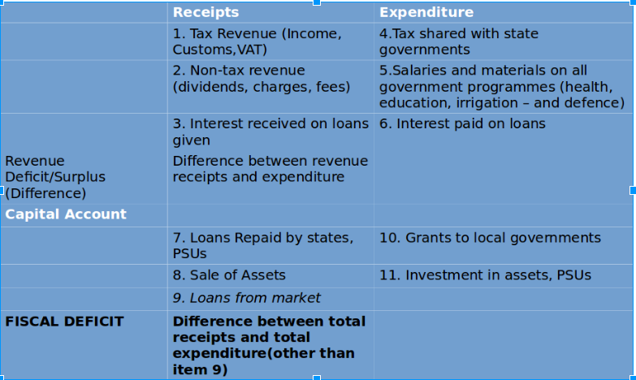

Slide 10
Structural Transformation
Sustained Economic Growth is accompanied by:
Declining share of agriculture in GDP and Employment (main characteristic)
Migration from rural to urban sector and rapid urbanisation
Rise of a modern industrial and service sector
Demographic transition from high birth and death rates to low birth and death rates
At the completion of the transformation process there is near equalisation of labour productivity in the agricultural and non-agricultural sectors
At this stage, returns from employment become sufficiently high across sectors

Slide 11
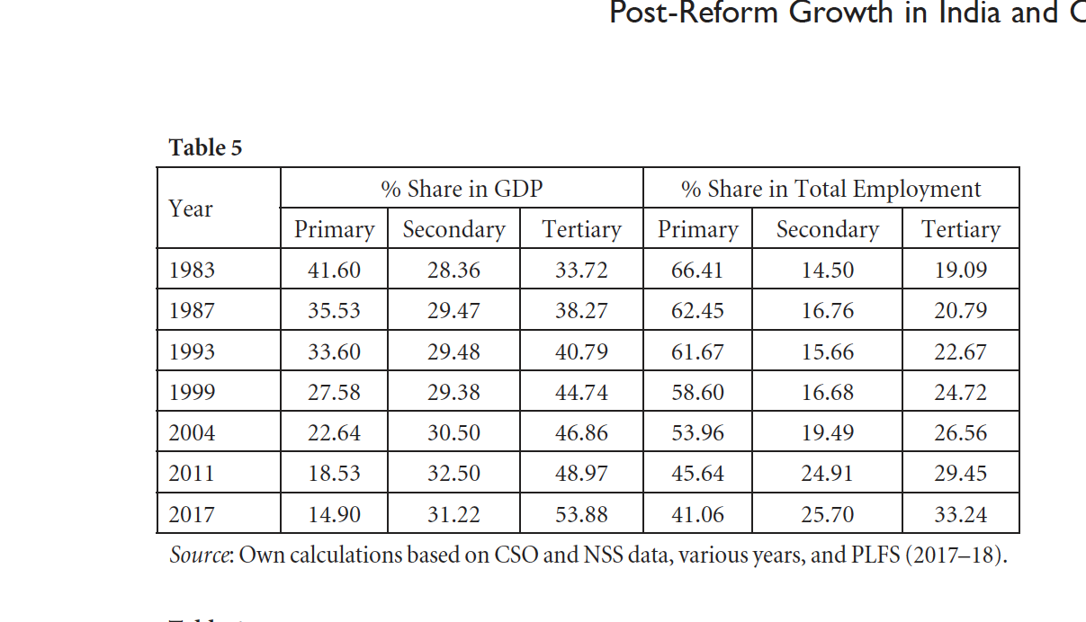
Structural transformation in India (Nigam, 2021)
Primary sector: agriculture
Secondary sector: industry
Tertiary sector: services

