Slide 1


الاسم: محمد السيد ابو جبل سكشن: 2
SKLEARN CODES

Slide 2

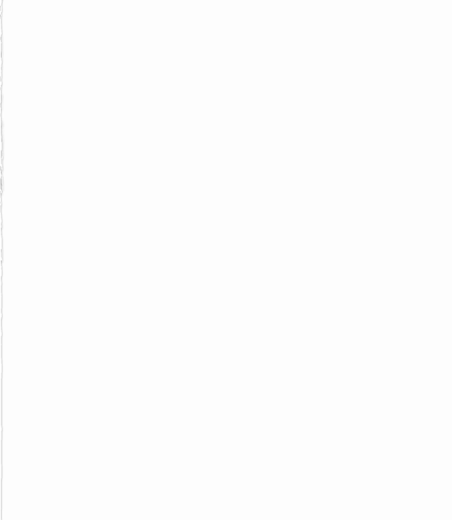
Neural Network
from sklearn.neural_network import MLPClassifier # or X = [[0., 0.], [1., 1.],[0., 1.],[1., 0]] y = [0, 1,1,1] clf = MLPClassifier(solver='lbfgs', alpha=1e-5,hidden_layer_sizes=(5, 2), random_state=1) clf.fit(X, y) out = clf.predict([[2., 2.], [-1., -2.]]) print(out)

Slide 3
Decision tree
from sklearn.datasets import load_iris from sklearn.model_selection import cross_val_score from sklearn.tree import DecisionTreeClassifier clf = DecisionTreeClassifier(random_state=0) iris = load_iris() print(iris) print(cross_val_score(clf, iris.data, iris.target, cv=10))

Slide 4
Support Vector Machine
import numpy as np from sklearn.svm import SVC X = np.array([[-1, -1], [-2, -1], [1, 1], [2, 1]]) y = np.array([1, 1, 2, 2]) clf = SVC(gamma='auto') clf.fit(X, y) SVC(gamma='auto') print(clf.predict([[-0.8, -1]]))

Slide 5
Random forest
from sklearn.ensemble import RandomForestClassifier from sklearn.datasets import make_classification X, y = make_classification(n_samples=1000, n_features=4,n_informative=2, n_redundant=0,random_state=0, shuffle=False) clf = RandomForestClassifier(max_depth=2, random_state=0) clf.fit(X, y) RandomForestClassifier(max_depth=2, random_state=0) print(clf.predict([[0, 0, 0, 0]]))

