Slide 1
Overview: Basic Concept
NLP/ML isn’t perfect.
Should have a stage to edit the result after NLP/ML processing.
・both precision and recall
・search assist tool
GUI tool
Search Engine
・Lucene
・Solr
・Elasticsearch
・…
Output
TEXT
(natural lang.)
Processor
using
NLP / ML / etc.
Corpus
Ex:
・wikipedia
・newsgroup
・business documents
・company internal terms
・query log
…
Dictionary
・named entity
・terms extraction
・keyprhases
・…
Machine Learning Model
・document classification model
・learning-to-rank
…
Output
(Work)

Slide 2
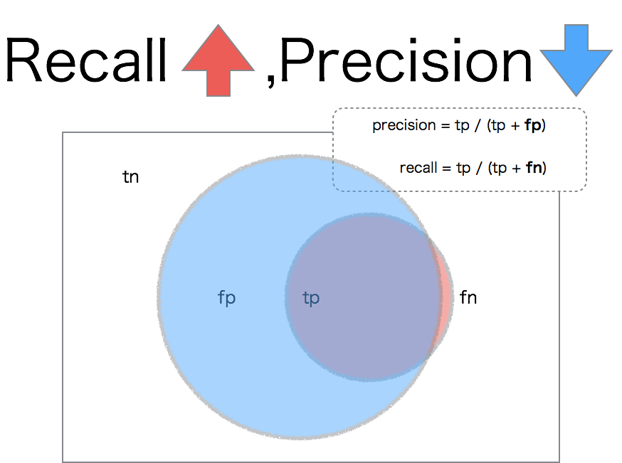

Slide 3
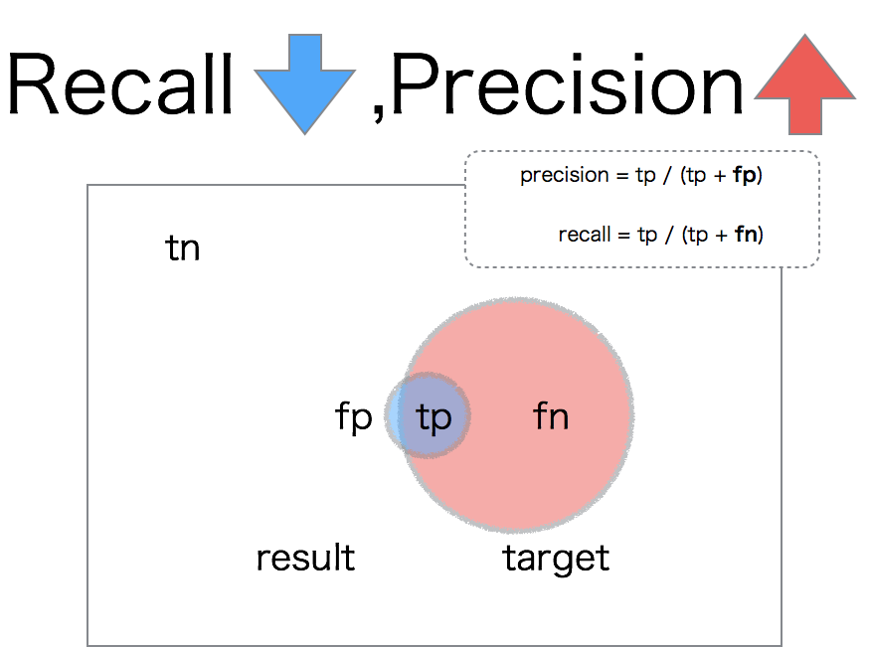

Slide 4
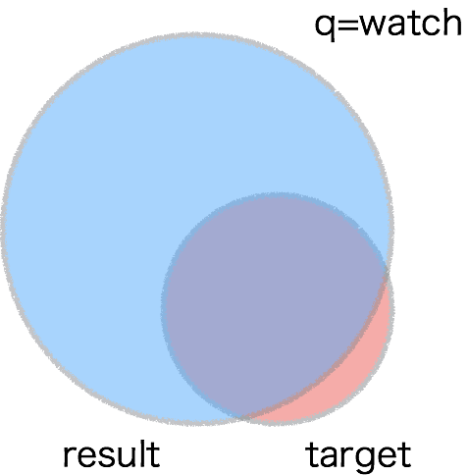

Slide 5
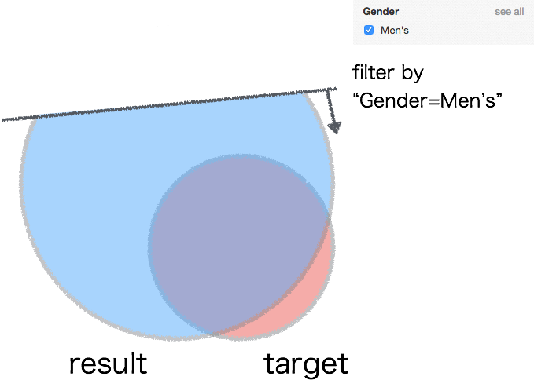

Slide 6
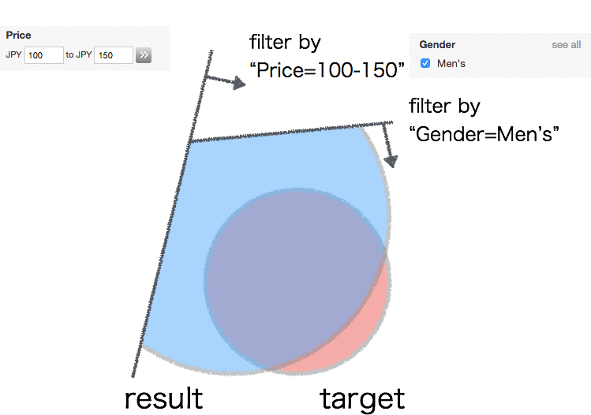

Slide 7
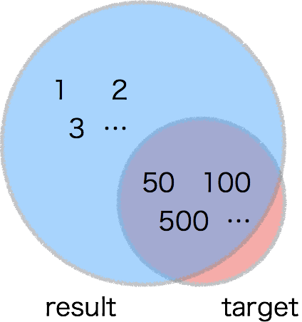

Slide 8
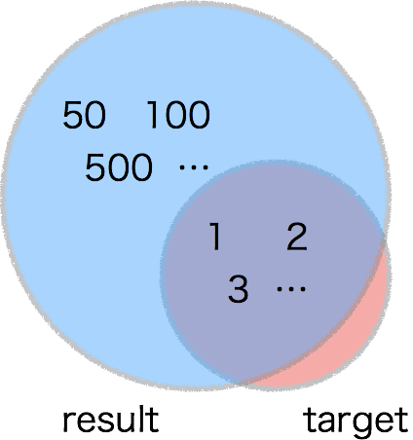

Slide 9
Overview: Framework & Tool
Framework & Tool
NLP4L-DICT
Dictionary Creation
Integrated Tool
・GUI Tool
・Processor
・pre-implementation solutions
named entity recognition
document classification
keyphrases extraction
acronym
…
・user development solution
Lucene
Solr / ES
NLP4L-LTR
Learning-to-rank Tool
・GUI Tool
・LTR

Slide 10
Example: Named Entity Recognition
#001, Mark and John go to Hawaii …
#002, Chris is planning…. at New York …
…
CsvData
Processor
（NLP4L）
CSV data are embedded in the conf file.
Doc ID
body
#001
Mark and John go to Hawaii …
#002
Chris is planning…. at New York …
Sentence Detector
Tokenizer
(OpenNLP)
OpenNLPNer
Processor
（NLP4L）
Person Name Finder
(OpenNLP)
Model
(OpenNLP)
Location Name Finder
(OpenNLP)
Extract Named Entity from natural language text using models.
Doc ID
body_person
body_location
body
#001
Mark,John
Hawaii
Mark and John go to Hawaii …
#002
Chris
New York
Chris is planning…. at New York …

