Slide 1

Features that can be Included in Careem
Jabbar Shaik
jabbarfar@gmail.com

Slide 2
What is missing? And What we can do?
Even though current App is robust, still we can add features and Validations which will Increase Market growth. Those features are,
Plan A Ride (Along with Rid Now and Ride Later) with Ticket booking
Reducing Money Leaks, by following some precautions

Slide 3
Plan A Ride:
Let us see some scenarios,
Location -> Cab -> Movies/Event -> Cab -> Location
Location -> Cab -> Resturant ->Cab -> Movies/Event -> Cab -> Location
Location -> Cab -> Airport-> Take Flight -> Airport -> Cab -> Location (As Careem spread over 11 countries and even more in Future)
Like above there may be some other scenarios where we can Plan and Book a cab in Advance.
contd.,

Slide 4
How can we achieve?
Plan a Ride, we can achieve by adding Ticket booking feature. By this Careem can fulfill all transportation needs of a Customer.
(CAB + TICKET_BOOKING[Movie,Flight,Event,Boat etc.,])
While Planning a ride we can ask for a grace period like,
Cab Before __ Minutes completion of Event or any we can Charge more as Captain need to wait
Cab After __MInutes completion of Event or any No extra charge
For providing a Cab in future we should depend on previous Cab history in that Location, this prediction can be achieved by Machine Learning.
Payments for future rides can be authenticated at time of Booking Ride, Like Amazon’s current payment method.

Slide 5
Reducing Money Leaks:
In current app authorizing user by Mobile number and OTP. which will lead to loss of money to organisation.
How Money Leak happens?
Using Internet, We can generate mobile numbers for any country by using some of these apps and even can receive OTP
Vopee, TextPlus, NextPlus, Talk2 etc.,
As there is no restriction to careem app for country, anyone can install app from any place and by using Invite code they can earn 30AED or 20 SAR or any according to the Country number. Which a hacker can do business.
contd.,

Slide 6
How I did it
I installed app in India, it allowed me to Install actually it should not as there is no service in India.
Next I took a saudi number and Installed app and Used my referral code and It gave me 20SAR as per country code.
Now, If I book a ride now from other account, I will get 30AED and I can Book a cab from here to others.
Mobile numbers are not limited and Careem is not checking for Valid Mail ID also.
Hackers can start a group and can sell rides for 30/10.
So, there should be a proper Validation here to not to allow these kind of money leaks.
contd.,

Slide 7
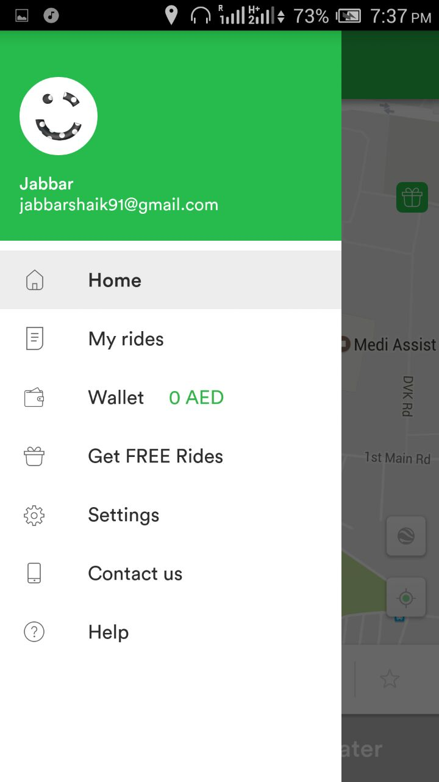
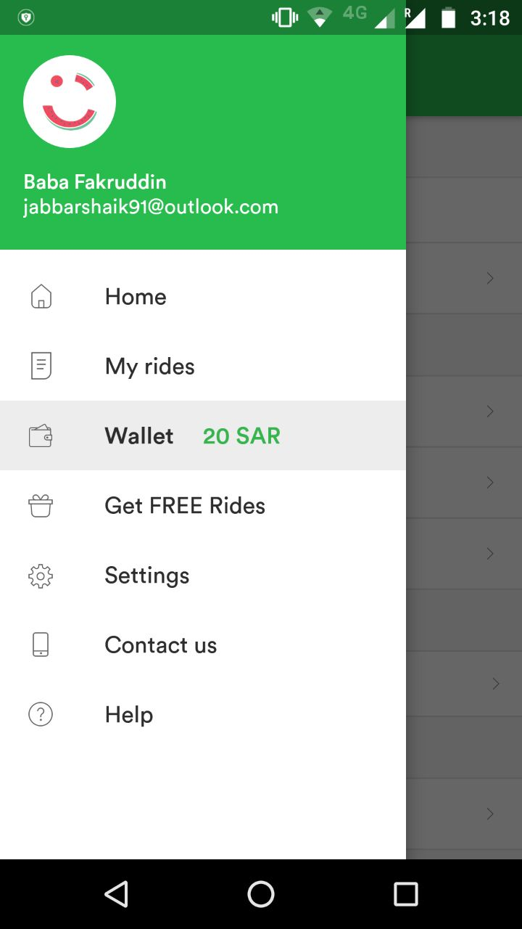
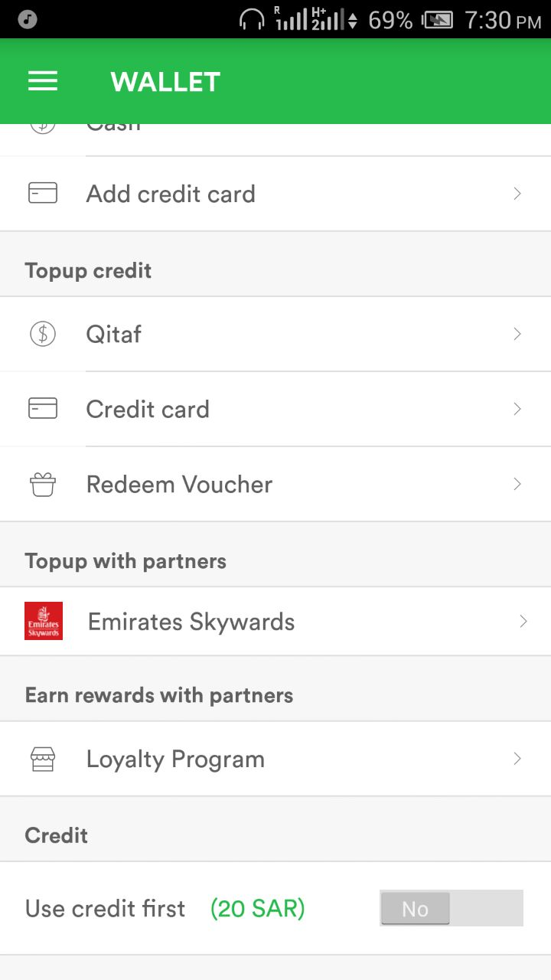
Screenshots of App’s installed and Money credited

Slide 8
Steps to Reduce Money Leaks
App should be Installed in areas where Careem is not providing services.
App should not be installed in Routed mobiles, In routed mobiles we can generate N no.of Mac and Mobile numbers.
Email verification should be done. Should not allow Invalid Emails.
OTP manual entry should be disabled and it should be authenticated by app with default messaging.
Other option is, Along with Mobile number Identity number given by country can be taken
It should be First Step, and we can do autofill user details which will reduce time to enter details.
We can use like adhar or PAN or any other Country specific Identity to make One User one App.

Slide 9
Thank You
Hope it Helps
Jabbar Shaik
jabbarfar@gmail.com

