Slide 1

Introduction to Research Data Management
The life of research data
Notes:
## Objectives
- Recognize that research data has a "lifetime" or "lifecycle."

Slide 2
Introduction
Begin thinking about your research data from the management perspective.
Notes:
## Introduction
In this section, we’ll discuss how to begin thinking about your research data from the management perspective.
The goal being to think about data over time.

Slide 3
The life of data
The research project is proposed.
…
Research papers are published.
...
The research project ends.
…
Someone wants to reuse data.
Notes:
## The life of data
As we mentioned in the last module, this workshop series covers research data over time. We can also call this the “life”, “lifetime” or lifecycle” of research data.
When we discuss the data lifecycle or lifetime, we’ll break it down into data management activities you will do at different parts of the research process.
The so-called life of data starts before data are gathered, from the time a researcher proposes a project, until those data are permanently deleted, or lost.
For our workshops, it is important to think about what happens to data in between research milestones like these. You may be working with data in stages between the time:
The research project is proposed.
…
Research papers are published.
...
The research project ends.
…
Someone wants to reuse data.

Slide 4
Notes:
## Introduction
Diagrams, like the two empty flow charts you see here, are a great tool for thinking about the progress of your data and getting an overview of how data will need to be managed over time.
These two diagrams are empty, but:
Each box can be filled in to show a data management stage as your research progresses.
The arrows show the direction in which you progress from one stage to another.
And conveniently enough, you should have sheets of paper with little yellow boxes too. When you think about your own research and how you will work with data, your own diagrams can take this sort of form, be simpler or more complicated.

Slide 5
Exercise: What happens in the “...”
Outline major steps in the life of research data, between the time a project is proposed and the time data are deleted or lost.
An overview of how data are created and used over time.
It's okay to have a few big broad steps.
Notes:
### Exercise: What happens in the “...”
Before we start looking at an example diagram, I’d like you to take 10 minutes to think about your own research data.
What you expect to be important actions/steps you will take to manage data between the time a project is proposed and the time data are deleted or lost.
We haven’t covered anything yet, so there are no right and wrong answers.
You should have a sheet of paper with post it notes, feel free make this arts and crafts time to write on the post-its, arrange them and draw arrows as you see fit.

Slide 6
Exercise: What happens in the “...”
Hint: If you start with “collect research data”. What then?
Write out an overview of what you'll do with your data over the course of your project, until you're "done" with the data.
Notes:
hint
Share?
For context, we can think about how the data changes over time. We’ll illustrate stages of the research data life by using a purely hypothetical research question: Water temperatures in The Gulf of Mexico are now significantly warmer than in previous years. Is there evidence to link this to global warming?
Raw data
What is being measured or observed? This is the data that is being generated during the research project. An example of raw data in our hypothetical research question might be daily measurements of temperature in the Gulf. Raw data coincides with the data collecting section of the research data life cycle.
Processed data
How can the raw data be made useful/manipulable?
To continue with the example above, Gulf temperature data may become processed once researchers remove clearly erroneous temperature measurements from the data set, and enter the remaining temperatures into a spreadsheet for manipulation and analysis. Processed data coincides with the processing data section of the research data life cycle.
Analyzed data
What does the data tell us? Is it significant? How so?
For example, we could analyze daily lake temperature data by finding average temperatures, looking at seasonal fluctuations, and generating graphs that demonstrate these changes. Analyzed data coincides with the analyzing data section of the research data lifecycle.
Finalized/published data
How does the data support your research question?
For example, a plot of our average lake temperatures for 2013 may show statistically significant differences when compared to the same data from 1913 and 1963. Finalized/published data coincides with a few sections of the research data lifecycle including preserving, giving access to, and re-using data.
Note that our Gulf temperature scenario is a very simplified example. In many cases, raw data from different sources will be collected, combined, and analyzed in support of a research question. Data does not always flow simply from raw to published stages in a single, linear direction. For example, raw data from one experiment may be repurposed for analysis in another. Processed or raw data may also be subjected to multiple rounds of different methods of analysis, whether by original researchers, collaborators, and/or by those they share data with.

Slide 7
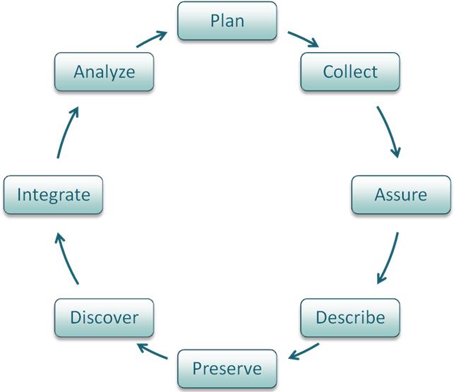
DataONE lifecycle diagram
Notes:
## DataONE lifecycle diagram
This is a very general data “lifecycle” or “lifetime” diagram that informs this workshop series.
The diagram was developed by DataONE (The Data Observation Network for Earth), one of many organizations promoting good practices in data management.
The full DataONE diagram has eight components or stages, starting at the top and following the arrows:
- Plan: description of the data that will be compiled, and how the data will be managed and made accessible throughout its lifetime
- Collect: observations are made either by hand or with sensors or other instruments and the data are placed a into digital form
- Assure: the quality of the data are assured through checks and inspections
- Describe: data are accurately and thoroughly described, relevant information about the data (metadata) is written using the appropriate standards
- Preserve: data are submitted to an appropriate long-term archive or repository
- Discover: potentially useful data are located and obtained, along with the relevant information about the data (metadata)
- Integrate: data from disparate sources are combined to form one homogeneous set of data that can be readily analyzed
- Analyze: data are analyzed
As I mentioned, this diagram is generic.

Slide 8
DataONE lifecycle diagram
Notes:
The life of your data will be much more specific for your research. This could be one way that you work with data over the course of your project.
As a graduate student, you may also only be responsible for specific components of the lifecycle. Nonetheless, you should be aware,that the life of research data involves many components. For which, you, or someone else, is likely to be responsible.

Slide 9
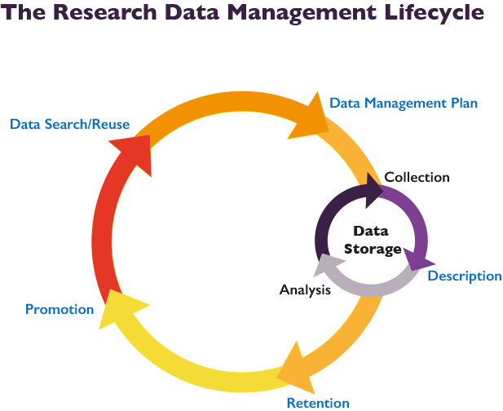
Notes:
This lifecycle diagram was developed by the Libraries at University of California in Santa Cruz. It describes the life of data a little differently.

Slide 10
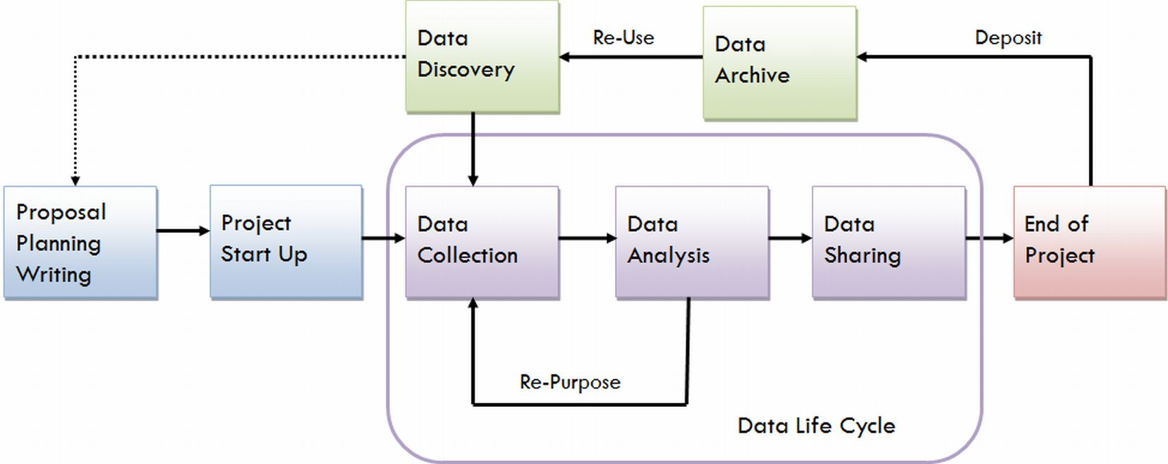
Notes:
This lifecycle diagram was developed by the Libraries at University of Virginia.

Slide 11
Discussion
Would you change anything about the diagram you made?
Notes:
## Discussion
Now that you’ve seen a few different overviews of how the management of research data progresses over time.
Would you change anything about the diagram you made?
Did you miss anything when you were thinking about your own data?
Maybe the lifecycles will account for something you didn’t think about?
Maybe they will be too general, and you included more detail?
The life of your data will be specific for your research. Ultimately, there isn’t a right or wrong way to outline the life of your data, but there are going to be common stages that you go through.
Everyone describe the general lifecycle a little differently. These are generic and written from the perspective of librarians and data curators. In particular they focus on the use and re-usability of the data, and this is an essential component of good data management. Thinking in terms of usability in the future, both for yourself and for others.

Slide 12
Workshops
1. Build an overview
2. Collect and document data
3. Store digital data
4. Work with data
5. Share and preserve data
6. Plan ahead
Notes:
This workshop series will follow steps in the data lifecycle. But it will take a simpler approach and more from the researcher (your) perspective.
Next workshop we will get more specifically at collecting data and documenting data throughout your research projects.
Then we’ll discuss good practices for storing data you’ve collected, including file organization, version control, storage media and data security.
We’ll move on the following week to working with data, including quality control and data processing to prepare for analysis.
In week 5 we will cover data sharing and preservation, including file format and metadata considerations, saving data for the long-term, sharing data with others, and reusing data that others have created.
Finally, in the last week we will discuss writing a formal plan for research data management (aka a data management plan) using the what we’ve learned in previous workshops, and strategies for working collaboratively.
We have one more topic as part of today’s overview. Up next: Legal and ethical considerations to be aware of.

Slide 13
References and resources
DataOne. "Data Lifecycle" [Website](https://www.dataone.org/data-life-cycle)
University of California, Santa Cruz. “Research Data Management Lifecycle” [Website](http://guides.library.ucsc.edu/datamanagement)
University of Virginia. “Steps in the Data Life Cycle” [Website](http://data.library.virginia.edu/data-management/lifecycle/)

Slide 14
Break

