Slide 1

Introduction to Research Data Management
Welcome
Notes:
Please sign in and grab a snack
## Objectives
- Understand the purpose of Research Data Management training.
- Understand the the scope of the workshop series.

Slide 2
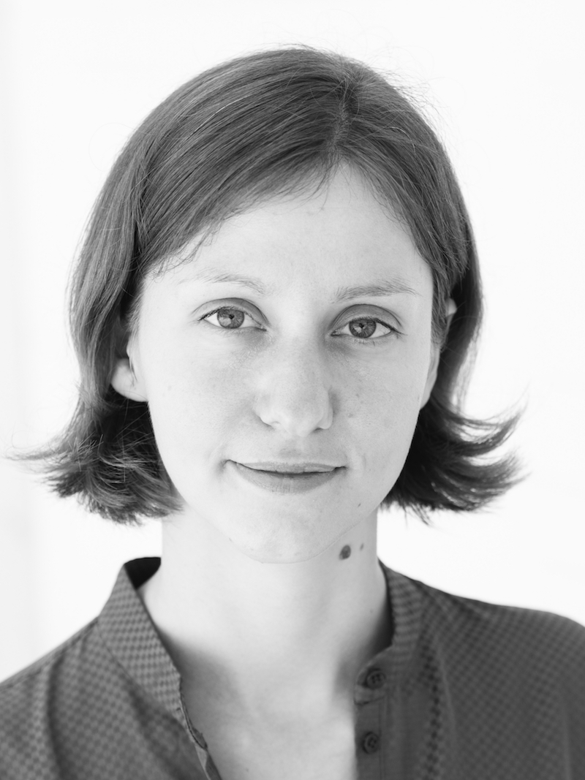
Anna Dabrowski Data Management Librarian Texas A&M University Libraries
Notes:
## Introduction
My name is Anna Dabrowski. I'm the Data Management Librarian at the Texas A&M University Libraries.
This is a new position, which means I'm working on expanding our data services here at the Libraries and this workshop series is one way for us to do that.
This is the first time I’m teaching this series and you are my guinea pigs. So, I’d appreciate your feedback.
Your subject librarians are also an excellent resource for you.

Slide 3
Introductions
1. Your name
2. What do you study, or intend to study, in your research?
3. Do already have, or work with, data?
Notes:
### Introductions
Go around and introduce yourselves, your name and a bit about yourself and your experience so far.
1. Your name
2. What do you study or intend to study in your research?
3. Do already have, or work with, data?

Slide 4
Our schedule
Six Thursday evenings
September 28 – November 2
4:30 pm – 7:00 pm
Two 10-minute breaks
Notes:
## About the workshop series
This workshop series is a 6-part introduction to Research Data Management. We will spend 2.5 hours in each workshop, with two 10-minute breaks.
Each week we will cover different topics, with the goal of helping you identify data management practices and tools that will improve your research and your graduate experience.
[Thursday]
[September 28 – November 2]

Slide 5
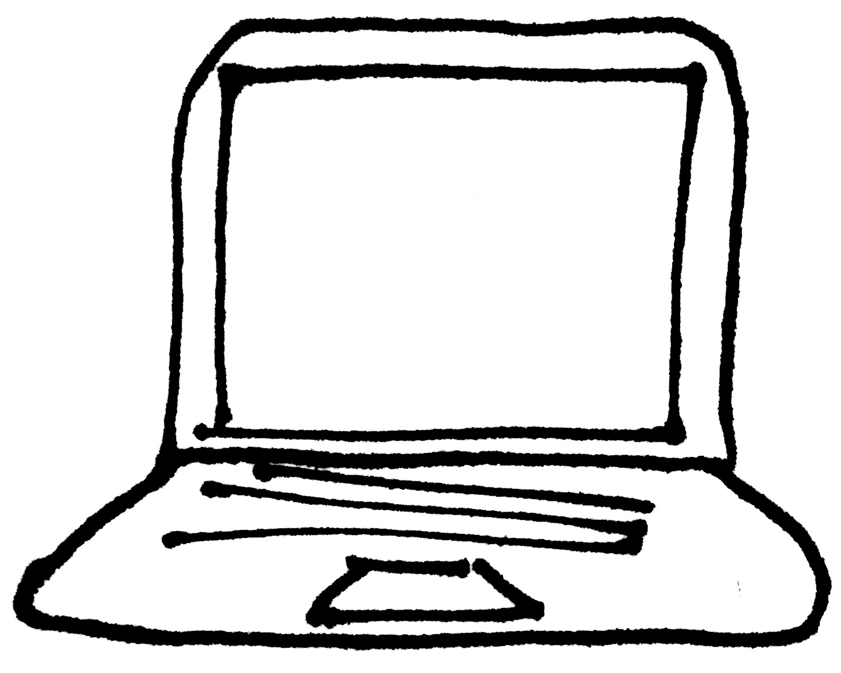

&
Notes:
- Bring a laptop if you have one. If not, you may borrow one from the library. Or use the computer at your seat
- Since it's late in the evening, we'll have snacks during our breaks.

Slide 6
Our agreement
Broad introduction.
No prerequisites and no grades.
Notes:
### Our agreement
By participating in this workshop series, we have an agreement.
Please be aware that we are a group of people with diverse experiences and who are dealing with different subject matter. This is a general introduction, with no prerequisites. The series is broad rather than deep. Some topics are likely to be more familiar to you than others, and (fair warning) we may even cover topics that aren't directly applicable to your specific research area.
This said, I'm eager to get your feedback and direct the material based on your interest. I would like you all to feel welcome to share your experience, and to express your thoughts, comments, and questions.

Slide 7
Our agreement
Broad introduction.
No prerequisites and no grades.
One rule Individuals who behave in a manner that shows indent to exclude, intimidate, or cause discomfort to others will be asked to leave.
Notes:
Along these lines, there is one rule:
**Individuals who behave in a manner that shows indent to exclude, intimidate, or cause discomfort to others will be asked to leave.**

Slide 8
Our agreement
Broad introduction.
No prerequisites and no grades.
One rule Individuals who behave in a manner that shows indent to exclude, intimidate, or cause discomfort to others will be asked to leave.
One expectation Active participation.
Notes:
Since there is no grade, this is a chance for you to gain familiarity, practice, ask questions, and be silly (if you want). You should be aware that exercises and hands-on activities are key elements of the workshops, and active participation is expected.
We have a long wait list for this workshop series. If you prefer not to participate, I ask that you please give up your seat to someone on the wait list. There are many great RDM resources available online.. I'm happy to send you all the resources for this series so that you can learn on your own without needing to participate.
If you're choosing to be here, then you're choosing to join in a group conversation.
If you have a question, or I'm unclear, please ask. I may not have an answer for you right away, but I will do my best to find one for you.

Slide 9
Defining data
How would you define research data? What is it to you?
Notes:
## Defining data
There are many definitions for data.
The National Institutes of Health define research data as “Recorded factual material commonly accepted in the scientific community as necessary to document and support research findings” (National Institutes of Health).
The National Science Foundation’s definition describes data as something “determined by the community of interest through the process of peer review and program management” (National Science Foundation). Examples of data provided by NSF include data, publications, samples, physical collections, software, and models.
The National Endowment for the Humanities defines data as “materials generated or collected during the course of conducting research” and provides a wider variety of examples of data than NIH or NSF (National Endowment for the Humanities).

Slide 10
Defining data
Research data are information artifacts that scholars draw upon for evidence in supporting research claims, and producing new knowledge.
Notes:
## Defining data
There are many definitions for data.
This is the definition of data we will work with in this workshop series: Research data are information artifacts that scholars draw upon for evidence in supporting research claims, and producing new knowledge.
What data are to you, will largely depend on your discipline, the sorts of things you study and the manner in which you study them.
We can think about data very broadly within this definition. Research data could include physical artifacts, such as a biological specimen, an architectural blue print, or a paper map. Our focus will be primarily on managing digital data.

Slide 11
Research data management
Research data management (RDM) refers to the practices of organizing, documenting, storing, sharing, and preserving data collected during a research project.
The aim of research data management is to ensure that data are usable over time.
Notes:
With that definition in mind, this workshop series will cover topics in Research Data Management.
Research Data Management (RDM) refers to the practices of organizing, documenting, storing, sharing, and preserving data collected during a research project.
The aim of research data management is to ensure that data are usable over time.
The idea of usability over time, and across platforms, will keep coming up in this workshop series and drives a lot of the recommended practices we will discuss.

Slide 12
Discussion
Why is research data "management" a thing?
Notes:
### Discussion
based on this definition.
I’d like to hear from you why you think research "data management" is a thing? Why do we think it’s important?
What could be the benefits of organizing, documenting, storing, sharing, and preserving data?
(It’s okay to say “my advisor seemed to think it’s important”)

Slide 13
Discussion
Why is research data "management" a thing?
Personal efficiency
Notes:
- Personal efficiency
- If you aren't already, you'll soon be busy. Or you'll just want to spend *some* of your time not working.
- Thinking about data management strategies early will help you be more effective throughout your PhD and reduce the amount of work at the end.

Slide 14
Discussion
Why is research data "management" a thing?
Personal efficiency
Happy advisors
Notes:
- Happy advisors
- Understanding these concepts will make your advisors happy, they'll be able to easily see what you're doing and spend less time teaching you.

Slide 15
Discussion
Why is research data "management" a thing?
Personal efficiency
Happy advisors
The future
Notes:
- The future
- The time will come when you've entirely forgotten what you did that one week in the 2nd or 3rd year of your PhD and don't want someone to emailing you to ask about it 5 years later.
- Good practices will benefit you and the community.
- Depending on how you share your data it will be reusable, by you, your advisor, your lab, and/or the research community in the future.
- And! You will get credit for your work.

Slide 16
Topics covered
Collecting and formatting data for easy analysis.
File organization and naming conventions for identification.
Documentation and version control for tracking changes and roll-back.
Managing storage and access locations for security and collaboration.
Back-up procedures for redundancy.
Quality control for integrity.
Policies for sharing and reuse.
Archiving for future accessibility.
Notes:
The Research Data Management topics we’ll cover include…

Slide 17
Question
What do you hope to gain from the workshop series?
Notes:
[Monday] Manage data on multiple projects (The practices and recommendations we discuss should help you with this, and in our last workshop we will discuss collaboration as a topic), Meet HIPAA requirements for data security, Document and store large datasets (These are both very project specific and we will cover this topics and should provide you with some resources).
[Thursday] Data management planning (We’ll package everything up into data management planning in our last workshop), Data visualization for reporting and analysis (We will briefly talk about data visualization, but this topic is a little tangential to RDM, and we actually have another workshop series, more oriented to data literacy that covers data visualization more in depth)

Slide 18
References and resources
DataONE. "Primer on data management" [PDF](http://escholarship.org/uc/item/7tf5q7n3)

Slide 19
Break

