Slide 1
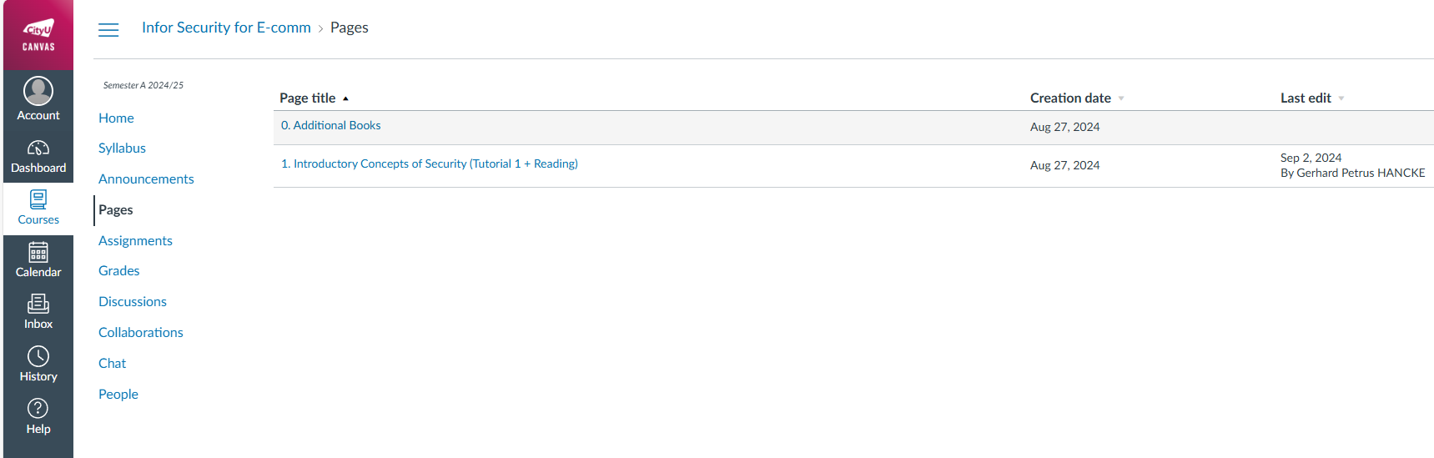
0. Additional Books
· Security Engineering - A Guide to Building Dependable Distributed Systems (cam.ac.uk)
· Handbook of Applied Cryptography (uwaterloo.ca)

Slide 2
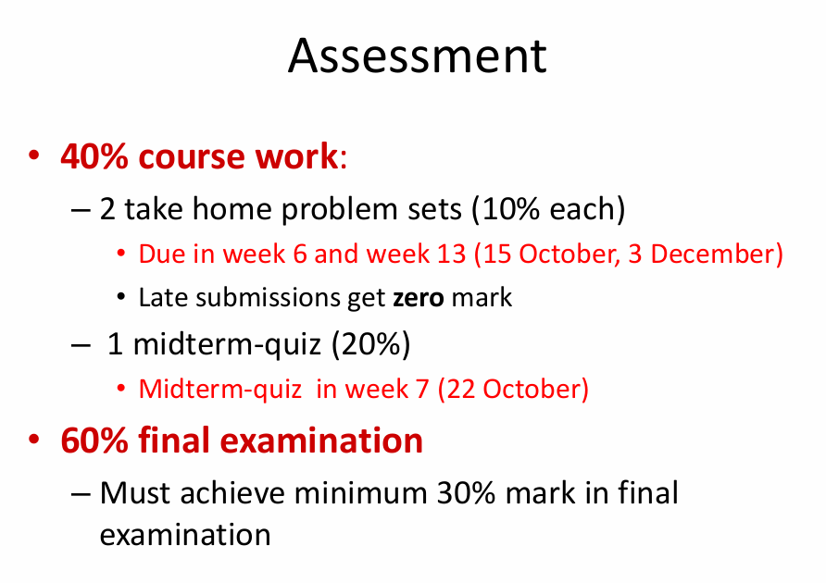
Teaching Team
• Instructor:
– Prof. Gerhard HANCKE
– Email: gp.hancke@cityu-dg.edu.cn
– Questions: Contact me
• Teaching Assistants:
– BOSHOFF Dutliff(dboshoff2-c@my.cityu.edu.hk)
– LI Yiyu (yiyuli2-c@my.cityu.edu.hk)
– NKROW Raphael (renkrow2-c@my.cityu.edu.hk)
– ZHANG Zhifu (zhifzhang3-c@my.cityu.edu.hk)

Slide 3
Terminology 术语
Symmetric encryption 对称加密
Asymmetric Encryption 非对称加密
Adversary n.对手

Slide 4
Week2 的Canvas的Pages说明
本周slides有pdf有ppt以便能看动画
谈到数据泄露案例，有两个网站可以看看：
https://www.informationisbeautiful.net/visualizations/worlds-biggest-data-breaches-hacks/
https://digitalguardian.com/blog/history-data-breaches

Slide 5
又补充了两本书：
Bruce Schneier’s Applied Cryptography
Introduction to Modern Cryptography

