Slide 1


COS711 Assignment 2 [Your Name and Student number]

Slide 2
Experimental Setup
Briefly discuss all libraries and tools that you have used. What hardware did you use to run experiments?
Bullets
Bullets
Bullets
Bullets
Bullets

Slide 3
Data Preparation
Discuss all data preparation steps taken
Bullets
Bullets
Bullets
Bullets
Bullets

Slide 4
Hyperparameter Tuning
Do not forget to add the heatmaps
Bullets
Bullets
Bullets
Bullets
Bullets

Slide 5
Sign-Based Adaptive Learning Rate
Discuss how you have implemented sign-based adaptive learning rate, and show the results: how successful was it?
Bullets
Bullets
Bullets
Bullets
Bullets

Slide 6
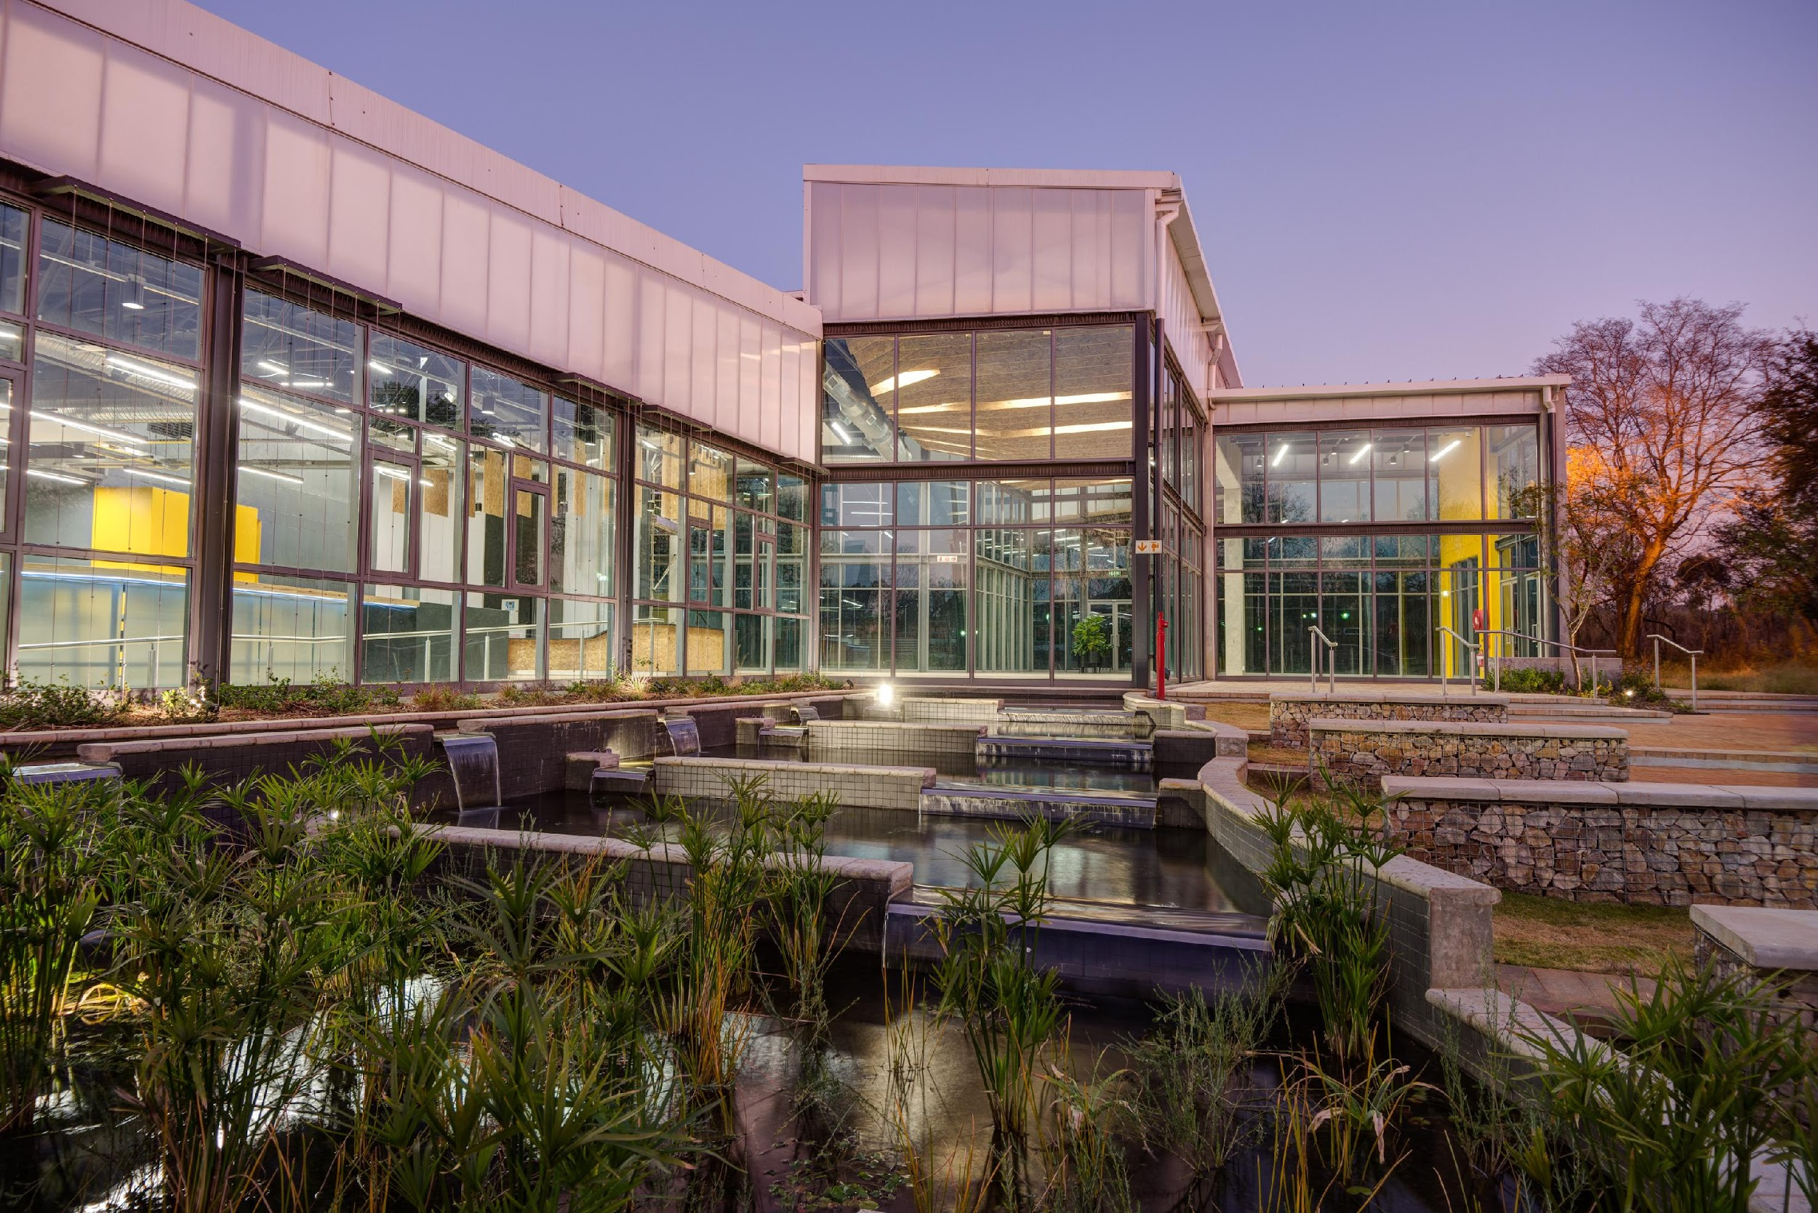
Conclusions
Very general conclusions about the assignment that you have done.
This section ``answers'' the questions and issues that you have raised and investigated.
This section is, in general, a summary of what you have done, what the results were, and finally what you concluded from these results

Slide 7
Bibliography
Paper 1
Paper 2
Website 3

