Slide 1

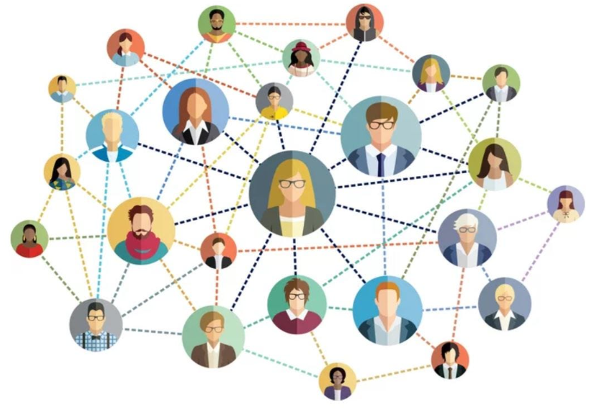
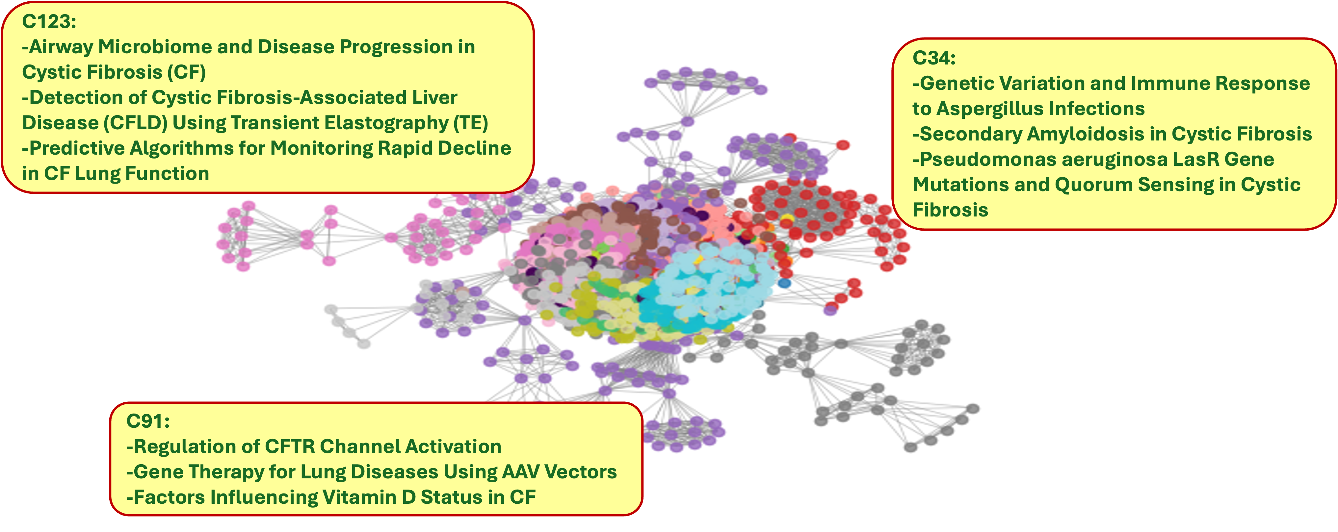
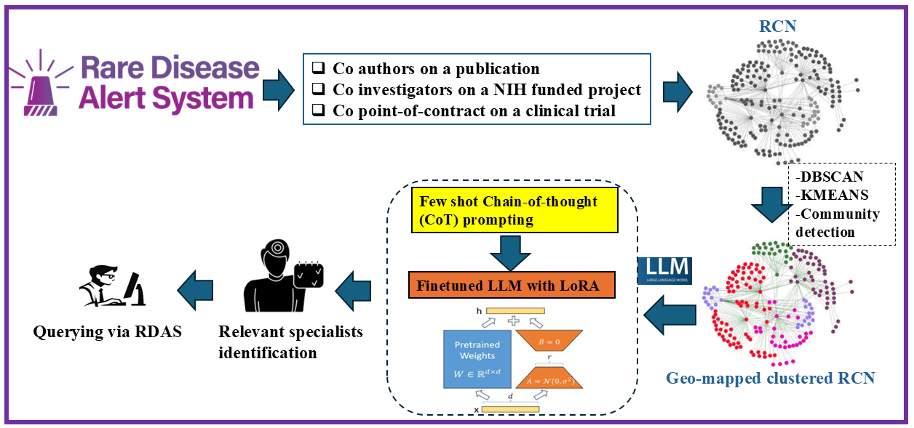
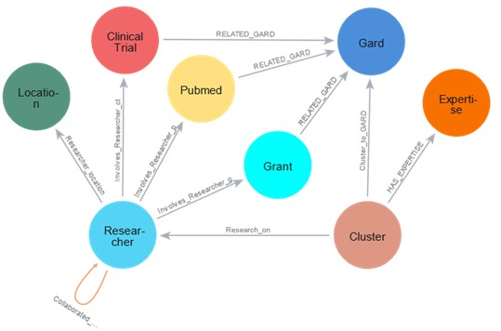
Rare Disease Research Collaborative Network (RCN) Development for Rare Disease Specialist Recommendation
Jaber Valinejad¹, Yanji Xu¹, Qian Zhu²
¹ Division of Rare Disease Research Innovation, National Center for Advancing Translational Sciences (NCATS), NIH
² Division of Preclinical Innovation, National Center for Advancing Translational Sciences (NCATS), NIH
Introduction
Results
Diagnostic Delay in Rare Diseases (RDs): Patients face significant delays in diagnosis due to a lack of awareness among general doctors and specialists (Phillips et al. 2024), hindering timely referral to experts (Zurynski et al. 2017).
Lack of RD Specialist Coordination: The absence of a coordinated network between RD researchers and specialists limits knowledge exchange (Wan et al 2019, Mason 2020) and impedes advancements in treatment (Tang et al. 2017, Yang et al, 2009, Sabot et al. 2017).
In the RCN, it includes: 91665 authors from PubMed, 44420 investigators in clinical trials and 74857 principal investigators in grant records. The results of the RCN is listed in Table 2.
Table 2. Statistical results for the RCN
Primary Classes | # of nodes | # of edges
GARD Disease | 7852 | 1625656
PubMed Article | 632290 | 2272483
NIH Funded Project | 310614 | 782401
Clinical Trial | 58158 | 174103
Researcher | 215462 | 2067656
Location of Affiliation | 3755 | 180951
Research Cluster | 50153 | 200312
Research Expertise | 150159 | 150159
Solution
Specialist: Dr Keith Brownlee
Affiliation: Cystic Fibrosis Trust
Expertise: respiratory infections and management of airway clearance in people with cystic fibrosis
Location: London, UK
Rare Disease Research Collaborative Network (RCN): Developed a network of RD researchers using clustering algorithms and large language models to identify potential collaborations and recommend specialized experts for improved patient care.
Researchers are grouped into clusters based on their specific areas of expertise and the extent of their collaborative interactions. Each cluster is visually differentiated by color, highlighting unique research themes or specialization areas within the network. An example of the clusters labeled with research expertise summarized by the LLM. With the labeled RCN, we would be able to recommend appropriate RD specialists and potential collaborations.
Method
In this project, we collect information about RD researchers from the Rare Disease Alert System (RDAS), including authors on publications, investigators on NIH funded projects and leads on clinical trials. The RCN was developed based on co-authorship, co-investigations and co-leaderships accordingly. We applied clustering algorithms to cluster the RCN, and the large language model (LLM) to summarize research expertise for each cluster, from where we would recommend RD specialists and potential research collaborations. Figure 1 illustrates the architecture of the RCN development. To semantically represent information, we collected and generated in a knowledge graph, we defined a data model shown in Figure 2. Table 1 lists data properties for each class.
Figure 3. An example of the RCN clusters labelled with the summarized research expertise
Discussion
The RCN reveals a significant number of collaborations between various researchers. However, it also highlights the presence of isolated researchers who lack connections, namely collaborations with others in the field.
Community detection was unsuitable due to isolated researchers being grouped into a single cluster. K-means, while incorporating textual data, required a predefined cluster count, which is challenging for rare diseases. To address these issues, we opted for DBSCAN.
We aim to refine our recommendation system using semantic similarity techniques, such as Microsoft BiomedNLP-PubMedBERT, to recommend top-ranked researchers based on expertise, ensuring more accurate and relevant collaboration matches.
Continued development of social network analysis and large language models will help overcome challenges in rare disease research, accelerating discovery and improving patient outcomes.
Figure 1. Architecture of the RCN development
Table 1. Data properties for each defined class
Acknowledgements
Primary Classes | Associated Data Properties
GARD Disease | GARD ID, GARD name
PubMed Article | full Name, title, affiliation, pubmed id, abstract Text, keyword, Mesh terms
NIH Funded Project | pi name, organization name, title, application id, abstract, terms, core project number
Clinical Trial | Official Name, Official Affiliation, Brief Title, Official Title, Brief Summary, NCT Id , Location City, Location State, Location Country, Interventions
Researcher | Name, Affiliation name, Contact information, Affiliation Zip code
Location of Affiliation | Affiliation country, Affiliation state, Affiliation county, Affiliation city, Affiliation FIPS
Research Cluster | Cluster ID, Cluster Size, Evidence, Key terms
Research Expertise | Summarized expertise
This project was partially supported by the intramural programs (ZIA TR000410-05) at NCATS.
References
Phillips, Christine, et al. "Time to diagnosis for a rare disease: managing medical uncertainty. A qualitative study." Orphanet Journal of Rare Diseases 19.1 (2024): 297.
Zurynski, Yvonne, Marie Deverell, Troy Dalkeith, Sandra Johnson, John Christodoulou, Helen Leonard, Elizabeth J. Elliott, and APSU Rare Diseases Impacts on Families Study group. "Australian children living with rare diseases: experiences of diagnosis and perceived consequences of diagnostic delays." Orphanet journal of rare diseases 12 (2017): 1-9.
Mason, S. (2020). Adoption and usage of ASNs: A Japan case study. Scientometrics.
Wan, H., Zhang, Y., Zhang, J., & Tang, J. (2019). AMiner: Search and Mining of ASNs. Data Intelligence.
Tang, J., Zhang, D., & Yao, L. (2007). Social Network Extraction of Academic Researchers. ICDM 2007.
Yang, Y., Au Yeung, C. M., Weal, M. J., & Davis, H. (2009). The Researcher Social Network. WebSci'09.
Sabot, K., Wickremasinghe, D., Blanchet, K., Avan, B., & Schellenberg, J. (2017). Use of SNA methods in healthcare. BMC.
Figure 2. Pre-defined data model for RCN

