Slide 1
A PROJECT ON THE PROJECTILE MOTION

Slide 2
Submitted By:
JABER AL MAHAMUD
BATCH-13(BU-EDGE) DEPARTMENT OF PHYSICS UNIVERSITY OF BARISHAL
Submitted To:
MD. ERFAN
ASSISTANT PROFESSOR & CHAIRMAN DEPARTMENT OF CSE UNIVERSITY OF BARISHAL

Slide 3
Contents:
What is Projectile?
What is Projectile Motion?
Picture Representation of Projectile.
Why is it necessary
Data Sample for EXCEL analysis.
EXCEL analysis of Given Data.

Slide 4
What is Projectile?
A projectile is any object thrown into space upon which the only acting force is gravity.
The primary force acting on a projectile is gravity. This doesn’t necessarily mean that other forces do not act on it, just that their effect is minimal compared to gravity.
The path followed by a projectile is known as a trajectory.
A baseball batted or thrown is an example of a projectile.

Slide 5
What is Projectile Motion?
When a particle is thrown obliquely near the earth’s surface, it moves along a curved path under constant acceleration directed towards the centre of the earth The path of such a particle is called a projectile, and the motion is called projectile motion.
In a Projectile Motion, there are two simultaneous independent rectilinear motions:
Along the x-axis: uniform velocity, responsible for the horizontal (forward) motion of the particle.
Along the y-axis: uniform acceleration, responsible for the vertical (downwards) motion of the particle.

Slide 6
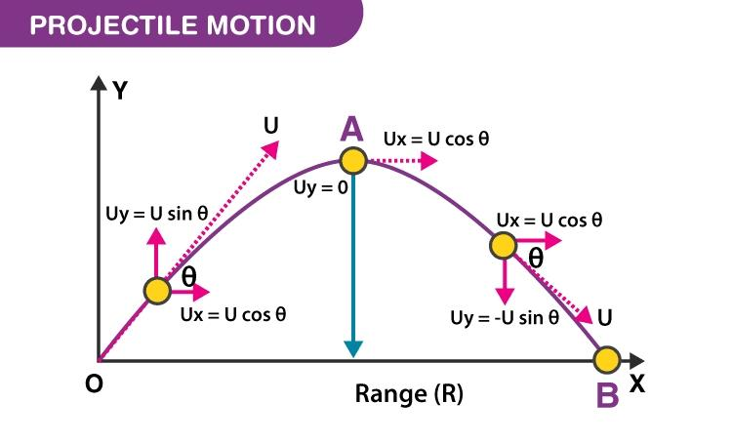
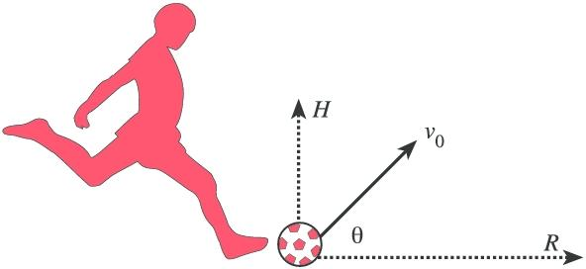
Picture Representation of Projectile:

Slide 7
Why is it Necessary?
Projectile motion is crucial in physics for its practical and theoretical importance:
Understanding Forces and Motion: It reveals how gravity and other forces affect moving objects, foundational in physics.
Engineering Applications: Engineers design and optimize trajectories in aerospace, automotive, and sports using projectile principles.
Predicting Trajectories: Accurate path prediction is essential for launching satellites and sports strategies.

Slide 8
Why is it Necessary?
Safety and Defense: Vital for military targeting and defense systems for accurate ordnance delivery.
5. Scientific Exploration: Space missions rely on projectile motion to plot spacecraft trajectories efficiently.
6. Everyday Applications: Useful in sports, entertainment, and daily activities to understand and predict object paths.

Slide 9
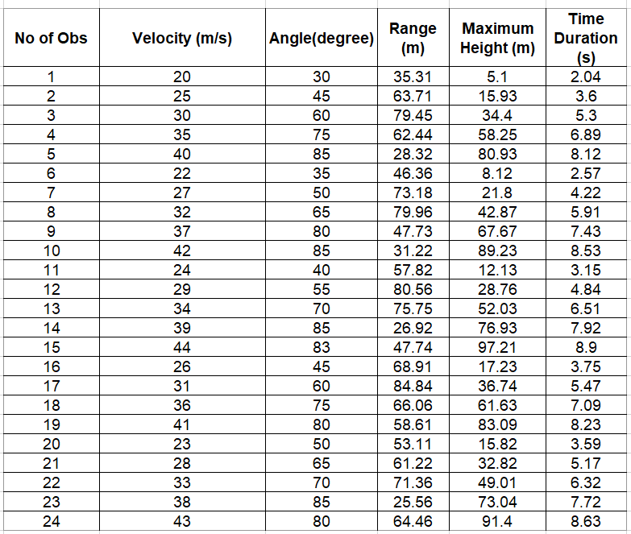
Data Sample for EXCEL analysis:

Slide 10
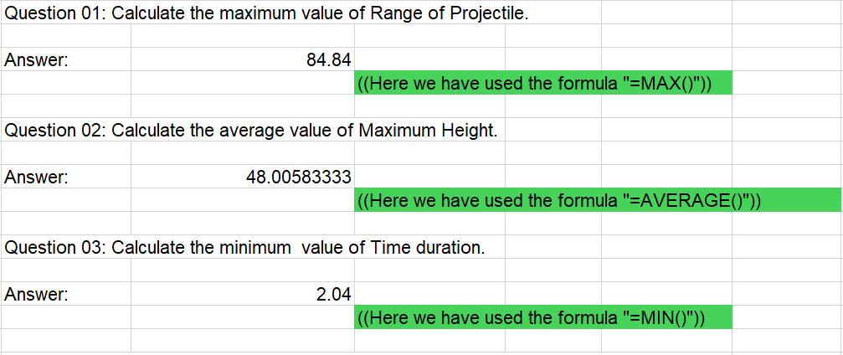
Excel analysis:
To watch the excel Click here

Slide 11
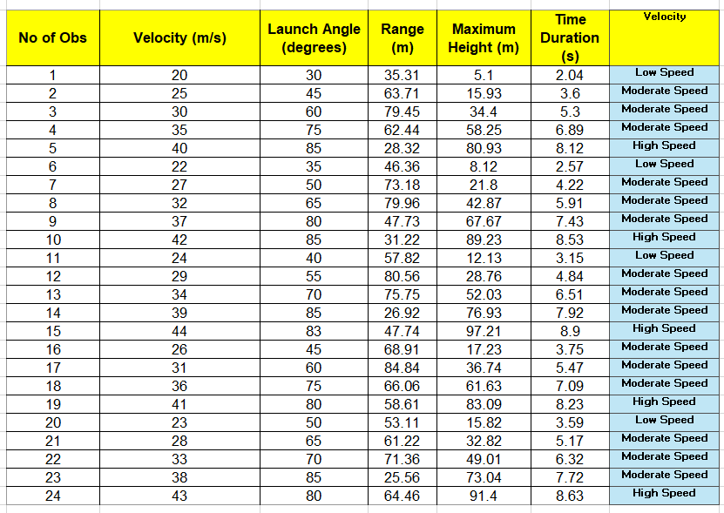
Excel analysis:
To watch the excel sheet Click here

Slide 12
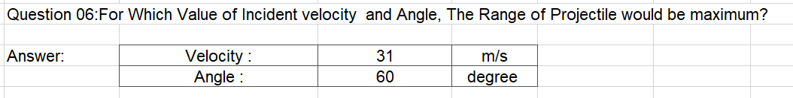
Excel analysis:
To watch the excel sheet Click here

Slide 13
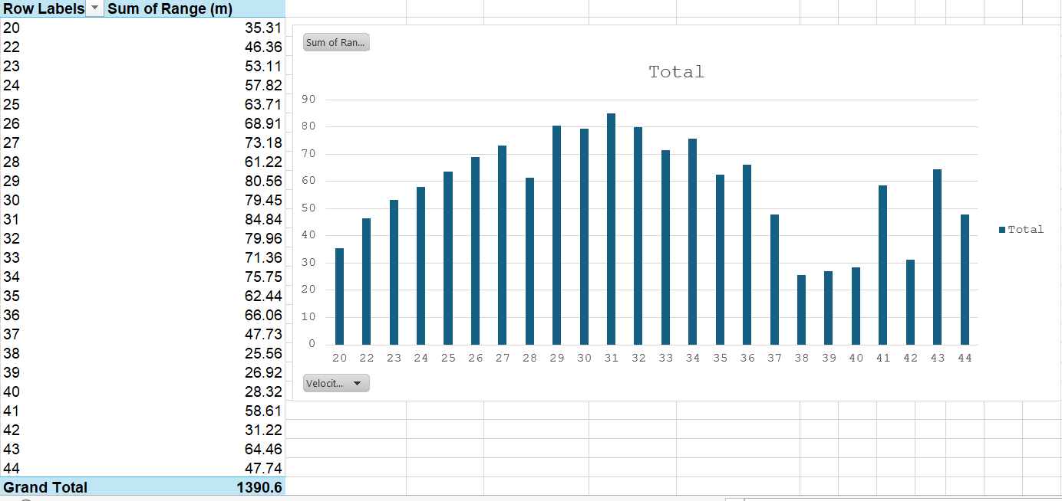
Excel analysis:
To watch the excel sheet Click here

Slide 14
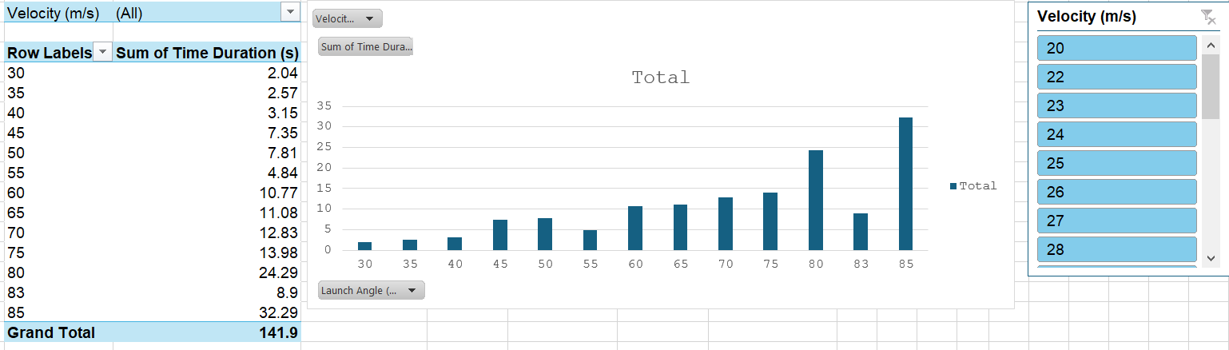
Excel analysis:
To watch the excel sheet Click here

Slide 15
THE END

