Slide 1
Introduction to Mininet / POX / Pyretic
In the name of Allah
December 2017

Slide 2
What Will We Talk About?
Introduction
Mininet
Installation
Basic Commands
Mininet with default controller
POX Controller
Installation
Layer 2 Learning Switch
Spanning Tree Switch
Exercise 1
Pyretic language
Installation
Example
Exercise 2

Slide 3
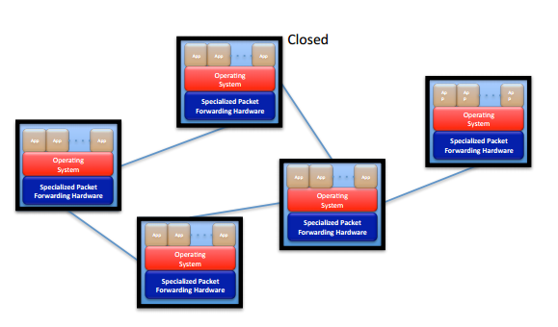
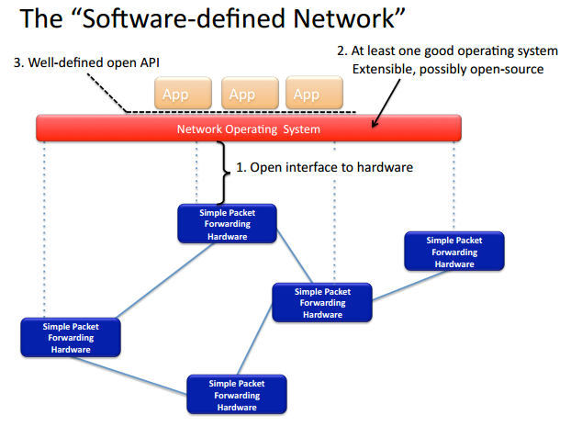
SDN Philosophy

Slide 4
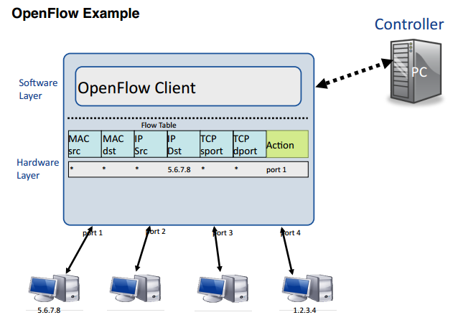
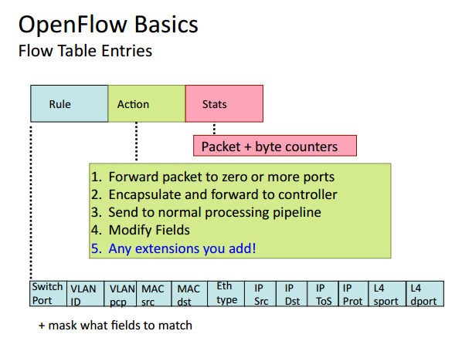
SDN Philosophy

Slide 5
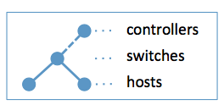
Mininet
Get Started With Mininet:
Mininet VM Installation
Installation from Packages
Native Installation from Source
git clone git://github.com/mininet/mininet
cd mininet
git tag
git checkout 2.2.2
cd ..
mininet/util/install.sh

Slide 6
Creating First Network with Mininet ☺
sudo mn --topo tree,depth=2,fanout=8 --test pingall
$ sudo mn -c
Start a minimal topology and enter the CLI:
mininet> help
mininet> nodes
mininet> net
mininet> dump
mininet> xterm h1 h2
Mininet’s API in Python

Slide 7
Mininet’s API in Python
from mininet.topo import Topo
from mininet.net import Mininet
class DCTreeTopo(Topo):
def build(self):
CoreSwitch1 = self.addSwitch('s1’)
AggSwitch1 = self.addSwitch('s' )
self.addLink(CoreSwitch1,AggSwitch1,bw=100, delay='5ms')
host1 = self.addHost('h1')
self.addLink(host1, EdgeSwitch1,bw=10, delay='15ms')
if __name__ == '__main__':
topo = DCTreeTopo(k)
net=Mininet(topo) net.addController(name='c0',controller=RemoteController,ip='127.0.0.1',port=6633)
net.start()
CLI(net)
net.stop()

Slide 8
Useful Utility
iperf:
Iperf is a tool to measure the bandwidth and the quality of a network link.
On server side (h2 for example):
# iperf –s
On client side (h1 for example):
# iperf –c 10.0.0.2

Slide 9
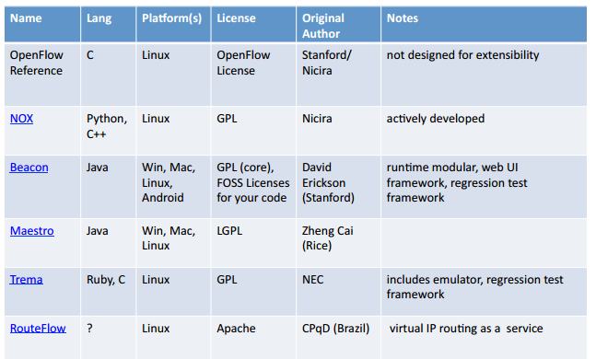
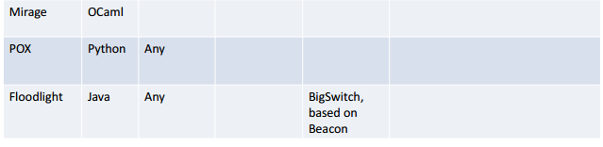
Controllers Suitable for Mininet

Slide 10
POX Controller
$ sudo mn --controller=remote, ip=[controller IP], port=[controller listening port]
Getting the Code / Installing POX
$ git clone http://github.com/noxrepo/pox
$ cd pox
Invoking POX
./pox.py forwarding.l2_learning

Slide 11
Hub Behavior
root@Ubuntu:# mn --topo single,3 --controller=remote,ip=127.0.0.1,port=6633
mininet> xterm h1 h2 h3
root@ubuntu:~/pox# ./pox.py forwarding.hub
In the xterms for h2 and h3, run tcpdump, a utility to print the packets seen by a host:
# tcpdump -XX -n -i h2-eth0
# tcpdump -XX -n -i h3-eth0
In the xterm for h1, send a ping:
# ping -c1 10.0.0.2
Now, see what happens when a non-existent host doesn't reply.
# ping -c1 10.0.0.5

Slide 12
pox/forwarding/l2_learning.py
The launch function
def launch (transparent=False, hold_down=_flood_delay):
core.registerNew(l2_learning)
A Class with Component name:
class l2_learning (object):
def __init__ (self, transparent):
core.openflow.addListeners(self)
self.transparent = transparent
def _handle_ConnectionUp (self, event):
LearningSwitch(event.connection, self.transparent)

Slide 13
LearningSwitch
class LearningSwitch (object):
def __init__ (self, connection, transparent):
self.connection = connection
self.transparent = transparent
self.macToPort = {}
def _handle_PacketIn (self, event):
def flood (message = None):
def drop (duration = None):
self.macToPort[packet.src] = event.port # 1

Slide 14
Packet_In Handler
if packet.dst.is_multicast:
flood()
else:
if packet.dst not in self.macToPort:
flood()
else:
port = self.macToPort[packet.dst]
if port == event.port:
drop()
return

Slide 15
Packet_In Handler
msg = of.ofp_flow_mod()
msg.match=of.ofp_match.from_packet(packet, event.port)
msg.idle_timeout = 10
msg.hard_timeout = 30
msg.actions.append(of.ofp_action_output(port = port))
msg.data = event.ofp
self.connection.send(msg)

Slide 16
POX APIs
Working with POX: The POX Core object
from pox.core import core
Working with Addresses: pox.lib.addresses
from pox.lib.addresses import IPAddr, IPAddr6, EthAddr
ip = IPAddr("192.168.1.1")
Events With Multiple Listeners
specifying priority in addListener() or addListeners()
halting events

Slide 17
OpenFlow Events & Messages
ConnectionUp
ConnectionDown
PacketIn
packet_out
flow_mod

Slide 18
Pyretic Language
Existing SDN controllers offer programmers a low-level programming interface akin to assembly language.
We present Pyretic, a programming platform that raises the level of abstraction and enables the creation of modular software, allowing programmers to create sophisticated SDN applications.
Pyretic encourages programmers to focus on how to specify a network policy at a high level of abstraction, rather than how to implement it using low-level OpenFlow mechanisms.

Slide 19
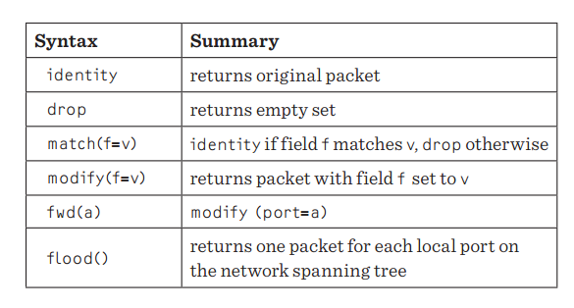
Network Policy as a Function
Building the Pyretic VM
Install Python dependencies
Patch asynchat Python dependency
Install git subtree
Clone the pyretic repository to your home directory
Setup your environment variables EITHER by adding the following lines to end of .profile
https://github.com/frenetic-lang/pyretic/wiki/Building-the-Pyretic-VM

Slide 20
Parallel and Sequential Composition
match(dstip=’2.2.2.8’) >> fwd(1)
match(switch=1) >> match(dstip=’2.2.2.8’) >> fwd(1)
L = match(dstip=’1.2.3.4’) >>
((match(srcip=’0.0.0.0/1’)>> modify(dstip=’2.2.2.8’)) +
(-match(srcip=’0.0.0.0/1’)>> modify(dstip=’2.2.2.9’)))
L=match(dstip=’1.2.3.4’) >>if_(match(srcip=’0.0.0.0/1’),
modify(dstip=’2.2.2.8’),modify(dstip=’2.2.2.9’))

Slide 21
The Exercises Explanation
Access Control Module in POX Controller
Firewall Module in Pyretic

Slide 22
Other Codes & Commands
sudo apt-get update
sudo apt-get upgrade
sudo apt-get install python
sudo apt-get install git
ssh mininet@192.168.206.137
export pythonpath=$home/pyretic:$home/mininet:$home/pox
chmod 777 –r .
scp my_firewall.py mininet@192.168.206.137:pyretic/pyretic/modules

Slide 23
Email: z330.sasan@gmail.com || High Speed Networks Lab

