Slide 1
Encrypto – hello world!
!dlrow olleh
Implemented by J. Zhong
Idea inspired by M. Adib
Criticized by R. Senaasdfasdfasdfasnayake

Slide 2
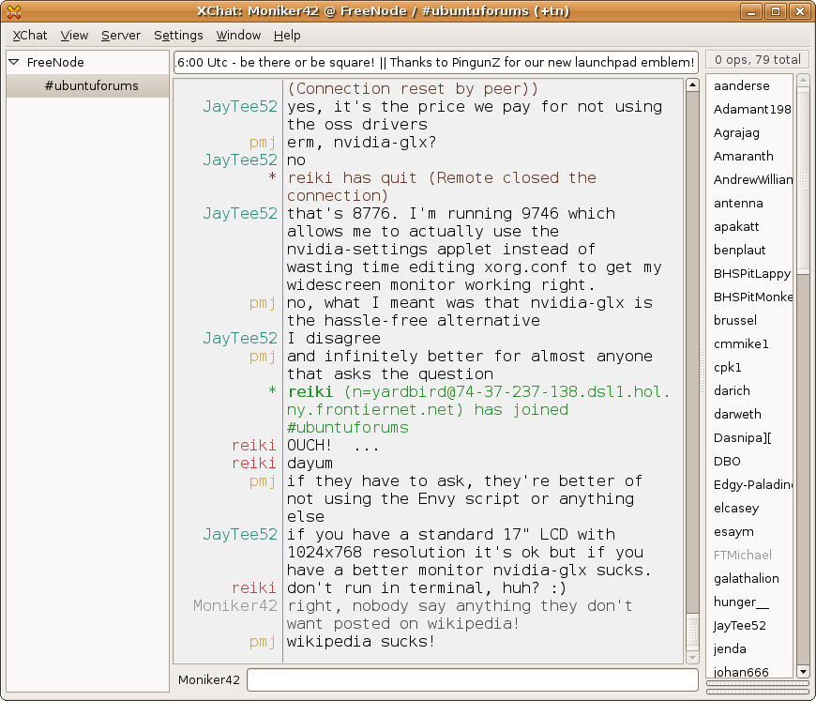
Initial Goals
IRC (Internet Relay Chat)
  “An application that facilitates transfer of messages in the form of text” (Wikipedia)
i.e.
  Facebook
  Skype
  picoCTF IRC
  Twitch.tv

Slide 3
But…
Instead of Chat Channels…
  Separation through Encryption!
Input -> Channel (server)
Input -> Encryption (client)
Channel Relays Input back to client(s) (server)
Instantaneous Relay back to client(s)
Output -> Decryption (client)

Slide 4
Difficulties
Security
  Hi Ryan.
Latency
  Server polling
Efficiency
  Live Encryption and Decryption

Slide 5
Easy Part
Login
General Implementation
  Simple PHP Post/Get

Slide 6
What to learn…
Login/Registration
  PHP/Javascript Sessions
Live Encrypting/Decrypting
  Javascript/Jquery
Live Polling
  Jquery(Ajax, Javascript, PHP, XMLHTTP)
  Socket.IO
    “Node.js is love, Node.js is life”

Slide 7
DEMO
Hello world.

Slide 8
Reflections
Security is hard
Speed is hard
  Javascript is fast, although expensive
PHP is hard

Slide 9
Results
Expectations
  Everything works, not elegantly
    Server vs Client
Workarounds
  Youtube, StackOverflow, W3Schools

Slide 10
Future
Design
Node.js
Different Encryption/Decryption Channels
Multiple Chat Channels

Slide 11
For more information
http://www.w3schools.com/php/
http://www.w3schools.com/ajax/
http://www.w3schools.com/js/
http://www.w3schools.com/jquery/

