Slide 1
DocLite
01 / 11
LESS PAPER. MORE PROOF.
DocLite
AI-Powered Risk-Based Documentation Reduction Engine for Medical Devices
“We don’t help you write 200 documents faster.
We prove you only needed 80.”
Vite · React 19 · TypeScript · cloud LLM gateway · no backend, no database

Slide 2
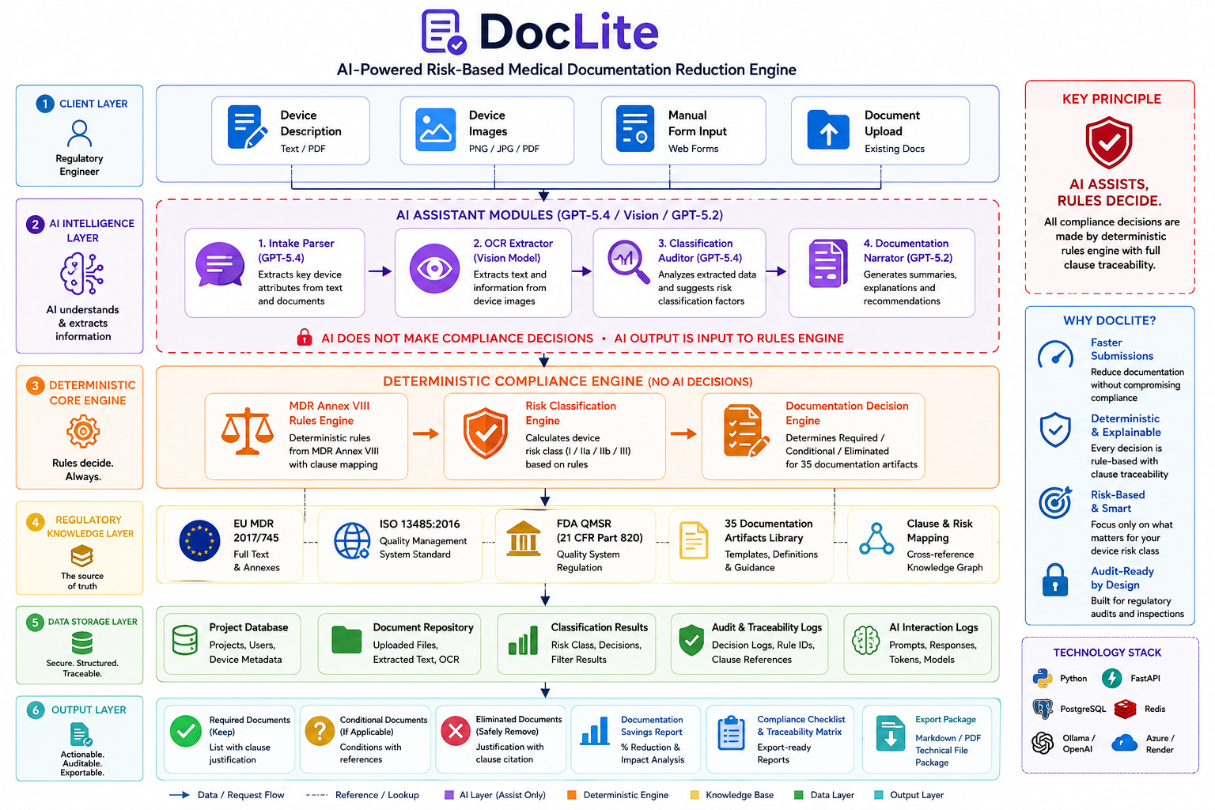

Slide 3
DocLite
02 / 11
THE PROBLEM
Regulation is risk-based.
Documentation practice isn’t.
EU MDR 2017/745 explicitly scales requirements to device risk — that’s the whole premise of Annex VIII. Manufacturers apply the same documentation rigor to a Class I stethoscope as to a Class III implant anyway. No tool defensibly maps device risk down to a minimal compliant documentation set — with proof for every cut.
4
EU MDR risk classes (I, IIa, IIb, III) — one uniform paper trail applied across all of them, today.

Slide 4
DocLite
03 / 11
WHY EXISTING TOOLS DON’T FIX THIS
FormlyAI, Celegence CAPTIS, Greenlight Guru — and DocLite
THEM
DOCLITE
FormlyAI / Dovetail · Celegence CAPTIS · Greenlight Guru
This project
Show you only needed 80 of them — with clause-cited proof for every one removed.
Write your 200 documents faster.

Slide 5
DocLite
04 / 11
THE SOLUTION
Classify. Generate. Prove.
01 · CLASSIFY
→
02 · GENERATE
→
03 · PROVE
Risk class
Minimal set
Cited decision
Every applicable EU MDR Annex VIII rule is evaluated; the strictest hit wins, per Annex VIII 3.5.
35 tracked artifacts sorted into Required, Conditional, or Eliminated for that exact class.
An ISO 13485 clause and MDR reference attach to every artifact — in all three buckets.

Slide 6
DocLite
05 / 11
HOW IT’S BUILT
Free text · photo (OCR) · form
intake
▾
AgentDock → ai/agents.ts
4 agents · mock fallback · parses only
CLOUD LLM GATEWAY
▾
DeviceProfile
Reasoning, vision & lightweight models — key injected server-side by the dev proxy, never bundled to the browser.
16 typed attributes
▾
engine/classify.ts
EU MDR Annex VIII · strictest rule wins
▾
engine/filter.ts × knowledgeBase.ts
35 artifacts · bucket + citation + effort-hours
▾
UI — buckets, traceability, savings, export
recomputes live, no submit button

Slide 7
DocLite
06 / 11
THE DEFENSIBILITY ARGUMENT
AI parses and explains. The deterministic engine decides.
No LLM output ever sets a device class or moves an artifact between buckets. That logic is plain, synchronous TypeScript. Same profile in, same checklist out — every time. Fully reproducible, fully auditable. This is the direct answer to “you can’t let AI decide medical device compliance.” We don’t.

Slide 8
DocLite
07 / 11
EVERY DECISION, TRACED
Class → MDR reference → ISO clause — for all three buckets
REQUIRED
CONDITIONAL
ELIMINATED
Clinical Evaluation Report
Instructions for Use
IEC 62304 Software File
AI sepsis SaMD · Class III
Digital thermometer · Class IIa
Reusable surgical scissors · Class Ir
MDR Art. 61 · Annex XIV
Annex I §23.1(d) — omission possible for Class I/IIa
Annex I §17.1 — n/a, no software component

Slide 9
DocLite
08 / 11
RIGOR SCALES WITH RISK
Effort-hours saved vs. uniform-rigor baseline
IIa and IIb fall between — exact savings depend on each device’s specific artifact mix, not a fixed interpolation.

Slide 10
DocLite
09 / 11
WATCH IT LIVE
Five pre-verified devices, spanning Class I to III
I
Ir
IIa
IIb
III
STETHOSCOPE
SURGICAL SCISSORS
DIGITAL THERMOMETER
HEMODIALYSIS MACHINE
AI SEPSIS SAMD
Non-invasive, passive — baseline case
Reusable surgical instrument — special label
Active, low risk — conditional IFU
Active, higher risk — life-supporting
Software as a medical device — highest scrutiny
LOW RISK ———————————→ HIGH RISK

Slide 11
DocLite
10 / 11
WHAT WE’RE NOT CLAIMING
Known limitations, stated openly
DECISION SUPPORT
Not a sign-off. An RA professional signs off — disclaimed in the UI and in every export.
RULE COVERAGE
Demo-scoped subset of Annex VIII. Rules 4, 12, and 15–22 (except 14) are not yet implemented.
“ELIMINATED”
Means regulatory minimum — a Notified Body or customer may still request the document.
US CLASS
An indicative mapping, not a product-code determination.

Slide 12
DocLite
11 / 11
THANK YOU
Every competitor here sells speed on 200 documents. DocLite sells proof that 120 of them were never required — with the clause number to back up every one we cut.
Deterministic rules engine · LLM-assisted intake · Vite + React 19 + TypeScript
QUESTIONS WELCOME

