Slide 1
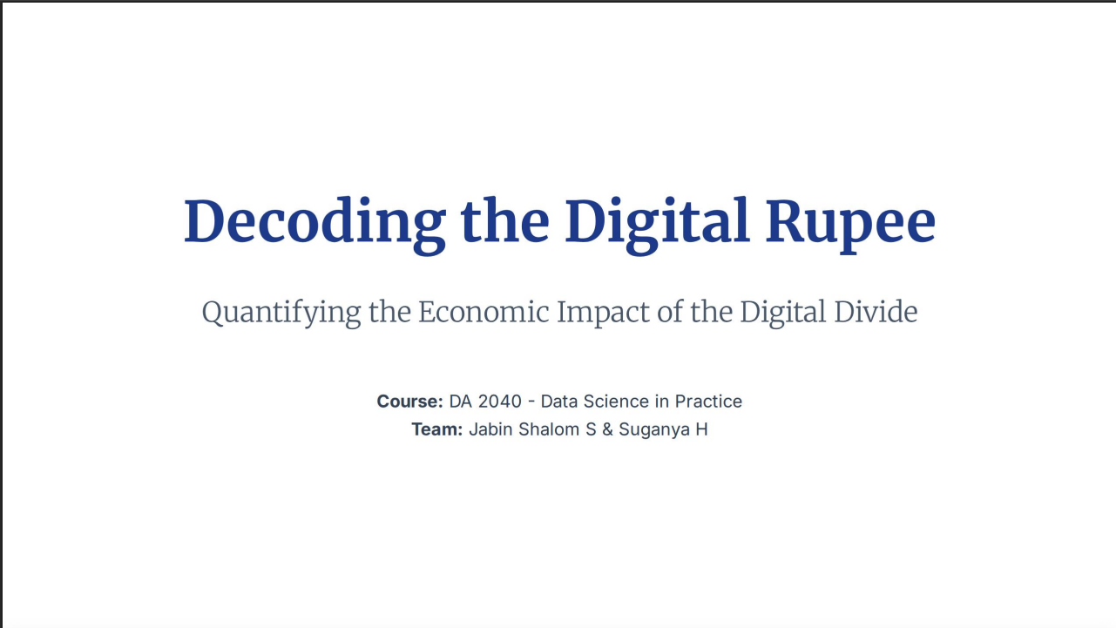

Slide 2
Problem & Motivation
The Challenge
Why It Matters?
•
Goal: Forecast the transaction amount (INR) of UPI payments.
•
Liquidity Management: Banks need to forecast payment flows to manage reserves and risk effectively.
•
Context: UPI is a high-velocity, high-volume ecosystem central to India's digital economy.
•
Fraud Detection: Identifying anomalous amounts that deviate significantly from the prediction.
•
Complexity: Spending data is highly non-linear and skewed, demanding robust modeling.
•
Consumer Insights: Understanding spending across categories and demographic segments for strategic planning.

Slide 3
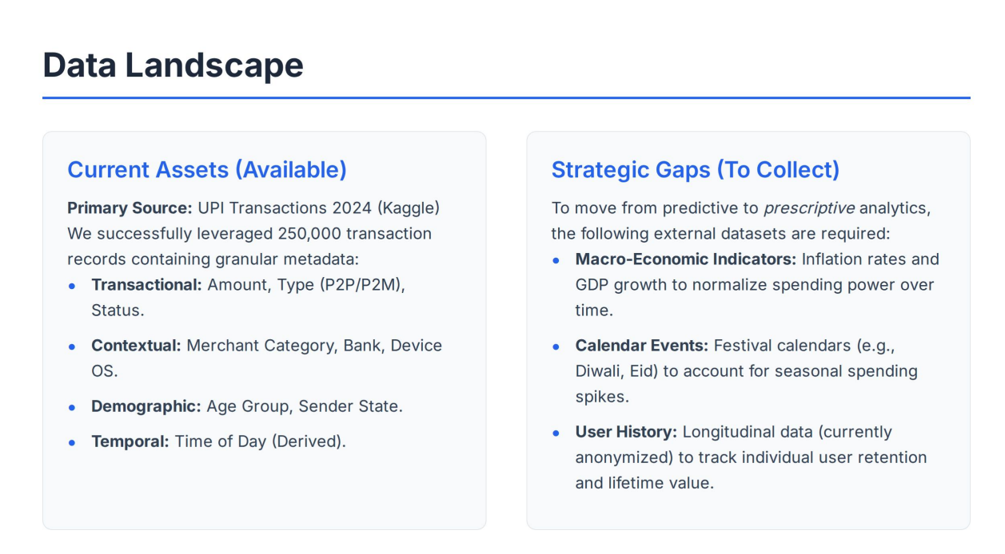

Slide 4
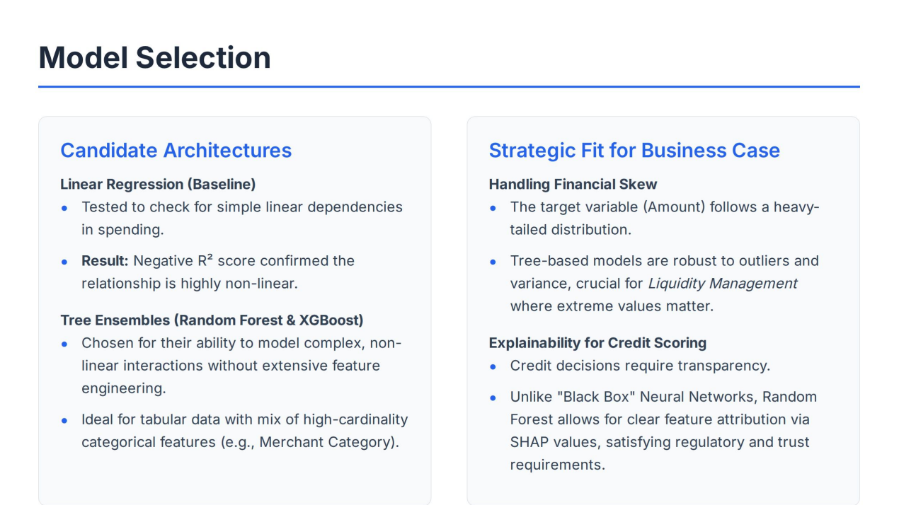

Slide 5
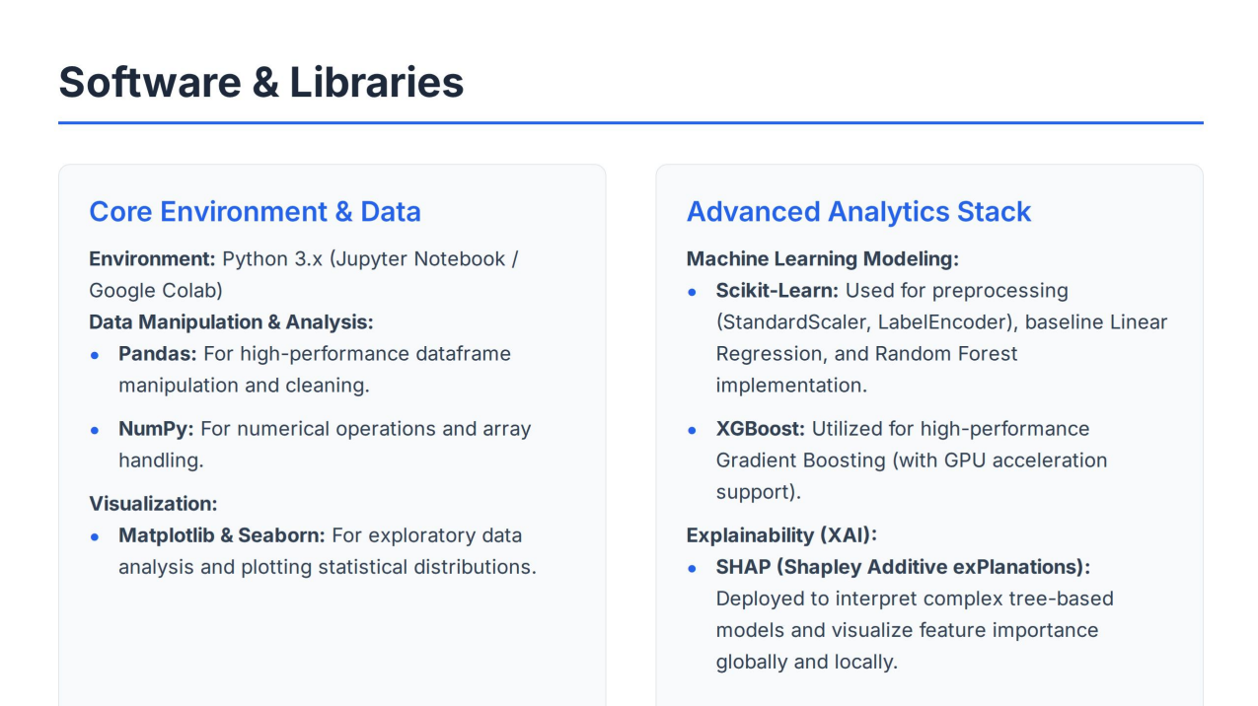

Slide 6


Data Selection & Cleansing
Data Selection & Relevance
Cleansing & Transformation Steps
The model focused on 250,000 UPI Transaction Records, selecting features that directly correlate with spending behavior.
•
Missing Data: **No Missing Values** were identified, eliminating the need for imputation.
•
Handling Skew (Crucial): The target variable (`amount`) was severely skewed. A **Log Transformation** ($\log(1+x)$) was applied to stabilize the variance and normalize the distribution for modeling.
•
Target Variable: Transaction **Amount (INR)** (The quantity we aim to predict).
•
Categorical Features: `Merchant Category` and `Sender/Receiver Bank` (Proxies for spending habits and financial context).
•
Feature Encoding: Categorical features (e.g., `Merchant Category`) were converted to numerical format using **Label Encoding** for tree-based algorithm compatibility.
•
Contextual Features: `Device Type` and engineered `Time of Day` (Indicate context of transaction).
•
Data Exclusions: Unique IDs and raw timestamps (Non-predictive, high-cardinality noise).
•
Time Features: Raw timestamp strings were engineered into categorical `Time of Day` features (e.g., Morning, Peak Evening) to capture diurnal patterns.

Slide 7










Methodology Pipeline
Clean
Transform
Model
Simulate
Explain
Dropped irrelevant IDs and timestamps.
Applied Log Transform to normalize skewed amount data.
Trained tree ensembles (Random Forest, XGBoost).
Realism Engine: Applied logic to reflect infrastructure-based spending constraints.
Used SHAP values for interpretability.

Slide 8
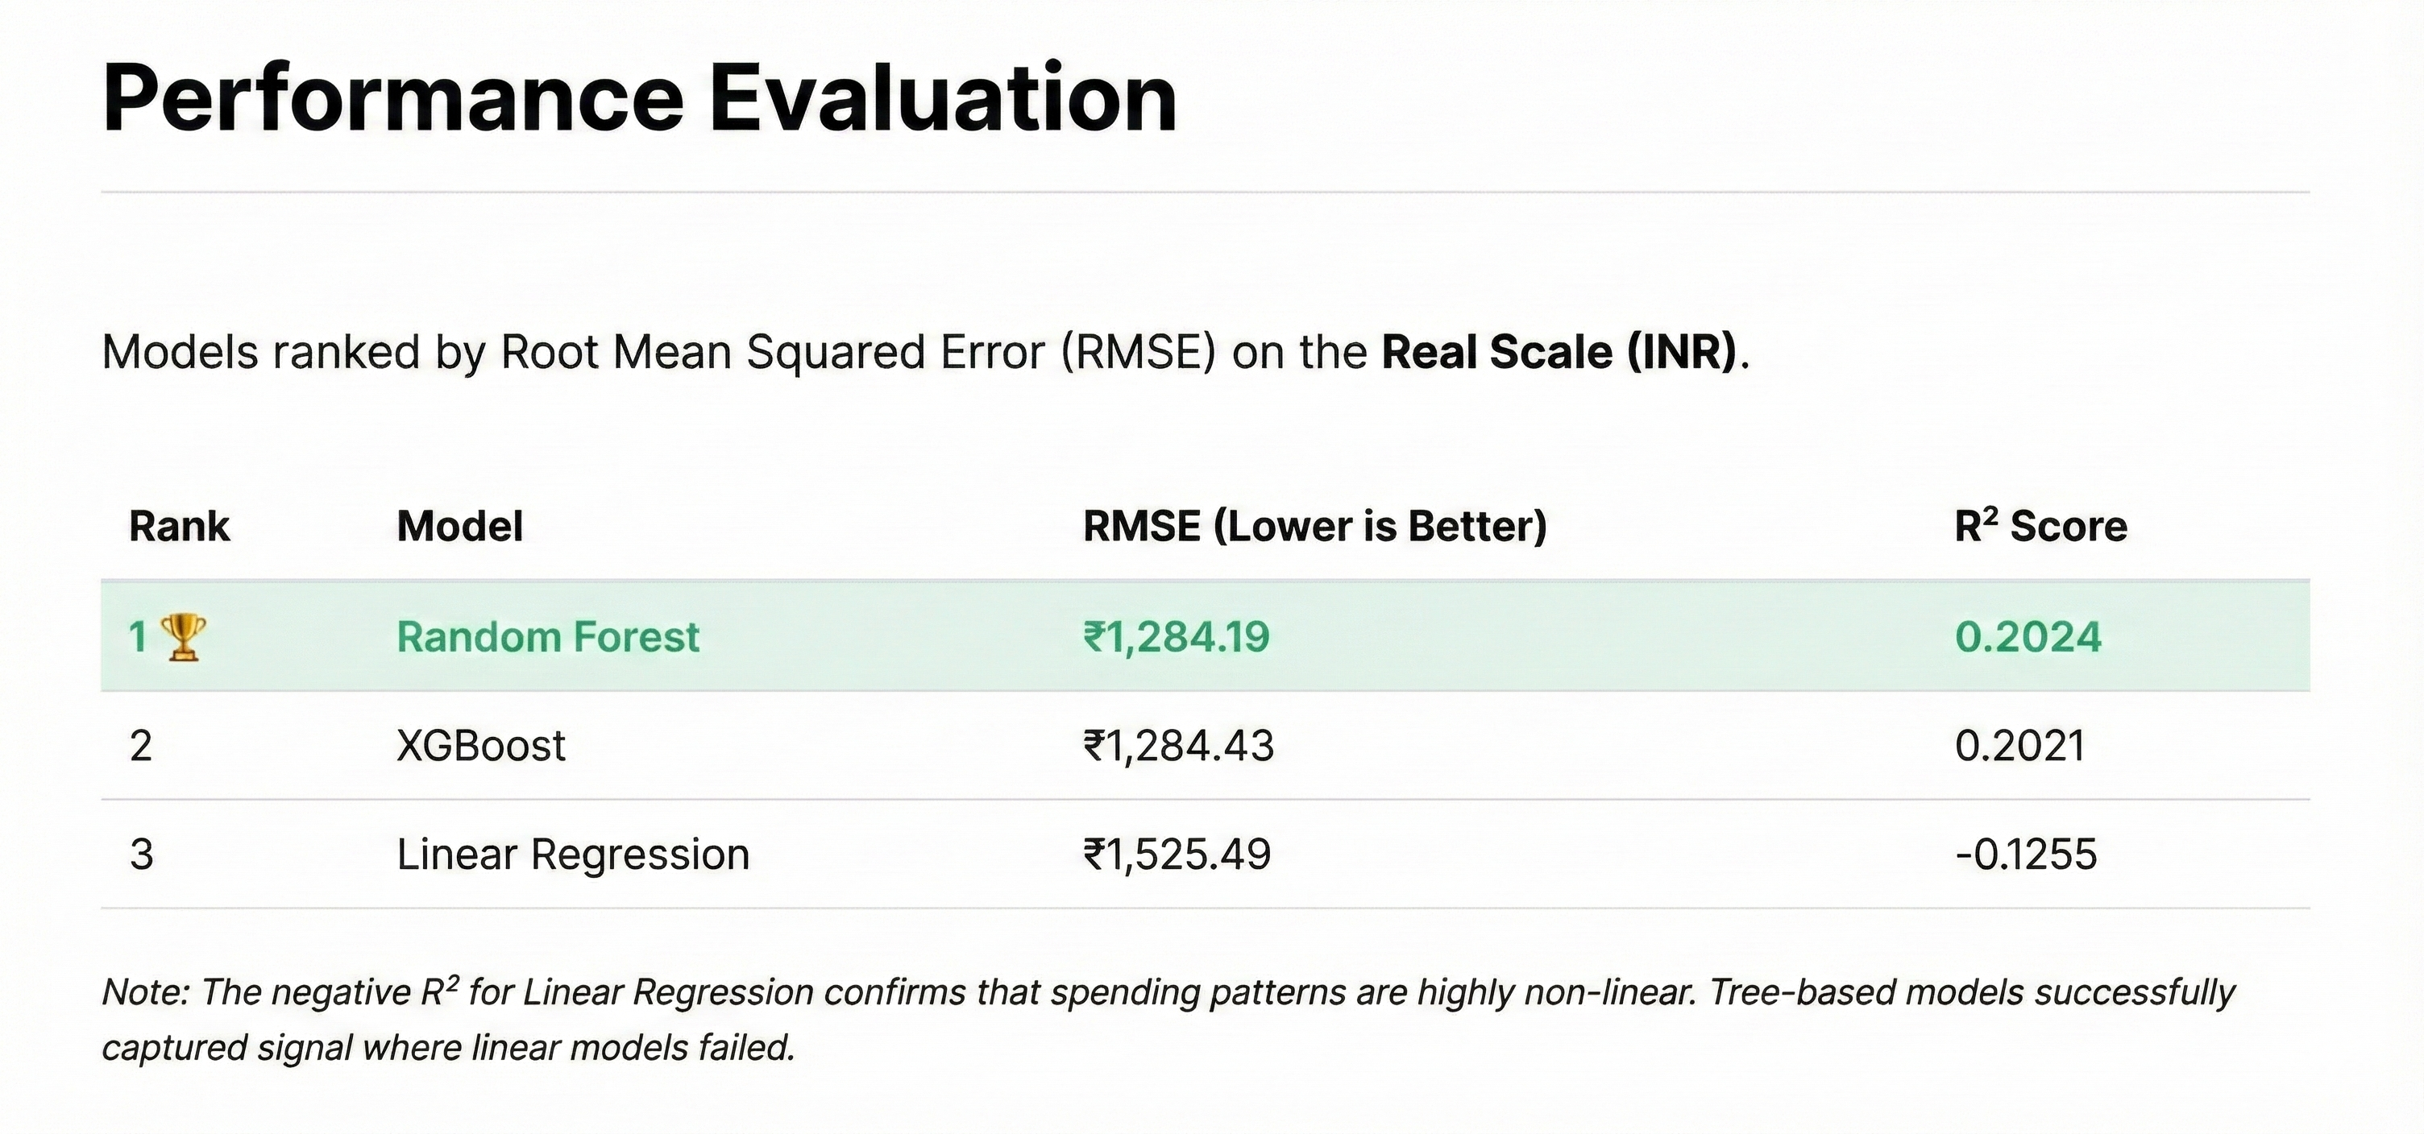

Slide 9

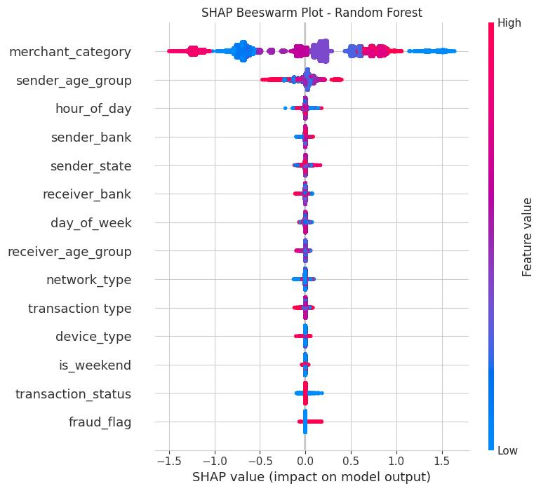

SHAP Analysis: Decoding the 'Why'
"Visualizing the Divide: Users with higher Tech Scores consistently demonstrate higher spending capacity."
We utilized SHAP (Shapley Additive exPlanations) to break down the "Black Box" nature of the model. It assigns a precise contribution value to every feature for each individual prediction.
Key Insights
•
Global Interpretability: Aggregating SHAP values reveals that features like Merchant Category and Sender are the primary drivers of transaction value.
•
Feature Impact: The summary plot (right) visualizes the magnitude and direction of each feature's impact on the final prediction.

Slide 10
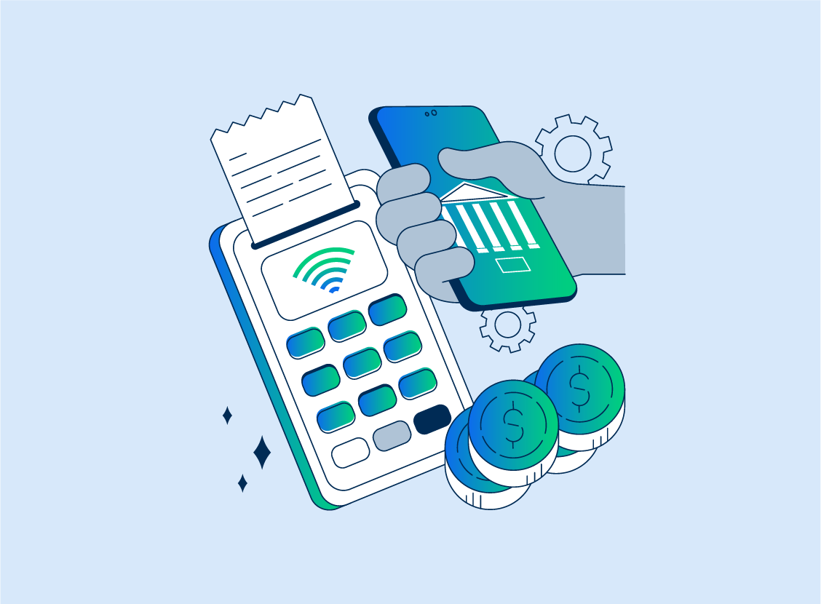
Conclusion & Strategic Insights
Key Strategic Takeaways
Ensembles Win
Random Forest and XGBoost significantly outperformed the baseline, successfully capturing the complex, non-linear spending behaviors that simpler linear models missed.
Digital Infrastructure
4G is the new economic baseline. The 'Digital Divide' is quantifiable: low-tech users are effectively locked out of high-value commerce.

