Slide 1
Autonomous Exploration in Volcanic Terrain using MDP
GROUP:05
S.M Jabir Mahmud (2031752642)
Sabrina Sabnom katha (2012917642)
Rafidul Islam (2022388642)
Mumin ahmod (2011926642)

Slide 2
Introduction – Problem Statement
Real-world volcanic terrains are dangerous for human exploration due to hazards like lava, gas emissions, and unstable ground.
Our goal: Develop an autonomous agent that can safely navigate this environment using Markov Decision Process (MDP).
Agent learns through Q-learning to balance exploration and safety under uncertainty.
Inspired by real-world applications in disaster zones, space exploration, and minefields.

Slide 3
MDP Components
MDP Breakdown for Navigation
States (S): Grid cells indicating position and proximity to hazards.
Actions (A): Move up, down, left, right, or check surroundings.
Transition Probabilities (P): Deterministic, simulating dynamic hazards.
Reward Function (R):
+10 for safe tile
-100 for lava
-50 for gas
-80 for crater
Policy (π): Action selection strategy using epsilon-greedy Q-learning.

Slide 4
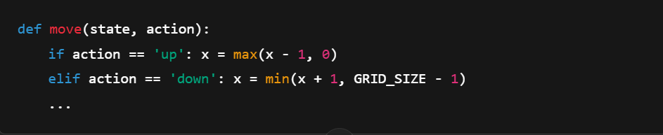
MDP Implementation – Movement & Hazards
Simulating the Hazardous Environment
A 5x5 grid simulates the terrain.
Hazards are randomly placed and dynamic.
Agent begins at random and aims to reach the goal (bottom-right).
“dynamic hazards, where the lava and gas emission zones could change over time.”

Slide 5
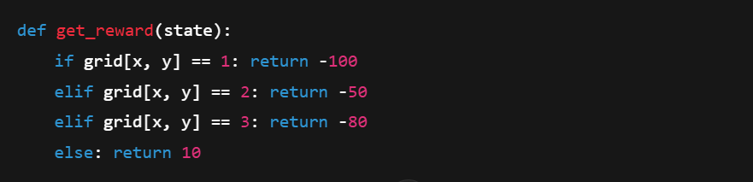
Rewards & Penalties
Designing the Reward Function
Rewards guide the agent’s behavior:
Encourage exploration
Penalize hazardous zones
Ensures learning efficiency via trial and error.

Slide 6
Strategies Used
Learning Techniques and Optimization
Core Algorithm: Q-Learning
Hyperparameters:
α (Alpha): Learning rate
γ (Gamma): Discount factor
Strategy: Epsilon-Greedy with decay
Start with exploration (ε = 1.0)
Slowly favor exploitation (ε → 0.05)
Tried alternatives: Boltzmann exploration, intrinsic motivation
📌 Formula:
Q(s,a) ← Q(s,a) + α [r + γ max(Q(s′)) − Q(s,a)]
“epsilon decay helps the agent become more efficient as it learns.”

Slide 7
Workflow Example
System Learning Cycle
Start at random location
Select action (explore/exploit)
Move and get reward
Update Q-table
Repeat until goal or max steps
📈 Visual: Include a simple diagram
[Start] → [Select Action] → [Move] → [Reward] → [Update Q] → [Next Step]

Slide 8
“The training process consisted of 100+ episodes with agent interacting and updating its knowledge.”

Slide 9
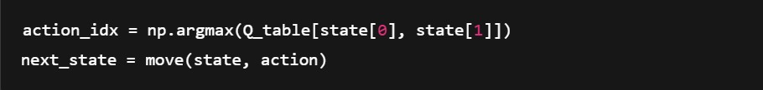
Testing & Evaluation
Performance Evaluation
Agent is tested from various start points (e.g., (0,0), (2,2), (0,4))
Evaluated by:
Path safety
Total reward per episode
Learning curve

Slide 10
📊 Visual: Plots of total rewards over episodes are given next :
“Rewards increased notably... agent was learning to avoid hazards.”

Slide 11
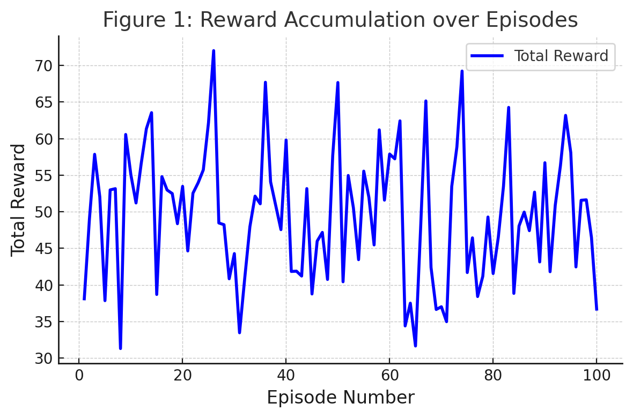
Figure 1: Reward Accumulation over Episodes
The title is now properly placed below the figure, and the x and y-axis labels are clear and consistently sized.
The grid lines are subtle for readability, and the plot has been styled with increased font size for clarity.

Slide 12
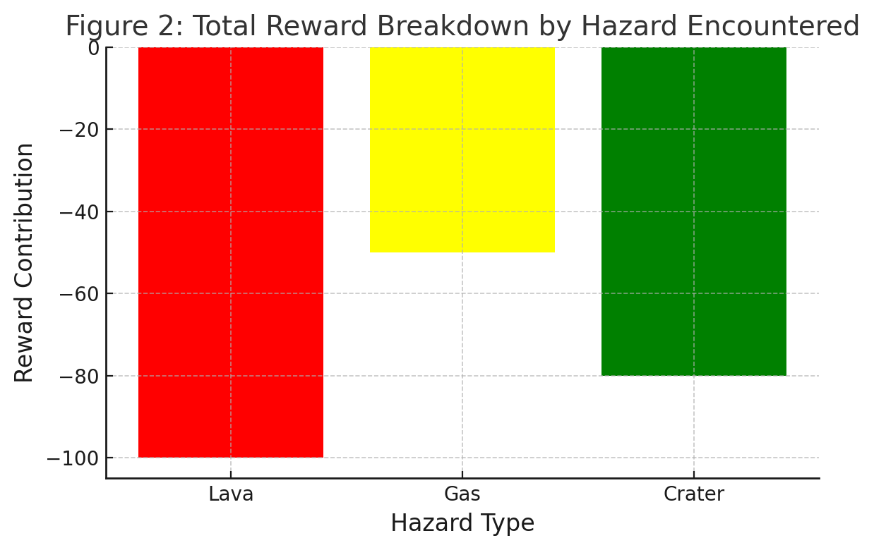
Figure 2: Total Reward Breakdown by Hazard Encountered
The bar chart uses distinct colors for each hazard type (Lava, Gas, Crater) and includes appropriate axis labels and title.
Font sizes for axis labels and ticks are consistent and larger for clarity.

Slide 13
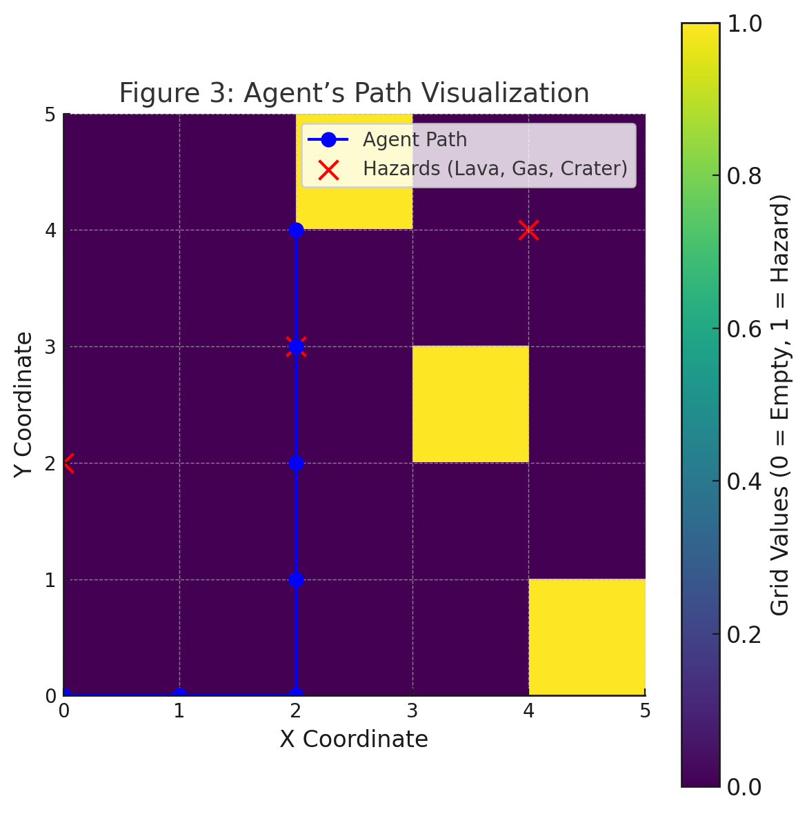
Figure 3: Agent’s Path Visualization
The agent’s path is visualized clearly, with labeled hazards and a color map showing grid values.
The figure is styled for clarity, with a legend indicating the agent's path and the hazards encountered.

