Slide 1


Slide 2
-EEW-
Calculation of an Earthquake’s Magnitude From The First Three Seconds of its P Wave Amplitude
By – Jabir Rahman

Slide 3
Types and Use
Regional Warning
Uses traditional methods
Locating, measuring, warning
On Site Warning -
Real time warning
Doesn’t necessarily need precise Magnitude or Location
Taiwan, Japan, Mexico etc.

Slide 4
Pros and Cons
Regional Warning
Reliable
Slow
On Site Warning
Quick
Not so precise

Slide 5


What Do We Want With On Site Warning!
IRAN-IRAQ BORDER
MEXICO

Slide 6
Why P?
Reaches First
Less Destructive
Travels in All Medium

Slide 7
Steps in My Project
Collecting Data
Processing Data
Calculation

Slide 8
First Step
Mexico and Gulf of Mexico
First Seven Months of This Year
-Magnitude >=4
-Single Station Method

Slide 9
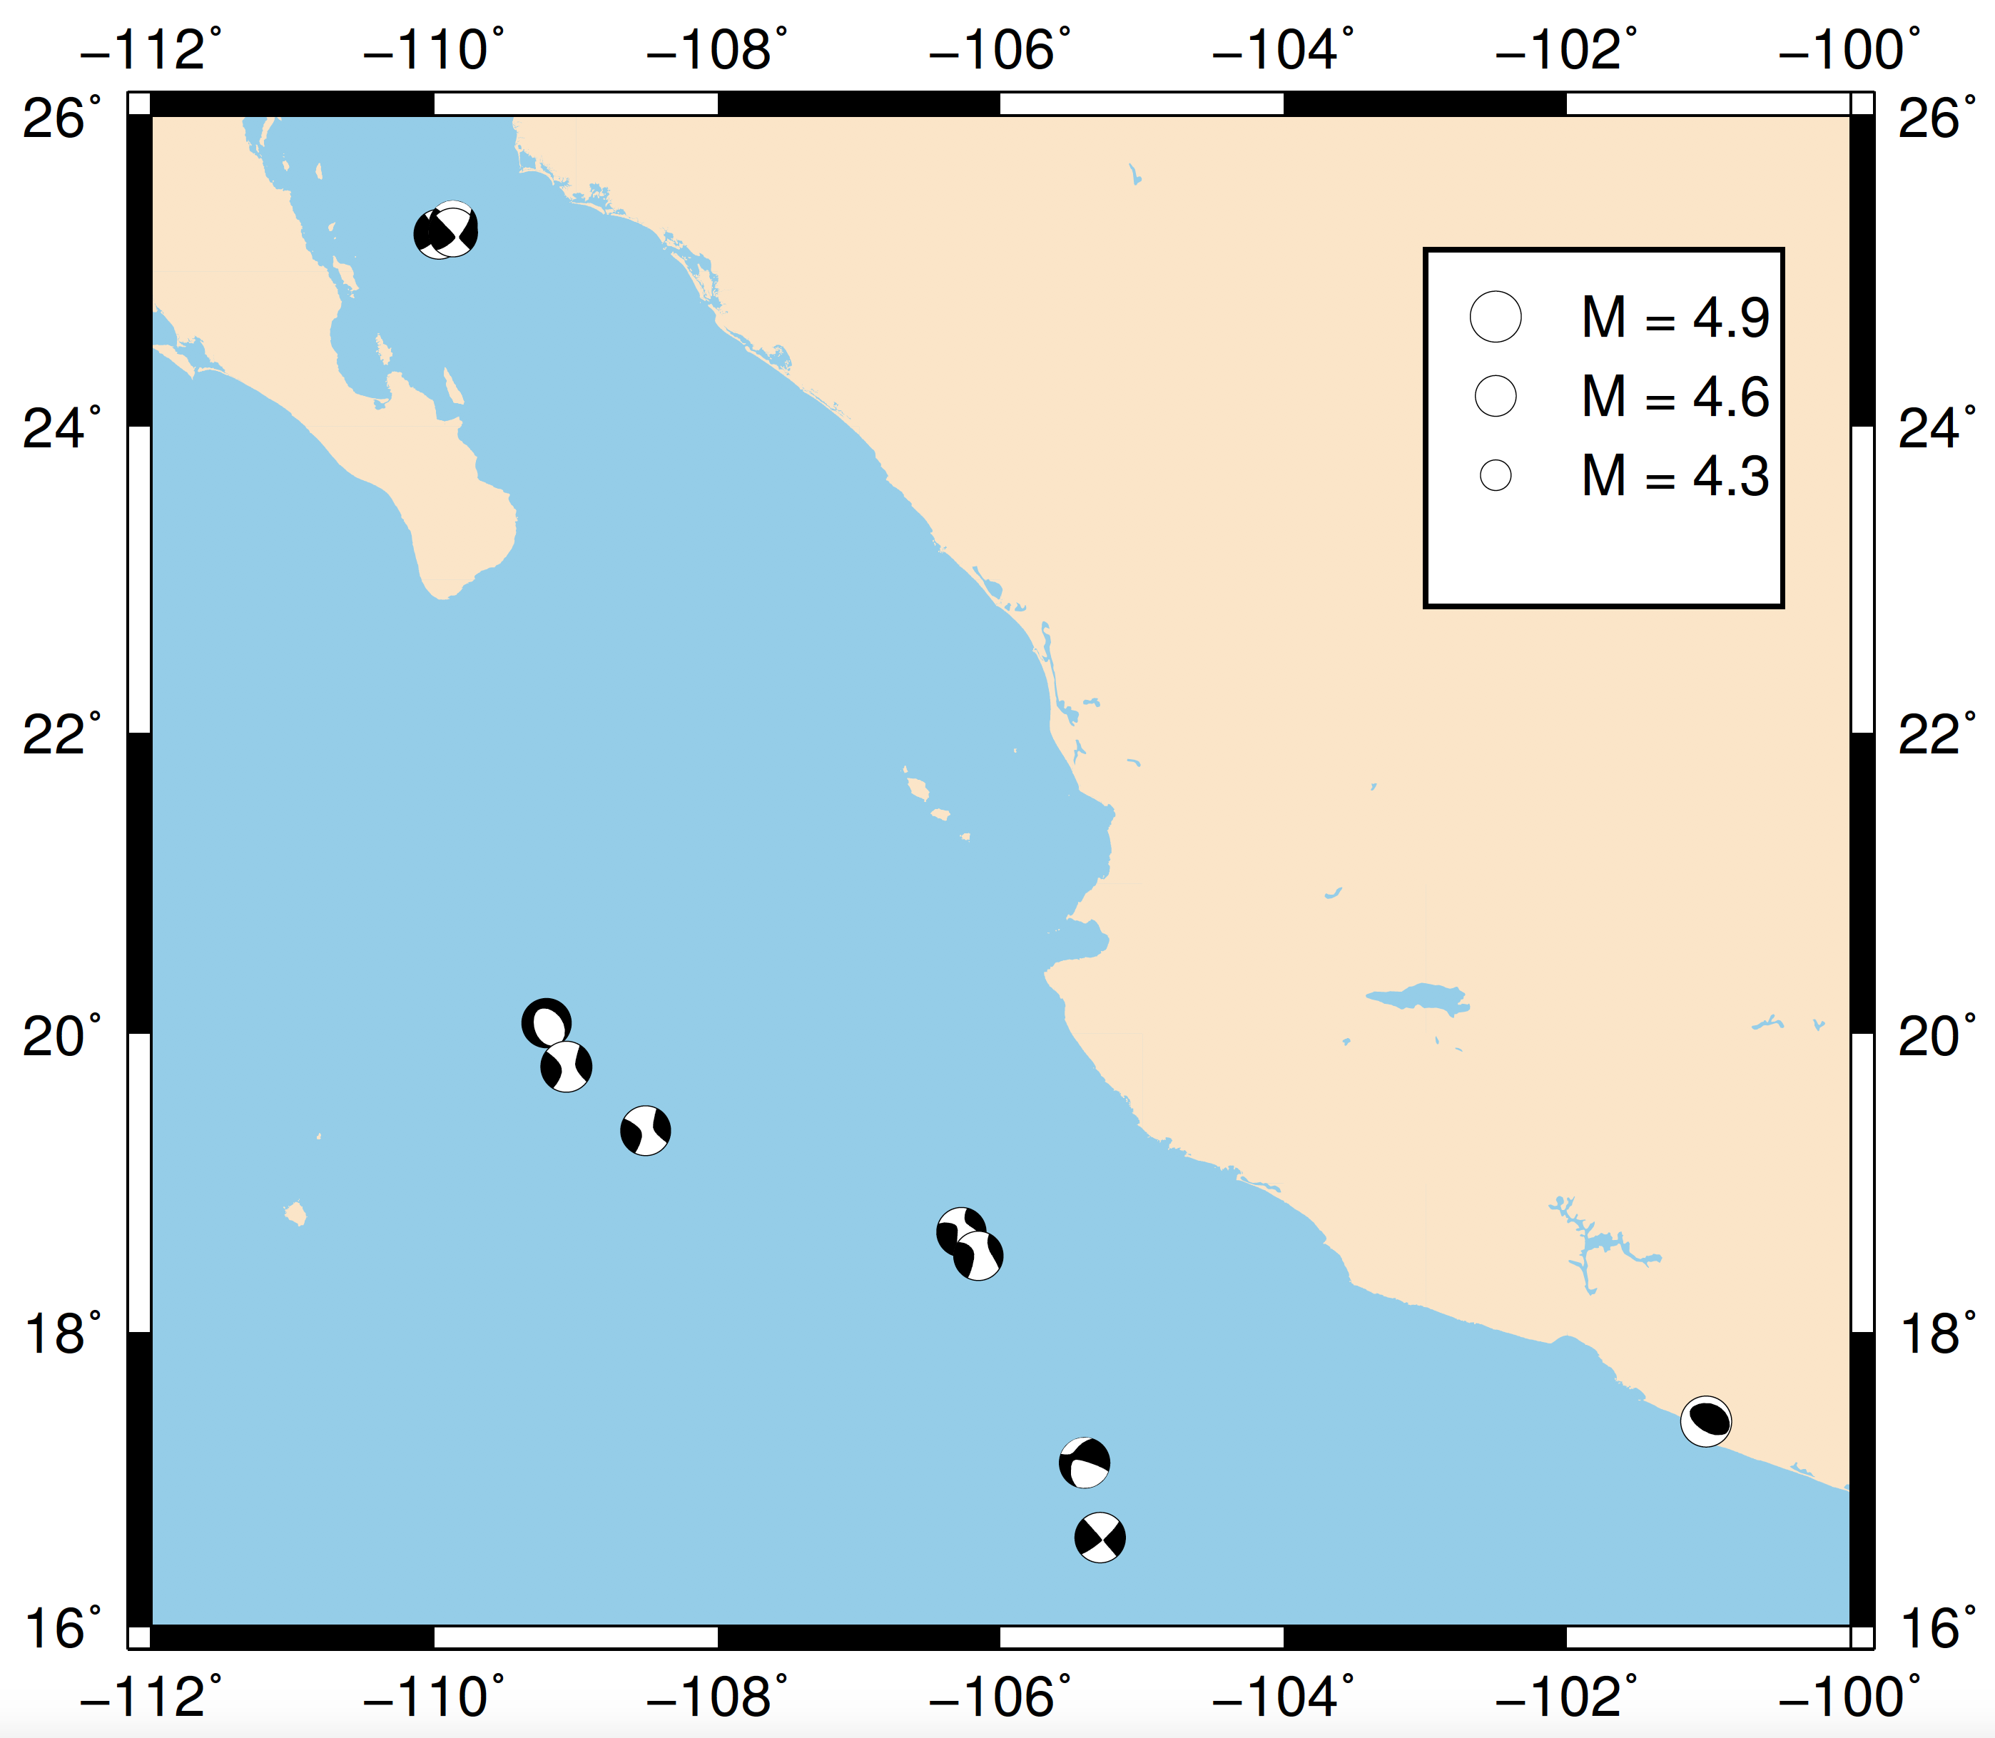
Second Step
Focal Mechanism

Slide 10
Equation Derivation
Use Matlab to Calculate Maximum Displacement and Maximum Velocity within 3 seconds of P arrival
M_calculated = (4.5 + (1.37*log(dis_max)) + (1.88*log((distance)/111)) - (log(vel_max)))

Slide 11
Results and Conclusion

Slide 12
Comments
Most values cam bigger than the actual values (Negative)
Did not miss even a single one
Better to live than to be precise !!!!

Slide 13
Thank You!

