Slide 1
Learning and development management application
JABITHA PATAKAMSETTI

Slide 2
PROJECT OVERVIEW:
We are building a web-based system to manage training programs efficiently.
The platform works on role-based
We have mainly three type of users
1.Admin
2.Manager
3.Employee
Each user have specific task to do

Slide 3
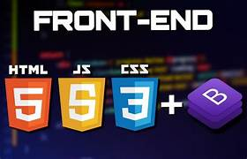


Tools Used:
FRONTEND
1.HTML
2.CSS
3.JAVASCRIPT
BACKEND
1.PYTHON
2.DJANGO
DATABASE
1.SQLITE

Slide 4
Admin :
1.Admin can Approve or Reject requests which are created by manager.
2.According to the requests approved he creates courses to the employees.
3.Tracks the employee progress.
4.He can also tracks the feedback given by emloyees
Manager :
1.Manager can create the request about the course needed.
2.He can view the requests created by him.
3.He can view the requested created by him is approved or rejected by admin.

Slide 5
Employee :
1.He can view the courses created by admin.
2.He can view his progress.
3.He can give general feedback and course feedback.
4.He notified when new courses are created by admin.

Slide 6

Modules In Project :
User Authentication and Role Management
Training Request and Management
Course Creation and Assignment
Employee Progress Tracking
Feedback Collection and Reporting
Dashboard Overview and Reporting
Notification System
Course Progress Analytics

Slide 7
MILESTONE-1:
In Milestone-1 we have 2 Modules
1. User Authentication and Role Management
2. Training Request and Management
In milestone-1 we have created
Home page, Login page, Signup page and Admin page

Slide 8
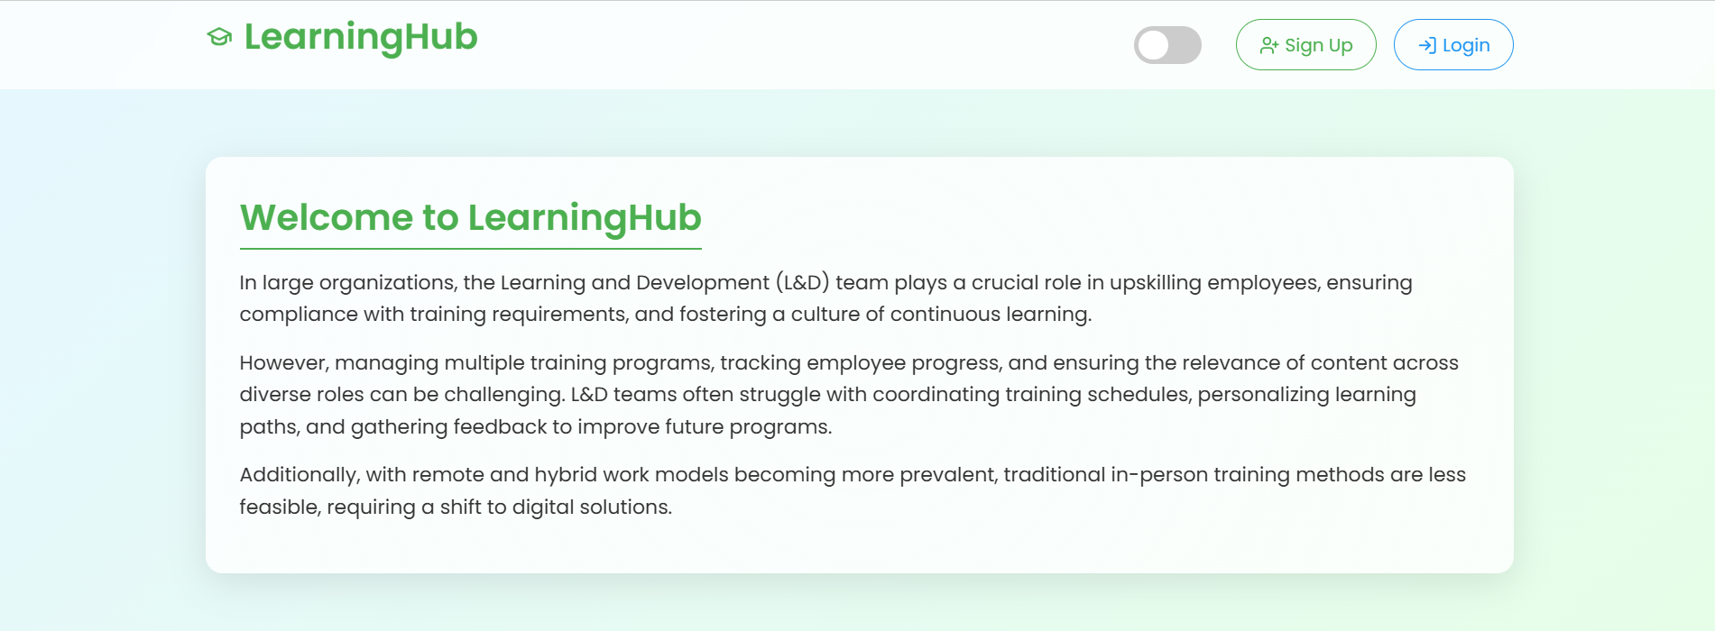
Home Page:

Slide 9
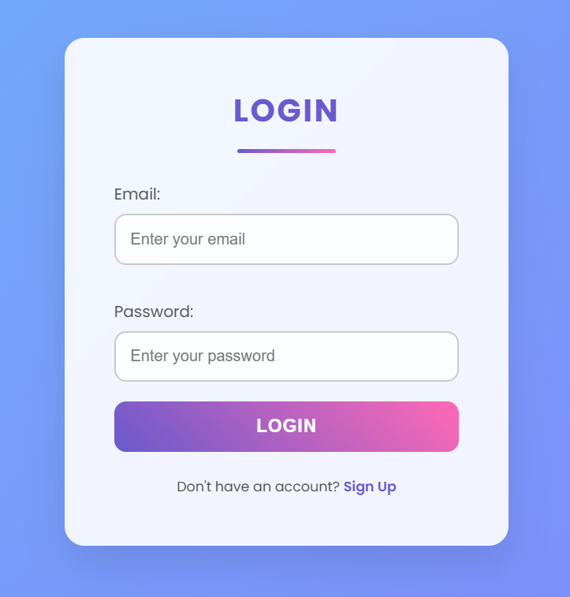
Login Page:

Slide 10
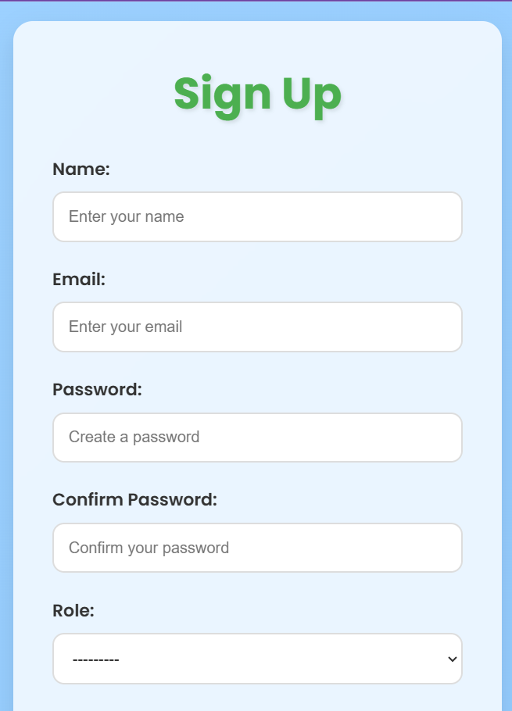
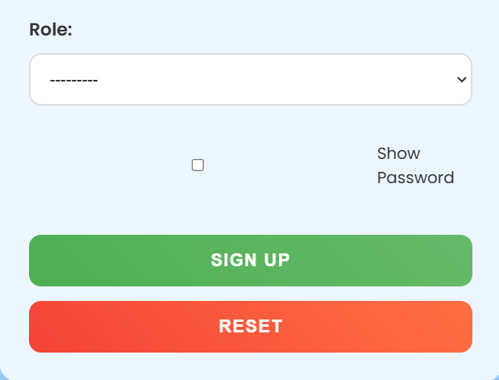
Signup Page:

Slide 11
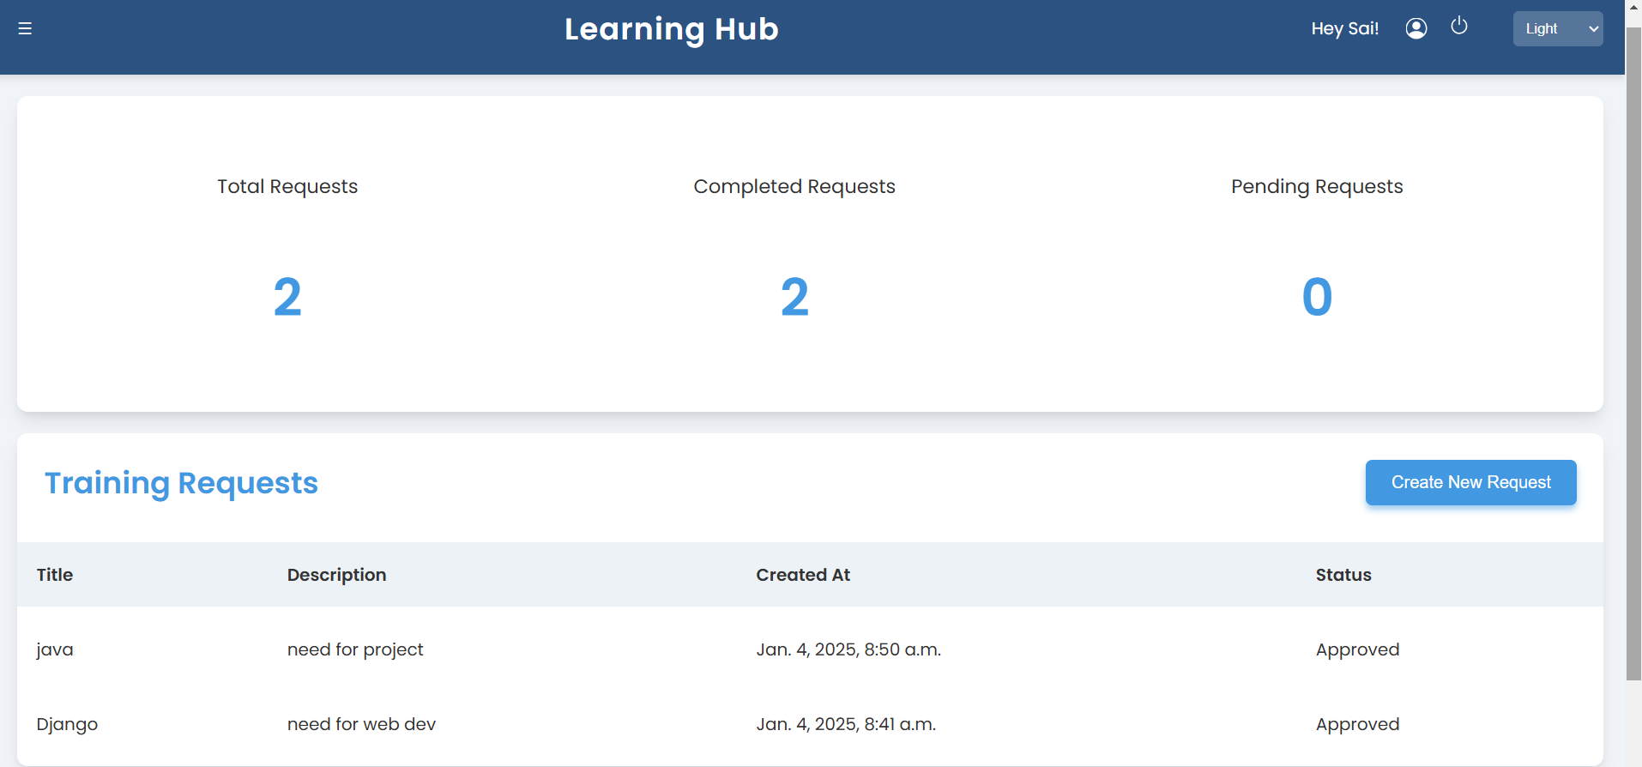
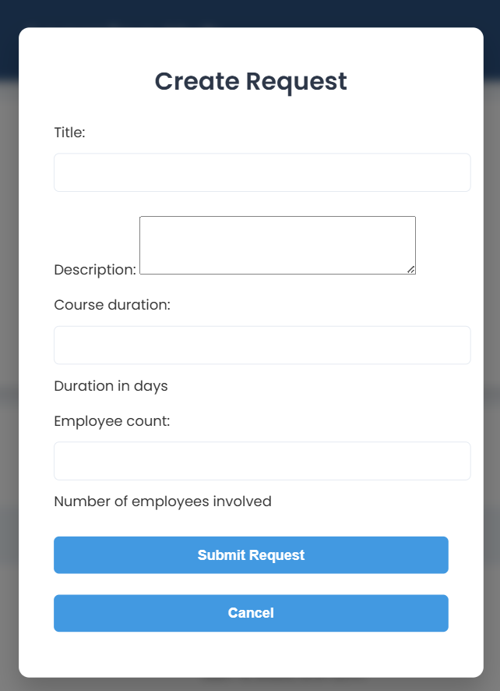
Manager Page:
In manager page where we have Total Requests, Completed Requests and Pending Requests status
We have Training request Details
We have Create New Request where we can create request

Slide 12
Challenges:
1.Facing issue while installing Django and setup environment
2.Facing an issue while configure it.

Slide 13

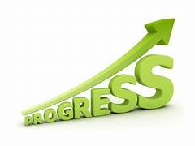
Milestone-2:
In milestone-2 We have 2 Modules
1.Course Creation And Assignment
2.Employee Progress Tracking
We created Admin page and Employee page

Slide 14
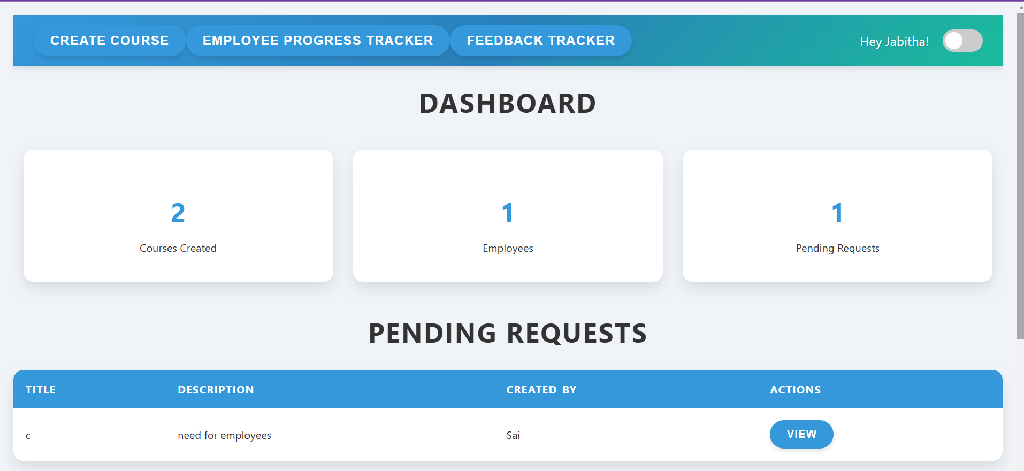
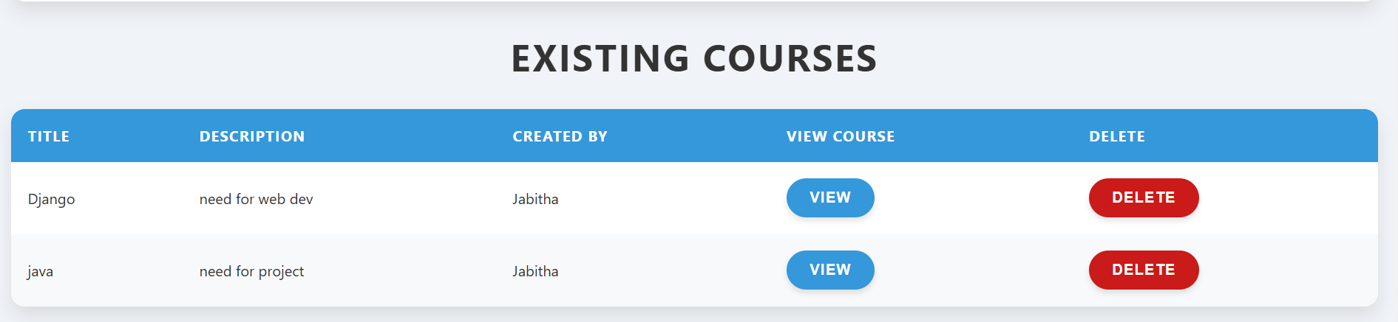
Admin page:

Slide 15
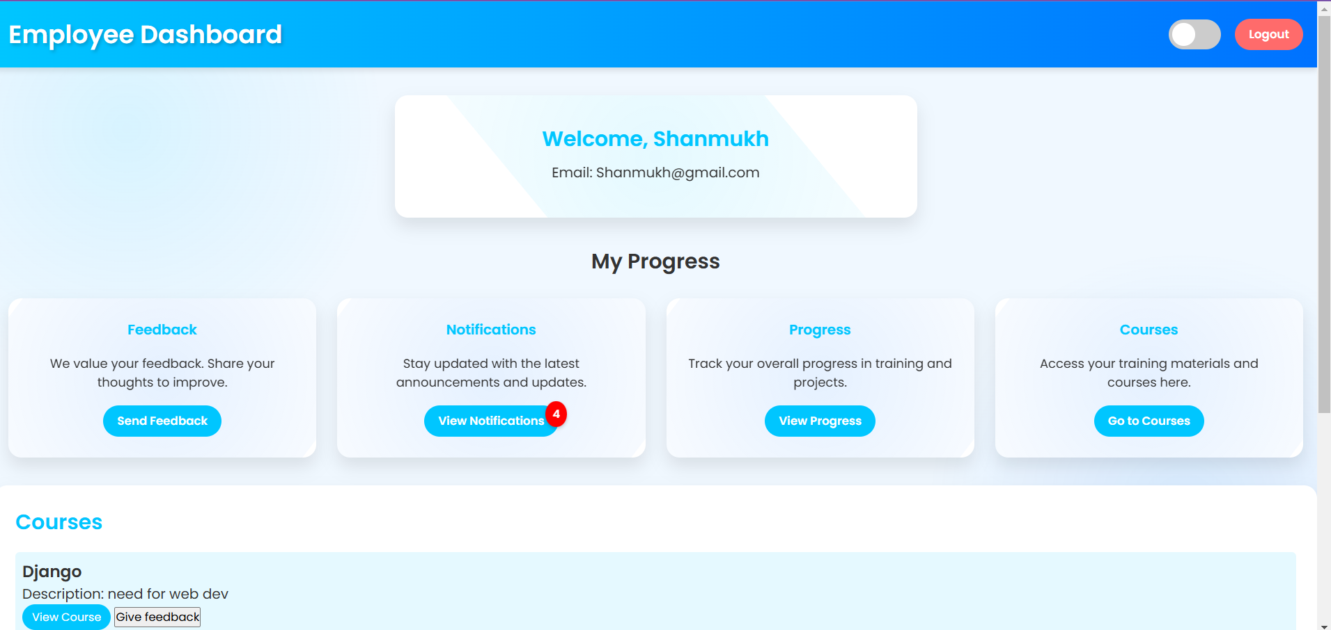
Employee page:

Slide 16
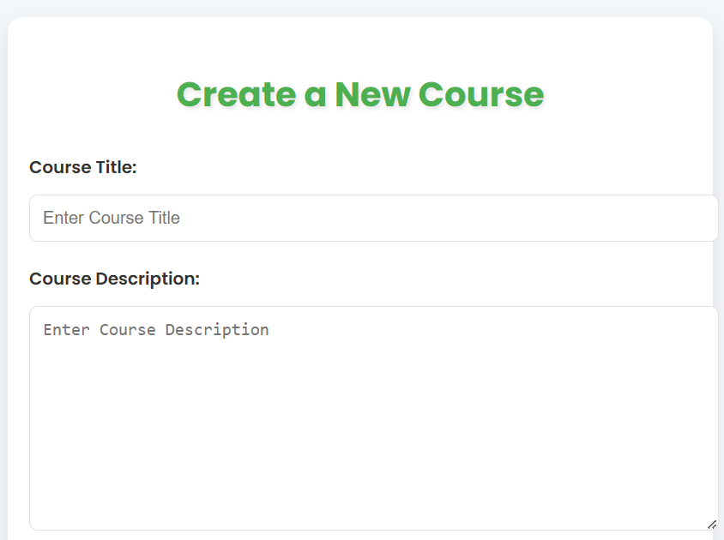
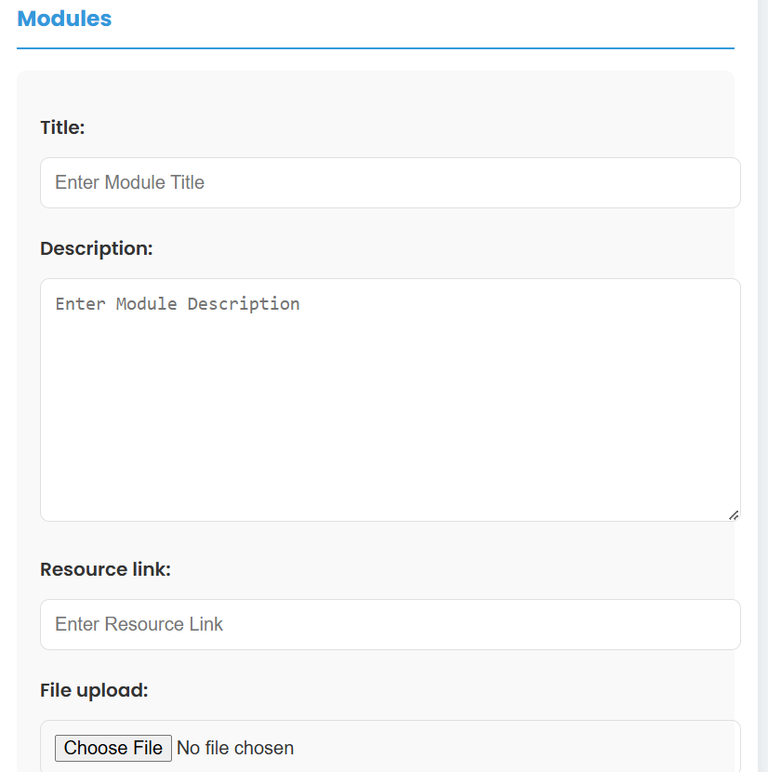
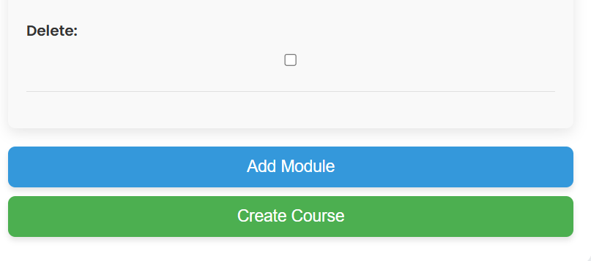
Course creation:

Slide 17
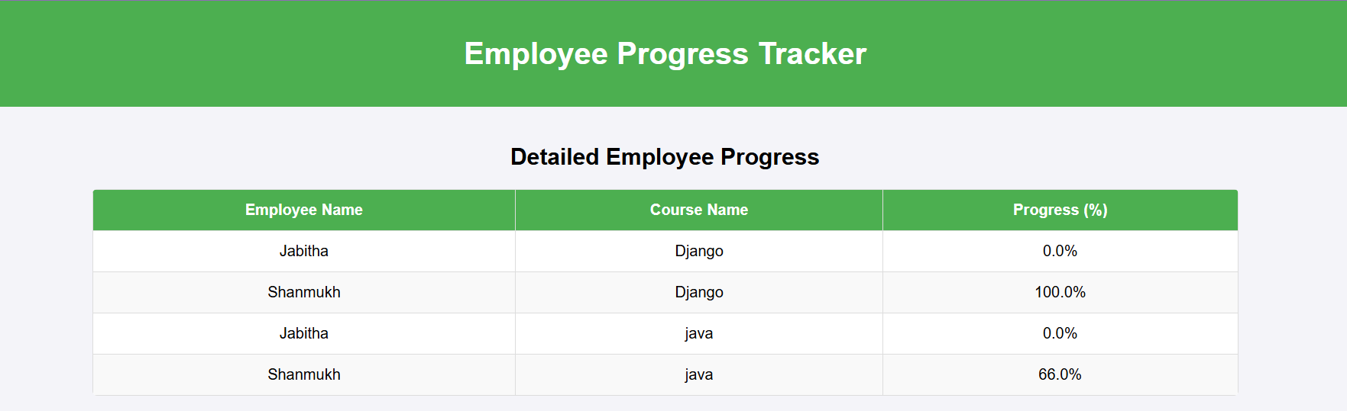
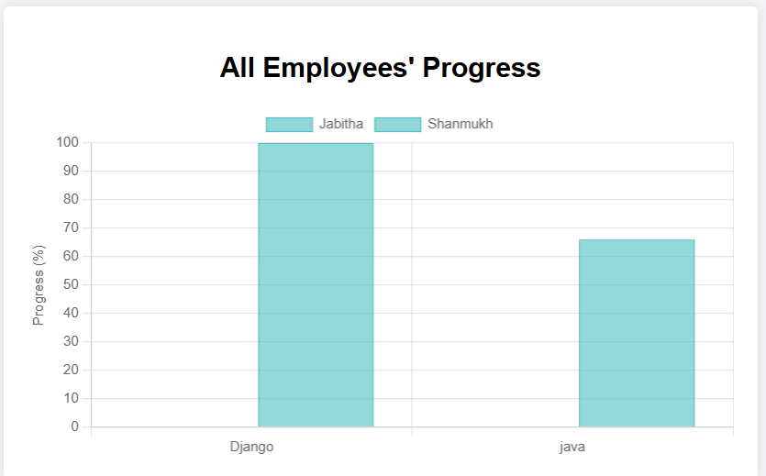
Employee Progress Tracking :

Slide 18

Milestone-3:
In milestone-3 We have 2 Modules
1.Feedback Collection
2.Feedback Reporting

Slide 19
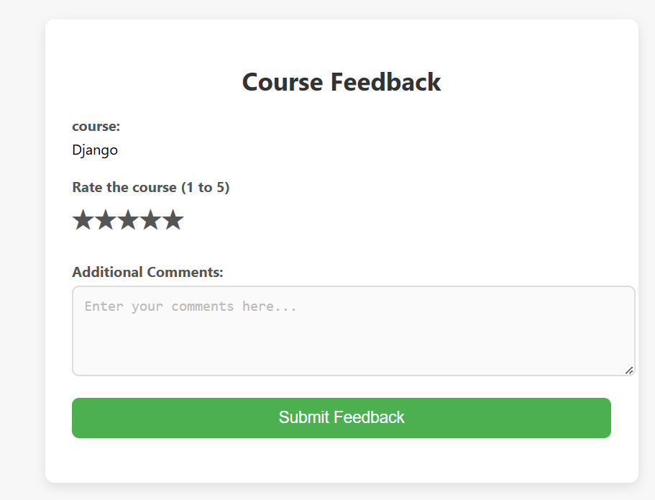
Feedback Collection :

Slide 20
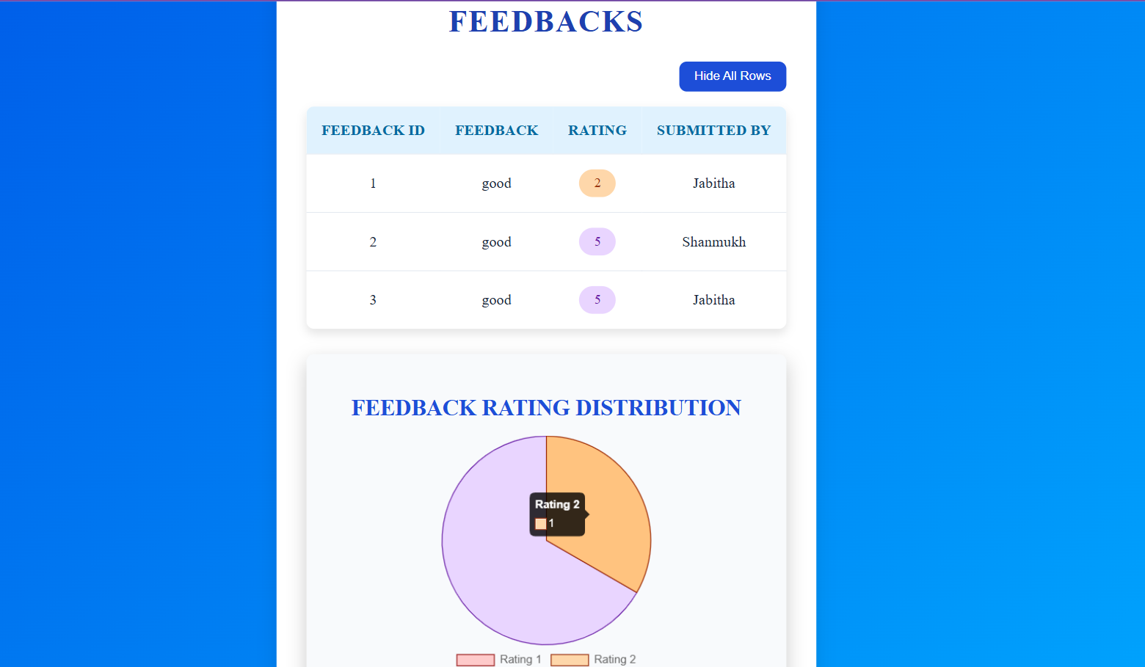
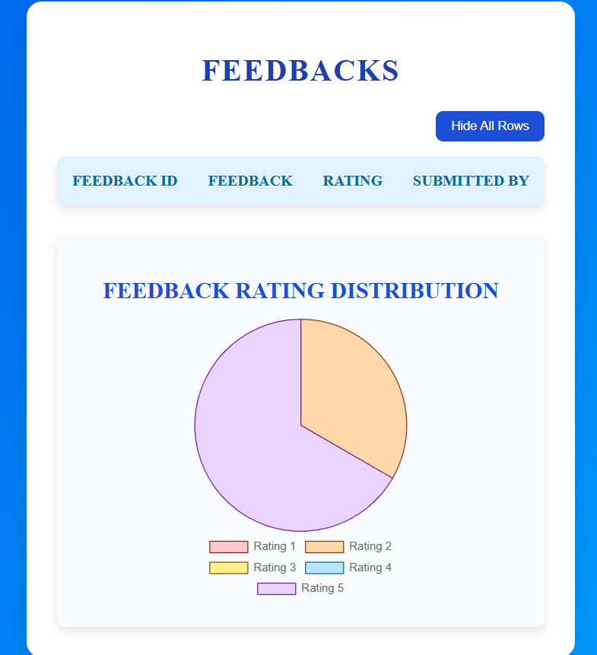
Feedback Reporting :

Slide 21

Milestone-4:
In milestone-4 We have 2 Modules
1.Notification System
2.Notification Alert

Slide 22
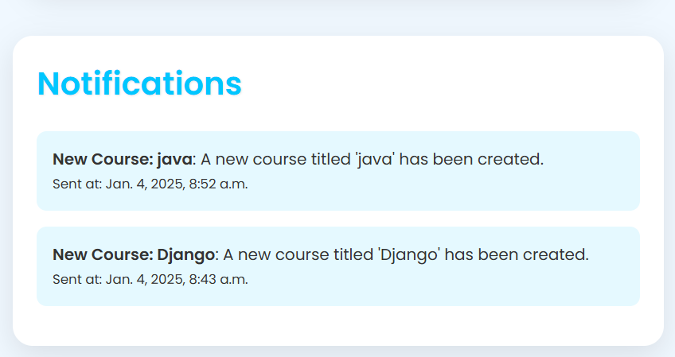
Notification System :

Slide 23
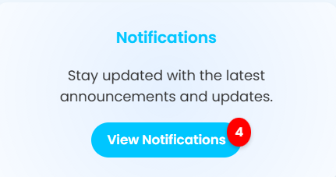
Notification Alert :

Slide 24
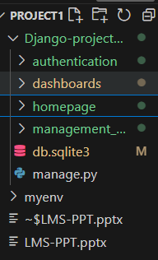
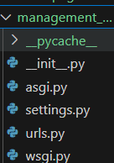
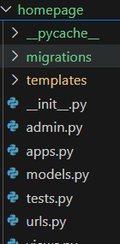
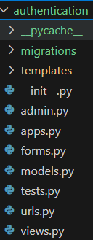
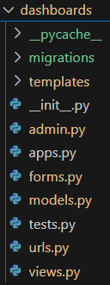
File Structure :
PROJECT MAIN PROJECT APP-1 APP-2 APP-3

Slide 25
Challenges :
1. Lack of Familiarity with the Technology
Issue: As students, we had limited knowledge about the technology used for the project, such as Django, Python. This made it difficult to get started and slowed down our progress initially.
Impact: We faced challenges in understanding the basics, troubleshooting errors, and implementing advanced features.
Solution:
We allocated extra time for self-study, referring to online tutorials, documentation, and open-source examples.
We also sought guidance from our mentor and peers who had prior experience with the technology.
Outcome: Over time, we developed a working knowledge of the tools and successfully implemented the required features. This experience taught us the importance of continuous learning and adaptability.

Slide 26
2. Scheduling and Communication Challenges
Issue: Coordinating with team members was difficult because of varying schedules and academic commitments. We could only meet and discuss the project when everyone was free, which limited the time available for collaboration.
Impact: Delayed decision-making and miscommunication about task progress caused bottlenecks in the workflow.
Solution:
We created a shared calendar to identify overlapping free time for meetings.
To ensure progress when synchronous meetings were not possible, we used collaboration tools like
Gmail
Weekly check-ins helped us to complete the project in time
Outcome: While scheduling remained a challenge, these strategies improved team coordination and kept the project on track.

Slide 27
THANK YOU

