Slide 1
K8s and Kafka
By Jose Paolo Javier

Slide 2
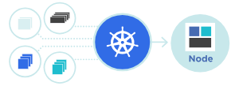
What is K8s(Kubernetes)?
Kubernetes, also known as K8s, is an open-source system for automating deployment, scaling, and management of containerized applications.
Containerize apps, deploy anywhere

Slide 3
Kubernetes Features
Automated Rollouts and Rollbacks
Service Discovery and Load Balancing
Storage Orchestration
Self-healing
Secret and configuration management
Automatic bin packing
Batch Execution
Horizontal Scaling
and others…

Slide 4
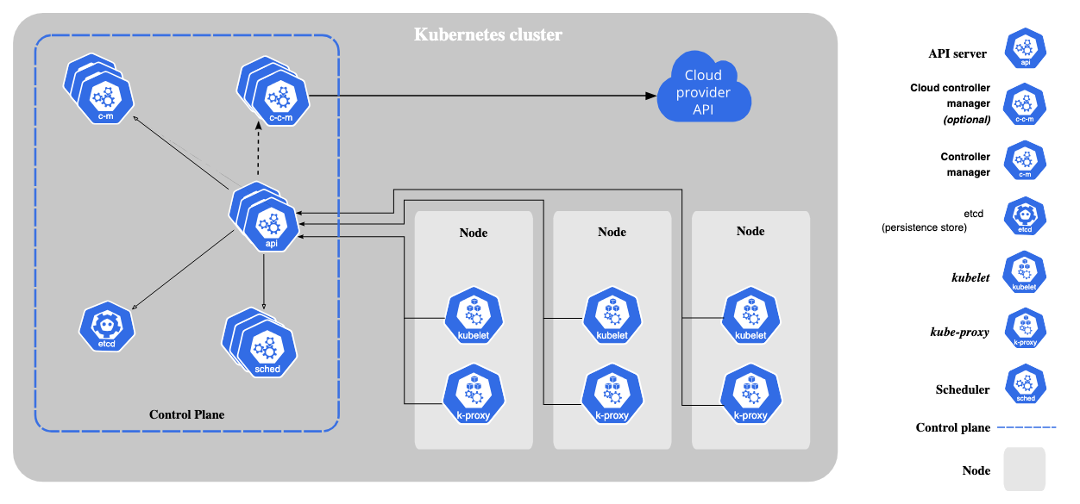
Kubernetes Architecture
Ref: https://kubernetes.io/docs/

Slide 5
What is Apache Kafka?
Apache Kafka is an open-source distributed event streaming platform used by thousands of companies for high-performance data pipelines, streaming analytics, data integration, and mission-critical applications.

Slide 6
Kafka Features
Scalability - has a distributed architecture capable of handling incoming messages with higher volume and velocity. As a result, Kafka is highly scalable without any downtime impact.
High Throughput - able to handle thousands of messages per second.
Low Latency - offers a very low latency, which is as low as ten milliseconds.
Fault Tolerance - By using replication, Kafka can handle failures at nodes in a cluster without any data loss. Running processes, too, can remain undisturbed.
Reliability - is a distributed platform with very high fault tolerance, making it a very reliable system to use.
Durability - Data present on the Kafka cluster is allowed to remain persistent more on the cluster than on the disk. This ensures that Kafka’s data remains durable.
Real-time - is an excellent choice when data has to be processed in real-time.

Slide 7
Kafka Components
Topics – Producers write to topics, consumers read from them
Partitions
Brokers – Container that holds multiple topics with different partitions
Consumers – Listens to topics and handles events accordingly
Consumer Groups – Distributing listeners for same topic or same sets of topics.

Slide 8
Kafka Components
Producers – Publishes messages to topics
Partition Offset - Specifies the position of the record within a partition
Replicas – for redundancy, backup, and high availability
Leaders – performs read/write to partitions
Followers – replicates the data of the leader, acts as backup in case of leader failure

Slide 9
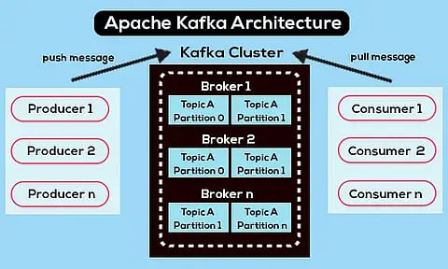
Kafka Architecture

Slide 10
What is Apache Zookeeper?
It is a library that enables coordination in distributed systems.
Configuration management - maintain any configuration in a centralized place so that all servers will see any change in configuration files/data
Leader election – Elects leaders to maintain a single point for an update request or distributing tasks from leader to worker nodes
Locks in distributed systems – distributed lock and release system
Manage cluster membership - Maintain and detect if any server leaves or joins a cluster and store other complex information of a cluster.

Slide 11
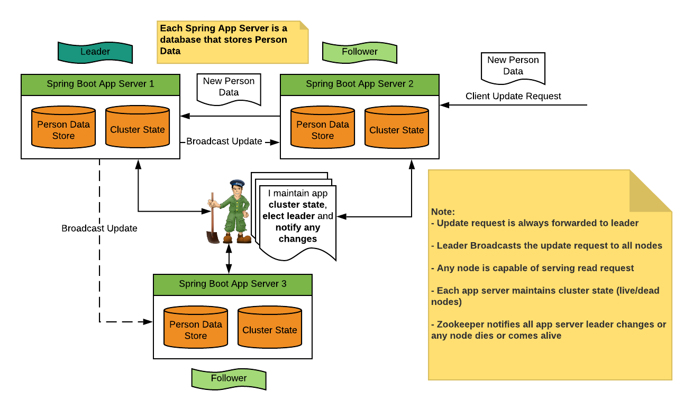
Apache Zookeeper
Ref: https://bikas-katwal.medium.com/zookeeper-introduction-designing-a-distributed-system-using-zookeeper-and-java-7f1b108e236e

Slide 12
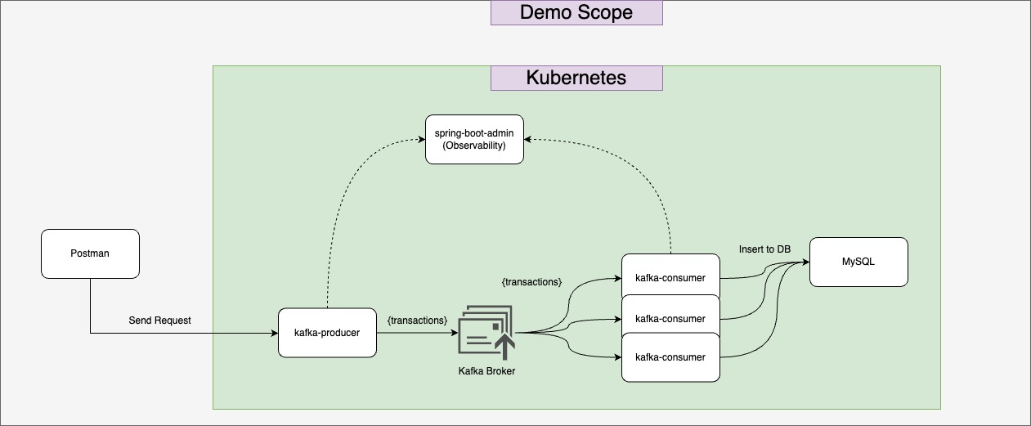
Showcase

