Slide 1
Proposed Solution(POE_M)

Slide 2
POE_M

Slide 3
POE_M Screen:
Request Detail :
A standalone screen where operations (of same operation sequence) from multiple orders can be started at one-go. There will also be an option for confirming multiple operations.
Current System :
Only a single operation can be selected in POE. This limits MES by having execution of only a single operation at any given point of time.
Benefits From CR:
Reduction of repetitive work. Increase in productivity.

Slide 4
Existing Solution :
In current system it is not possible to Start/Confirm multiple operation from POE screen.
After selection of single record from left hand side grid of POE screen page gets refreshed & below things happen on screen
System keeps the selection of selected record from left hand side grid
Based on configuration right side tabs will get populated
If user selected other record(Operation) from left hand side grid then page gets refreshed & below this happen on screen
System highlight newly selected record & remove the selection of old record
Based on configuration right side tabs will get populated
As right hand side tabs are completed depends of selection of data from left hand side grid & it is not possible to select multiple operations at a time.

Slide 5
Proposed Solution :
To perform multiple Start/Confirm activity new screen will be added with the name POE_M
POE_M is the new screen which does not have any relation with any existing system.
As this is light weight screen below functionalities will not be available on POE_M screen
Print
Login
Alert
Calculate MAV
Export
Stop
Change Work Station
Profile creation
Automatic operation start facility.
In POE_M screen below are the operation available to perform
Single/Multiple selection option from operations visible in side the grid
Start single/multiple operations having same operation sequence number
Confirm single/multiple operations having same operation sequence number

Slide 6
In Operations grid below columns will be visible & their sequence
Logged In Users
Status
Previous Operation Status
Operation Description
Work Station
Sales Order
Sales Order Item
Production Order
Material
Material Description
Operation
Production Line
Work Centre (Remove)
We will make a list of all available columns and user can create profile to set required columns. However, these profiles will not be linked with OGC screen for better performance. [Similar to IVL screen]
Kindly provide all columns which you want to be available.

Slide 7
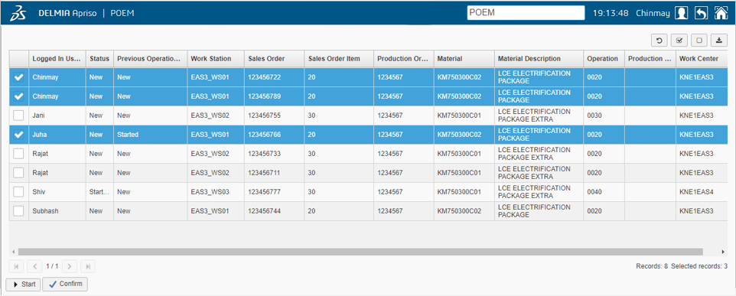
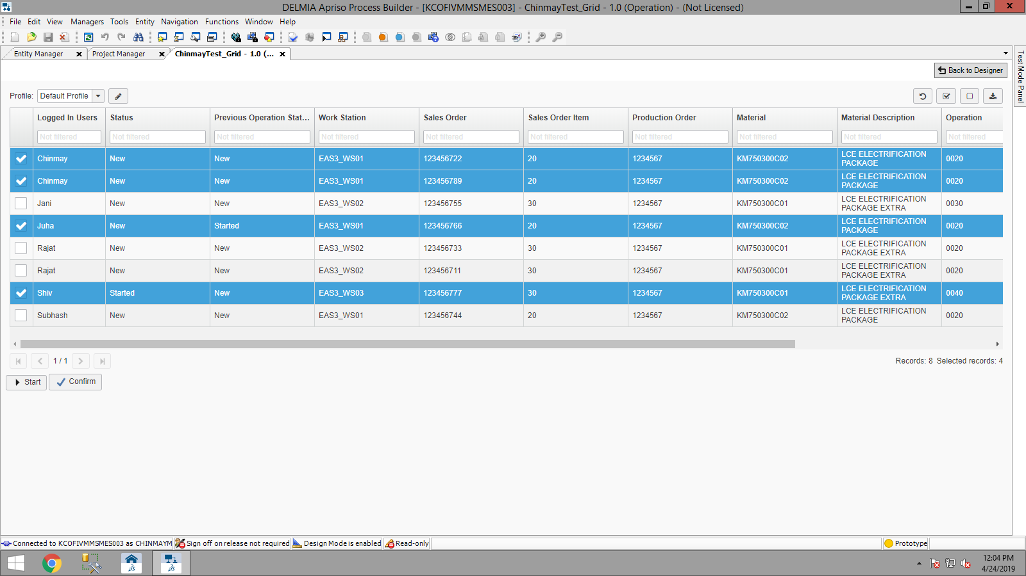
Mock up screen
Ver 1.01:
Filters for all columns added.
As profile option is available user can set width as required.

Slide 8
Constraint:
Validation for all operations at single step, i.e. error in starting of one operation will halt the entire action. Same is applicable for Confirmation of operations.
All operations must be of same operation sequence number.
WorkStation can’t be changed in this screen.
A configurable limit must be there which will define maximum number of operations that can be started.
Can’t have details of an operation similar to the right grid in POE.
Can’t stop the operation from this screen.
Column configuration facility will not be there (No profile option & no connection to OGC screen)
Rework & packing operations will not be visible in this screen
MTO & MTS order operations will not be visible (will include)
As per the new requirement user will be required to provide KM Code + Serial no for each order after confirmation for MTS/ MTO orders. So what is your expected behavior on those case?

Slide 9
Assumptions:
Starting all and Confirm all can be iteration of existing Start and Confirm code in POE.
Even if user selects multiple operations & perform action is one go operation Start/Confirm times will be different. It is completely based on processing time.
Operation confirmation popup will be only one for all & contain the message “Operations Confirmed…”
If the descriptions are not available in current personalization language then system will display description in English (if available). If description is not available in current personalization language & in English then system will display blank.
Missing inventory error need to be then solved by confirming one by one with POE.

Slide 10
Need to discuss:
Where to keep created sum assemblies for respective operations.
If missing scans or missing inventory errors then should we popup message will create a problem for end user.
Should we consider newly created functionality to prevent inventory loss.
Do you need a LU by default, if so can you please advice on what basis that will be decided?
New inventory loss prevention solution need to be reviewed

