Slide 1
Proposed Solution(POE_M)

Slide 2
POE_M

Slide 3
POE_M Screen:
Request Detail :
A standalone screen where operations (of same series) from multiple orders can be started at one-go. There will also be an option for confirming multiple operations. To improve performance there will not be any Grid profiles or an option of changing workstation. It will be single grid screen with a simple UI by omitting the right grid of POE.
Current System :
Only a single operation can be selected in POE. This limits MES by having execution of only a single operation at any given point of time.
Benefits From CR:
Reduction of repetitive work. Increase in productivity.

Slide 4
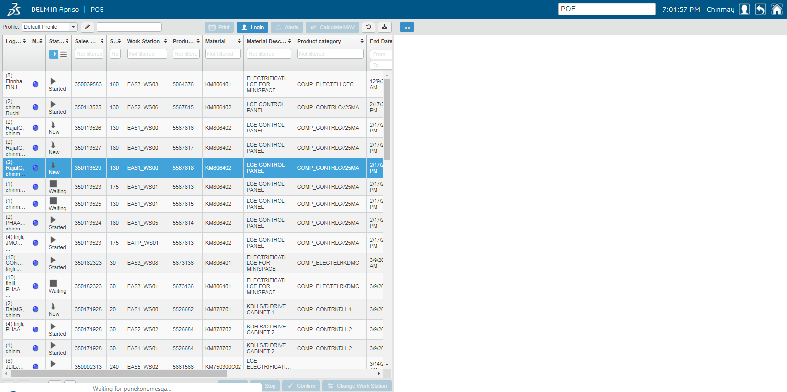
Existing Solution :
Execution of a single operation.

Slide 5
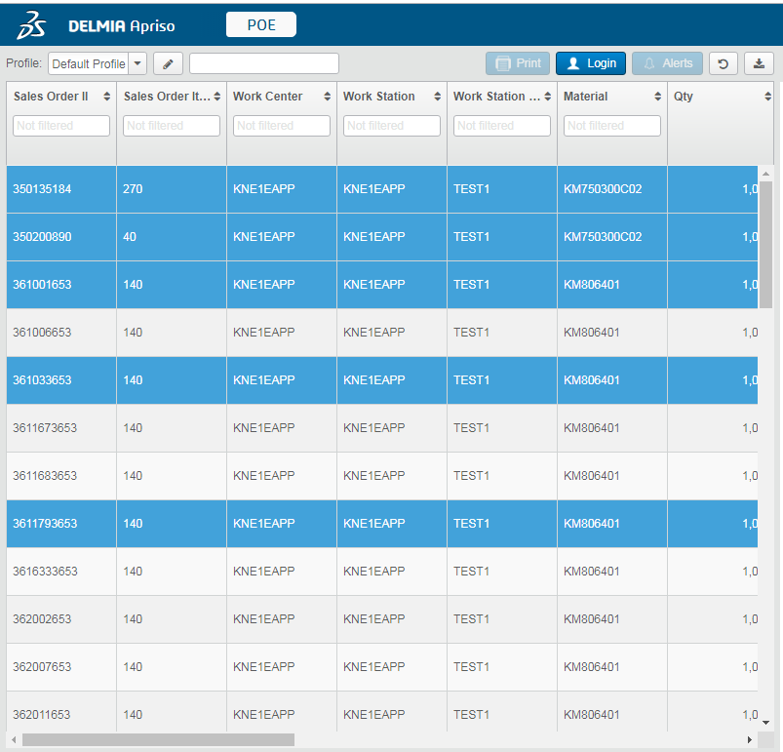
Proposed Solution :
Execution for multiple operation.

Slide 6
Constraint:
Validation for all operations at single step, i.e. error in starting of one operation will halt the entire action.
All operations must be of same series.
Operations from collective WorkStation can’t included.
WorkStation can’t be changed in this screen.
A configurable limit must be there which will define maximum number of operations that an be started.
Can’t have details of an operation similar to the right grid in POE.
Assumptions:
Starting all and Confirm all can be iteration of existing Start and Confirm code in POE.

