Slide 1




IDEAS
CONCLUSION & REFERENCE
REASON FOR DECLINE
TEAM
EUREKA
9
3
2
Pooja Mishra
Pramod Nayeeni

Slide 2






2
We need a Virat Kohli to live without Tendulkar; in short Indian fans need superstars. Many wrestling giants’ departure ^{[3]} has created the viewers to lose interest in the show. This can only be creating new Heroes.
Major Issues Leading to Decline
THE SHOW DIDN’T GO ON
SHORT AND CRISP
We need a Virat Kohli to live without Tendulkar; in short Indian fans need superstars. Many wrestling giants’ departure ^{[0.2]} has created the viewers to lose interest in the show. This can only be creating new Heroes.
With 3.6 Billion Viewership FIFA WC matches run for 90 to 130 minutes ^{[0.3]}. Decade long Undertaker vs. Kane storylines ^{[0.4]} doesn’t keep today’s viewers involved. No time bound stories leads to boredom ^{[0.5]}.
INDISCIPLINE
GENDER DISCRIMINATION
BAD BOOKING
Instances of wrestlers misbehaving with crowd is not rare ^{[0.6]} . Cases of authorities more involved in show is also disliked by crowd. Frequent partial judgements also creates distrust.
Several instances of sexual assaults, gender discrimination and extreme sexism came under media watch which created a bad reputation ^{[0.7, 0.8]} . Far less importance is also given while broadcasting female WWE matches.
Though being the largest content consumer of WWE ^{[0.1]} there is hardly (if) any live events in India. Shows were cut off from half of the tour even though there was great interest among fans, creates a very bad reputation.

Slide 3




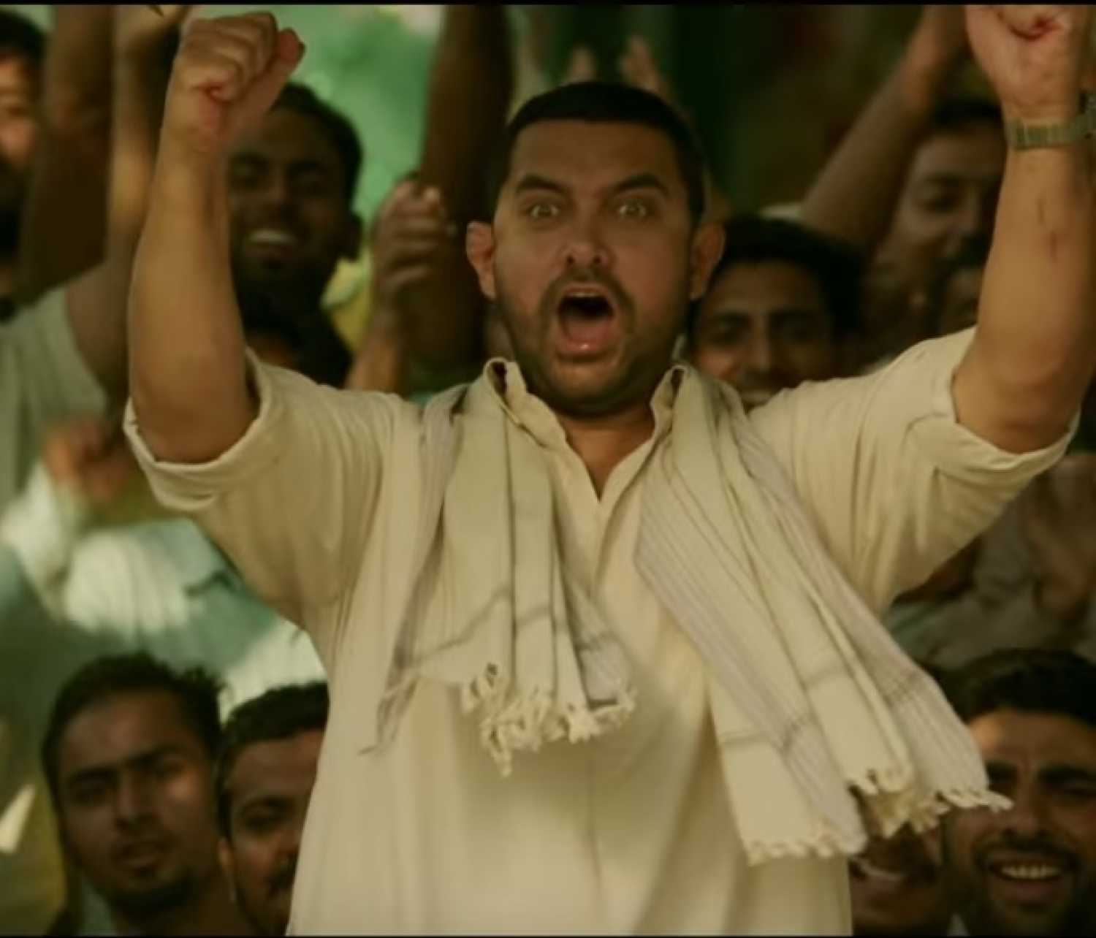
3
We need a Virat Kohli to live without Tendulkar; in short Indian fans need superstars. Many wrestling giants’ departure ^{[3]} has created the viewers to lose interest in the show. This can only be creating new Heroes.
1. The Homeland WWE
THE IDEA
IMPACT ON SPNI
A reality show to find next India’s next Wrestling Superstar who will represent India International events.
Indian participation ^{[1.5]} will increase in WWE and consequently their showmanship.
SPNI will have loyal audience as the viewers would have seen the wrestlers journey and connected emotionally.
Sony will have to invite giants of the WWE to the finals.
AB DANGAL HOGA
INSIGHT BEHND THE IDEA
LAUNCH & SUSTENANCE STRATEGIES
Popular reality shows claiming audience as high as 114 millions ^{[1.1, 1.3]} and the absence of any popular sports reality shows; WWE Homeland India can be expected to attract viewers from many taste.
Auditions in T1 and T2 cities with ex-WWE players as judges.
Live audience ^{[1.4]} with voting participation.
Analyzing this, subsequent seasons can be organized in each 1 or 2 years penetrating more cities ^{[1.6]}.
Following SmackDown success in embracing female participants^{[1.2]} ,Women Championship can also be brought to the Homeland WWE .

Slide 4
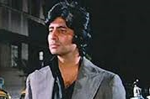
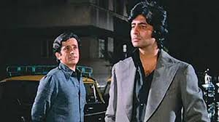
4
We need a Virat Kohli to live without Tendulkar; in short Indian fans need superstars. Many wrestling giants’ departure ^{[3]} has created the viewers to lose interest in the show. This can only be creating new Heroes.
2. OTT for Smart Viewing
THE IDEA
IMPACT ON SPNI
Providing viewers an alternative to TV through streaming media with advance features for ‘Smart Viewing’.
From OTT, SPNI can gather and analyze information regarding viewership based on demographics, geography etc. This will help SPNI keep a track quality of the content and audience-based suggestions.
Pocket Friendly on-boarding will attract more viewers compared to other expensive OTT competitors. Later revenue can be generated with Prime content from persisting users.
INSIGHT BEHND THE IDEA
MERE PASS GoT, Narcos, HoC HEY, TERE PAAS KYA HEY?
- As digital will overtake TV viewership in India within 2 years ^{[2.1]} we must focus on improving OTT Services.
- Features such as Best Move Replay, Player Profile Viewer, Continue from where one left can be included.
LAUNCH & SUSTENANCE STRATEGIES
WWE Superstars endorsing about SonyLIV .
Frequent player interaction for fans through the application.
View credits count and monthly freebies for viewers with higher credits.
After popularizing, exclusivity to own OTT platform will help in sustaining viewership.
WWE

Slide 5
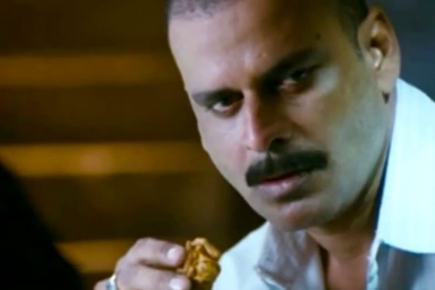
5
We need a Virat Kohli to live without Tendulkar; in short Indian fans need superstars. Many wrestling giants’ departure ^{[3]} has created the viewers to lose interest in the show. This can only be creating new Heroes.
3. Big Screen Entertainment
THE IDEA
IMPACT ON SPNI
Organizing open projector previews of important matches in city centers, malls, street-corners and cafes.
SPNI can project other upcoming shows with teasers and trailers to create a hype.
Street Previews will attract more viewers who are not aware about WWE in TV or OTT.
Perception of WWE as an elite audience show will change.
KAH KAH KE
LENGE
INSIGHT BEHND THE IDEA
LAUNCH & SUSTENANCE STRATEGIES
- The new age consumers want experiences, not things ^{[3.1]}. As the demand of live matches can not be full filled an alternative is creating broadcast hubs for interesting matches.
Providing small cafes and restaurants with big screen TVs or Projector to preview matches.
WWE Superstars touring multiple cities and inaugurating these screen.
Tie up with ageing Cinemas ^{[3.3]} and theaters of Tier – 3 and 4 cities. And weekdays multiplex previews in big cities.
KHA KHA KE
DEKHENGE

Slide 6
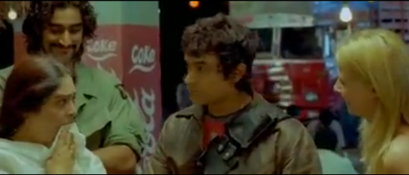
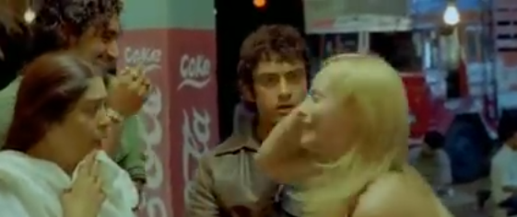
6
We need a Virat Kohli to live without Tendulkar; in short Indian fans need superstars. Many wrestling giants’ departure ^{[3]} has created the viewers to lose interest in the show. This can only be creating new Heroes.
4. Adapting WWE for India
THE IDEA
IMPACT ON SPNI
Regional language commentary and Indian hosts and ex-players for match discussion.
Regional commentary will penetrate market in rural; regional aspiration in WWE will go up.
The insurance of post retirement period for the veteran wrestlers will encourage many newcomers to choose WWE as a career choice.
MAA TERI BOHU
INSIGHT BEHND THE IDEA
LAUNCH & SUSTENANCE STRATEGIES
NAMASTE MAAJI!
Commentary in Telegu, Marathi, Gujurati, Tamil and Punjabi as these are hotspots.
Bollywood superstars, legends from other sports can be invited to pre-match shows.
Broadcasting WWE in SPNI’s other regional channels like Sony Marathi.
As only one tenth of Indian population understands Western English ^{[4.1]}, visuals without audio makes less attractive.
Places where WWE is popular i.e. Gujarat, Maharashtra, Tamilnadu And AP combined has about a population 400 million ^{[4.2]}, crowd this large can be pleased with regional commentary.
AREY YEH TOH HINDI BOLTI HEY.

Slide 7
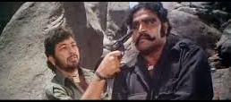
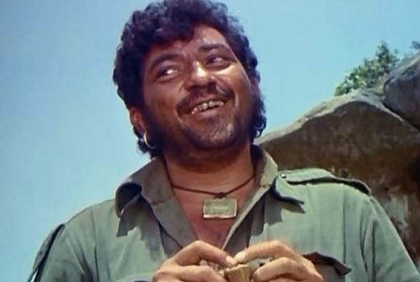
7
We need a Virat Kohli to live without Tendulkar; in short Indian fans need superstars. Many wrestling giants’ departure ^{[3]} has created the viewers to lose interest in the show. This can only be creating new Heroes.
5. User Engagement
THE IDEA
IMPACT ON SPNI
Engaging users with games, quizzes, cards and online discussions.
Games can have character journey like FIFA.
Revenue can be generated with paid add-ons and in-app purchases.
KITNE TICKET JITEY?
INSIGHT BEHND THE IDEA
LAUNCH & SUSTENANCE STRATEGIES
With projected 62 million Indians ^{[5.1]} playing in mobile, WWE game will boost user engagement. WWE Games with VR will also create great hype. These can be sold in bundle with Sony’s Play Station.
Indians getting highly involved in social media discussion sites like Quora ^{[5.2]}. Online buzz can be started in these sites with frequent topics on day’s match.
Application can be launched by WWE Superstars in season finale.
Users credited with enough game points or winners of quizzes will be eligible for freebies and tickets in live events.
Yearly upgrades to keep the game evolved.
Commentary and weekly discussion podcast in Radios and Music apps.
DO SARDAR
BOHUT MAJA AYEGA

Slide 8
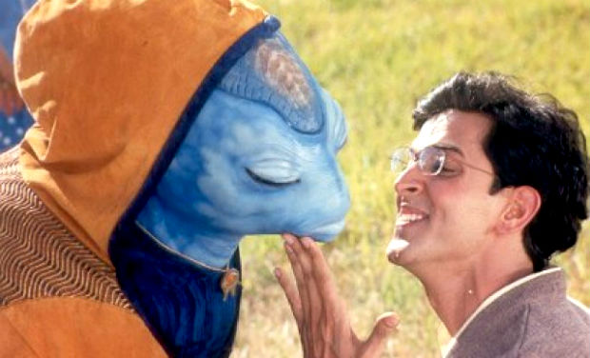
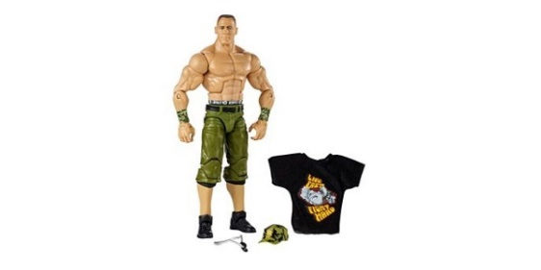
8
We need a Virat Kohli to live without Tendulkar; in short Indian fans need superstars. Many wrestling giants’ departure ^{[3]} has created the viewers to lose interest in the show. This can only be creating new Heroes.
6. Apparels & Action Figures
THE IDEA
IMPACT ON SPNI
YE KYA KHATA HEY? DHOOP
WWE Apparels and action figures to improve player visibility.
Designing and marketing these products will take a separate team of professionals.
Stars can popularize these products.
INSIGHT BEHND THE IDEA
LAUNCH & SUSTENANCE STRATEGIES
With more than 500 million below age 20 ^{[6..1]} markets for apparels, figurines and stationary is wide.
To make Superstars characters must get out of TVs and Mobile screens.
Sample copy of products can be bundled with other Sony products.
Tie up stationary brands like Classmates and apparels brands like Jack & Jones.
Low cost printed t-shirts through e-commerce.
Figurines with meals in popular food chain like Subway and McDonalds.
AAUR YEH?
BAS ATTENTION!

Slide 9
9
We need a Virat Kohli to live without Tendulkar; in short Indian fans need superstars. Many wrestling giants’ departure ^{[3]} has created the viewers to lose interest in the show. This can only be creating new Heroes.
Conclusion
We conducted a survey over sample of viewers with various interests, background, age and location. These are some of the data we found.
As seen from these data, enthusiasm among viewership is low. The strategies suggested will help come a great way for revival of WWE.

Slide 10
10
https://www.firstpost.com/india/latest-census-data-shows-youth-surge-nearly-41-of-indias-population-is-below-the-age-of-20-2581730.html
Reference
Sr. No. | Links
0.1 | Analysis: How Does India Fit Into WWE’s Business Model?
0.2 | 6 Wrestlers who retired in 2017
0.3 | 10 Most-Watched Sport Events In The History Of Television
0.4 | 6 of the longest storylines in WWE history
0.5 | WWE reduces India tour to one show
0.6 | Wrestler spits at a child, gets assaulted by an adult
0.7 | It’s Time for the WWE to Close Its Gender Pay Gap
0.8 | WWE women face blatant discrimination, sexism in wrestling universe
1.1 | In India, Reality TV Catches On, With Some Qualms
1.2 | WWE SmackDown Is Embracing Female Viewers, And It's Working
1.3 | Reality wave hits Indian television
Sr. No. | Links
1.4 | Which TV shows are taped or aired in front of a live audience?
1.5 | A look at all the Indian stars in the history of WWE
1.6 | How do small towns produce so many pro athletes?
2.1 | Digital will overtake TV viewership in India by 2020
3.1 | The Multitasking Generation
3.2 | IPL 2018: Now, watch matches on big screens for free; here is how
4.1 | English or Hinglish - which will India choose?
4.2 | List of states and union territories of India by population
5.1 | Online Gaming in India
5.2 | Indians in Quora
6.1 | Latest Census data shows youth surge
Thank You.

