Slide 1
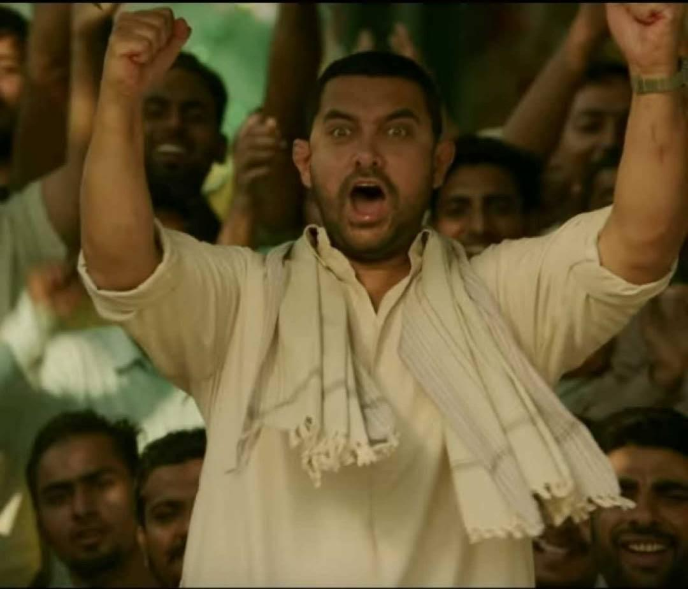
3
Big Screen Previews
Organizing open projector previews of important WWE and homeland matches in city centers, malls, nukkads and cafes.
As the viewers will have the have the knowledge of the Wrestlers journey they’ll be more involved with his/her fights in WWE.
Will lead to more wrestlers going to WWE from India. Both of these will increase viewership.
aAA
AB DANGAL HOGA
Starting with auditions in Tier-1 and Tier-2 cities with ex-WWE players as judges. Leading to a maximum of 3 to 4 more rounds in big cities with live audience to decide winners.
Analyzing the success of first season organizing subsequent one in each 1 or 2 years penetrating more cities.
If the demands of live shows cannot be full filled then we must create our own show to keep the viewers interested.

Slide 2
Organizing open projector previews of important WWE and homeland matches in city centers, malls, nukkads and cafes.

