Slide 1
Major Issues behind TRP Fall

Slide 2



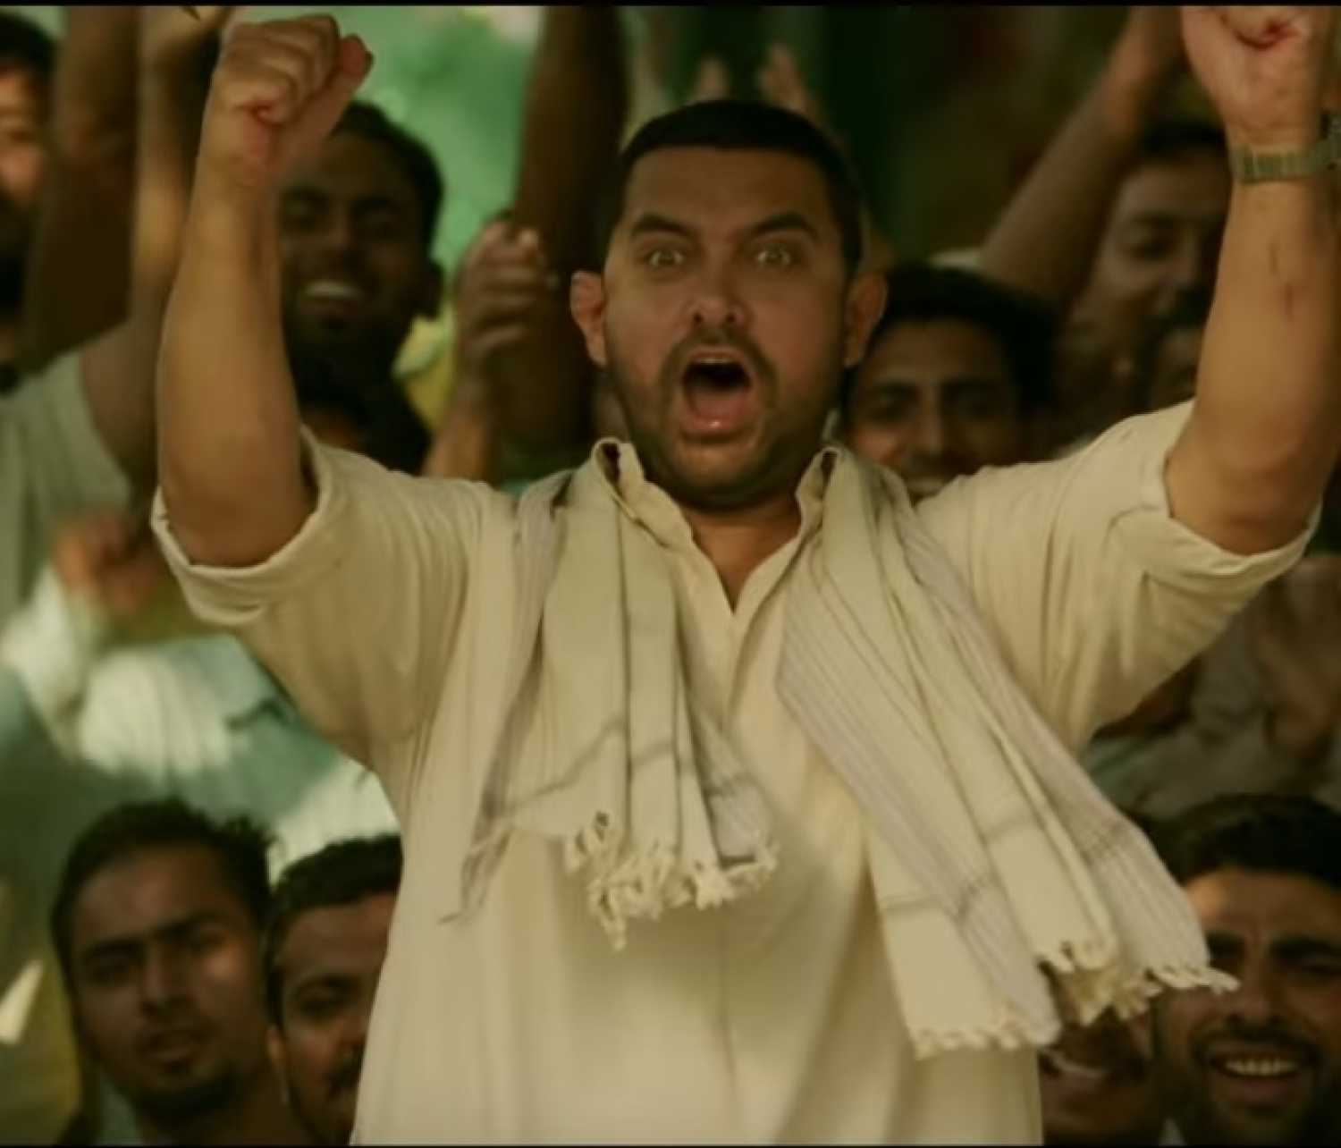

The Homeland WWE
1
The Idea
A reality show to find next India’s next wrestling superstar who’ll represent India international WWE events.
The Insights
Launch & Sustenance Strategies
Popular reality shows claiming audience as high as 114 millions ^{[1.1, 1.3]} and the absence of any popular sports reality shows; WWE Homeland India can be expected to attract viewers from many taste.
Auditions in T1 and T2 cities with ex-WWE players as judge. Another 2 to 3 rounds before finals to keep the season short.
Live audience ^{[1.4]} with voting participation.
Analyzing this, subsequent seasons can be organized in each 1 or 2 years penetrating more cities ^{[1.6]}.
Following SmackDown success in embracing female participants^{[1.2]} ,woman championship can also be brought to the Homeland WWE .
AB DANGAL HOGA
Impact on SPNI
Indian participation ^{[1.5]} will increase in WWE and consequently their showmanship.
SPNI will have loyal audience as the viewers would have seen the wrestlers journey and connected emotionally.
The human side of wrestlers stories can be programmed in Entertainment channels like Sony.
Sony will have to invite giants of the WWE to the finals.

Slide 3
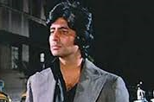
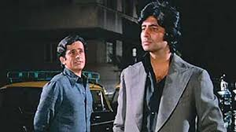
OTT for Smart Viewing
2
The Idea
Providing viewers an alternative to TV through streaming media with advance features for ‘Smart Viewing’.
The Insights
Launch & Sustenance Strategies
- As digital will overtake TV viewership in India within 2 years ^{[2.1]} we must focus on improving OTT Services.
- Features such as Best Move Replay, Player Profile Viewer, Continue from where one left can be included.
- With 260 million Indian using social medias ^{[2.2]}, sharing GIFs and Memes with WWE watermark from Sony Liv app itself.
Advertisement of match clips in other OTTs and YouTube.
WWE Superstars endorsing about Sony Liv .
A step ahead in Technology message can be passed to attracting younger audience.
Frequent player interaction for fans through the application.
View credits count and monthly freebies for viewers with higher credits.
After popularizing, exclusivity to own OTT platform will help in sustaining viewership.
MERE PASS GoT, Narcos, HoC HEY, TERE PAAS KYA HEY?
Impact on SPNI
From OTT SPNI can gather and analyze info such as which part of the match, which match, at what time, from which region is viewed or liked. This will help SPNI keep a track of the content quality and audience based suggestions.
Pocket Friendly on-boarding will attract more viewers compared to other expensive OTT competitors. Later revenue can be generated with Prime content from persisting users along with advertisement.
WWE

Slide 4
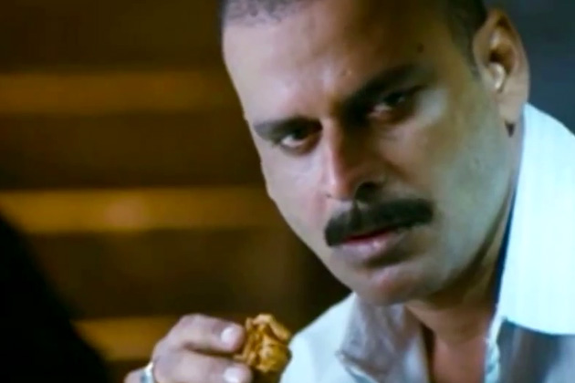
Big Screen Entertainment
3
The Idea
Organizing open projector previews of important matches in city centers, malls, nukkads and cafes.
The Insights
Launch & Sustenance Strategies
KAH KAH KE LENGE
- The new age consumers want experiences, not things ^{[3.1]}. As the demand of live matches can not be full filled an alternative is creating broadcast hubs for interesting matches.
- Spare times are on the verge of extinction, this idea will help the multi-tasking generation ^{[3.2]}.
Providing small cafes and restaurants with big screen TVs or Projector.
Initial investment can be done in partnership with multinational food and beverages company like Coke and Pepsi.
WWE Superstars touring multiple cities and inaugurating these screen.
Tie up with ageing Cinemas ^{[3.3]} and theaters of Tier – 3 and 4 cities. And weekdays multiplex previews in big cities.
Impact on SPNI
- SPNI can project other shows with teasers and trailers to make hype.
- Street Previews will create more audience who are not aware in WWE in TV or OTT.
- Perception of WWE as an elite audience show will change.
KHA KHA KE
DEKHENGE

Slide 5
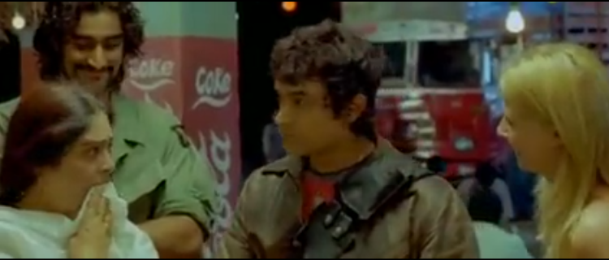
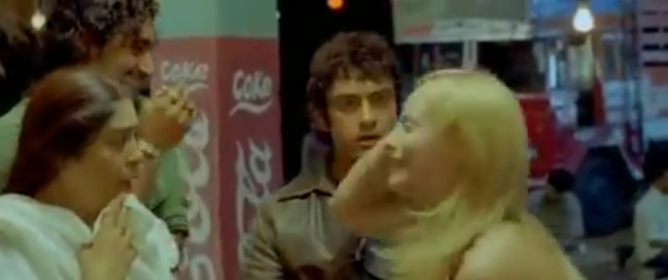
Adapting WWE for India
4
The Idea
Regional language commentary and Indian hosts and ex-players for match discussion.
The Insights
Launch & Sustenance Strategies
MAA TERI BOHU
As only one tenth of Indian understand Western English ^{[4.1]}, visuals without audio makes less attractive.
Places where WWE is popular i.e. Gujarat, Maharashtra, Tamilnadu And AP combined has about a population 400 million ^{[4.2]}, crowd this large can be pleased with regional commentary.
Commentary in Telegu, Marathi, Gujurati, Tamil and Punjabi as these are hotspots.
Bollywood superstars, legends from other sports can be invited to pre-match shows.
If RC succeeds, experimenting with even more regional languages can be done.
Broadcasting WWE in SPNI’s other regional channels like Sony Marathi.
NAMASTE MAAJI!
Impact on SPNI
Collecting user choices, TV polls and questionnaires raised in these shows in Sony Liv app during these shows.
Regional commentary will penetrate market in rural; regional aspiration in WWE will go up.
The insurance of post retirement period for the veteran wrestlers will encourage many newcomers to choose WWE as a career choice.
Trained Indian language commentators can further assist in broadcasting other sports.
AREY YEH TOH HINDI BOLTI HEY.

Slide 6
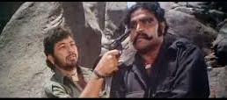
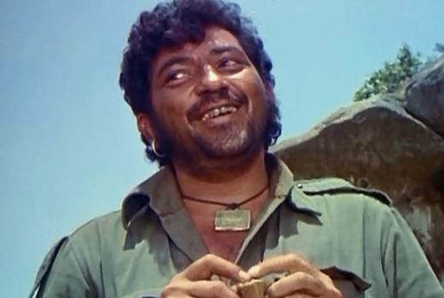
User Engagement
5
The Idea
Engaging users with games, quizzes, cards and online discussions.
The Insights
Launch & Sustenance Strategies
KITNE TICKET JITEY?
With projected 62 million Indians ^{[5.1]} playing in mobile, WWE game will boost UE. Game with VR will also create great hype. These can be sold in bundle with Sony’s Play Station.
SmackDown, RAW as quiz topics in popular application like Quizapp. Sunday newspaper quiz and online impression quiz can also be explored.
Indians getting highly involved in social media discussion sites like Quora ^{[5.2]}. Online buzz can be started in these sites with frequent topics on day’s match.
Application can be launched by WWE Superstars in season finale.
Users credited with enough game points or winners of quizzes will be eligible for freebies and tickets in live events.
Gaming contests can be organized.
Yearly upgrades to keep the game evolved.
Commentary and weekly discussion podcast in Radios and Music apps.
DO SARDAR
Impact on SPNI
Games can have character journey like FIFA.
Revenue can be generated with paid add-ons, in-app purchases and advertisement.
BOHUT MAJA AYEGA

Slide 7
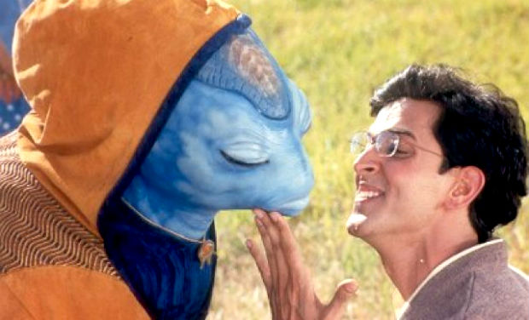
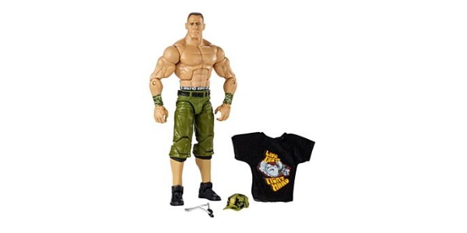
Apparels & Figurine
6
The Idea
WWE Apparels and figurines to improve player visibility.
The Insights
Launch & Sustenance Strategies
YE KYA KHATA HEY? DHOOP
People have more Linkin Park and Beatles t-shirts in their cupboard compared to the songs in their playlists.
With more than 500 million below age 20 ^{[7..1]} markets for apparels, figurines and stationary is wide.
To make Superstars characters must get out of TVs and Mobile screens.
Sample copy of products can be bundled with other Sony products.
Tie up stationary brands like Classmates and apparels brands like Jack & Jones.
Low cost printed t-shirts through e-commerce.
Figurines with meals in popular food chain like Subway and McDonalds.
Encouraging collectors with special events.
AAUR YEH?
Impact on SPNI
Designing and marketing these products will take a separate team of professionals.
Stars can popularize these products.
BAS ATTENTION!

